Slide 1
Chapter 3 Finite Markov Decision Processes

Slide 2
MDP
A classical formalization of sequential decision making
Actions influence not just immediate rewards, but also subsequent situations, or states, and through those future rewards.

Slide 3
3.1 The Agent–Environment Interface
Agent
The learner and decision maker
Environment
The thing it interacts with, comprising everything outside the agent

Slide 4
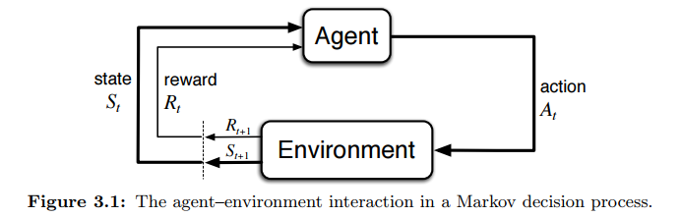

Time step
$t=0, 1, 2, …$
States
$𝒮:$ set of all states
$S_{t}∈𝒮$
Actions
$𝒜(s)$: set of all actions for state $s$
$A_{t}∈𝒜(s)$
Rewards
$ℛ$: set of all rewards
$R_{t+1}∈ℛ$
Trajectory
$S_{0}, A_{0}, R_{1}, S_{1}, A_{1}, R_{2}, …$

Slide 5
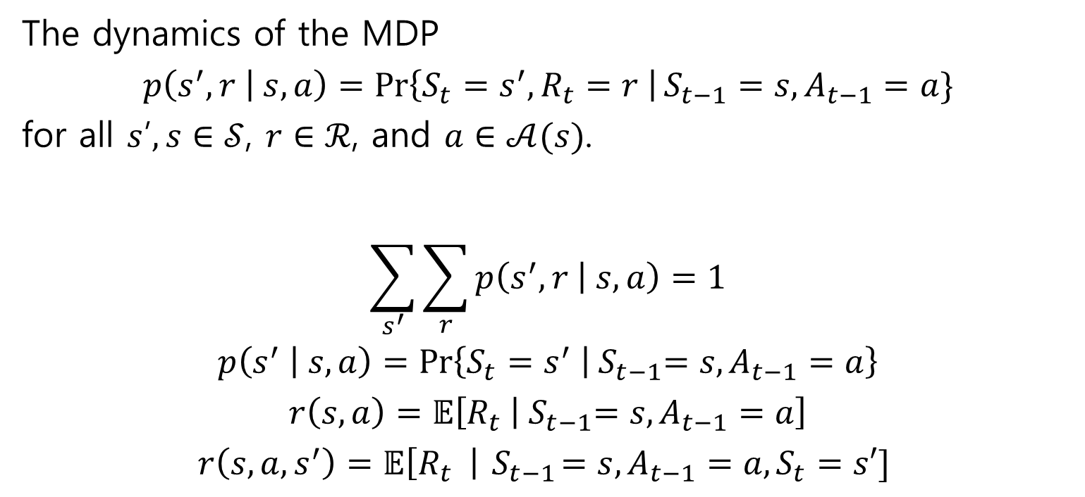
The dynamics of the MDP
$$p\left(s^{′}, r | s, a\right)=\operatorname{Pr}\left\{S_{t}=s^{′}, R_{t}=r \right|S_{t−1}=s, A_{t−1}=a\}$$
for all $s$’$, s∈𝒮$, $r∈ℛ$, and $a∈𝒜(s)$.
$$\sum_{s^{′}}{\sum_{r}{p\left(s^{′},r | s,a\right)}}=1$$
$$p\left(s^{′} | s,a\right)=\operatorname{Pr}\left\{S_{t}=s^{′} | { S}_{t−1}=s,A_{t−1}=a\right\}$$
$$r\left(s,a\right)=𝔼\left[R_{t} | { S}_{t−1}=s,A_{t−1}=a\right]$$
$$r\left(s, a, s^{′}\right)=𝔼\left[R_{t} \right|{ S}_{t−1}=s, A_{t−1}=a, S_{t}=s′]$$

Slide 6
3.2 Goals and Rewards
Goal
To maximize the total amount of reward

Slide 7
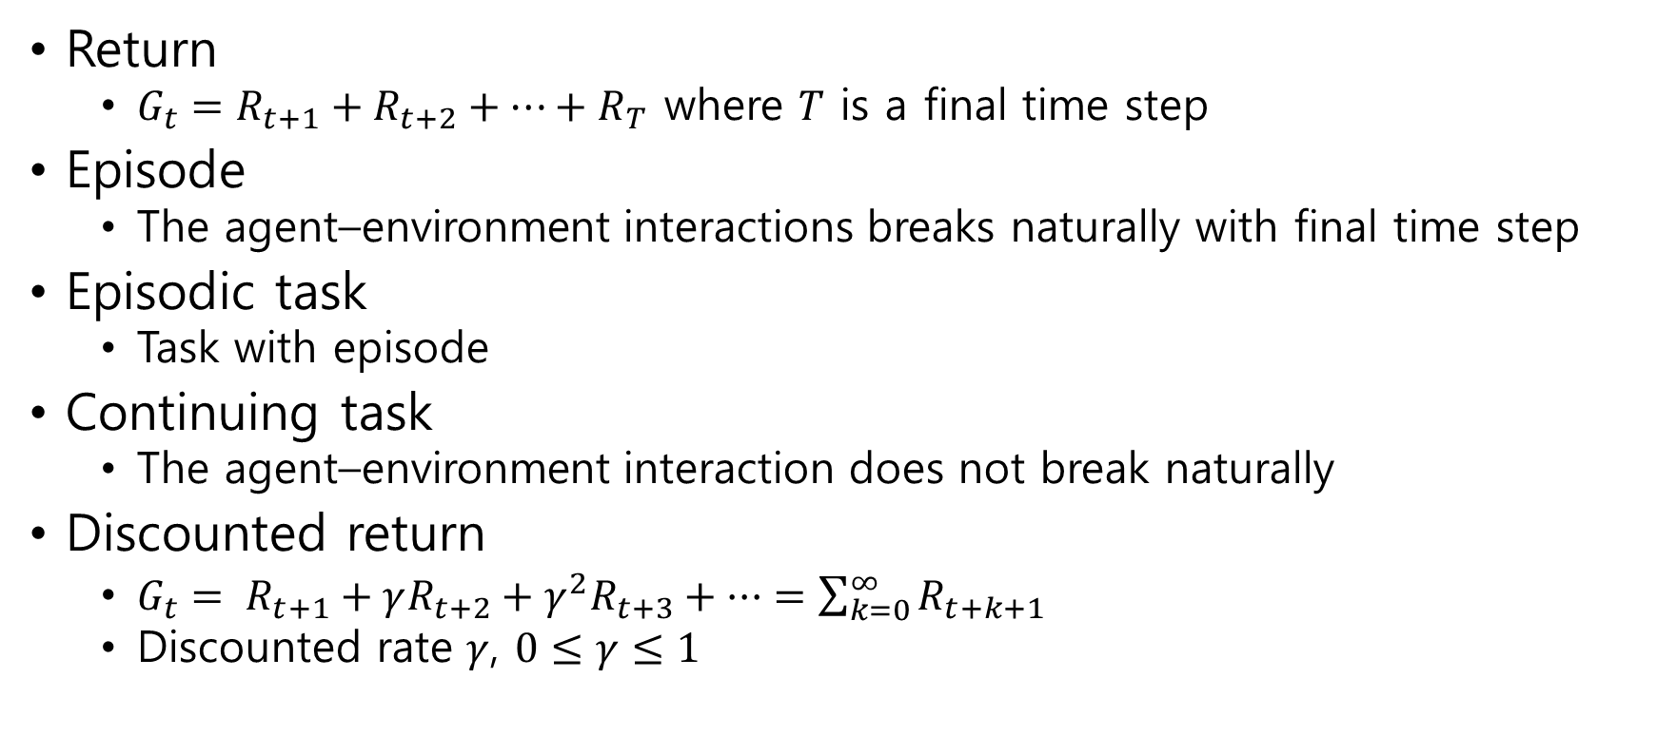
3.3 Returns and Episodes
Return
$G_{t}=R_{t+1}+R_{t+2}+⋯+R_{T}$ where $T$ is a final time step
Episode
The agent–environment interactions breaks naturally with final time step
Episodic task
Task with episode
Continuing task
The agent–environment interaction does not break naturally
Discounted return
$G_{t}= R_{t+1}+γR_{t+2}+γ^{2}R_{t+3}+ ··· =\sum_{k=0}^{∞}{R_{t+k+1}}$
Discounted rate $γ$, $0≤γ≤1$

Slide 8
3.4 Unified Notation for Episodic and Continuing Tasks

Slide 9

3.5 Policies and Value Functions
Policy $π$
Probabilities of selecting an action
$π\left(a | s\right)=\operatorname{Pr}\left\{A_{t}=a | S_{t}=s\right\}$

Slide 10
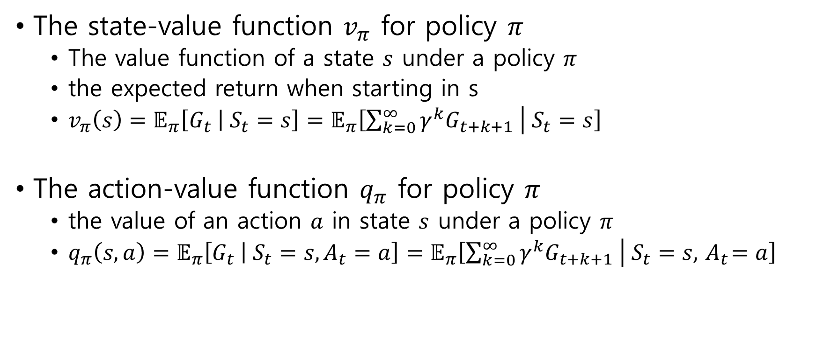
3.5 Policies and Value Functions
The state-value function $v_{π}$ for policy $π$
The value function of a state $s$ under a policy $π$
the expected return when starting in s
$v_{π}\left(s\right)=𝔼_{π}\left[G_{t} | S_{t}=s\right]=𝔼_{π}\left[\sum_{k=0}^{∞}{γ^{k}G_{t+k+1}} | S_{t}=s\right]$
The action-value function $q_{π}$ for policy $π$
the value of an action $a$ in state $s$ under a policy $π$
$q_{π}\left(s,a\right)=𝔼_{π}\left[G_{t} | S_{t}=s, A_{t}=a\right]=𝔼_{π}\left[\sum_{k=0}^{∞}{γ^{k}G_{t+k+1}} | S_{t}=s, { A}_{t}=a\right]$

Slide 11
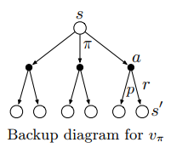
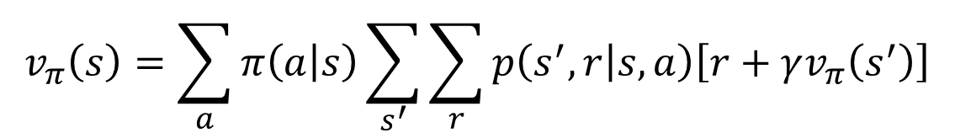

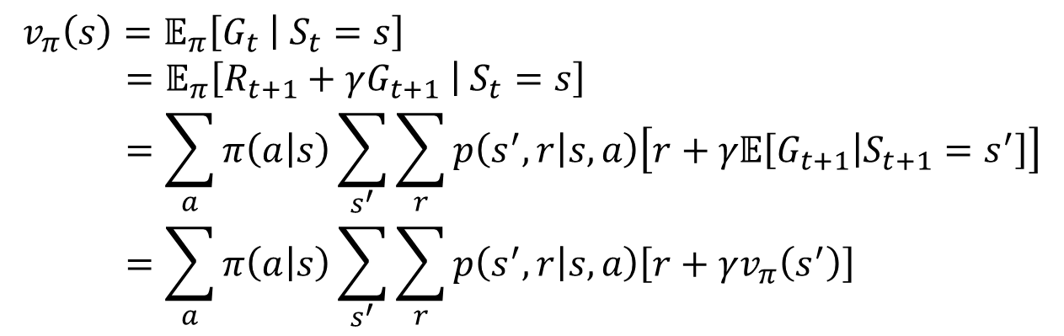
Bellman equation for $v_{π}$
Proof
$$v_{π}\left(s\right)=\sum_{a}{π\left(a | s\right)\sum_{s^{′}}{\sum_{r}{p\left(s^{′},r | s,a\right)\left[r+γv_{π}\left(s^{′}\right)\right]}}}$$
$$v_{π}\left(s\right)=𝔼_{π}\left[G_{t} | S_{t}=s\right] \\ =𝔼_{π}\left[R_{t+1}+γG_{t+1} | S_{t}=s\right] \\ =\sum_{a}{π\left(a | s\right)\sum_{s^{′}}{\sum_{r}{p\left(s^{′},r | s,a\right)\left[r+γ𝔼\left[G_{t+1} | S_{t+1}=s^{′}\right]\right]}}} \\ =\sum_{a}{π\left(a | s\right)\sum_{s^{′}}{\sum_{r}{p\left(s^{′},r | s,a\right)\left[r+γv_{π}\left(s^{′}\right)\right]}}}$$

Slide 12
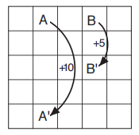

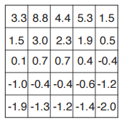
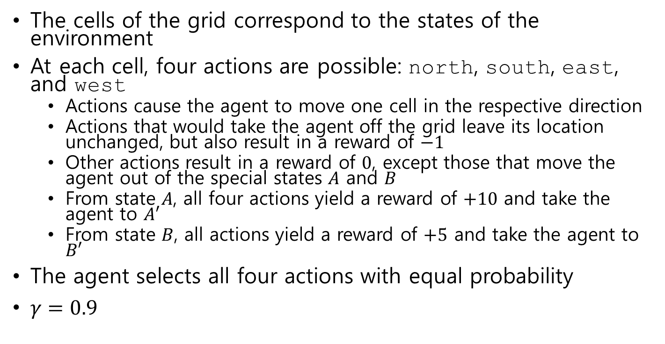
Example 3.5: Gridworld
The cells of the grid correspond to the states of the environment
At each cell, four actions are possible: north, south, east, and west
Actions cause the agent to move one cell in the respective direction
Actions that would take the agent off the grid leave its location unchanged, but also result in a reward of $−1$
Other actions result in a reward of $0$, except those that move the agent out of the special states $A$ and $B$
From state $A$, all four actions yield a reward of $+10$ and take the agent to $A′$
From state $B$, all actions yield a reward of $+5$ and take the agent to $B′$
The agent selects all four actions with equal probability
$γ=0.9$

Slide 13
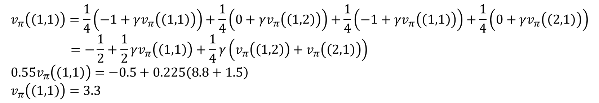
$$v_{π}\left(\left(1,1\right)\right)=\frac{1}{4}\left(−1+γv_{π}\left(\left(1,1\right)\right)\right)+\frac{1}{4}\left(0+γv_{π}\left(\left(1,2\right)\right)\right)+\frac{1}{4}\left(−1+γv_{π}\left(\left(1,1\right)\right)\right)+\frac{1}{4}\left(0+γv_{π}\left(\left(2,1\right)\right)\right) \\ =−\frac{1}{2}+\frac{1}{2}γv_{π}\left(\left(1,1\right)\right)+\frac{1}{4}γ\left(v_{π}\left(\left(1,2\right)\right)+v_{π}\left(\left(2,1\right)\right)\right) \\ 0.55v_{π}\left(\left(1,1\right)\right)=−0.5+0.225\left(8.8+1.5\right) \\ v_{π}\left(\left(1,1\right)\right)=3.3$$

Slide 14
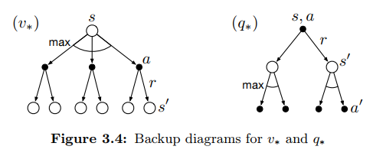

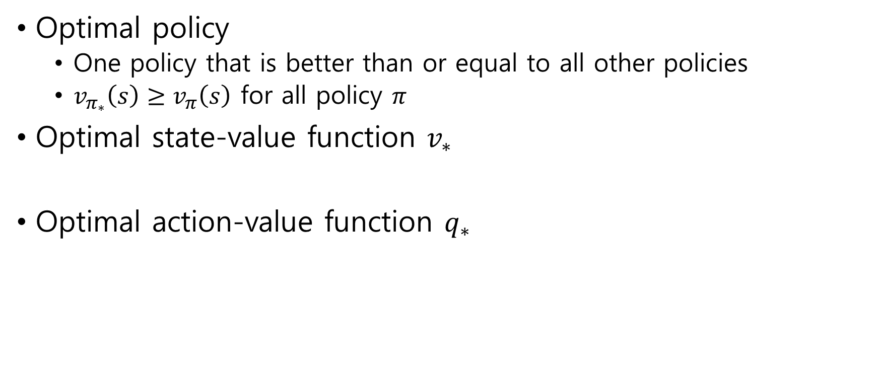

3.6 Optimal Policies and Optimal Value Functions
Optimal policy
One policy that is better than or equal to all other policies
$v_{π_{∗}}\left(s\right)≥v_{π}\left(s\right)$ for all policy $π$
Optimal state-value function $v_{∗}$
Optimal action-value function $q_{∗}$
$$v_{∗}\left(s\right)=\max_{π}{v_{π}\left(s\right)}$$
$$q_{∗}\left(s,a\right)=\max_{π}{q_{π}\left(s,a\right)}$$

Slide 15
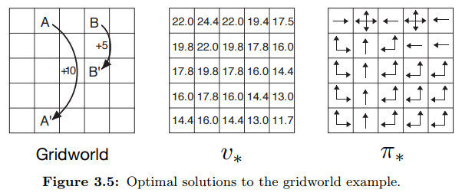
Example 3.8: Solving the Gridworld

Slide 16
3.7 Optimality and Approximation
Optimal policies can be generated only with extreme computational cost
It is an ideal that agents can only approximate

