Slide 1
Chapter 5 Efficient Inference in Trees

Slide 2
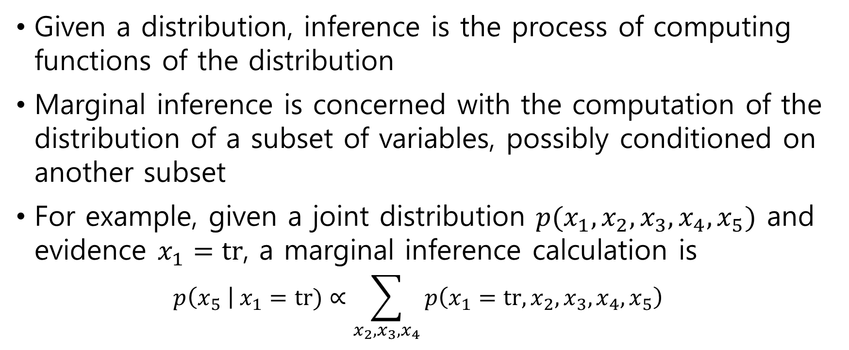
5.1 Marginal Inference
Given a distribution, inference is the process of computing functions of the distribution
Marginal inference is concerned with the computation of the distribution of a subset of variables, possibly conditioned on another subset
For example, given a joint distribution $p(x_{1}, x_{2}, x_{3}, x_{4}, x_{5})$ and evidence $x_{1}=tr$, a marginal inference calculation is $p\left(x_{5} \right| x_{1}=tr)∝\sum_{x_{2},x_{3},x_{4}}{p\left(x_{1}=tr,x_{2},x_{3},x_{4},x_{5}\right)}$

Slide 3


5.1.1 Variable elimination in a Markov chain and message passing
Markov chain
$$p\left(a,b,c,d\right)=p\left(a | b\right)p\left(b | c\right)p\left(c | d\right)p(d)$$

Slide 4



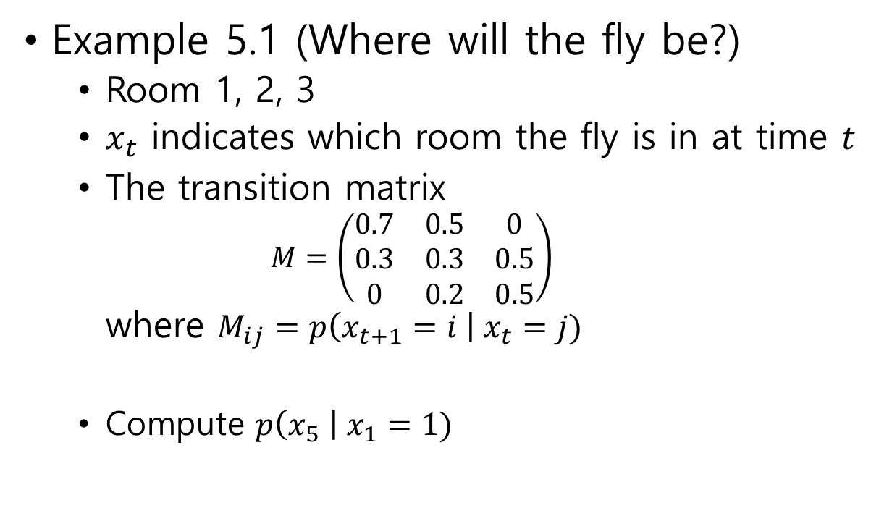





Example 5.1 (Where will the fly be?)
Room 1, 2, 3
$x_{t}$ indicates which room the fly is in at time $t$
The transition matrix $M=\left(\begin{matrix}0.7 & 0.5 & 0 \\ 0.3 & 0.3 & 0.5 \\ 0 & 0.2 & 0.5\end{matrix}\right)$ where $M_{ij}=p\left(x_{t+1}=i \right| x_{t}=j)$
Compute $p\left(x_{5} \right| x_{1}=1)$
$$0.7$$
$$0.3$$
$$0.5$$
$0.$5
$$0.5$$
$$0.3$$
$$0.2$$
Room 1
Room 2
Room 3

Slide 5

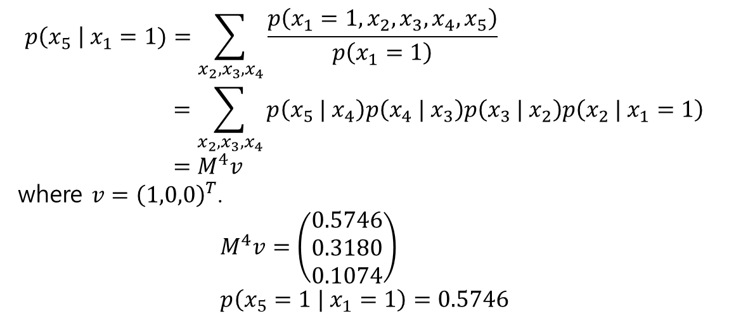





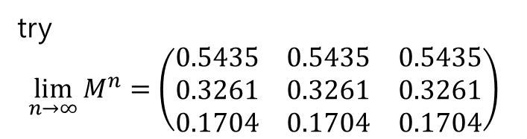
$$x_{5}$$
$$x_{4}$$
$$x_{3}$$
$$x_{2}$$
$$x_{1}$$
$$p\left(x_{5} \right| x_{1}=1)=\sum_{x_{2},x_{3},x_{4}}{\frac{p\left(x_{1}=1,x_{2},x_{3},x_{4},x_{5}\right)}{p\left(x_{1}=1\right)}} \\ =\sum_{x_{2},x_{3},x_{4}}{p\left(x_{5} | x_{4}\right)p\left(x_{4} | x_{3}\right)p\left(x_{3} | x_{2}\right)p\left(x_{2} | x_{1}=1\right)} \\ =M^{4}v$$ where $v={\left(1,0,0\right)}^{T}$. $$M^{4}v=\left(\begin{matrix}0.5746 \\ 0.3180 \\ 0.1074\end{matrix}\right) \\ p\left(x_{5}=1 | x_{1}=1\right)=0.5746$$
try $$\lim_{n→∞}{M^{n}}=\left(\begin{matrix}0.5435 & 0.5435 & 0.5435 \\ 0.3261 & 0.3261 & 0.3261 \\ 0.1704 & 0.1704 & 0.1704\end{matrix}\right)$$

Slide 6
5.1.2 The sum-product algorithm on factor graphs

