Slide 1
Chapter 2 Basic Graph Concepts

Slide 2
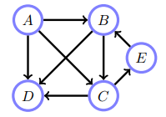
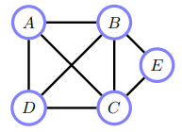
2.1 Graphs
Definition 2.1
Graph
Nodes – vertices
Edges – links
Directed graph
All edges are directed
Undirected graph
All edges are undirected
directed graph
undirected graph

Slide 3

Definition 2.2
Path $A⟼B$
Sequence of nodes that connects $A$ to $B$
Directed path
Path with directed edges
$A$ is a ancestor of $B$, $B$ is a descendant of $A$

Slide 4
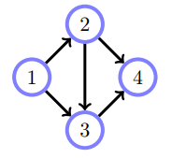


Definition 2.3
Cycle
a directed path
starts and returns to the same node $a → b →⋯→ z → a$
Loop
a path
containing more than two nodes
starts and returns to the same node
irrespective of edge direction
$$B→C→E$$
1 − 2 − 4 − 3 − 1

Slide 5
Definition 2.4
Directed acyclic graph(DAG)
A directed graph
Without cycles
Not DAG
DAG

Slide 6
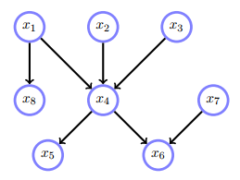
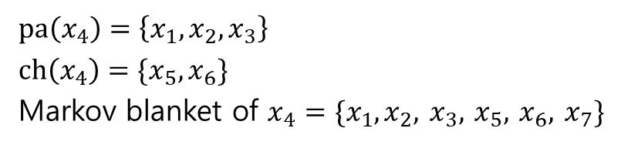
Definition 2.5
Parents of a node
Children of a node
Family of a node
Itself and its parents
Markov blanket of a node
Its parents, children and the parents of its children
Excluding itself
$$pa\left(x_{4}\right)=\left\{x_{1}, x_{2}, x_{3}\right\}$$
$$ch\left(x_{4}\right)=\{x_{5},x_{6}\}$$
Markov blanket of $x_{4}=\{x_{1},x_{2},$ $x_{3},$ $x_{5},$ $x_{6},$ $x_{7}\}$

Slide 7


Definition 2.6
Neighbor
For an undirected graph
The neighbours of $x$, $ne(x)$
those nodes directly connected to $x$
$$ne\left(A\right)= ?$$

Slide 8
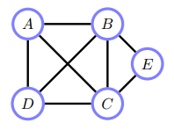
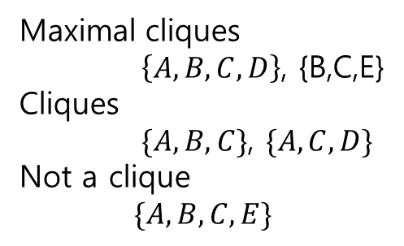
Definition 2.7
Clique
Fully connected subset of nodes i.e. All the members are neighbours of other member
Maximal clique
There is no larger clique that contains the clique
Maximal cliques $\left\{A,B,C,D\right\}$, {B,C,E}
Cliques
$\{A,B,C\}$, $\{A,C,D\}$
Not a clique
$$\{A,B,C,E\}$$

Slide 9
Definition 2.8
Connected graph
An undirected graph
There is a path between every pair of nodes i.e. there are no isolated islands

Slide 10
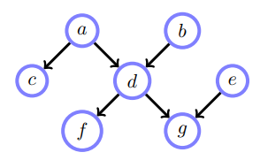
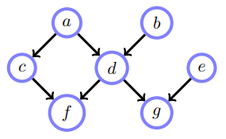
Definition 2.9
Singly Connected Graph
There is only one path from any node to any other node
Multiply connected(roopy)
Not singly connected
Singly connected graph
Multiply connected graph

Slide 11
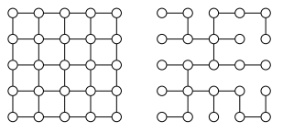
Definition 2.10
Spanning Tree
A singly connected subset
Covers all nodes

Slide 12
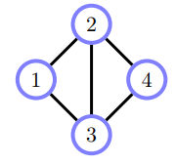
2.2 Numerically Encoding Graphs
2.2.1 Edge list
Edge list
All node-node pairs
$$L = \{(1, 2),(2, 1),(1, 3),(3, 1),(2, 3),(3, 2),(2, 4),(4, 2),(3, 4),(4, 3)\}$$

Slide 13
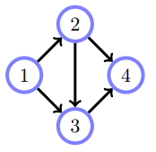
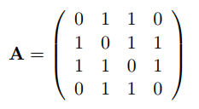
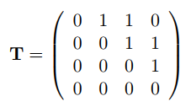
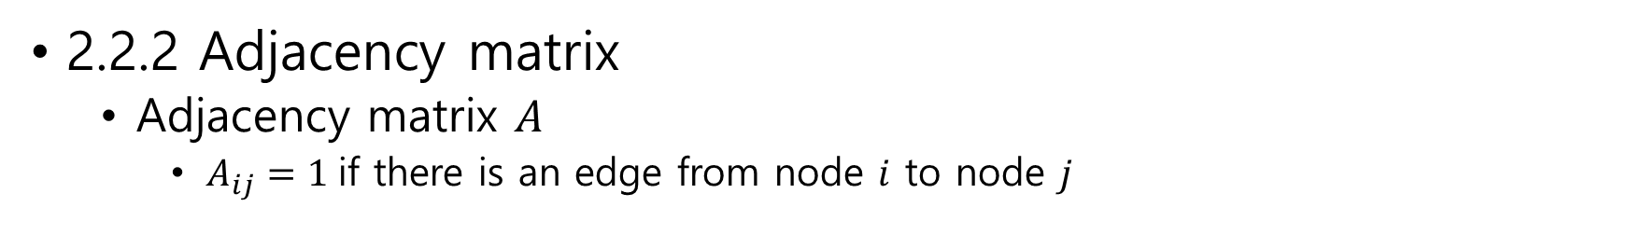
2.2.2 Adjacency matrix
Adjacency matrix $A$
$A_{ij}=1$if there is an edge from node $i$ to node $j$

Slide 14
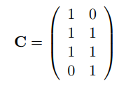

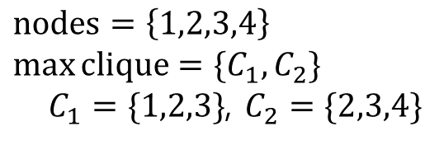
2.2.3 Clique matrix
Clique matrix
A matrix of nodes – maximal cliques relation
A graph has $N$ nodes and $K$ maximal cliques ➔ $N×K$ clique matrix
$nodes=\left\{1,2,3,4\right\}$ $\max{clique=\{C_{1},C_{2}\}}$
$C_{1}=\{1,2,3\}$, $C_{2}=\{2,3,4\}$

