Slide 1
Chapter 3 Convolutional Neural Networks

Slide 2

3.1 Filters, Strides, and Padding
Input $I$, kernel $K$ $V(x, y)=(I·K)(x, y)=\sum_{m}{\sum_{n}{I\left(x+m,y+n\right)K(m,n)}}$

Slide 3




1-dimensional CNN
$$a_{1}$$
$$a_{2}$$
$$a_{3}$$
$$a_{4}$$
$$a_{5}$$
$$a_{6}$$
$$a_{1}w_{1}+a_{2}w_{2}+a_{3}w_{3}$$
$$w_{1}$$
$$w_{2}$$
$$w_{3}$$
$$a_{2}w_{1}+a_{3}w_{2}+a_{4}w_{3}$$
filter
output
input

Slide 4









padding=‘VALID’
padding=‘SAME’
$$0$$
$$a_{1}$$
$$a_{2}$$
$$a_{3}$$
$$a_{4}$$
$$a_{5}$$
$$a_{6}$$
$$0$$
$$0w_{1}+a_{1}w_{2}+a_{2}w_{3}$$
$$a_{1}$$
$$a_{2}$$
$$a_{3}$$
$$a_{4}$$
$$a_{5}$$
$$a_{6}$$
$$a_{1}w_{1}+a_{2}w_{2}+a_{3}w_{3}$$
$$a_{1}w_{1}+a_{2}w_{2}+a_{3}w_{3}$$
$$w_{1}$$
$$w_{2}$$
$$w_{3}$$
$$w_{1}$$
$$w_{2}$$
$$w_{3}$$
$$a_{2}w_{1}+a_{3}w_{2}+a_{4}w_{3}$$
$$a_{2}w_{1}+a_{3}w_{2}+a_{4}w_{3}$$

Slide 5








stride = 2
stride = 3
$$a_{1}$$
$$a_{2}$$
$$a_{3}$$
$$a_{4}$$
$$a_{5}$$
$$a_{6}$$
$$a_{7}$$
$$a_{1}$$
$$a_{2}$$
$$a_{3}$$
$$a_{4}$$
$$a_{5}$$
$$a_{6}$$
$$a_{7}$$
$$w_{1}$$
$$w_{2}$$
$$w_{3}$$
$$a_{1}w_{1}+a_{2}w_{2}+a_{3}w_{3}$$
$$w_{1}$$
$$w_{2}$$
$$w_{3}$$
$$a_{1}w_{1}+a_{2}w_{2}+a_{3}w_{3}$$
$$a_{3}w_{1}+a_{4}w_{2}+a_{5}w_{3}$$
$$a_{4}w_{1}+a_{5}w_{2}+a_{6}w_{3}$$

Slide 6
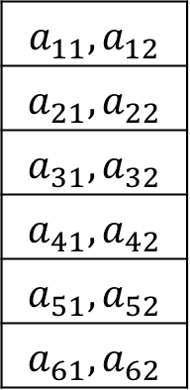
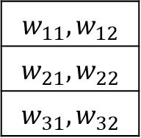
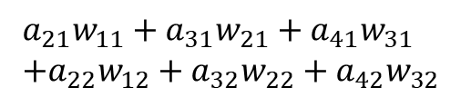
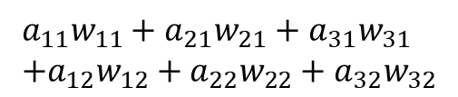
input channels
$$a_{11}w_{11}+a_{21}w_{21}+a_{31}w_{31} \\ +a_{12}w_{12}+a_{22}w_{22}+a_{32}w_{32}$$
$$a_{11},a_{12}$$
$$a_{21},a_{22}$$
$$a_{31},a_{32}$$
$$a_{41},a_{42}$$
$$a_{51},a_{52}$$
$$a_{61},a_{62}$$
$$w_{11},w_{12}$$
$$w_{21},w_{22}$$
$$w_{31},w_{32}$$
$$a_{21}w_{11}+a_{31}w_{21}+a_{41}w_{31} \\ +a_{22}w_{12}+a_{32}w_{22}+a_{42}w_{32}$$
filter
channels=2
output
input
channels=2

Slide 7







output channels
=# of filters
$$a_{1}w_{1}^{1}+a_{2}w_{2}^{1}+a_{3}w_{3}^{1}$$
$$a_{1}w_{1}^{2}+a_{2}w_{2}^{2}+a_{3}w_{3}^{2}$$
$$a_{1}$$
$$a_{2}$$
$$a_{3}$$
$$a_{4}$$
$$a_{5}$$
$$a_{6}$$
$$w_{1}^{1}$$
$$w_{2}^{1}$$
$$w_{3}^{1}$$
,
,
,
,
$$a_{2}w_{1}^{1}+a_{3}w_{2}^{1}+a_{4}w_{3}^{1}$$
$$w_{1}^{2}$$
$$w_{2}^{2}$$
$$w_{3}^{2}$$
$$a_{2}w_{1}^{2}+a_{3}w_{2}^{2}+a_{4}w_{3}^{2}$$
filter
#=2
output
channels=2

Slide 8
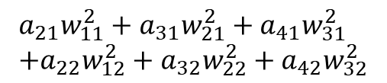
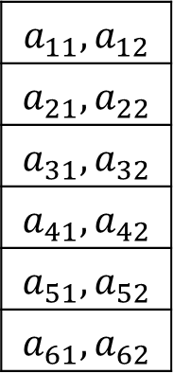
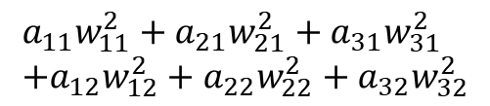
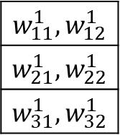
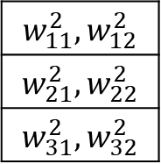
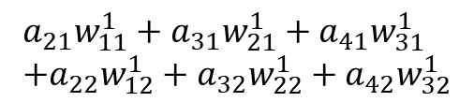
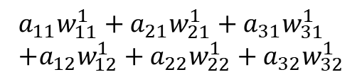
input channels
and
output channels
$$a_{11}w_{11}^{1}+a_{21}w_{21}^{1}+a_{31}w_{31}^{1} \\ +a_{12}w_{12}^{1}+a_{22}w_{22}^{1}+a_{32}w_{32}^{1}$$
$$a_{11},a_{12}$$
$$a_{21},a_{22}$$
$$a_{31},a_{32}$$
$$a_{41},a_{42}$$
$$a_{51},a_{52}$$
$$a_{61},a_{62}$$
$$a_{11}w_{11}^{2}+a_{21}w_{21}^{2}+a_{31}w_{31}^{2} \\ +a_{12}w_{12}^{2}+a_{22}w_{22}^{2}+a_{32}w_{32}^{2}$$
$$w_{11}^{1},w_{12}^{1}$$
$$w_{21}^{1},w_{22}^{1}$$
$$w_{31}^{1},w_{32}^{1}$$
,
,
,
,
$$w_{11}^{2},w_{12}^{2}$$
$$w_{21}^{2},w_{22}^{2}$$
$$w_{31}^{2},w_{32}^{2}$$
$$a_{21}w_{11}^{1}+a_{31}w_{21}^{1}+a_{41}w_{31}^{1} \\ +a_{22}w_{12}^{1}+a_{32}w_{22}^{1}+a_{42}w_{32}^{1}$$
$$a_{21}w_{11}^{2}+a_{31}w_{21}^{2}+a_{41}w_{31}^{2} \\ +a_{22}w_{12}^{2}+a_{32}w_{22}^{2}+a_{42}w_{32}^{2}$$
filter
channels=2
#=2
output
channels=2
input
channels=2

Slide 9
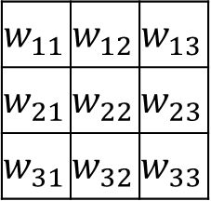
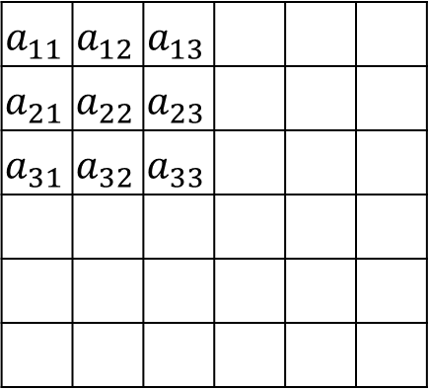
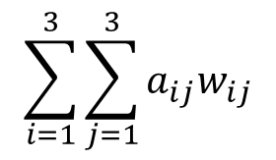
2-dimensional CNN
$$\sum_{i=1}^{3}{\sum_{j=1}^{3}{a_{ij}w_{ij}}}$$
$$a_{11}$$ | $$a_{12}$$ | $$a_{13}$$
$$a_{21}$$ | $$a_{22}$$ | $$a_{23}$$
$$a_{31}$$ | $$a_{32}$$ | $$a_{33}$$
$$w_{11}$$ | $$w_{12}$$ | $$w_{13}$$
$$w_{21}$$ | $$w_{22}$$ | $$w_{23}$$
$$w_{31}$$ | $$w_{32}$$ | $$w_{33}$$
filter
output
input

Slide 10
input
channels=3
output
channels=2
filter
channels=3
#=2

Slide 11

Stride $s_{h}$, $s_{v}$
Padding ‘SAME’, ‘VALID’
Tensorflow code
tf.nn.conv2d(input, filters, strides, padding)

Slide 12
3.2 A Simple TF Convolution Example
ii = [[[[0], [0], [2], [2]],
[[0], [0], [2], [2]],
[[0], [0], [2], [2]],
[[0], [0], [2], [2]]]]
I = tf.constant(ii, tf.float32)
print(I.shape) # (1, 4, 4, 1) – batch size, width, height, input channels
ww = [[[[-1]], [[-1]], [[1]]],
[[[-1]], [[-1]], [[1]]],
[[[-1]], [[-1]], [[1]]]]
W = tf.constant(ww, tf.float32)
print(W.shape) # (3, 3, 1, 1) – width, height, input channels, # of filters
C = tf.nn.conv2d(I, W, strides=[1, 1, 1, 1], padding='VALID')
sess = tf.Session()
print(res.shape)
print(res) # (1, 2, 2, 1) – batch size, width, height, output channels

Slide 13
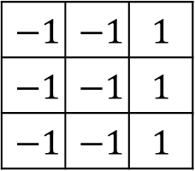
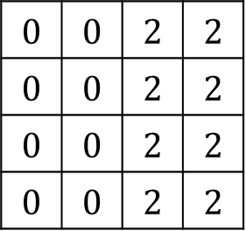
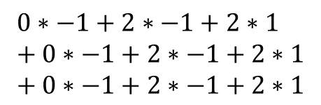
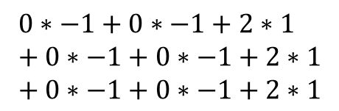
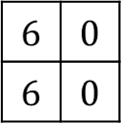
$$0∗−1+0∗−1+2∗1 \\ + 0∗−1+0∗−1+2∗1 \\ + 0∗−1+0∗−1+2∗1$$
$$0$$ | $$0$$ | $$2$$ | $$2$$
$$0$$ | $$0$$ | $$2$$ | $$2$$
$$0$$ | $$0$$ | $$2$$ | $$2$$
$$0$$ | $$0$$ | $$2$$ | $$2$$
$$−1$$ | $$−1$$ | $$1$$
$$−1$$ | $$−1$$ | $$1$$
$$−1$$ | $$−1$$ | $$1$$
$$6$$ | $$0$$
$$6$$ | $$0$$
$$0∗−1+2∗−1+2∗1 \\ + 0∗−1+2∗−1+2∗1 \\ + 0∗−1+2∗−1+2∗1$$

Slide 14
Modified Figure 2.2
# ==========================================================================
image = tf.reshape(img, [batchSz, 28, 28, 1])
flts = tf.Variable(tf.truncated_normal([4, 4, 1, 4], stddev=0.1))
convOut = tf.nn.conv2d(image, flts, [1, 2, 2, 1], 'SAME’)
convOut = tf.nn.relu(convOut)
print(convOut.shape, 'batch size, width, height, numFlters=output channels')
convOut = tf.reshape(convOut, [100, 784])
prbs = tf.nn.softmax(tf.matmul(convOut, W) + b)
# prbs = tf.nn.softmax(tf.matmul(img, W) + b)
# ==========================================================================
Output
(100, 14, 14, 4) batch size, width, height, numFlters=output channels
Test Accuracy: 0.9625000046491623

Slide 15
3.3 Multilevel Convolution
# ================================================================
image = tf.reshape(img, [batchSz, 28, 28, 1])
flts = tf.Variable(tf.random_normal([4, 4, 1, 16], stddev=0.1))
convOut = tf.nn.conv2d(image, flts, [1, 2, 2, 1], "SAME")
convOut = tf.nn.relu(convOut)
flts2 = tf.Variable(tf.random_normal([2, 2, 16, 32], stddev=0.1))
convOut2 = tf.nn.conv2d(convOut, flts2, [1, 2, 2, 1], "SAME")
convOut2 = tf.reshape(convOut2, [100, 1568])
prbs = tf.nn.softmax(tf.matmul(convOut2, W) + b)
# prbs = tf.nn.softmax(tf.matmul(img, W) + b)
# =================================================================
Test Accuracy: 0.9663000059127808

Slide 16
3.4 Convolution Details
3.4.1 Biases
Number of output filters = 16
3.4.2 Layers with Convolution
3.4.3 Pooling
bias = tf.Variable(tf.zeros [16])
convOut += bias
tf.contrib.layers.conv2d(inpt, numFlts, fltDim, strides, pad)
convOut = layers.conv2d(image, 16, [4,4], 2, "Same")
convOut = tf.nn.conv2d(image, flts, [1,1,1,1], "SAME")
convOut = tf.nn.max pool(convOut, [1,2,2,1], [1,2,2,1], "SAME")

