Slide 1
Chapter 1 Probabilistic Reasoning

Slide 2
Intelligence
Understanding, reasoning, planning, problem-solving, …
Natural intelligence / Artificial intelligence
Artificial intelligence(AI)
Intelligence demonstrated by machines
Machine learning (ML)
A part of artificial intelligence
Study of computer algorithms that improve automatically through experience and by the use of data
Goal - understanding and prediction

Slide 3
Machine learning
Supervised learning / Unsupervised learning / Reinforcement learning
Statistical learning / Artificial neural networks
Statistical learning
A framework for machine learning
Drawing from the fields of statistics and functional analysis

Slide 4

1.1 Probability Refresher
Joint distribution $p\left(x,y\right)=p(x and y)$
Marginalisation $p\left(x\right)=\sum_{y}{p(x,y)}$ $p\left(x_{1},…,x_{i−1},x_{i+1},…x_{n}\right)=\sum_{x_{i}}{p(x_{1}},…,x_{n})$

Slide 5
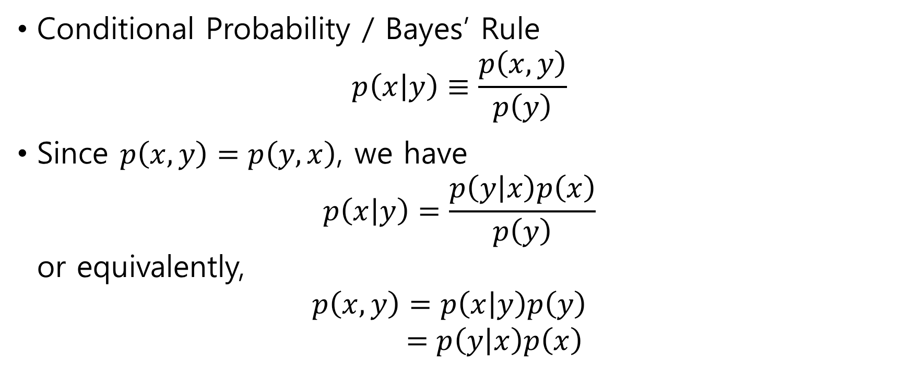
Conditional Probability / Bayes’ Rule $p\left(x | y\right)≡\frac{p\left(x,y\right)}{p\left(y\right)}$
Since $p\left(x,y\right)=p\left(y,x\right)$, we have $p\left(x | y\right)=\frac{p\left(y | x\right)p\left(x\right)}{p\left(y\right)}$ or equivalently, $p\left(x,y\right)=p\left(x | y\right)p\left(y\right)$ $=p\left(y | x\right)p\left(x\right)$

Slide 6

Probability Density Function $f\left(x\right)≥0$ $\int_{−∞}^{∞}{f\left(x\right)dx=1}$
Probability that $x∈\left[a,b\right]$ $p\left(a≤x≤b\right)=\int_{a}^{b}{f\left(x\right)dx}$

Slide 7
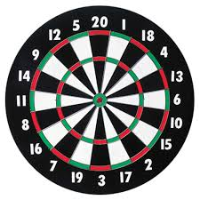
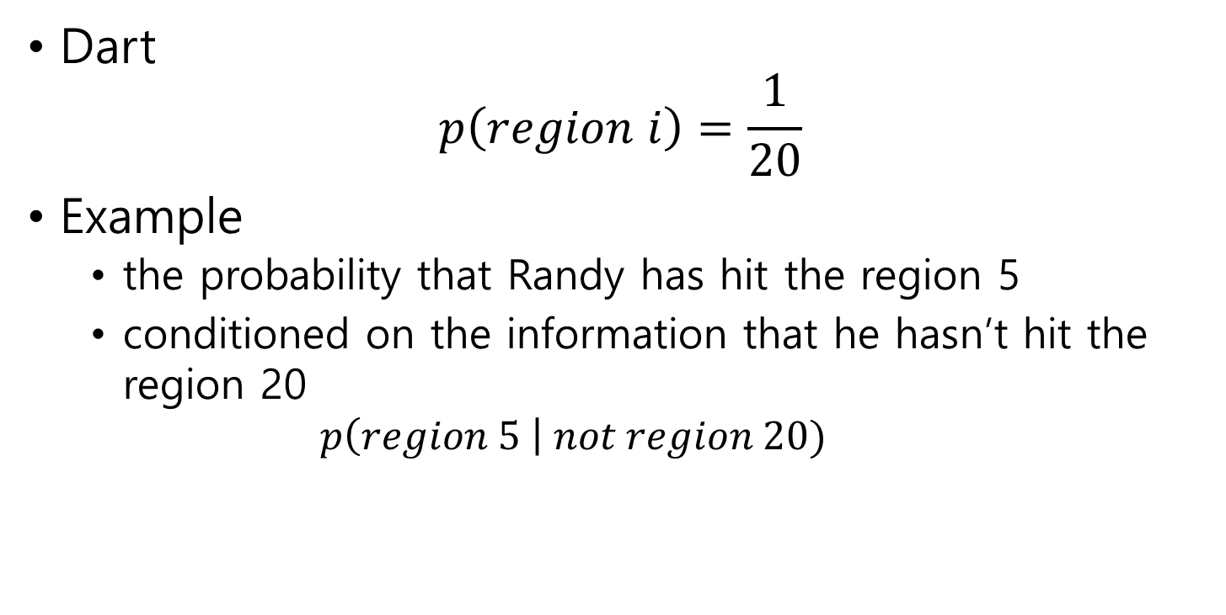
1.1.1 Interpreting Conditional Probability
Dart $p\left(region i\right)=\frac{1}{20}$
Example
the probability that Randy has hit the region 5
conditioned on the information that he hasn’t hit the region 20 $p\left(region 5 \right| not region 20)$

Slide 8
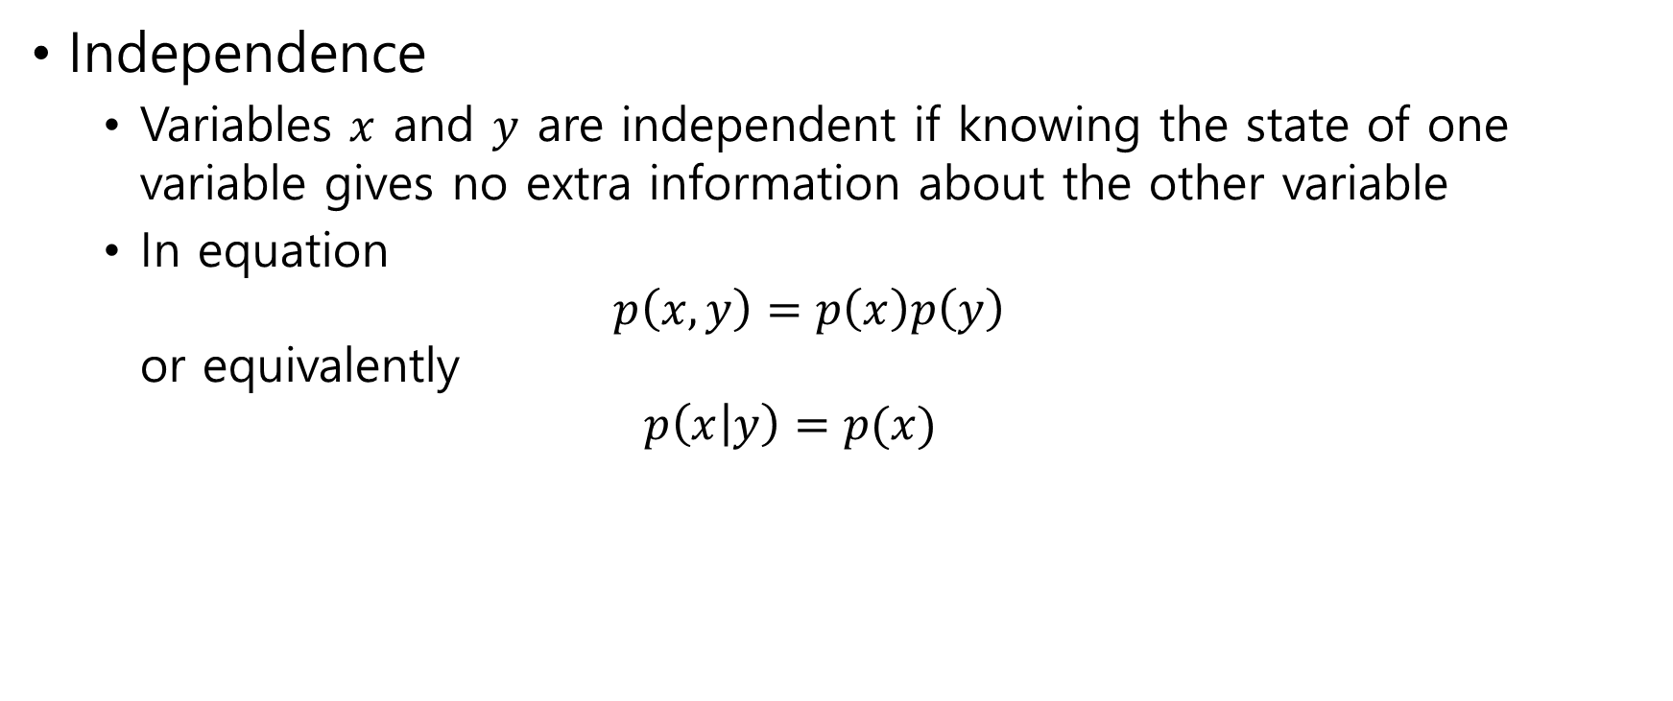
Independence
Variables $x$ and $y$ are independent if knowing the state of one variable gives no extra information about the other variable
In equation $p\left(x,y\right)=p\left(x\right)p\left(y\right)$ or equivalently $p\left(x | y\right)=p(x)$

Slide 9

Example $p(x=a, y=1)=1$, $p(x=a, y=2)=0$, $p(x=b, y=2)=0$, $p\left(x=b, y=1\right)=0$ Are $x$ and $y$ dependent?
Note variable $x$, value $a$

Slide 10
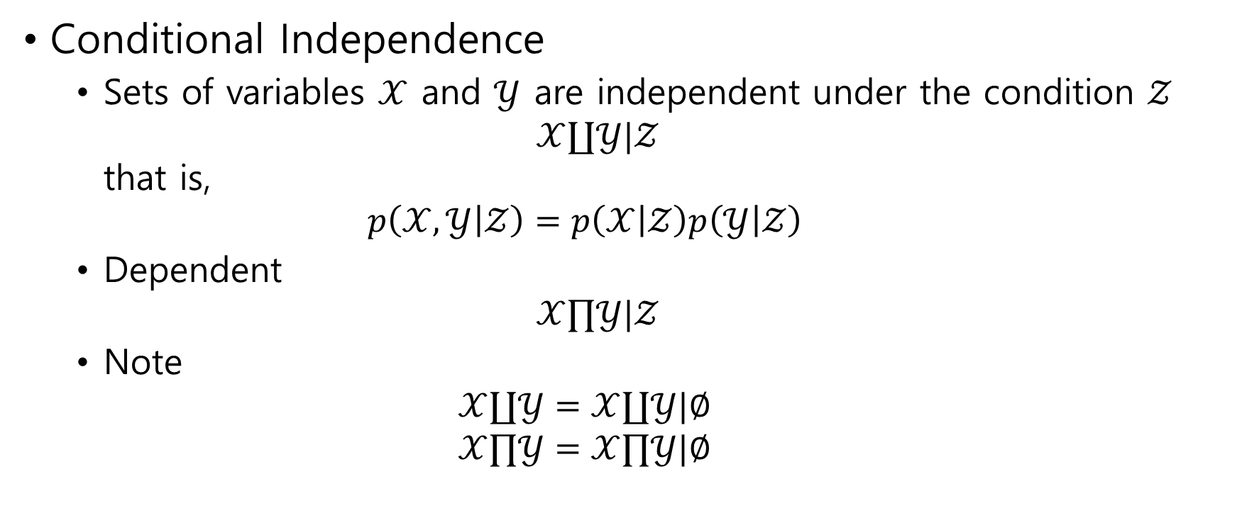
Conditional Independence
Sets of variables $𝒳$ and $𝒴$ are independent under the condition $𝒵$ $𝒳∐𝒴|𝒵$ that is, $p\left(𝒳,𝒴 | 𝒵\right)=p\left(𝒳 | 𝒵\right)p\left(𝒴 | 𝒵\right)$
Dependent $𝒳∏𝒴|𝒵$
Note $𝒳∐𝒴=𝒳∐𝒴|∅$ $𝒳∏𝒴=𝒳∏𝒴|∅$

Slide 11

Independence implications $a∐b, b∐c ⇒ a∐c$
Prove that $p\left(a,b\right)=p\left(a\right)p(b)$, $p\left(b,c\right)=p\left(b\right)p\left(c\right)$ $⇒$ $p\left(a,c\right)=p\left(a\right)p\left(c\right)$

Slide 12
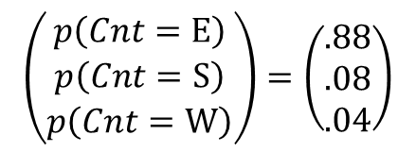
1.1.2 Probability Tables
Populations of UK
England(E) – 60776238
Scotland(S) – 5116900
Wales(W) – 2980700
Mother Tongue(MT)
$$\left(\begin{matrix}p\left(Cnt=E\right) \\ p\left(Cnt=S\right) \\ p\left(Cnt=W\right)\end{matrix}\right)=\left(\begin{matrix}.88 \\ .08 \\ .04\end{matrix}\right)$$

Slide 13


$p\left(Cnt,MT\right)=p\left(MT | Cnt\right)p\left(Cnt\right)$
Eg $p\left(Cnt=E, MT=Eng\right)=p\left(MT=Eng | Cnt=E\right)p\left(Cnt=E\right)$ $=0.95×0.88$

Slide 14

1.2 Probabilistic Reasoning
The central paradigm of probabilistic reasoning is
to identify all variables $x_{1},…,x_{N}$ in the environment
make a probabilistic model $p\left(x_{1}, …, x_{N}\right)$

Slide 15

Hamburgers
Kreuzfeld-Jacob disease (KJ) $p\left(Hamburger Eater | KJ\right)=0.9$ $p\left(KJ\right)=1/100,000$
Problem $p\left(KJ | Hamburger Eater\right)=?$

Slide 16

Inspector Clouseau
Scene of crime victim lies dead, a knife suspects: Butler(B), Maid(M)
Prior belief of inspector Butler is the murderer - $60\%$ Maid is the murderer - $20\%$

Slide 17
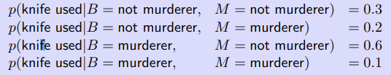

Mathematical formulation
$p\left(B | K\right)=?$
$p(B=murderer|K=knife used)$

Slide 18
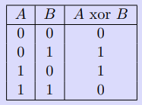
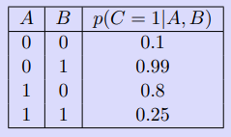

XOR Gate
Soft XOR Gate
$$p\left(A=1 | C=0\right)=?$$

Slide 19

1.3 Prior, Likelihood and Posterior
Our interest $p\left(θ|𝒟\right)=\frac{p\left(𝒟 | θ\right)p\left(θ\right)}{p(𝒟)}=\frac{p\left(𝒟 | θ\right)p\left(θ\right)}{\int_{θ}{p\left(𝒟 | θ\right)p\left(θ\right)}}$
Prior - $p(θ)$
Posterior - $p\left(θ|𝒟\right)$
Likelihood - $p\left(𝒟 | θ\right)$

Slide 20
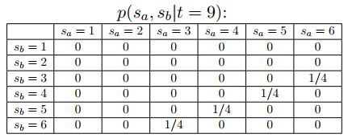

1.3.1 Two dice
Rolling two fair dice
The sum of the two scores is 9
What is the posterior distribution of the dice scores?
Scores $s_{a}$, $s_{b}$, sum $t$
Find all $p(s_{a}, s_{b}|t=9)$

Slide 21
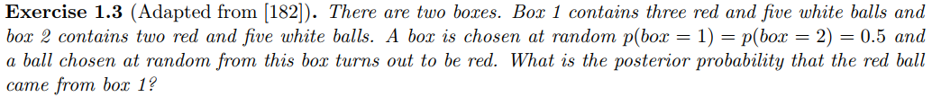

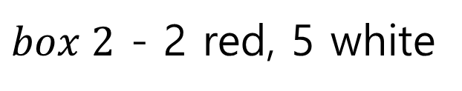
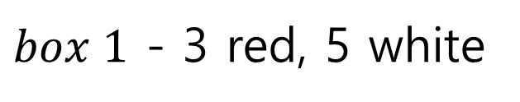
1.6 Exercises
$dom\left(box\right)=\{1, 2\}$, $dom\left(ball\right)=\left\{red, white\right\}$ $$p\left(box=1\right)=p\left(box=2\right)=0.5$$
$$p\left(box=1 | ball=red\right)=?$$
$box 1$ - 3 red, 5 white
$box 2$ - 2 red, 5 white

