Slide 1
Chapter 4 Graphical Models

Slide 2
4.1 Graphical Models
GM for modelling
To describe how variables can interact, such as independence
Belief networks, Markov networks, chain graphs and influence diagrams
GM for inference
To perform inference on a distribution
Factor graphs and junction trees

Slide 3
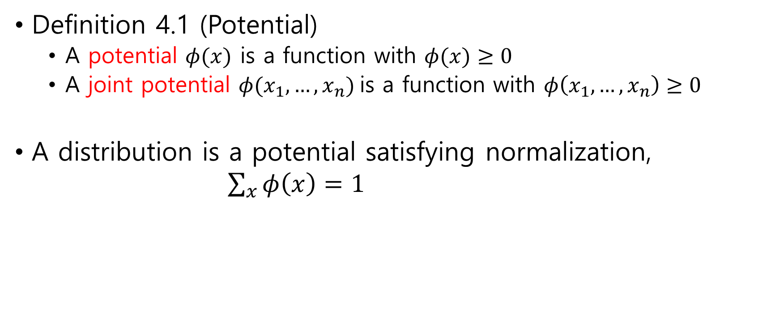
4.2 Markov Networks
Definition 4.1 (Potential)
A potential $φ(x)$ is a function with $φ(x)≥0$
A joint potential $φ(x_{1}, …, x_{n})$is a function with $φ\left(x_{1},…, x_{n}\right)≥0$
A distribution is a potential satisfying normalization, $\sum_{x}{φ\left(x\right)=1}$

Slide 4
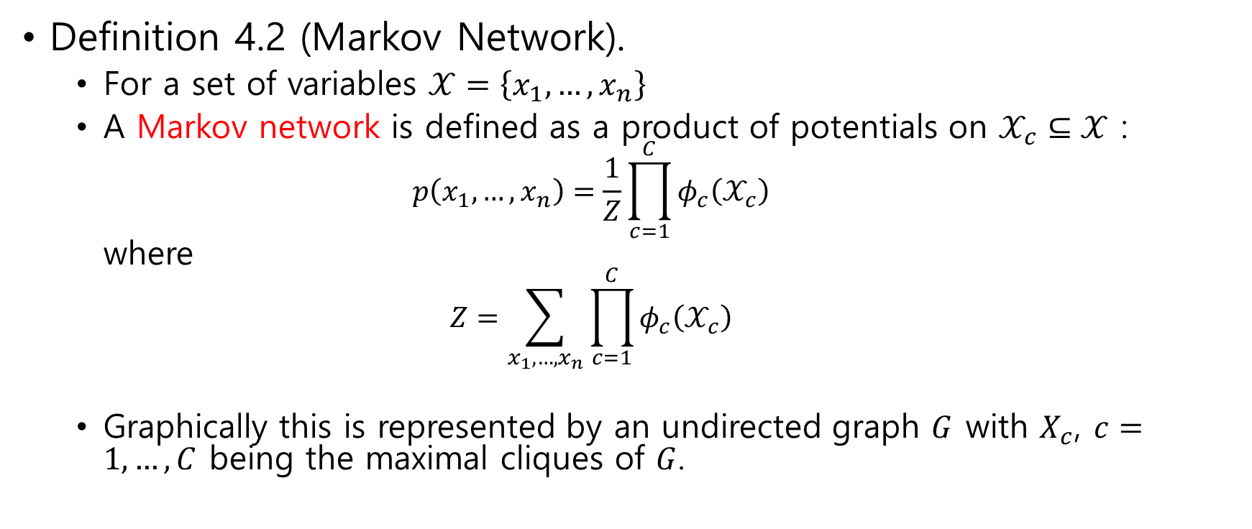
Definition 4.2 (Markov Network).
For a set of variables $𝒳=\left\{x_{1}, …, x_{n}\right\}$
A Markov network is defined as a product of potentials on $𝒳_{c}⊆𝒳$ : $p\left(x_{1}, …, x_{n}\right)=\frac{1}{Z}\prod_{c=1}^{C}{φ_{c}\left(𝒳_{c}\right)}$ where $Z=\sum_{x_{1},…,x_{n}}{\prod_{c=1}^{C}{φ_{c}\left(𝒳_{c}\right)}}$
Graphically this is represented by an undirected graph $G$ with $X_{c}$, $c=1,…,C$ being the maximal cliques of $G$.

Slide 5

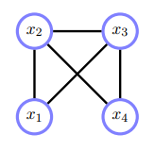
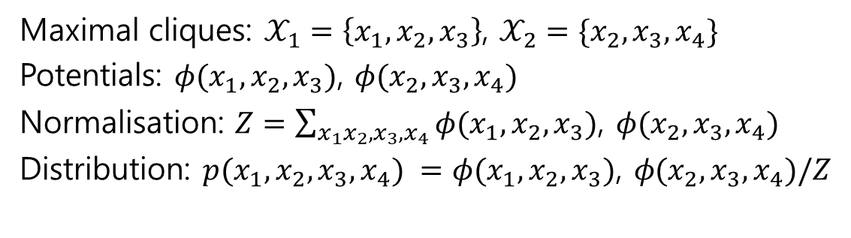
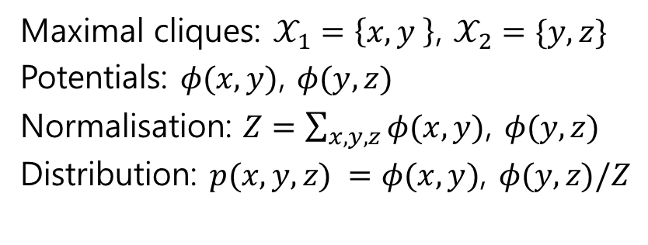
Maximal cliques: $𝒳_{1}=\left\{x,y \right\}$, $𝒳_{2}=\{y,z\}$
Potentials: $φ(x,y)$, $φ(y,z)$
Normalisation: $Z=\sum_{x,y,z}{φ(x,y)\text{, }φ(y,z) }$
Distribution: $p(x,y, z) =φ(x,y)\text{, }φ(y,z)/Z$
Maximal cliques: $𝒳_{1}=\left\{x_{1},x_{2}, x_{3}\right\}$, $𝒳_{2}=\{x_{2},x_{3},x_{4}\}$
Potentials: $φ(x_{1},x_{2},x_{3})$, $φ(x_{2},x_{3},x_{4})$
Normalisation: $Z=\sum_{x_{1}x_{2},x_{3},x_{4}}{φ(x_{1},x_{2},x_{3})\text{, }φ(x_{2},x_{3},x_{4}) }$
Distribution: $p(x_{1}, x_{2}, x_{3}, x_{4}) =φ(x_{1},x_{2},x_{3})\text{, }φ(x_{2},x_{3},x_{4})/Z$

Slide 6
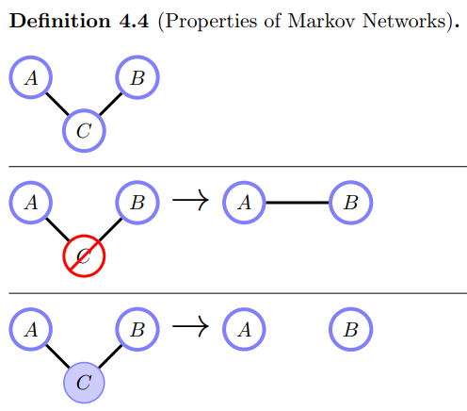
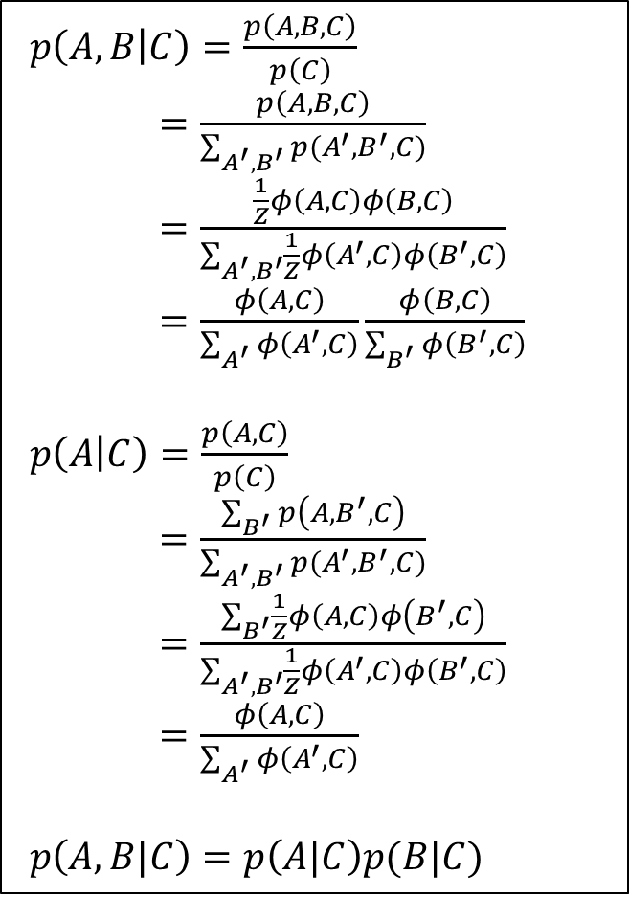



$p\left(A,B | C\right)=\frac{p\left(A,B,C\right)}{p\left(C\right)}$ $=\frac{p\left(A,B,C\right)}{\sum_{A^{′},B^{′}}{p(A^{′},B^{′},C)}}$ $=\frac{\frac{1}{Z}φ\left(A,C\right)φ\left(B,C\right)}{\sum_{A^{′},B^{′}}{\frac{1}{Z}φ\left(A^{′},C\right)φ\left(B^{′},C\right)}}$ $=\frac{φ\left(A,C\right)}{\sum_{A^{′}}{φ\left(A^{′},C\right)}}\frac{φ\left(B,C\right)}{\sum_{B^{′}}{φ\left(B^{′},C\right)}}$
$p\left(A | C\right)=\frac{p\left(A,C\right)}{p\left(C\right)}$ $=\frac{\sum_{B^{′}}{p\left(A,B^{′},C\right)}}{\sum_{A^{′},B^{′}}{p(A^{′},B^{′},C)}}$ $=\frac{\sum_{B^{′}}{\frac{1}{Z}φ\left(A,C\right)φ\left(B^{′},C\right)}}{\sum_{A^{′},B^{′}}{\frac{1}{Z}φ\left(A^{′},C\right)φ\left(B^{′},C\right)}}$ $=\frac{φ\left(A,C\right)}{\sum_{A^{′}}{φ\left(A^{′},C\right)}}$
$p\left(A, B|C\right)=p\left(A|C\right)p(B|C)$
$$p(A, B, C) =φ_{AC}\left(A, C\right)φ_{BC}(B, C)/Z$$
$$p\left(A, B\right)≠p\left(A\right)p(B)$$
$$p\left(A, B|C\right)=p\left(A|C\right)p(B|C)$$

Slide 7
4.2.1 Markov properties
properties of Markov networks, such as independence

Slide 8
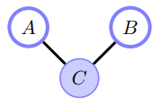
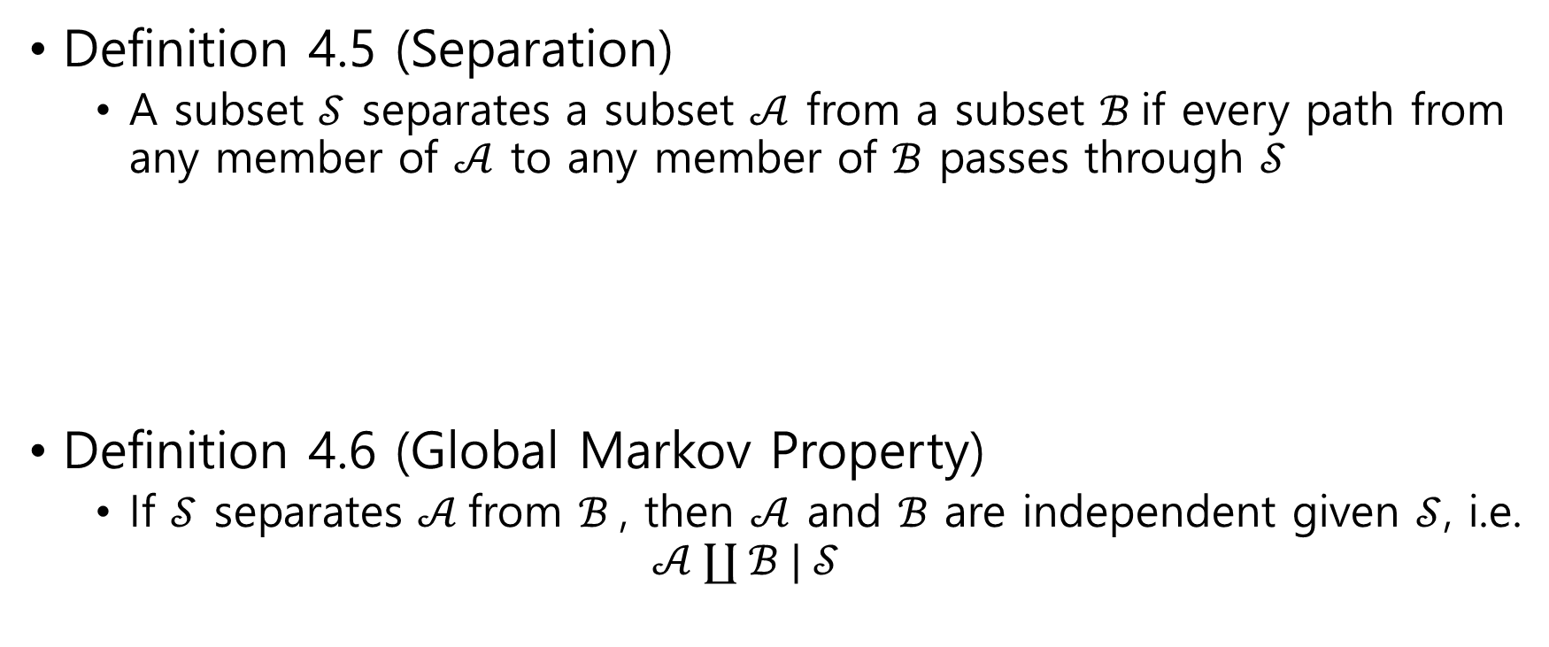

Definition 4.5 (Separation)
A subset $𝒮$ separates a subset $𝒜$ from a subset $ℬ$if every path from any member of $𝒜$ to any member of $ℬ$ passes through $𝒮$
Definition 4.6 (Global Markov Property)
If $𝒮$ separates $𝒜$from $ℬ$, then $𝒜$ and $ℬ$ are independent given $𝒮$, i.e. $𝒜 ∐ ℬ | 𝒮$
$C$ separates $A$ from $B$

Slide 9
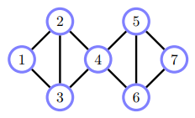
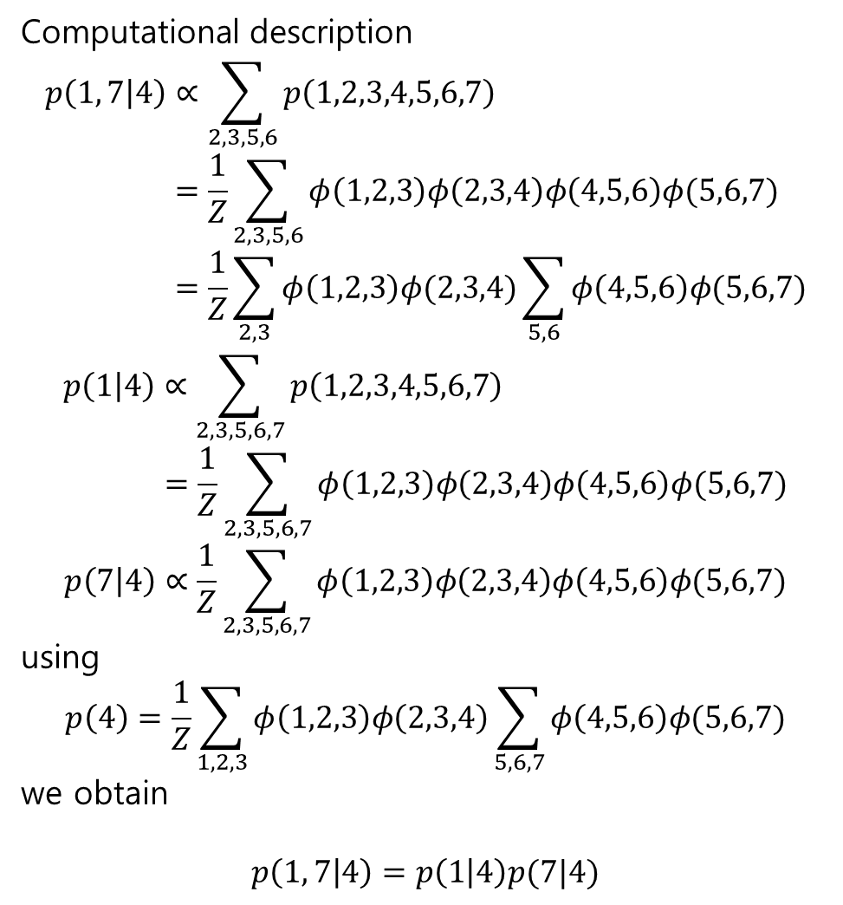

Computational description
$$p\left(1, 7 | 4\right)∝\sum_{2,3,5,6}{p\left(1,2,3,4,5,6,7\right)} \\ =\frac{1}{Z}\sum_{2,3,5,6}{φ\left(1,2,3\right)φ\left(2,3,4\right)φ\left(4,5,6\right)φ(5,6,7)} \\ =\frac{1}{Z}\sum_{2,3}{φ\left(1,2,3\right)φ(2,3,4)}\sum_{5,6}{φ\left(4,5,6\right)φ(5,6,7)}$$
$$p\left(1 | 4\right)∝\sum_{2,3,5,6,7}{p\left(1,2,3,4,5,6,7\right)} \\ =\frac{1}{Z}\sum_{2,3,5,6,7}{φ\left(1,2,3\right)φ\left(2,3,4\right)φ\left(4,5,6\right)φ(5,6,7)}$$
$$p\left(7 | 4\right)∝\frac{1}{Z}\sum_{2,3,5,6,7}{φ\left(1,2,3\right)φ\left(2,3,4\right)φ\left(4,5,6\right)φ(5,6,7)}$$
using
$$p\left(4\right)=\frac{1}{Z}\sum_{1,2,3}{φ\left(1,2,3\right)φ\left(2,3,4\right)\sum_{5,6,7}{φ\left(4,5,6\right)φ(5,6,7)}}$$
we obtain
$$p\left(1, 7 | 4\right)=p\left(1 | 4\right)p(7|4)$$
$$1 ∐ 7 | 4$$

Slide 10

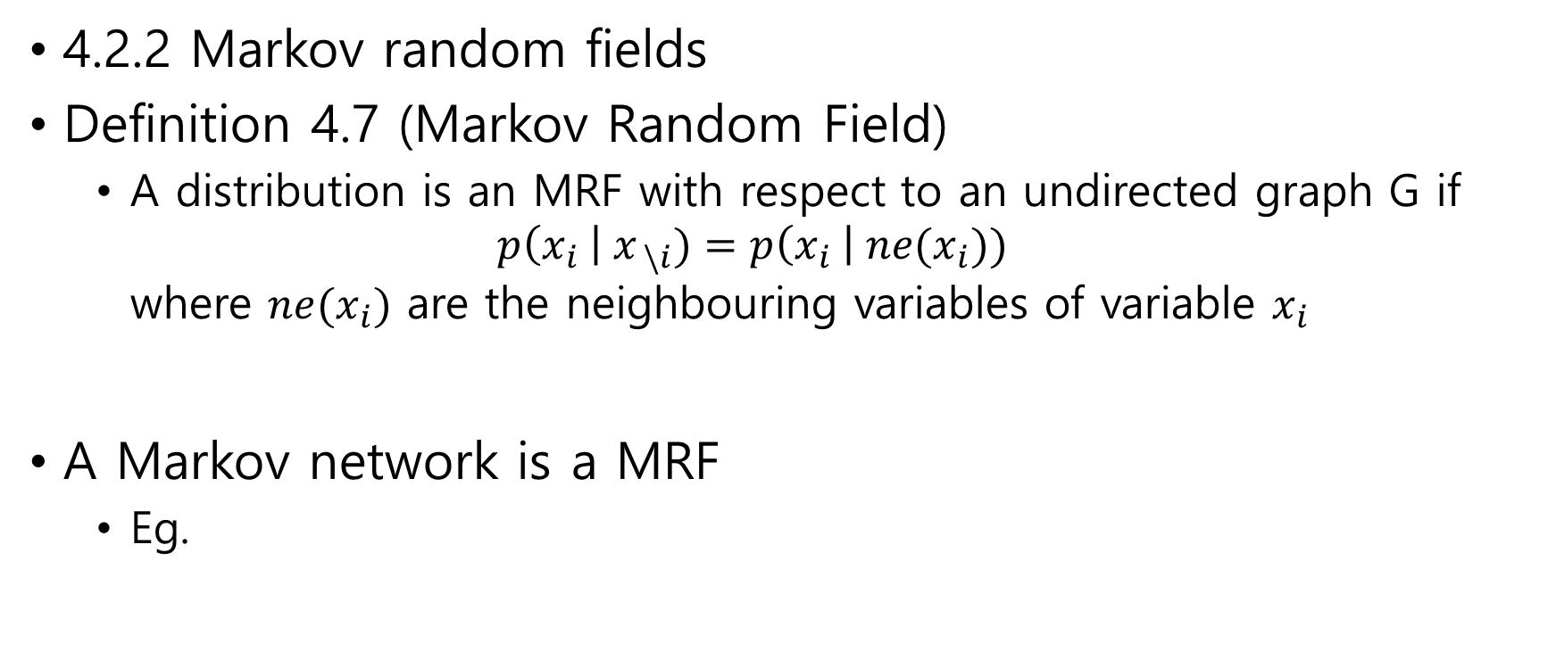
4.2.2 Markov random fields
Definition 4.7 (Markov Random Field)
A distribution is an MRF with respect to an undirected graph G if $p\left(x_{i} \right| x_{ \backslash i})=p\left(x_{i} \right| ne(x_{i}))$ where $ne(x_{i})$ are the neighbouring variables of variable $x_{i}$
A Markov network is a MRF
Eg.
$$p\left(x | y,z\right)=p(x|y)$$

Slide 11
4.3 Chain Graphical Models

Slide 12
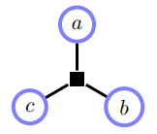
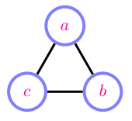
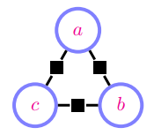
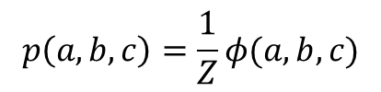
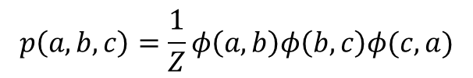
4.4 Factor Graphs
$$p\left(a,b,c\right)=\frac{1}{Z}φ(a,b,c)$$
$$p\left(a,b,c\right)=\frac{1}{Z}φ\left(a,b\right)φ\left(b,c\right)φ(c,a)$$

Slide 13
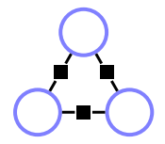


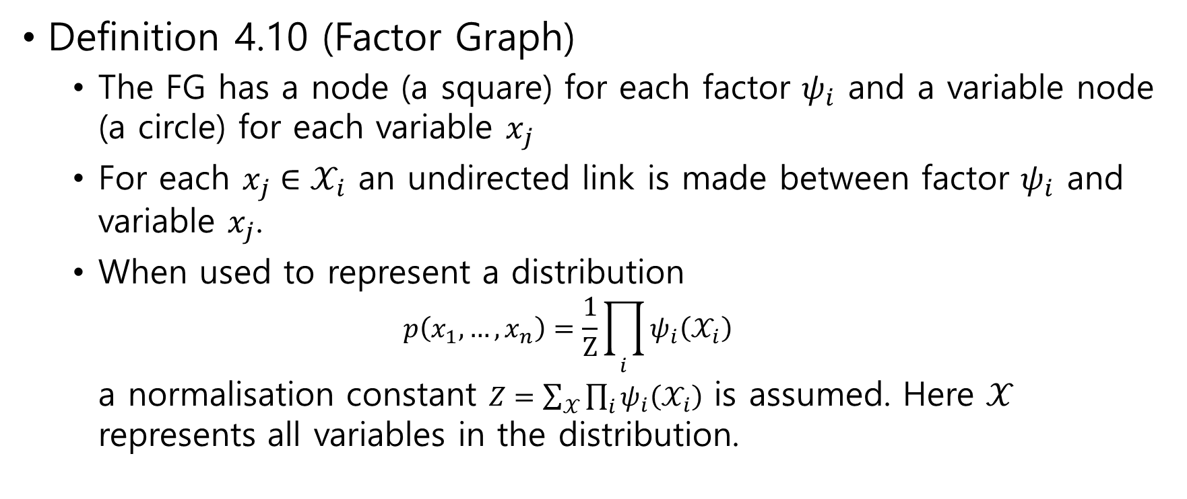




$$x_{1}$$
$$ψ_{3}$$
$$ψ_{1}$$
$$x_{3}$$
$$x_{2}$$
$$ψ_{2}$$
Definition 4.10 (Factor Graph)
The FG has a node (a square) for each factor $ψ_{i}$ and a variable node (a circle) for each variable $x_{j}$
For each $x_{j}∈𝒳_{i}$ an undirected link is made between factor $ψ_{i}$ and variable $x_{j}$.
When used to represent a distribution $p\left(x_{1}, …, x_{n}\right)=\frac{1}{Z}\prod_{i}{ψ_{i}\left(𝒳_{i}\right)}$ a normalisation constant $Z=\sum_{𝒳}{\prod_{i}{ψ_{i}\left(𝒳_{i}\right)}}$ is assumed. Here $𝒳$ represents all variables in the distribution.

Slide 14
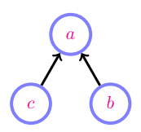
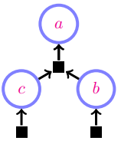
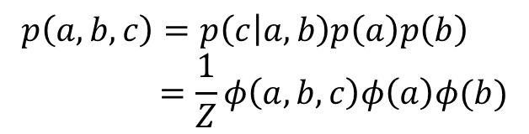
$$p\left(a,b,c\right)=p\left(c | a,b\right)p\left(a\right)p\left(b\right) \\ =\frac{1}{Z}φ\left(a,b,c\right)φ\left(a\right)φ(b)$$

