Slide 1
Chapter 4 Word Embeddings and Recurrent NNs

Slide 2
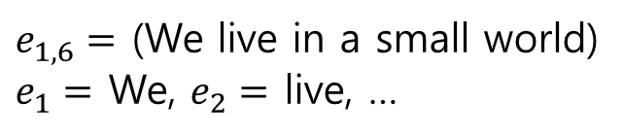
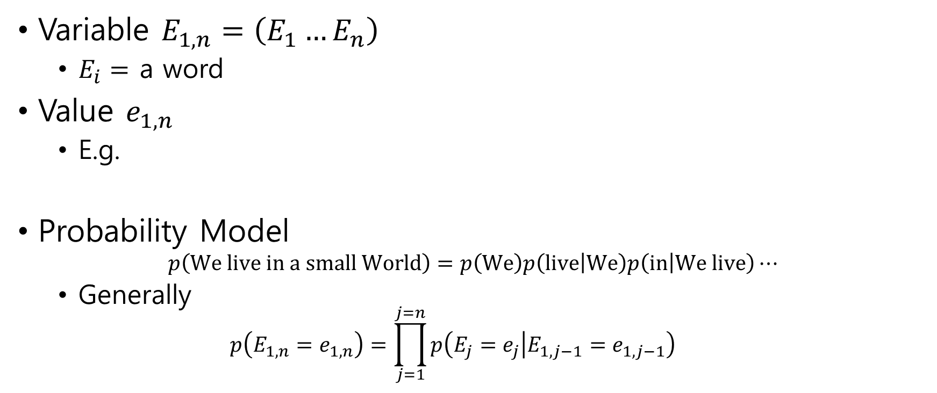
4.1 Word Embeddings for Language Models
Variable $E_{1,n}=\left(E_{1}…E_{n}\right)$
$E_{i}=$ a word
Value $e_{1,n}$
E.g.
Probability Model $p\left(We live in a small World\right)=p\left(We\right)p\left(live | We\right)p\left(in | We live\right)⋯$
Generally $p\left(E_{1,n}=e_{1,n}\right)=\prod_{j=1}^{j=n}{p\left(E_{j}=e_{j} | E_{1,j−1}=e_{1,j−1}\right)}$
$e_{1,6}=$ (We live in a small world)
$e_{1}=$ We, $e_{2}=$ live, …

Slide 3
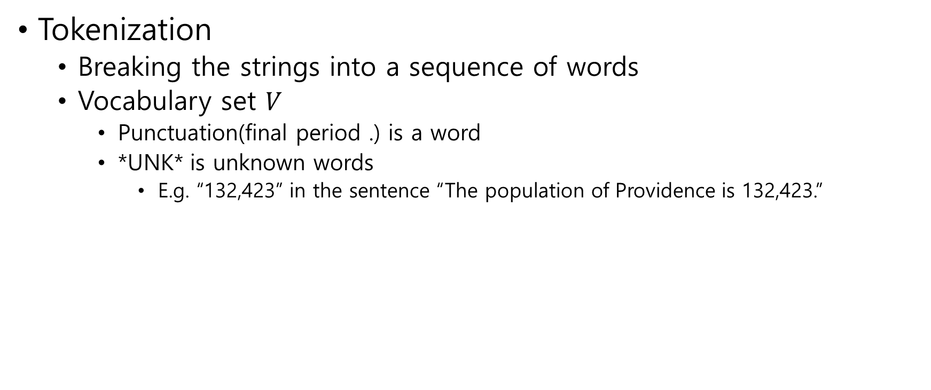
Tokenization
Breaking the strings into a sequence of words
Vocabulary set $V$
Punctuation(final period .) is a word
*UNK* is unknown words
E.g. “132,423” in the sentence “The population of Providence is 132,423.”

Slide 4
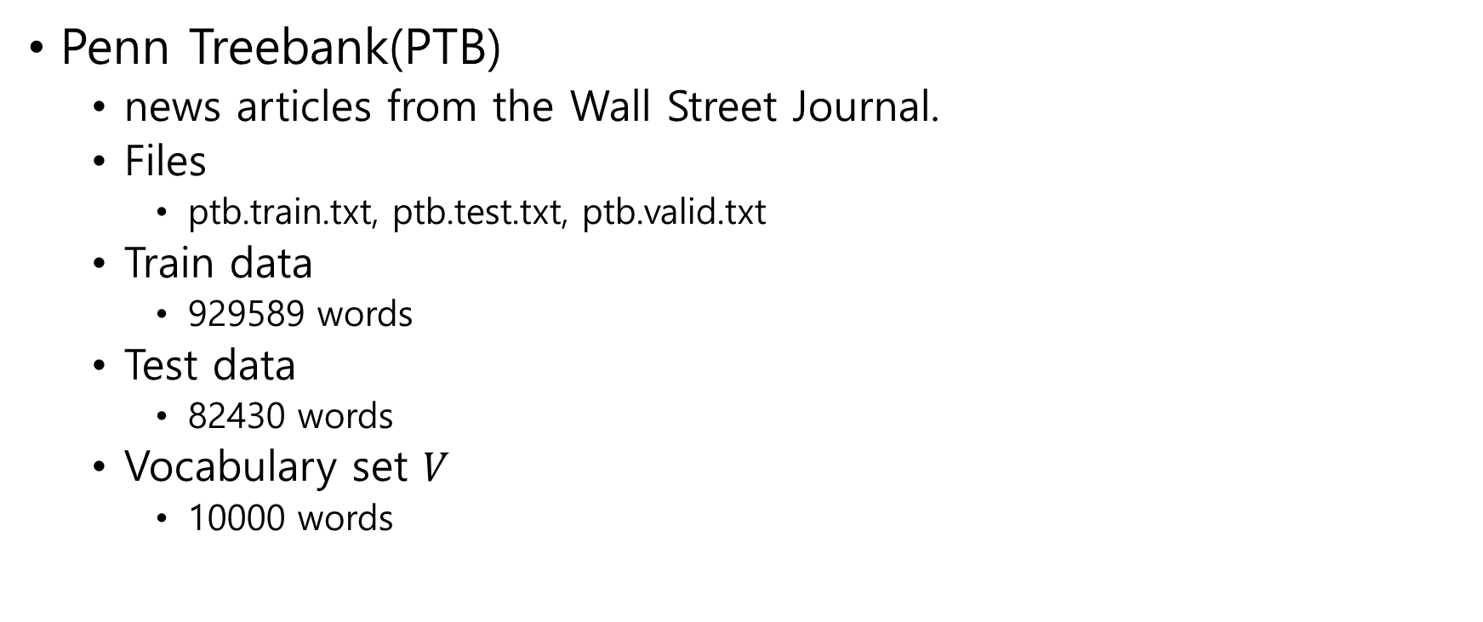
Penn Treebank(PTB)
news articles from the Wall Street Journal.
Files
ptb.train.txt, ptb.test.txt, ptb.valid.txt
Train data
929589 words
Test data
82430 words
Vocabulary set $V$
10000 words
aer banknote berlitz calloway centrust cluett fromstein gitano guterman hydro-quebec ipo kia memotec mlx nahb punts rake regatta rubens sim snack-food ssangyong swapo wachter
pierre <unk> N years old will join the board as a nonexecutive director nov. N
mr. <unk> is chairman of <unk> n.v. the dutch publishing group

Slide 5
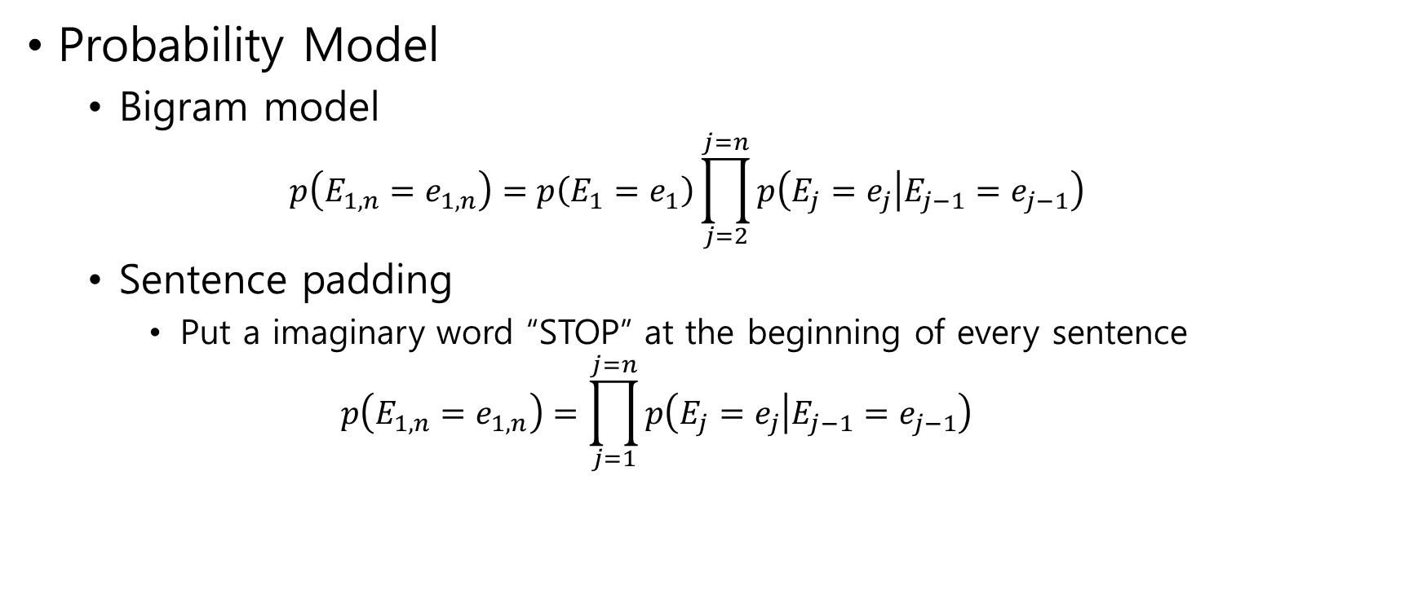
Probability Model
Bigram model $p\left(E_{1,n}=e_{1,n}\right)=p\left(E_{1}=e_{1}\right)\prod_{j=2}^{j=n}{p\left(E_{j}=e_{j} | E_{j−1}=e_{j−1}\right)}$
Sentence padding
Put a imaginary word “STOP” at the beginning of every sentence $p\left(E_{1,n}=e_{1,n}\right)=\prod_{j=1}^{j=n}{p\left(E_{j}=e_{j} | E_{j−1}=e_{j−1}\right)}$

Slide 6







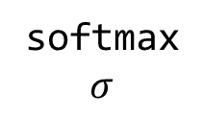

Neural Network
Word embedding
word $→$ index $→$ one hot vector $→$ $e$-dimensional vector
$e=20$, $100$ or $1000$
softmax
$$σ$$
$E$
$W,b$
$$Σ$$
Words
batch_size $×$ 1
$e$-dim vectors
batch_size $×e$
One hot vectors
batch_size $×|V|$
Output vectors
batch_size $×|V|$

Slide 7
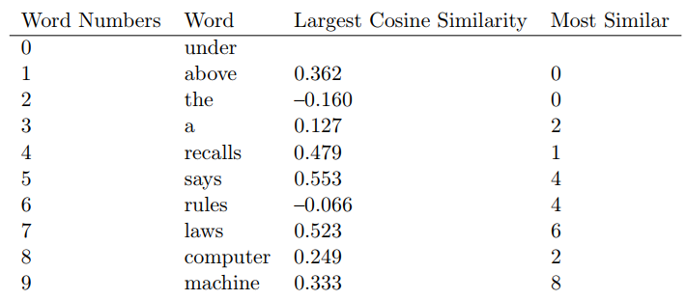

Words embedding
Cosine similarity
$\cos\left(x,y\right)=\frac{x⋅y}{∥x∥∥y∥}$
Cosine of angle between $x$ and $y$

Slide 8
4.2 Building Feed-Forward Language Models
inpt = tf.placeholder(tf.int32, shape=[batchSz])
answr = tf.placeholder(tf.int32, shape=[batchSz])
E = tf.Variable(tf.random_normal([vocabSz, embedSz], stddev = 0.1))
embed = tf.nn.embedding_lookup(E, inpt)
xEnt = tf.nn.sparse_softmax_cross_entropy_with_logits(logits=logits,labels=answr)
loss = tf.reduce_sum(xEnt)

Slide 9
4.3 Improving Feed-Forward Language Models
1. Adding layer
2. Trigram model
embed2 = tf.nn.embedding_lookup(E, inpt2)
both = tf.concat([embed,embed2], 1)

Slide 10
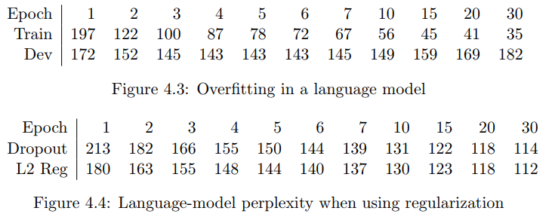
4.4 Overfitting
Regularization
Early stopping
Dropout
L2 regularization

Slide 11
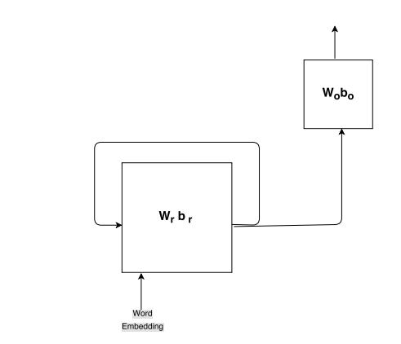

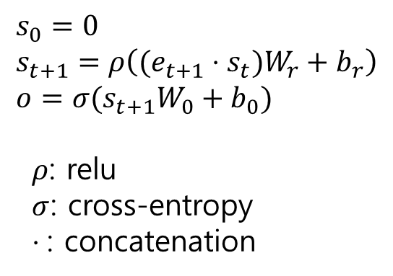



4.5 Recurrent Networks
$$o$$
$$s_{0}=0 \\ s_{t+1}=ρ\left((e_{t+1}⋅s_{t})W_{r}+b_{r}\right) \\ o=σ(s_{t+1}W_{0}+b_{0})$$
$ρ$: relu
$σ$: cross-entropy
$⋅$: concatenation
$$s_{t}$$
$$s_{t+1}$$
$$e_{t+1}$$
RNN(recurrent neural network

Slide 12
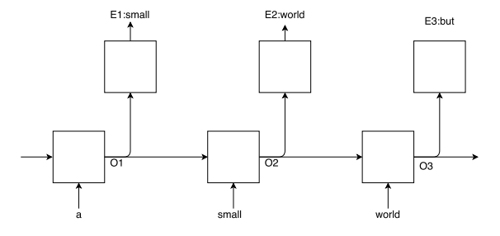
It is a small world but I like it that way

Slide 13
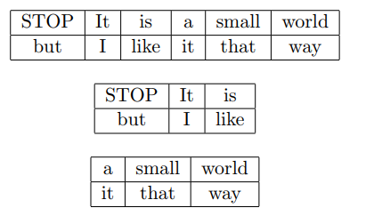
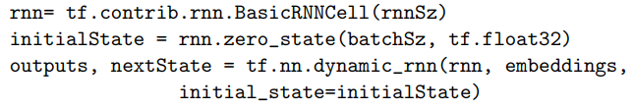
batch 1
batch 2
Batch size = 2
Window size = 3

Slide 14
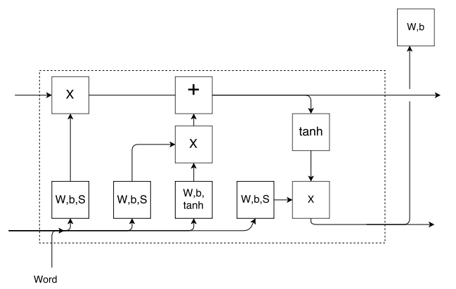
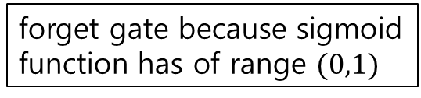
4.6 Long Short-Term Memory
element–wise multiplication
forget gate because sigmoid
function has of range $(0,1)$
cell state
concatenation

Slide 15
TF program
replace with

