Slide 1
Chapter 8 Statistics for Machine Learning

Slide 2
8.1 Representing Data
Numeric encoding of data
3 types
Categorical, Ordinal, Numerical

Slide 3
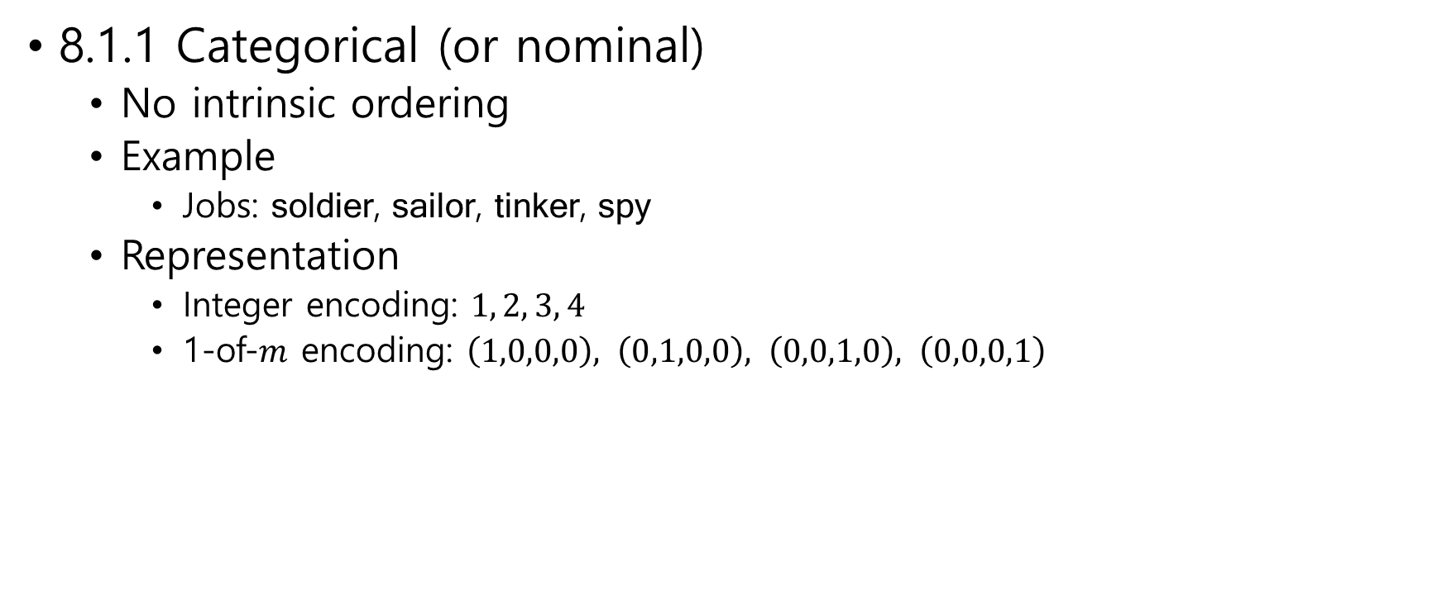
8.1.1 Categorical (or nominal)
No intrinsic ordering
Example
Jobs: soldier, sailor, tinker, spy
Representation
Integer encoding: $1, 2, 3, 4$
1-of-$m$ encoding: $\left(1,0,0,0\right), \left(0,1,0,0\right), \left(0,0,1,0\right), \left(0,0,0,1\right)$

Slide 4

8.1.2 Ordinal
Discrete
Intrinsic ordering or ranking
Example
cold, cool, warm, hot
Representation
To preserve the ordering
$−1, 0, 1, 2$

Slide 5
8.1.3 Numerical
Values that are real numbers
Example
Temperature
Salary

Slide 6
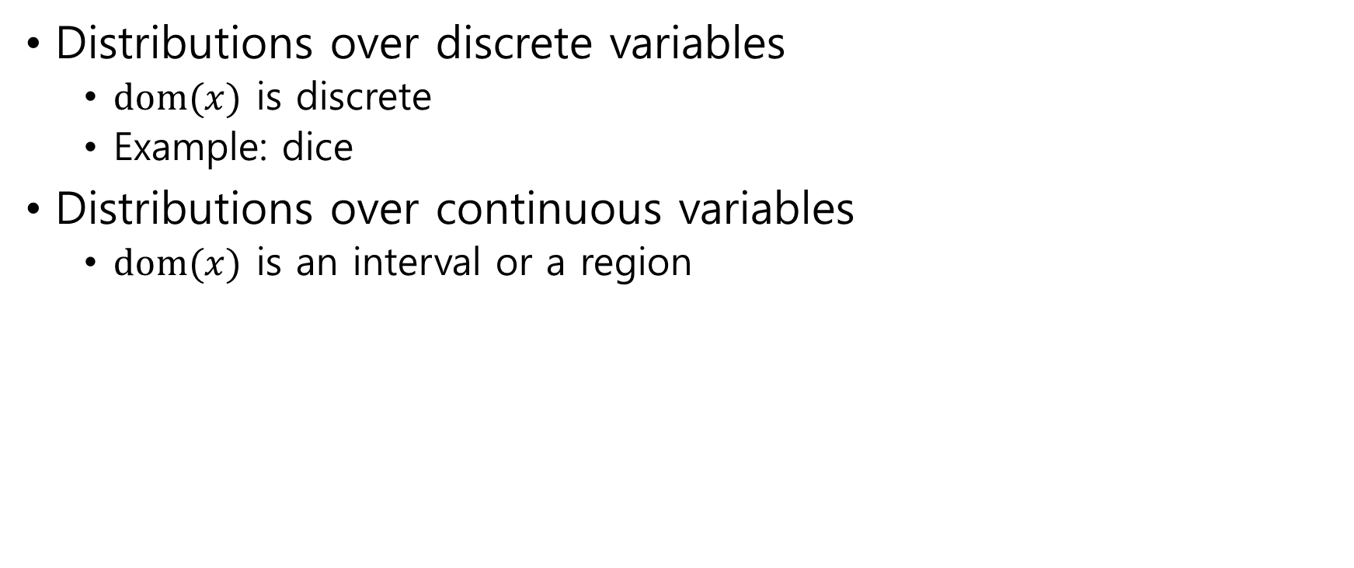
8.2 Distributions
Distributions over discrete variables
$dom(x)$ is discrete
Example: dice
Distributions over continuous variables
$dom(x)$ is an interval or a region

Slide 7
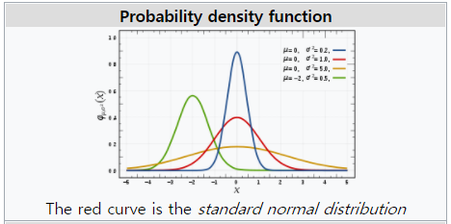

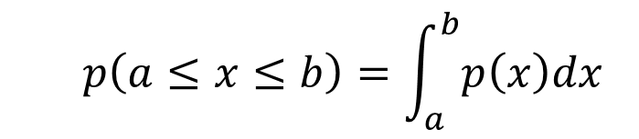
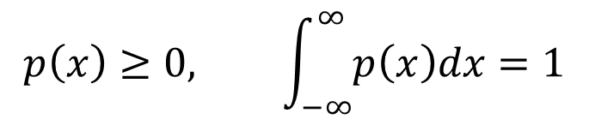
Definition 8.1 (Probability Density Functions)
Probability density function $p\left(x\right)$ $p\left(x\right)≥0, \int_{−∞}^{∞}{p\left(x\right)dx=1}$
Probability $p\left(a≤x≤b\right)=\int_{a}^{b}{p\left(x\right)dx}$
$$p\left(x\right)≥0, \int_{−∞}^{∞}{p\left(x\right)dx=1}$$
$$p\left(a≤x≤b\right)=\int_{a}^{b}{p\left(x\right)dx}$$

Slide 8


Definition 8.2 (Averages and Expectation)
Average (or expectation)
${\left\langle f\left(x\right)\right\rangle }_{p\left(x\right)}$
$𝔼(f\left(x\right))$
Discrete case
$${\left\langle f\left(x\right)\right\rangle }_{p\left(x\right)}=\sum_{x}{f\left(x\right)p(x)}$$
Continuous case
$${\left\langle f\left(x\right)\right\rangle }_{p\left(x\right)}=\int_{−∞}^{∞}{f\left(x\right)p\left(x\right)dx}$$

Slide 9


Result 8.1 (Change of variables)
$1$-dimensional $x$
$$y=f(x)$$
$$p\left(x\right)=p\left(y\right)\frac{dy}{dx}$$
$n$-dimensional $x$
$$y=f\left(x\right)$$
$$p\left(x\right)=p\left(y\right)\left|\det\left(\frac{∂y}{∂x}\right)\right|$$

Slide 10
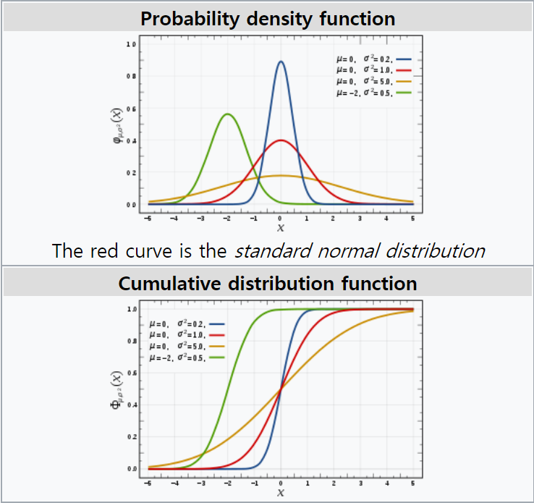
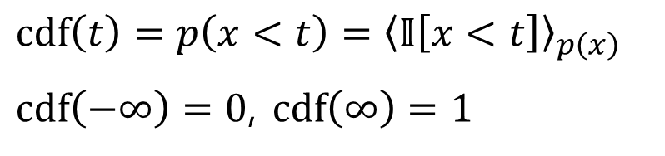
Definition 8.4 (Cumulative Distribution Function)
$cdf\left(t\right)=p\left(x<t\right)={\left\langle 𝕀\left[x<t\right]\right\rangle }_{p\left(x\right)}$
$cdf\left(−∞\right)=0$, $cdf\left(∞\right)=1$

Slide 11


Definition 8.3 (Moments)
$k$-th moment
$${\left\langle x^{k}\right\rangle }_{p\left(x\right)}$$
1st moment = mean
${\left\langle x\right\rangle }_{p\left(x\right)}$

Slide 12
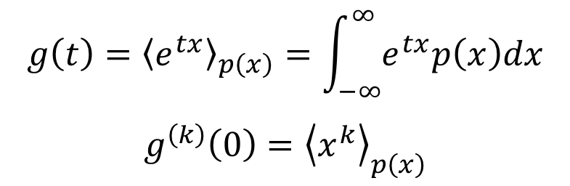
Definition 8.5 (Moment Generating Function)
$$g\left(t\right)={\left\langle e^{tx}\right\rangle }_{p\left(x\right)}=\int_{−∞}^{∞}{e^{tx}p\left(x\right)dx}$$
$$g^{\left(k\right)}\left(0\right)={\left\langle x^{k}\right\rangle }_{p\left(x\right)}$$

Slide 13
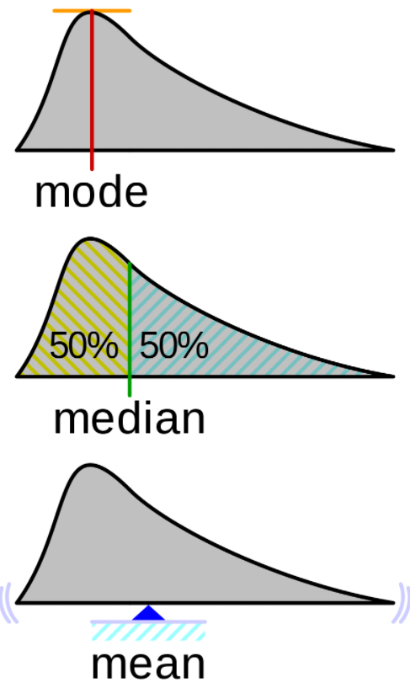
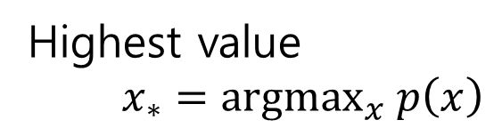
Definition 8.6 (Mode)
Highest value
$x_{∗}={argmax}_{x} p\left(x\right)$

Slide 14
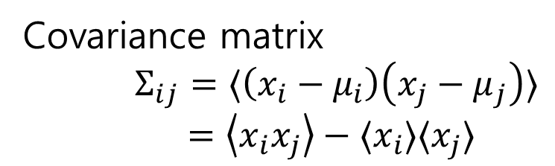
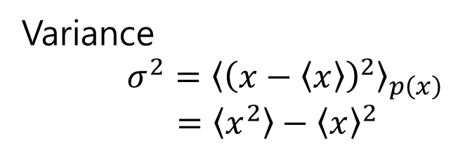

Definition 8.7 (Variance and Correlation)
Variance
$σ^{2}={\left\langle {\left(x−\left\langle x\right\rangle \right)}^{2}\right\rangle }_{p\left(x\right)}$ $=\left\langle x^{2}\right\rangle −{\left\langle x\right\rangle }^{2}$
Correlation matrix
$ρ_{ij}=\left\langle \frac{x_{i}−μ_{i}}{σ_{i}}\frac{x_{j}−μ_{j}}{σ_{j}}\right\rangle$
Covariance matrix
$Σ_{ij}=⟨\left(x_{i}−μ_{i}\right)\left(x_{j}−μ_{j}\right)⟩$
$=\left\langle x_{i}x_{j}\right\rangle −⟨x_{i}⟩⟨x_{j}⟩$

Slide 15
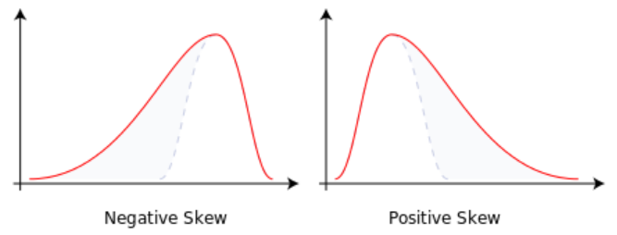
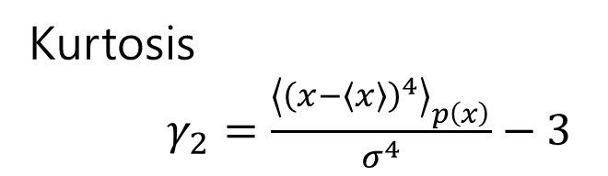

Definition 8.8 (Skewness and Kurtosis)
Skewness
$γ_{1}=\frac{{\left\langle {\left(x−\left\langle x\right\rangle \right)}^{3}\right\rangle }_{p\left(x\right)}}{σ^{3}}$
Kurtosis
$γ_{2}=\frac{{\left\langle {\left(x−\left\langle x\right\rangle \right)}^{4}\right\rangle }_{p\left(x\right)}}{σ^{4}}−3$

Slide 16
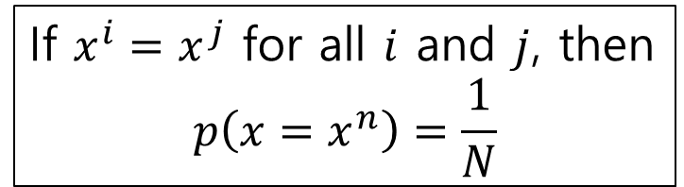


Definition 8.10 (Empirical Distribution)
$dom\left(x\right)=\{x^{1},…,x^{N}\}$
$$p\left(x\right)=\frac{1}{N}\sum_{n=1}^{n}{𝕀\left[x=x^{n}\right]}$$
Mean
$$μ=\frac{1}{N}\sum_{n=1}^{N}{x^{n}}$$
Variance
$$σ^{2}=\frac{1}{N}\sum_{n=1}^{N}{{\left(x^{n}−μ\right)}^{2}}$$
If $x^{i}=x^{j}$ for all $i$ and $j$, then
$$p\left(x=x^{n}\right)=\frac{1}{N}$$

Slide 17
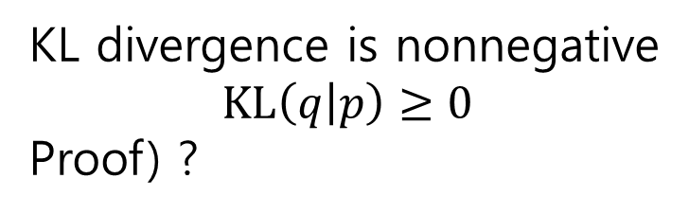
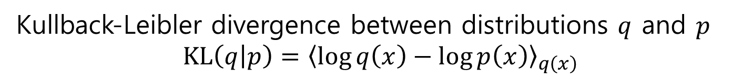
Definition 8.11 (KL divergence)
Kullback-Leibler divergence between distributions $q$ and $p$
$$KL\left(q | p\right)={\left\langle \log{q\left(x\right)}−\log{p\left(x\right)}\right\rangle }_{q\left(x\right)}$$
KL divergence is nonnegative
$$KL\left(q | p\right)≥0$$
Proof) ?

Slide 18
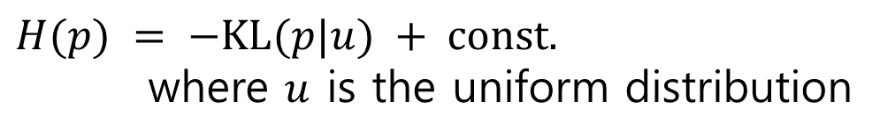

Entropy
$H\left(p\right)=−{\left\langle \log{p\left(x\right)}\right\rangle }_{p\left(x\right)}$
$H(p) = −KL(p|u) + const.$
where $u$ is the uniform distribution

Slide 19
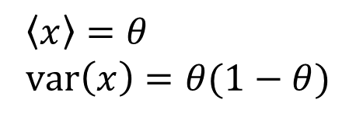
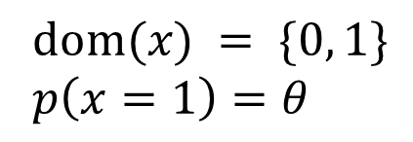
8.3 Classical Distributions
Definition 8.14 (Bernoulli Distribution)
$dom(x) = \{0, 1\}$
$p\left(x=1\right)=θ$
$\left\langle x\right\rangle =θ$
$var\left(x\right)=θ(1−θ)$
Example: a coin toss

Slide 20
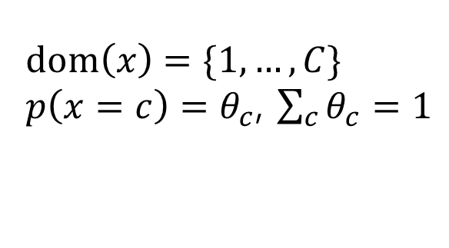
Definition 8.15 (Categorical Distribution)
$dom\left(x\right)=\{1,…,C\}$
$p\left(x=c\right)=θ_{c}$, $\sum_{c}{θ_{c}}=1$
Example: the roll of a dice

Slide 21
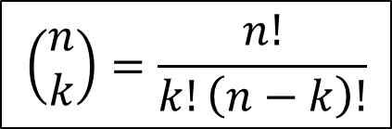
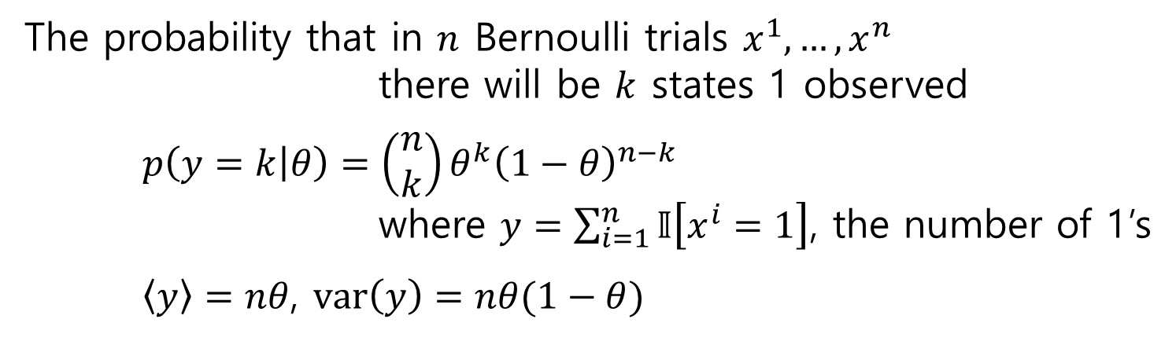

Definition 8.16 (Binomial Distribution)
The probability that in $n$ Bernoulli trials $x^{1},…,x^{n}$
there will be $k$ states 1 observed
$p\left(y=k | θ\right)=\left(\begin{matrix}n \\ k\end{matrix}\right)θ^{k}{\left(1−θ\right)}^{n−k}$
where $y=\sum_{i=1}^{n}{𝕀\left[x^{i}=1\right]}$, the number of 1’s
$\left\langle y\right\rangle =nθ$, $var\left(y\right)=nθ(1−θ)$
$$\left(\begin{matrix}n \\ k\end{matrix}\right)=\frac{n!}{k!\left(n−k\right)!}$$
Example: coin toss $n$ times

Slide 22
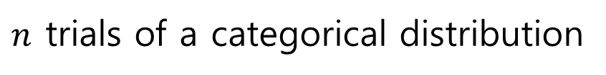

Definition 8.17 (Multinomial Distribution)
$n$ trials of a categorical distribution
Example: $n$ rolls of a dice

Slide 23
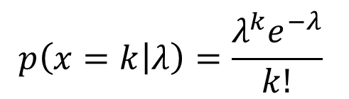
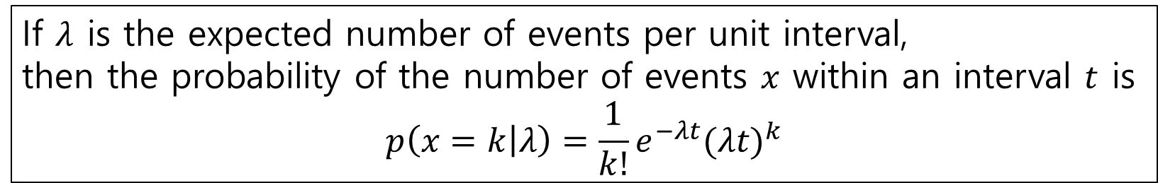
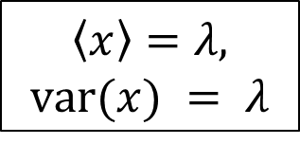
Definition 8.18 (Poisson Distribution)
The probability of a given number of events occurring in an interval of time
Example: train
$$p\left(x=k | λ\right)=\frac{λ^{k}e^{−λ}}{k!}$$
$$\left\langle x\right\rangle =λ,$$
$$var(x) = λ$$
If $λ$ is the expected number of events per unit interval,
then the probability of the number of events $x$ within an interval $t$ is
$$p\left(x=k | λ\right)=\frac{1}{k!}e^{−λt}{(λt)}^{k}$$

Slide 24
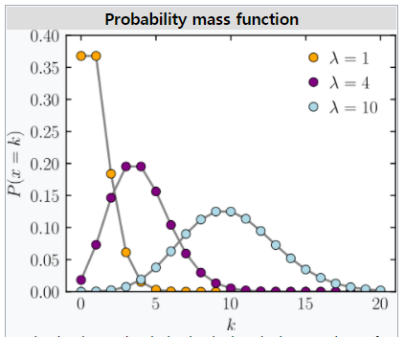
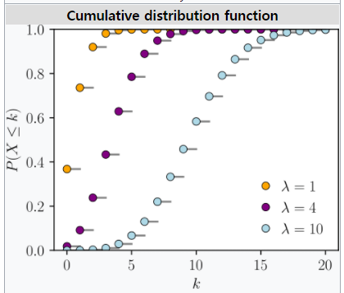

Slide 25

Definition 8.19 (Uniform distribution)
$$p\left(x\right)=const.$$

Slide 26
Definition 8.21 (Gamma Distribution)
Definition 8.22 (Inverse Gamma distribution)
Definition 8.23 (Beta Distribution)

Slide 27
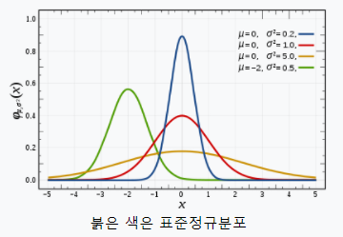

Definition 8.25 (Univariate Gaussian Distribution)
$$p\left(x | μ,σ^{2}\right)=𝒩\left(x | μ,σ^{2}\right)$$
$$=\frac{1}{\sqrt{2πσ^{2}}}e^{− \frac{1}{2σ^{2}}{\left(x−μ\right)}^{2}}$$
$\left\langle x\right\rangle =μ$
$var\left(x\right)=σ^{2}$

Slide 28
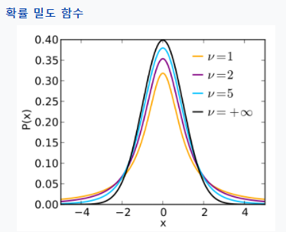
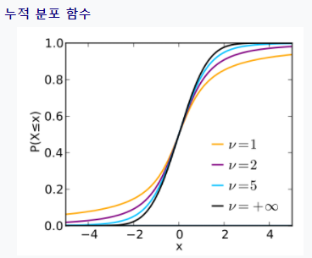
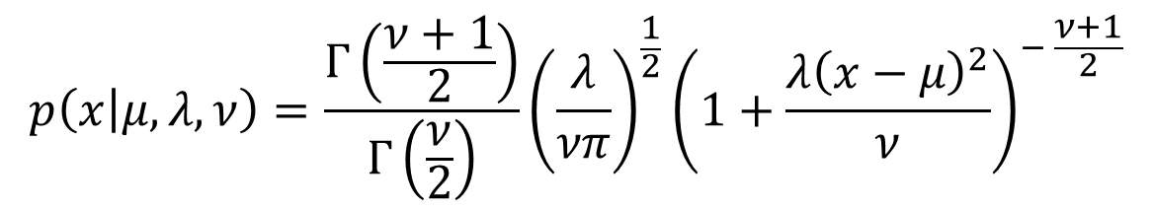
Definition 8.26 (Student’s t-distribution).
$$p\left(x | μ,λ,ν\right)=\frac{Γ\left(\frac{ν+1}{2}\right)}{Γ\left(\frac{ν}{2}\right)}{\left(\frac{λ}{νπ}\right)}^{\frac{1}{2}}{\left(1+\frac{λ{\left(x−μ\right)}^{2}}{ν}\right)}^{− \frac{ν+1}{2}}$$

Slide 29
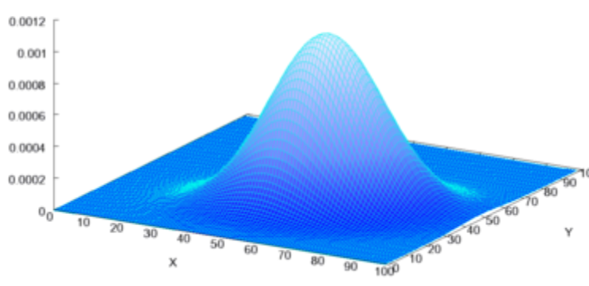
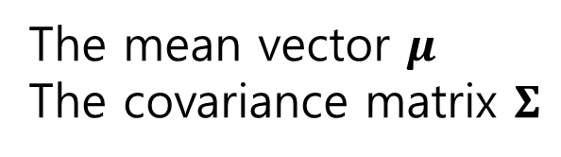
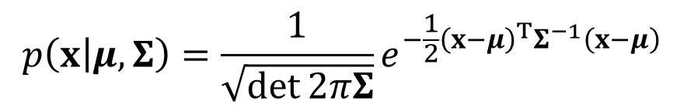
8.4 Multivariate Gaussian
$$p\left(x | μ,Σ\right)=\frac{1}{\sqrt{\det{2πΣ}}}e^{−\frac{1}{2}{\left(x−μ\right)}^{T}Σ^{−1}\left(x−μ\right)}$$
The mean vector $μ$
The covariance matrix $Σ$

Slide 30
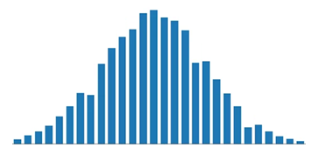
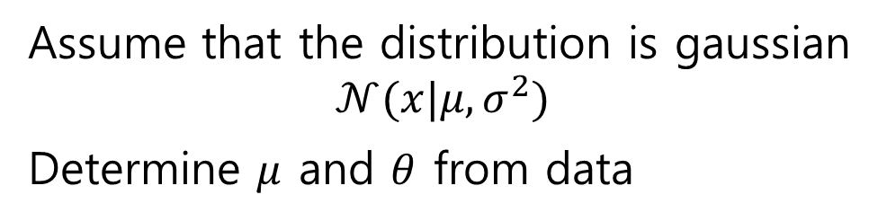

8.6 Learning distributions
Learning is Inferring the distribution from data
Inferring the distribution $p\left(x | θ\right)$ from $\left\{x^{1},…,x^{N}\right\}$
i.e. determining $θ$
Assume that the distribution is gaussian
$$𝒩(x|μ,σ^{2})$$
Determine $μ$ and $θ$ from data

Slide 31


Uniform distribution $p\left(x\right)=c$
Inferring is to determine $c$

Slide 32

Maximum A posteriori
$θ^{MAP}=argmax_{θ} p(θ|𝒳)$
Maximum Likelihood
$θ^{ML}=argmax_{θ} p(𝒳|θ)$
Moment Matching
$θ$ is set such that the moment of the distribution matches the empirical moment
Pseudo Likelihood

Slide 33





Definition 8.30. Prior, Likelihood and Posterior
$M$ is a model, such as gaussian
The most probable a posteriori (MAP) setting is that which maximises the posterior
The maximum likelihood (ML) setting is that which maximises the likelihood

Slide 34




A coin is known to be $p\left(H\right)=p\left(T\right)=0.5$
Experiment: toss a coin 10 times, 6 heads and 4 tails
Infer $p(H)$
Let $θ=p(H)$ and $𝒳=\{H,H,H,H,H,H,T,T,T,T\}$
Model = the binomial distribution
ML
$p\left(𝒳 | θ\right)=θ^{6}{\left(1−θ\right)}^{4}$
$argmax_{θ}$ $p\left(𝒳 | θ\right)=0.4$
MAP
$p\left(θ | 𝒳\right)=p\left(𝒳 | θ\right)p(θ)/p(𝒳)$
$\sim p\left(𝒳 | θ\right)p(θ)$
depends on the distribution of $θ$

