Slide 1
Chapter 4 Dynamic Programming

Slide 2
The term dynamic programming (DP) refers to a collection of algorithms that can be used to compute optimal policies given a perfect model of the environment as a Markov decision process (MDP)

Slide 3
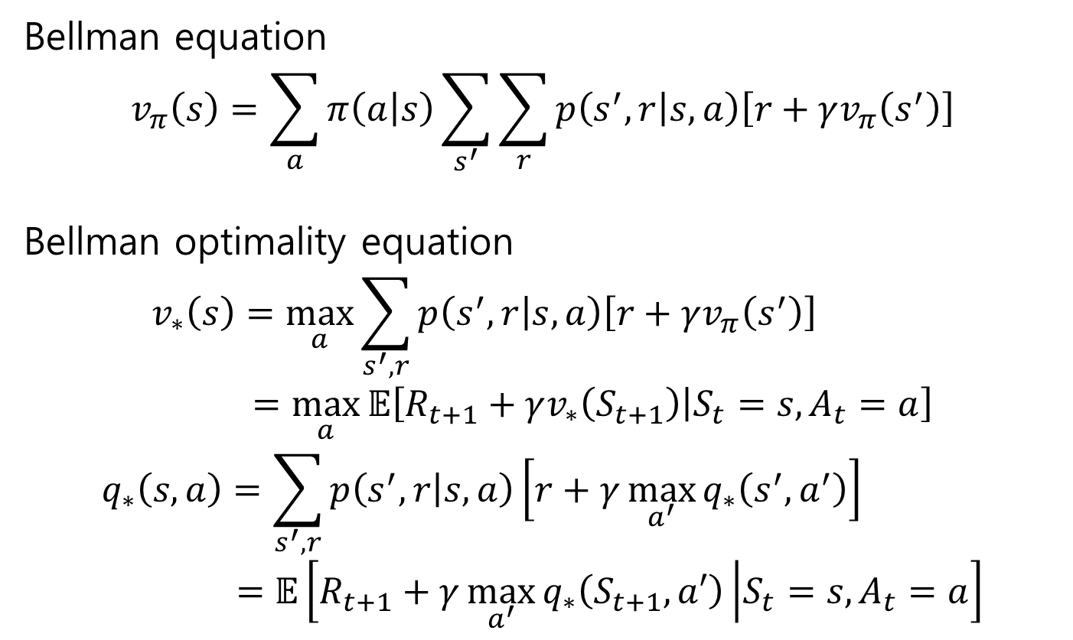
Bellman equation
$$v_{π}\left(s\right)=\sum_{a}{π\left(a | s\right)\sum_{s^{′}}{\sum_{r}{p\left(s^{′},r | s,a\right)\left[r+γv_{π}\left(s^{′}\right)\right]}}}$$
Bellman optimality equation
$$v_{∗}\left(s\right)=\max_{a}{\sum_{s^{′},r}{p\left(s^{′}, r | s,a\right)\left[r+γv_{π}\left(s^{′}\right)\right]}} \\ =\max_{a}{𝔼\left[R_{t+1}+γv_{∗}\left(S_{t+1}\right) | S_{t}=s,A_{t}=a\right]}$$
$$q_{∗}\left(s,a\right)=\sum_{s^{′},r}{p\left(s^{′}, r | s,a\right)\left[r+γ\max_{a^{′}}{q_{∗}\left(s^{′},a^{′}\right)}\right]} \\ =𝔼\left[R_{t+1}+γ\max_{a^{′}}{q_{∗}\left(S_{t+1},a′\right)} | S_{t}=s,A_{t}=a\right]$$

Slide 4
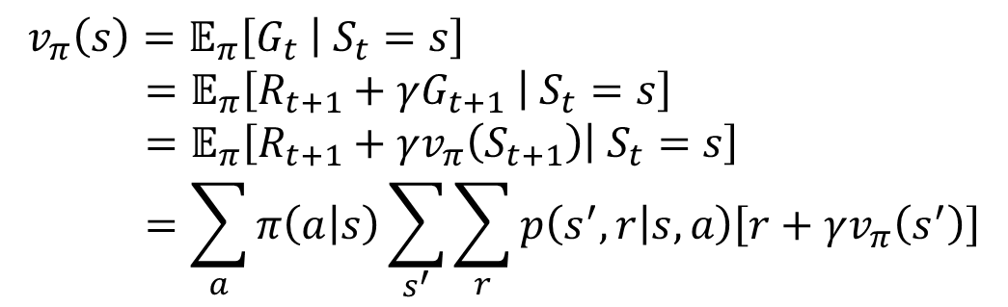

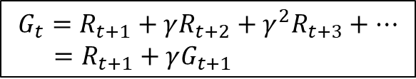
4.1 Policy Evaluation (Prediction)
For a policy $π$
$$v_{π}\left(s\right)=𝔼_{π}\left[G_{t} | S_{t}=s\right] \\ =𝔼_{π}\left[R_{t+1}+γG_{t+1} | S_{t}=s\right] \\ =𝔼_{π}\left[R_{t+1}+γv_{π}\left(S_{t+1}\right) | S_{t}=s\right] \\ =\sum_{a}{π\left(a | s\right)\sum_{s^{′}}{\sum_{r}{p\left(s^{′},r | s,a\right)\left[r+γv_{π}\left(s^{′}\right)\right]}}}$$
$$G_{t}=R_{t+1}+γR_{t+2}+γ^{2}R_{t+3}+⋯ \\ =R_{t+1}+γG_{t+1}$$

Slide 5
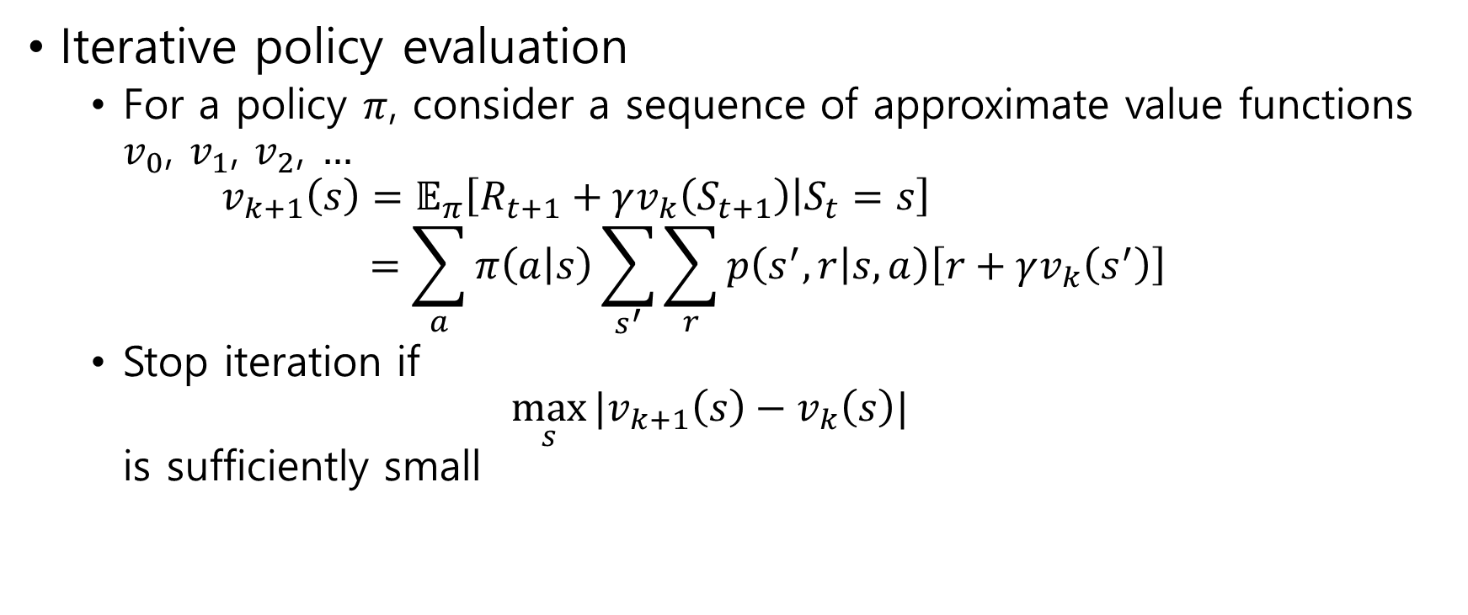
Iterative policy evaluation
For a policy $π$, consider a sequence of approximate value functions $v_{0}$, $v_{1}$, $v_{2}$, $…$ $v_{k+1}\left(s\right)=𝔼_{π}\left[R_{t+1}+γv_{k}\left(S_{t+1}\right) | S_{t}=s\right]$ $=\sum_{a}{π\left(a | s\right)\sum_{s^{′}}{\sum_{r}{p\left(s^{′},r | s,a\right)\left[r+γv_{k}\left(s^{′}\right)\right]}}}$
Stop iteration if $\max_{s}{|v_{k+1}\left(s\right)−v_{k}\left(s\right)|}$ is sufficiently small

Slide 6
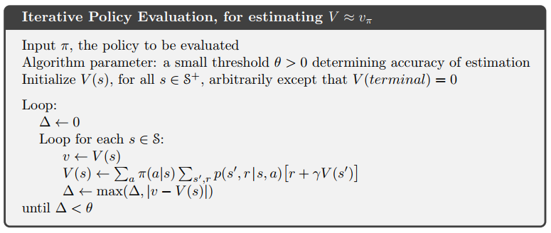

Slide 7
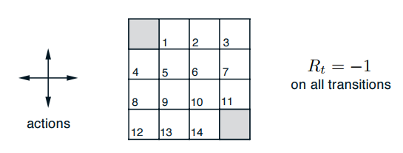
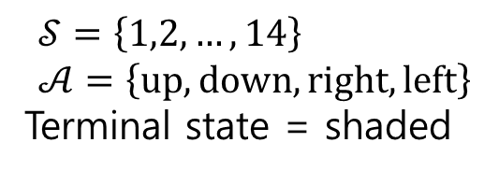
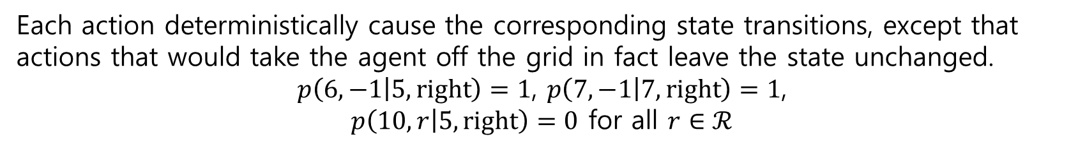
Example 4.1 Gridworld
$$𝒮=\left\{1,2,…,14\right\} \\ 𝒜=\left\{up, down,right, left\right\}$$
Terminal state = shaded
Each action deterministically cause the corresponding state transitions, except that actions that would take the agent off the grid in fact leave the state unchanged.
$p\left(6,−1 | 5,right\right)=1$, $p\left(7,−1 | 7,right\right)=1$,
$p\left(10,r | 5,right\right)=0$ for all $r∈ℛ$

Slide 8
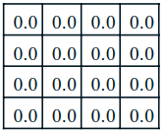
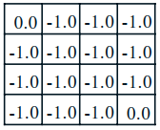
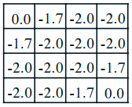
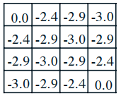
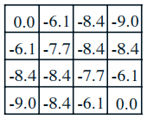
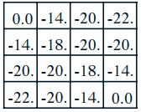




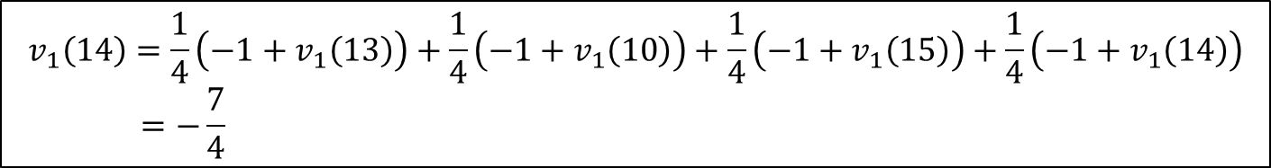

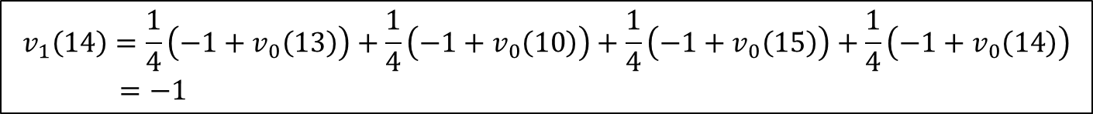


$v_{k}$ for the random policy, i.e. $π\left(a | s\right)=\frac{1}{4}$
$$k=0$$
$k=$1
$$k=2$$
$$k=3$$
$$k=10$$
$$k=∞$$
$$v_{1}\left(14\right)=\frac{1}{4}\left(−1+v_{0}\left(13\right)\right)+\frac{1}{4}\left(−1+v_{0}\left(10\right)\right)+\frac{1}{4}\left(−1+v_{0}\left(15\right)\right)+\frac{1}{4}\left(−1+v_{0}\left(14\right)\right) \\ =−1$$
$$v_{1}\left(14\right)=\frac{1}{4}\left(−1+v_{1}\left(13\right)\right)+\frac{1}{4}\left(−1+v_{1}\left(10\right)\right)+\frac{1}{4}\left(−1+v_{1}\left(15\right)\right)+\frac{1}{4}\left(−1+v_{1}\left(14\right)\right) \\ =−\frac{7}{4}$$

Slide 9
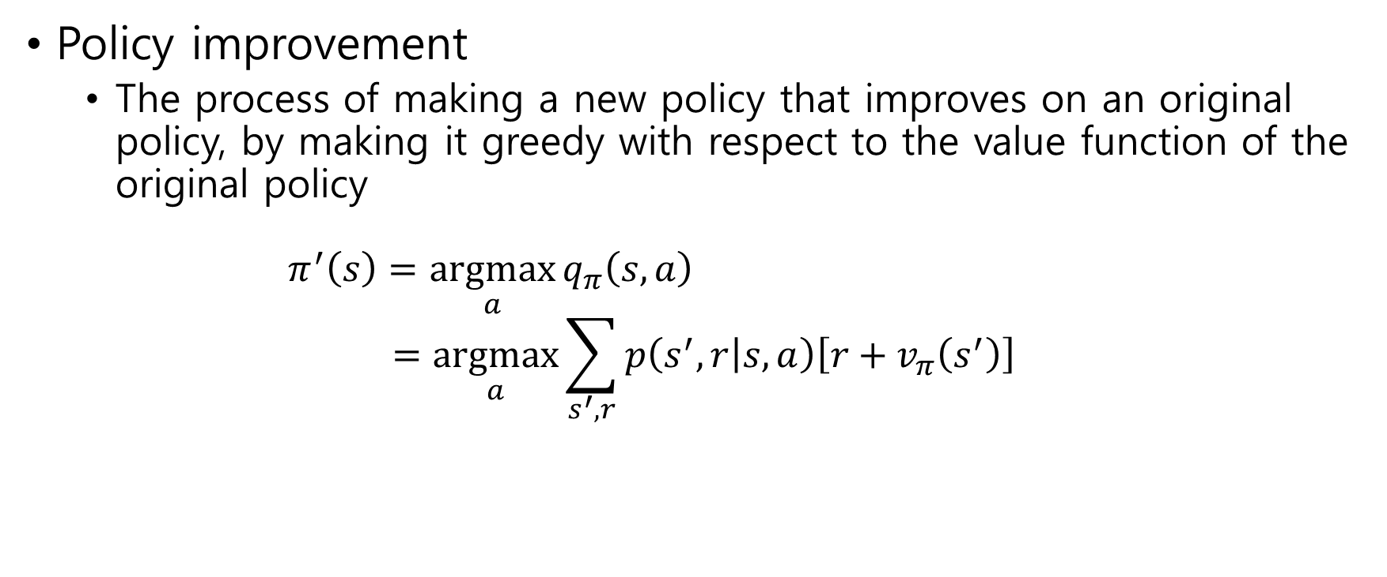
4.2 Policy Improvement
Policy improvement
The process of making a new policy that improves on an original policy, by making it greedy with respect to the value function of the original policy $π^{′}\left(s\right)=\underset{a}{argmax}{q_{π}\left(s,a\right)}$ $=\underset{a}{argmax}{\sum_{s^{′},r}{p\left(s^{′},r | s,a\right)\left[r+v_{π}\left(s^{′}\right)\right]}}$

Slide 10
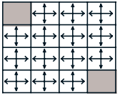
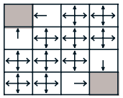
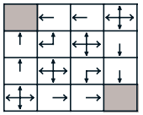
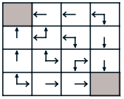
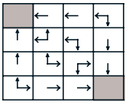
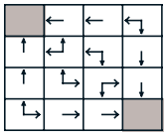







Example 4.1 Gridworld
$v_{k}$ for the random policy, i.e. $π\left(a | s\right)=\frac{1}{4}$
$$k=0$$
$k=$1
$$k=2$$
$$k=3$$
$$k=10$$
$$k=∞$$
Policies by greedy actions

Slide 11
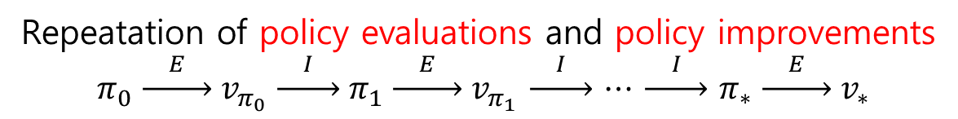
4.3 Policy Iteration
Repeatation of policy evaluations and policy improvements
$$π_{0} \underset{→}{ E } v_{π_{0}} \underset{→}{ I } π_{1} \underset{→}{ E } v_{π_{1}} \underset{→}{ I } ⋯ \underset{→}{ I } π_{∗} \underset{→}{ E } v_{∗}$$

Slide 12
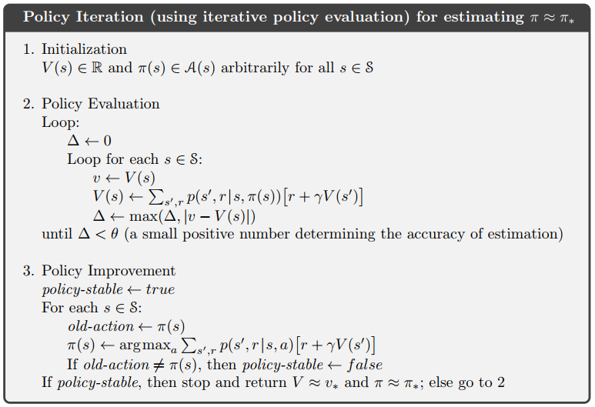

Slide 13
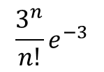
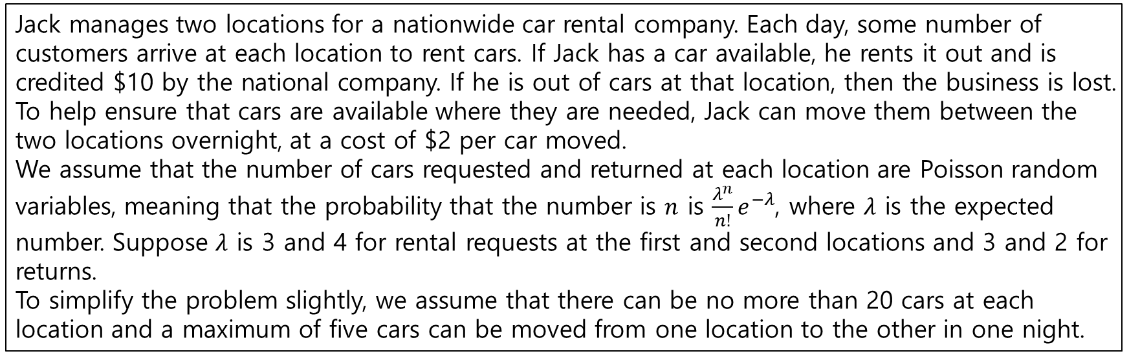
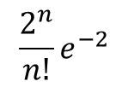
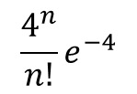
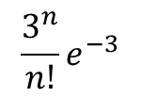
Example 4.2: Jack’s Car Rental
Jack manages two locations for a nationwide car rental company. Each day, some number of customers arrive at each location to rent cars. If Jack has a car available, he rents it out and is credited $10 by the national company. If he is out of cars at that location, then the business is lost. To help ensure that cars are available where they are needed, Jack can move them between the two locations overnight, at a cost of $2 per car moved.
We assume that the number of cars requested and returned at each location are Poisson random variables, meaning that the probability that the number is $n$ is $\frac{λ^{n}}{n!}e^{−λ}$, where $λ$ is the expected number. Suppose $λ$ is 3 and 4 for rental requests at the first and second locations and 3 and 2 for returns.
To simplify the problem slightly, we assume that there can be no more than 20 cars at each location and a maximum of five cars can be moved from one location to the other in one night.
$$\frac{3^{n}}{n!}e^{−3}$$
$$\frac{4^{n}}{n!}e^{−4}$$
1st loc
2nd loc
$$\frac{3^{n}}{n!}e^{−3}$$
$$\frac{2^{n}}{n!}e^{−2}$$

Slide 14
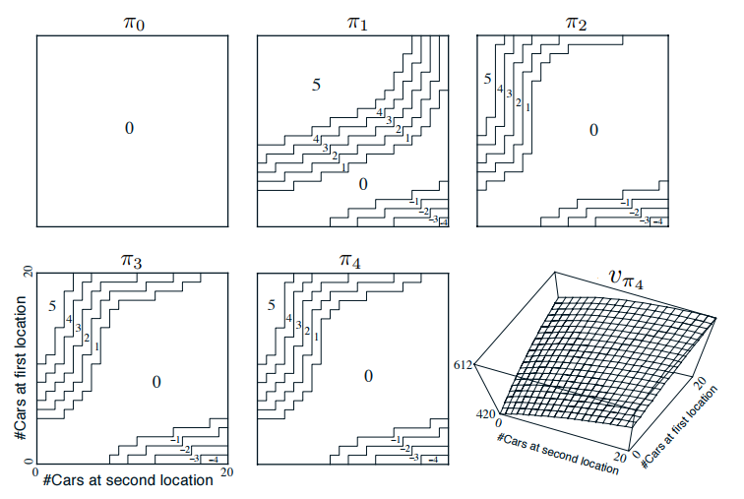
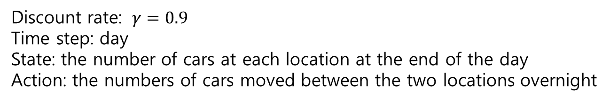
Discount rate: $γ=0.9$
Time step: day
State: the number of cars at each location at the end of the day
Action: the numbers of cars moved between the two locations overnight
1st loc: 8 cars
2nd loc: 0 cars
move: 4 cars

Slide 15
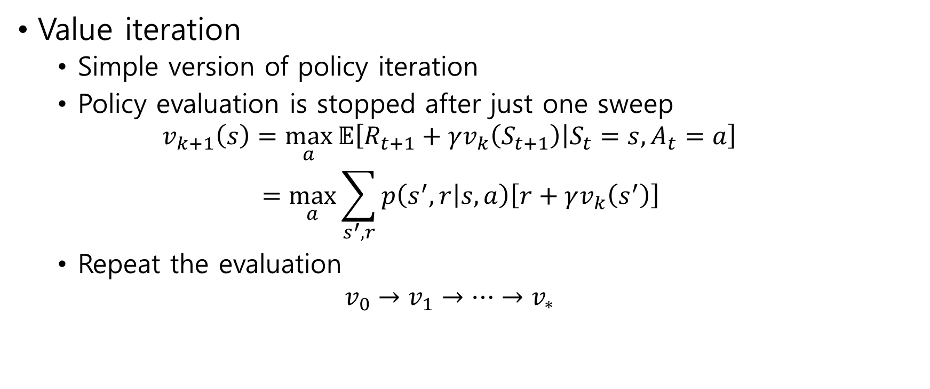
4.4 Value Iteration
Value iteration
Simple version of policy iteration
Policy evaluation is stopped after just one sweep $v_{k+1}\left(s\right)=\max_{a}{𝔼\left[R_{t+1}+γv_{k}\left(S_{t+1}\right) | S_{t}=s,A_{t}=a\right]}$ $=\max_{a}{\sum_{s^{′},r}{p\left(s^{′},r | s,a\right)\left[r+γv_{k}\left(s^{′}\right)\right]}}$
Repeat the evaluation $v_{0}→v_{1}→⋯→v_{∗}$
max means greedy policy

Slide 16
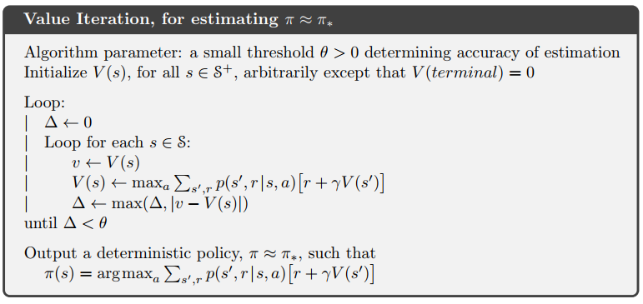

Slide 17
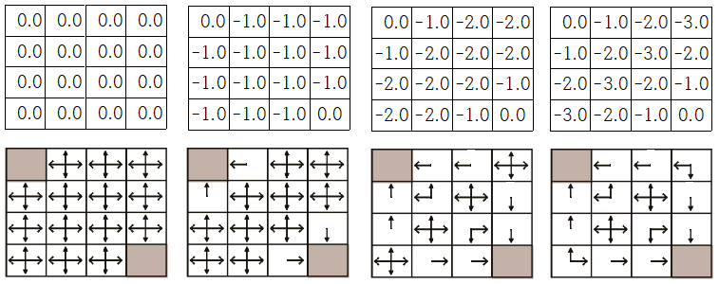




Example 4.1 Gridworld
$$k=0$$
$k=$1
$$k=2$$
$$k=3$$

Slide 18
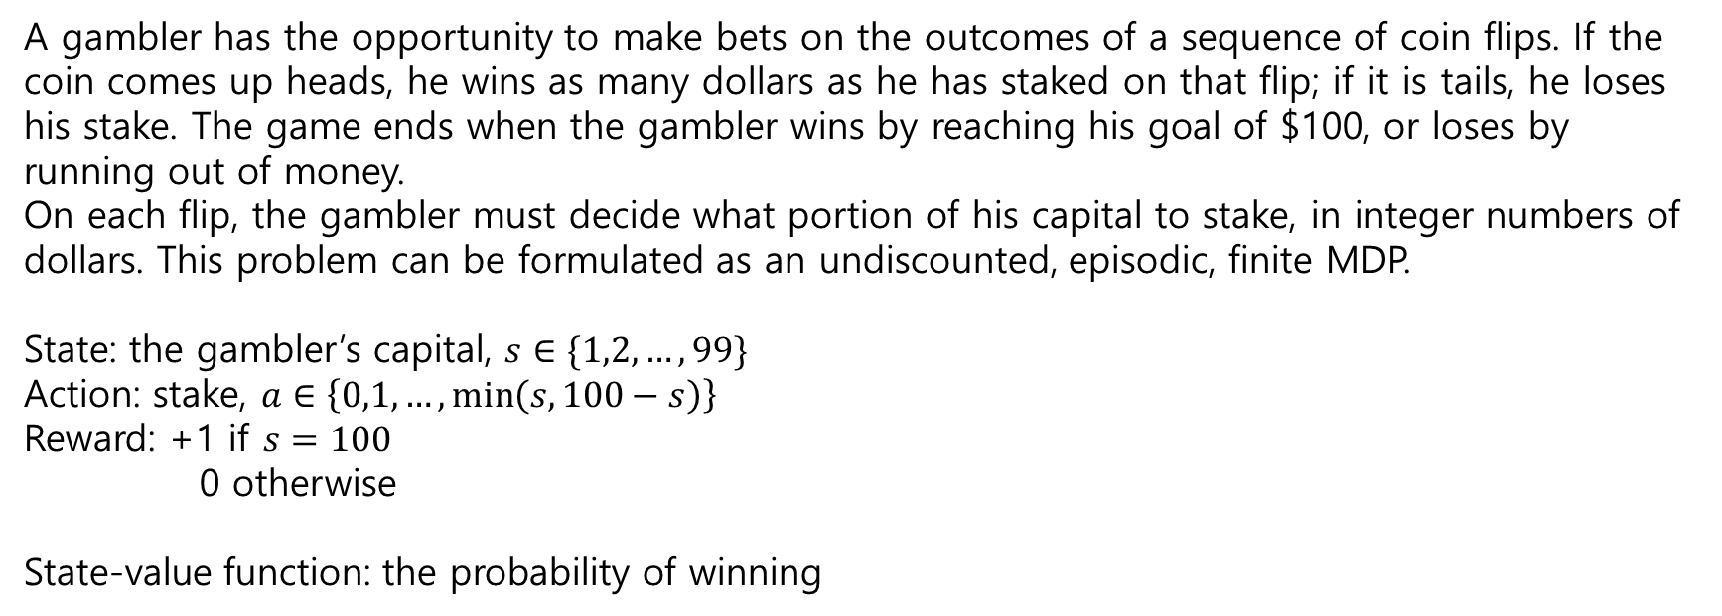
Example 4.3: Gambler’s Problem
A gambler has the opportunity to make bets on the outcomes of a sequence of coin flips. If the coin comes up heads, he wins as many dollars as he has staked on that flip; if it is tails, he loses his stake. The game ends when the gambler wins by reaching his goal of $100, or loses by running out of money.
On each flip, the gambler must decide what portion of his capital to stake, in integer numbers of dollars. This problem can be formulated as an undiscounted, episodic, finite MDP.
State: the gambler’s capital, $s∈\{1,2,…,99\}$
Action: stake, $a∈\left\{0,1,…,\min\left(s,100−s\right)\right\}$
Reward: +1 if $s=100$
0 otherwise
State-value function: the probability of winning

Slide 19
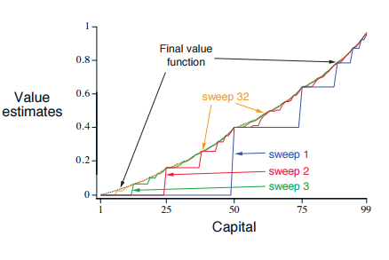
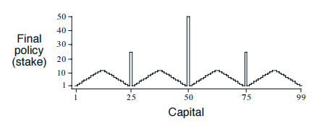
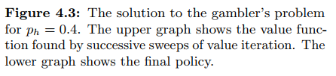
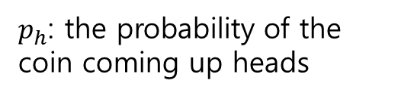
$p_{h}$: the probability of the coin coming up heads

