Slide 1
Chapter 6 Temporal-Difference Learning

Slide 2
Temporal-difference (TD) learning
A combination of Monte Carlo ideas and dynamic programming ideas.
Like MC, TD methods can learn directly from raw experience without a model of the environment
Like DP, TD methods update values based on other learned values, without waiting for a final outcome
TD is bootstrapping(주어진 상황에서 어떻게든 해결한다)

Slide 3


6.1 TD Prediction
Recall
Constant-$α$ MC method (Nonstationary MC method) $v_{π}\left(S_{t}\right)←v_{π}\left(S_{t}\right)+α\left(G_{t}−v_{π}\left(S_{t}\right)\right)$
$$A_{n}=\frac{1}{n}\left(B_{1}+⋯+B_{n}\right) \\ =\frac{1}{n}\left(\left(n−1\right)A_{n−1}+B_{n}\right) \\ =A_{n−1}+\frac{1}{n}\left(B_{n}−A_{n−1}\right)$$
$A←A+α(B_{n}−A)$
Prediction: evaluating the value function
of a policy

Slide 4

TD(0), one-step TD
The simplest TD method
For a policy $π$, we estimate the optimal value function $v_{π}$ as $V\left(S_{t}\right)←V\left(S_{t}\right)+α\left[R_{t+1}+γV\left(S_{t+1}\right)−V\left(S_{t}\right)\right]$ where $α∈\left(0,1\right]$ is the step size

Slide 5
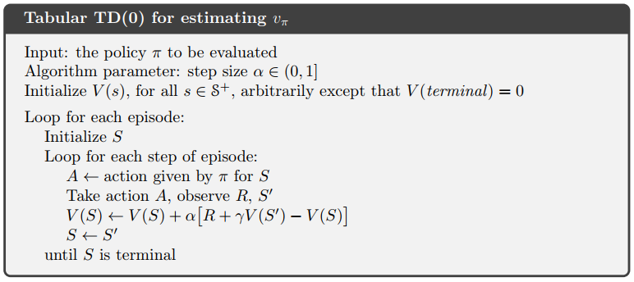

Slide 6
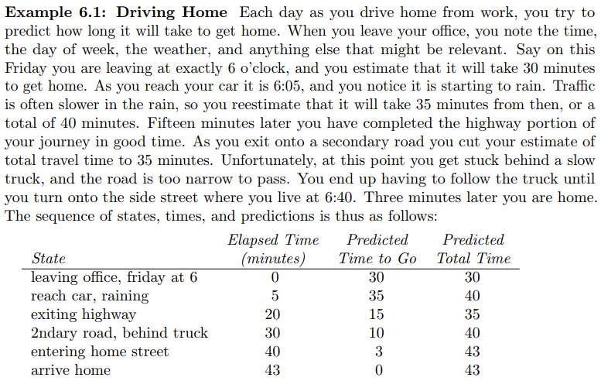
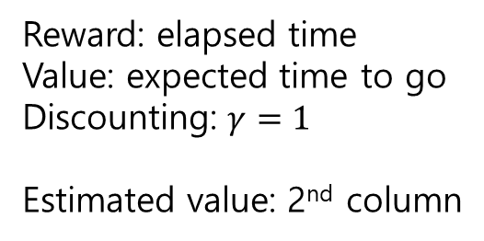
Example 6.1: Driving Home
Reward: elapsed time
Value: expected time to go
Discounting: $γ=1$
Estimated value: 2nd column

Slide 7
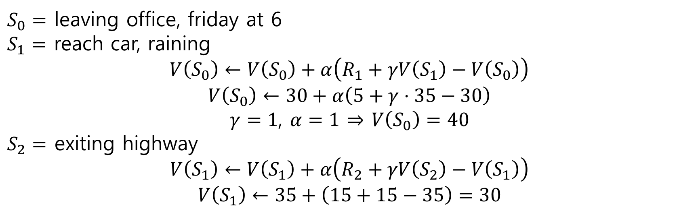
$S_{0}=$ leaving office, friday at 6
$S_{1}=$ reach car, raining
$$V\left(S_{0}\right)←V\left(S_{0}\right)+α\left(R_{1}+γV\left(S_{1}\right)−V\left(S_{0}\right)\right)$$
$$V\left(S_{0}\right)←30+α\left(5+γ⋅35−30\right)$$ $γ=1$, $α=1$ $⇒$ $V\left(S_{0}\right)=40$
$S_{2}=$ exiting highway $$V\left(S_{1}\right)←V\left(S_{1}\right)+α\left(R_{2}+γV\left(S_{2}\right)−V\left(S_{1}\right)\right)$$
$$V\left(S_{1}\right)←35+\left(15+15−35\right)=30$$

Slide 8
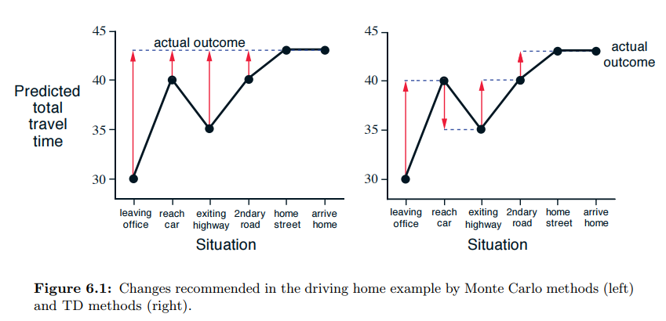
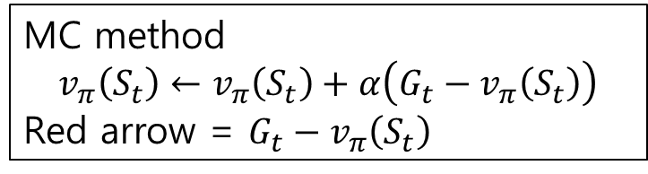
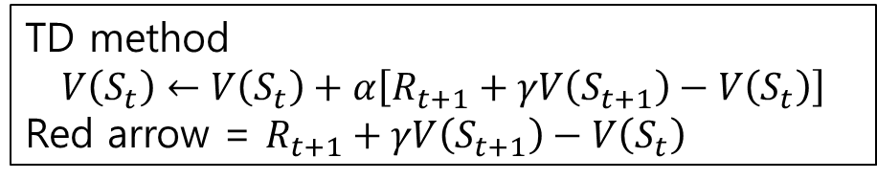
MC method
$$v_{π}\left(S_{t}\right)←v_{π}\left(S_{t}\right)+α\left(G_{t}−v_{π}\left(S_{t}\right)\right)$$
Red arrow = $G_{t}−v_{π}\left(S_{t}\right)$
TD method
$$V\left(S_{t}\right)←V\left(S_{t}\right)+α\left[R_{t+1}+γV\left(S_{t+1}\right)−V\left(S_{t}\right)\right]$$
Red arrow = $R_{t+1}+γV\left(S_{t+1}\right)−V\left(S_{t}\right)$

Slide 9
6.2 Advantages of TD Prediction Methods
TD methods learn a guess from a guess
they bootstrap
Advantages
do not require a model of the environment
are naturally implemented in an online
We wait only one time step
We can still guarantee convergence to the correct answer

Slide 10

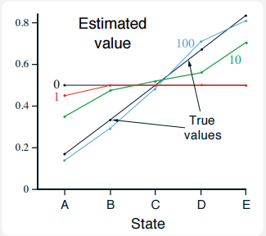
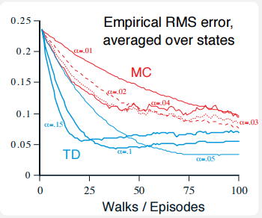
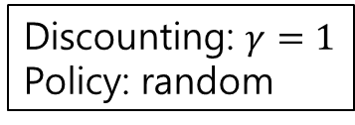
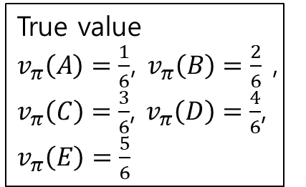
Example 6.2 Random Walk
Discounting: $γ=1$
Policy: random
True value
$v_{π}\left(A\right)=\frac{1}{6}$, $v_{π}\left(B\right)=\frac{2}{6}$ , $v_{π}\left(C\right)=\frac{3}{6}$, $v_{π}\left(D\right)=\frac{4}{6}$, $v_{π}\left(E\right)=\frac{5}{6}$
number of episodes
TD(0) estimated values
RMS = root mean squared

Slide 11
6.3 Optimality of TD(0)
Batch updating
To use a batch of training data repeatedly
To use the same set of experience repeatedly

Slide 12
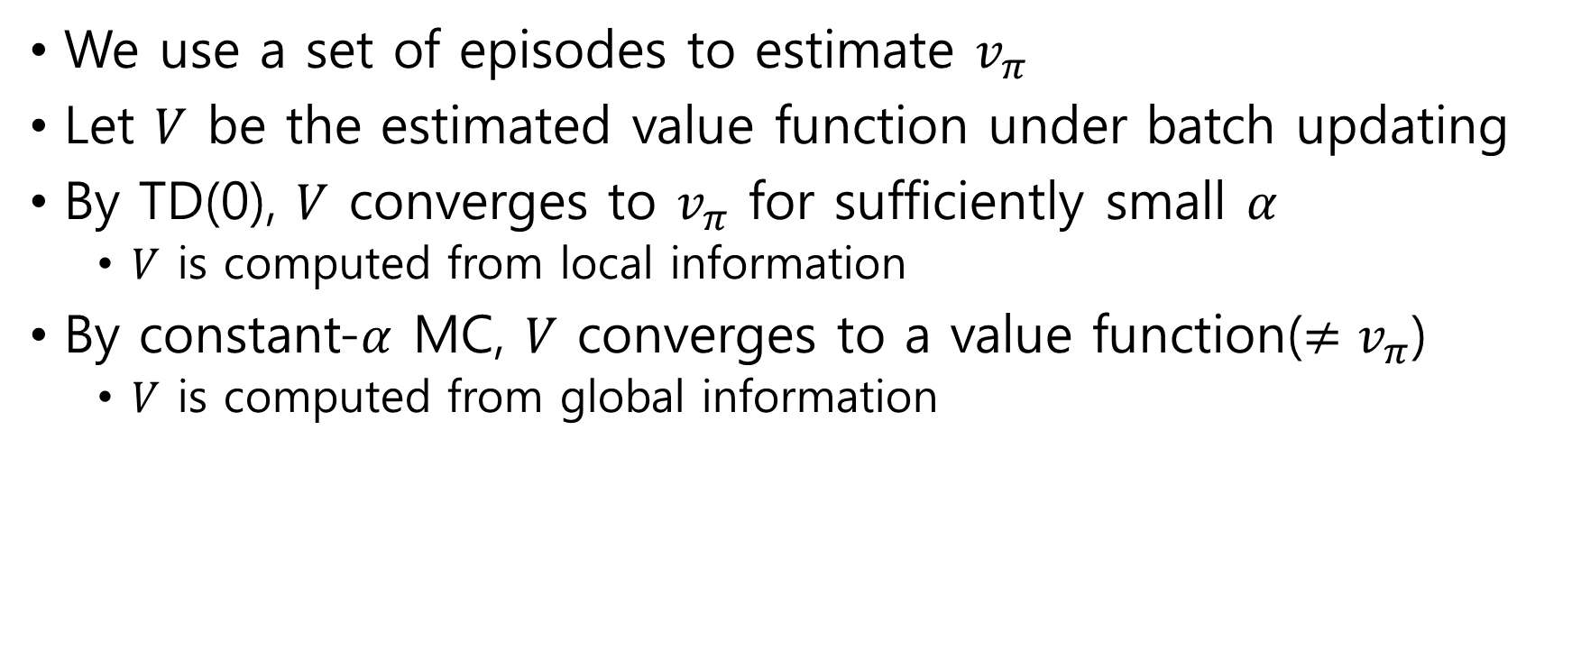
Example 6.3: Random walk under batch updating
We use a set of episodes to estimate $v_{π}$
Let $V$ be the estimated value function under batch updating
By TD(0), $V$ converges to $v_{π}$ for sufficiently small $α$
$V$ is computed from local information
By constant-$α$ MC, $V$ converges to a value function($≠v_{π}$)
$V$ is computed from global information

Slide 13
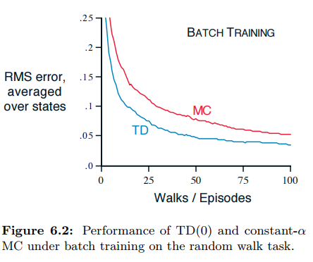

Slide 14
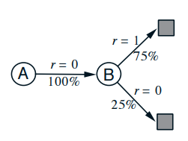
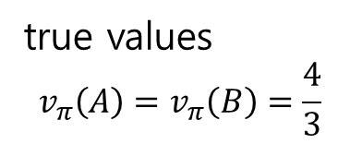
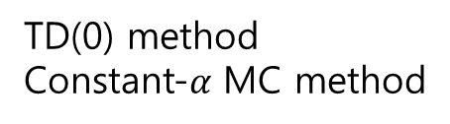
Example 6.4: You are the Predictor
Batch of data
A, 0, B, 0 B, 1
B, 1 B, 1
B, 1 B, 1
B, 1 B, 0
true values
$$v_{π}\left(A\right)=v_{π}\left(B\right)=\frac{4}{3}$$
TD(0) method
Constant-$α$ MC method

Slide 15





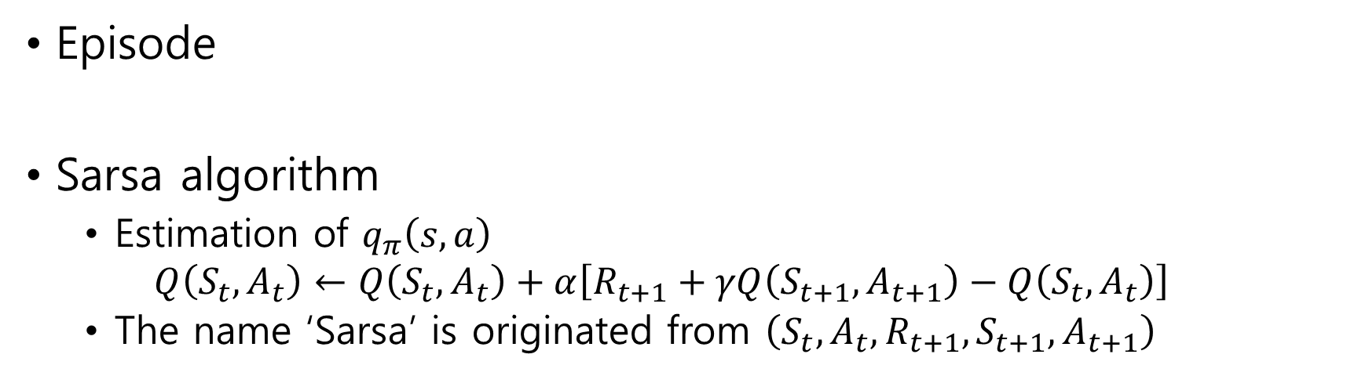
6.4 Sarsa: On-policy TD Control
Episode
Sarsa algorithm
Estimation of $q_{π}\left(s,a\right)$ $Q\left(S_{t},A_{t}\right)←Q\left(S_{t},A_{t}\right)+α\left[R_{t+1}+γQ\left(S_{t+1},A_{t+1}\right)−Q\left(S_{t},A_{t}\right)\right]$
The name ‘Sarsa’ is originated from $\left(S_{t},A_{t},R_{t+1},S_{t+1},A_{t+1}\right)$
State
Action

Slide 16
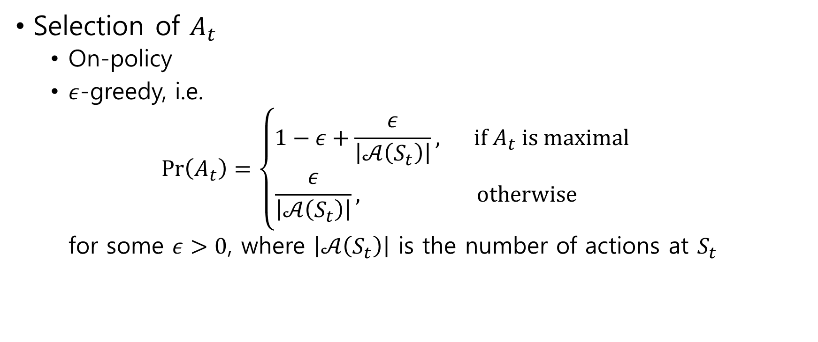
Selection of $A_{t}$
On-policy
$ε$-greedy, i.e. $\operatorname{Pr}\left(A_{t}\right)=\left\{\begin{aligned}\begin{matrix}1−ε+\frac{ε}{\left|𝒜\left(S_{t}\right)\right|}, & if A_{t} is maximal\end{matrix} \\ \begin{matrix}\frac{ε}{\left|𝒜\left(S_{t}\right)\right|}, & otherwise \end{matrix}\end{aligned}\right.$ for some $ε>0$, where $\left|𝒜\left(S_{t}\right)\right|$ is the number of actions at $S_{t}$

Slide 17
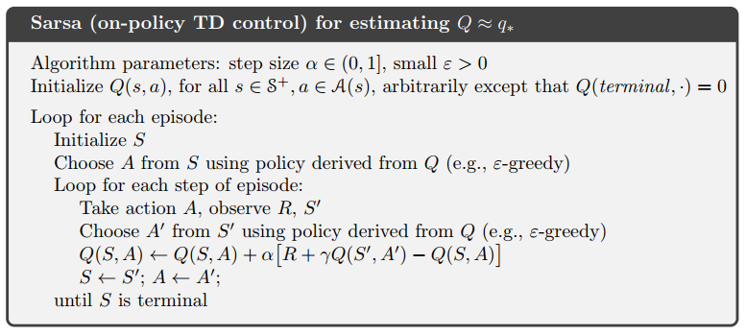

Slide 18
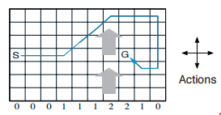
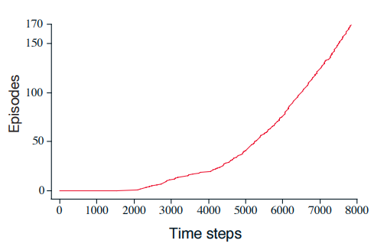
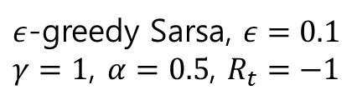
Example 6.5: Windy Gridworld
$ε$-greedy Sarsa, $ε=0.1$
$γ=1$, $α=0.5$, $R_{t}=−1$
There is a crosswind running upward
The strength of wind
(shift upward by wind)

Slide 19
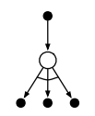
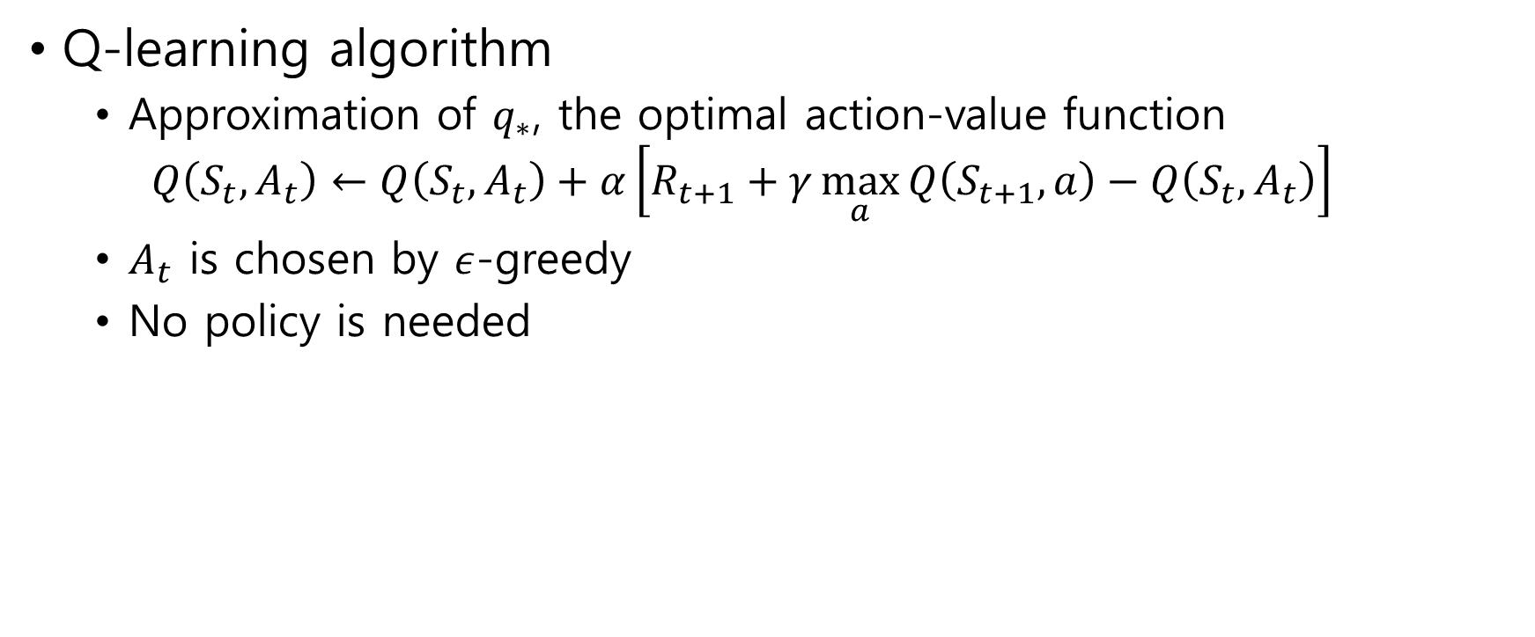
6.5 Q-learning: Off-policy TD Control
Q-learning algorithm
Approximation of $q_{∗}$, the optimal action-value function $Q\left(S_{t},A_{t}\right)←Q\left(S_{t},A_{t}\right)+α\left[R_{t+1}+γ\max_{a}{Q\left(S_{t+1},a\right)}−Q\left(S_{t},A_{t}\right)\right]$
$A_{t}$ is chosen by $ε$-greedy
No policy is needed

Slide 20
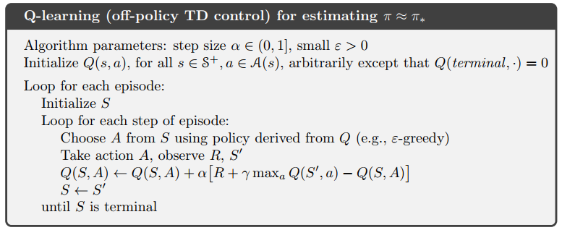

Slide 21
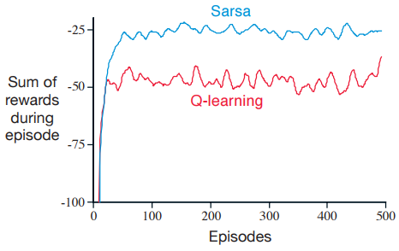
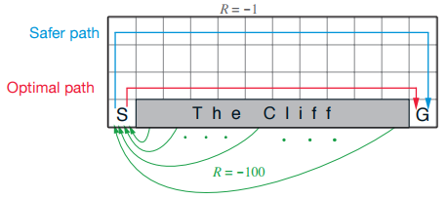


Example 6.6: Cliff Walking
$$ε=0.1$$

Slide 22
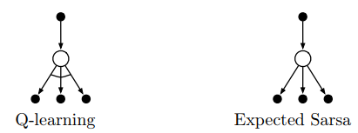

6.6 Expected Sarsa
Algorithm $Q\left(S_{t},A_{t}\right)←Q\left(S_{t},A_{t}\right)+α\left[R_{t+1}+γ𝔼\left[Q\left(S_{t+1},a\right) | S_{t+1}\right]−Q\left(S_{t},A_{t}\right)\right]$ $←Q\left(S_{t},A_{t}\right)+α\left[R_{t+1}+γ\sum_{a}{π\left(a | S_{t+1}\right)}Q\left(S_{t+1},a\right)−Q\left(S_{t},A_{t}\right)\right]$

Slide 23
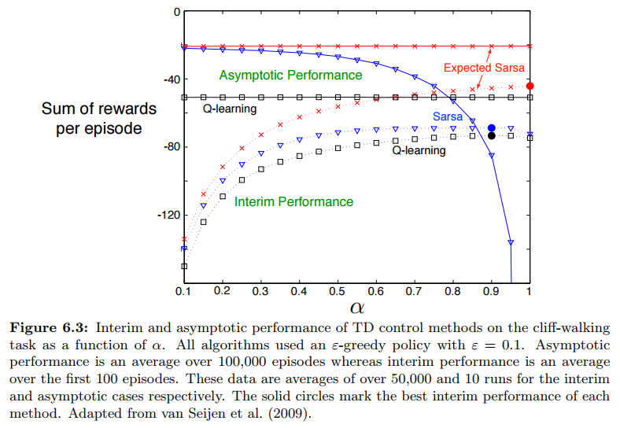

Slide 24
6.7 Maximization Bias and Double Learning

Slide 25
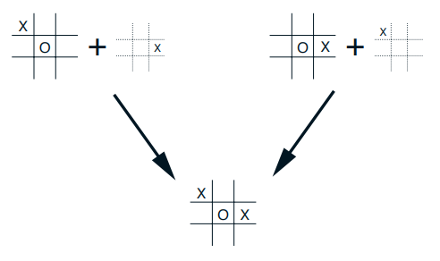
6.8 Games, Afterstates, and Other Special Cases
Afterstate
Board position after the agent has made its move
afterstate value functions are useful in games like tic-tac-toe
afterstate

Slide 26
Summary
TD
Policy evaluation - prediction
Estimating state values
Sarsa
Update policy - on-policy control
Estimating action values by policy
Q-learning
Update policy - off-policy control
Estimating action values by maximum
Expected sarsa
Update policy - on-policy control
Estimating action values by average

