Slide 1
Chapter 2 Multi-armed Bandits

Slide 2
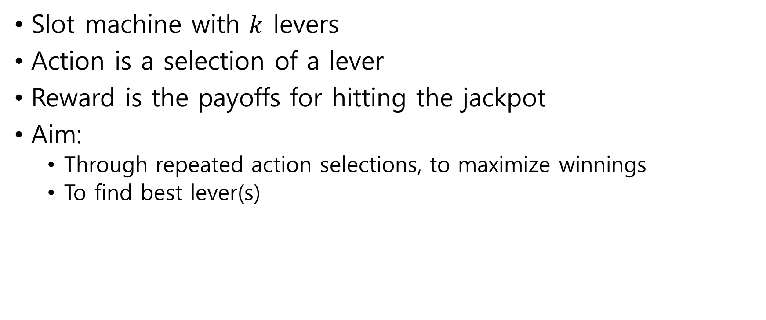
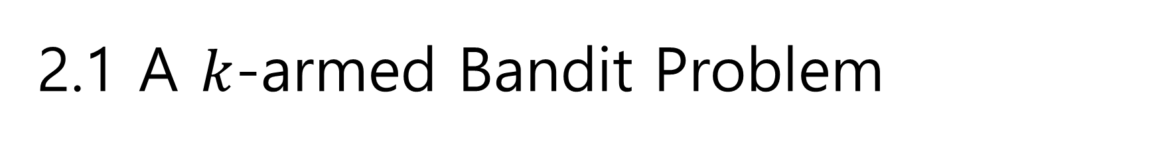
2.1 A $k$-armed Bandit Problem
Slot machine with $k$ levers
Action is a selection of a lever
Reward is the payoffs for hitting the jackpot
Aim:
Through repeated action selections, to maximize winnings
To find best lever(s)

Slide 3
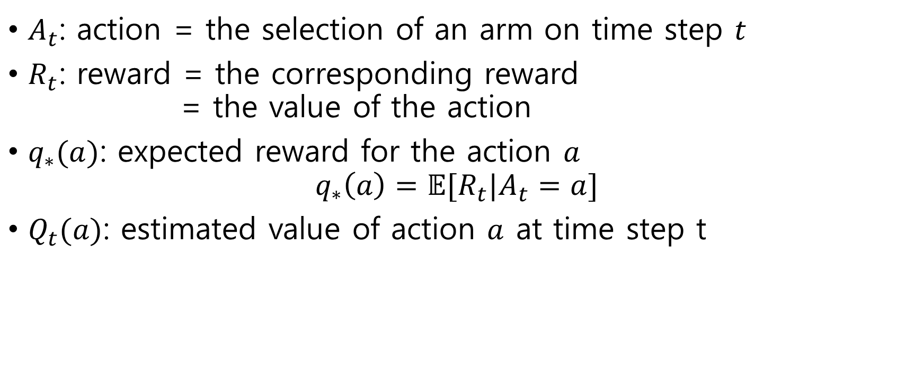
$A_{t}$: action = the selection of an arm on time step $t$
$R_{t}$: reward = the corresponding reward = the value of the action
$q_{∗}(a)$: expected reward for the action $a$ $q_{∗}\left(a\right)=𝔼[R_{t}|A_{t}=a]$
$Q_{t}(a)$: estimated value of action $a$ at time step t

Slide 4
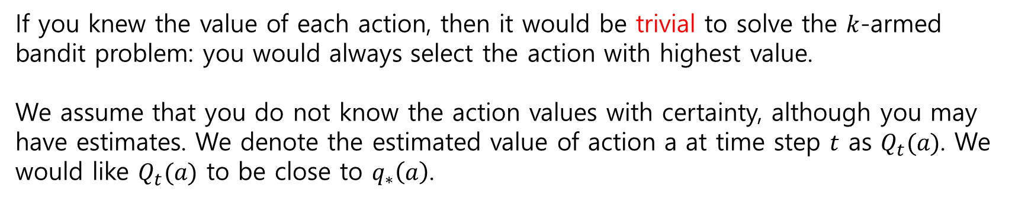
If you knew the value of each action, then it would be trivial to solve the $k$-armed bandit problem: you would always select the action with highest value.
We assume that you do not know the action values with certainty, although you may have estimates. We denote the estimated value of action a at time step $t$ as $Q_{t}(a)$. We would like $Q_{t}(a)$ to be close to $q_{∗}\left(a\right)$.

Slide 5
Greedy action: action whose estimated value is greatest
Exploiting: selecting greedy action
Exploring: selecting nongreedy action
Exploitation is the right thing to do to maximize the expected reward on the one step, but exploration may produce the greater total reward in the long run.

Slide 6
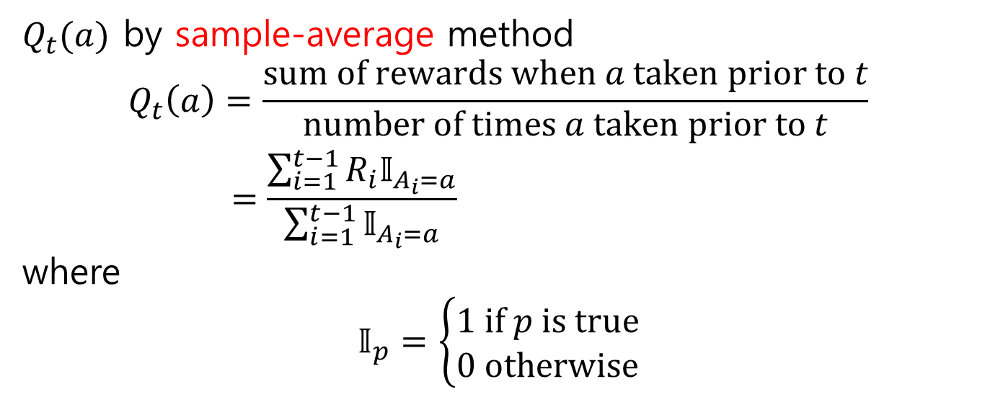
2.2 Action-value Methods
$Q_{t}(a)$ by sample-average method
$$Q_{t}\left(a\right)=\frac{sum of rewards when a taken prior to t}{number of times a taken prior to t} \\ =\frac{\sum_{i=1}^{t−1}{R_{i}𝕀_{A_{i}=a}}}{\sum_{i=1}^{t−1}{𝕀_{A_{i}=a}}}$$ where
$$𝕀_{p}=\left\{\begin{aligned}1 if p is true \\ 0 otherwise\end{aligned}\right.$$

Slide 7
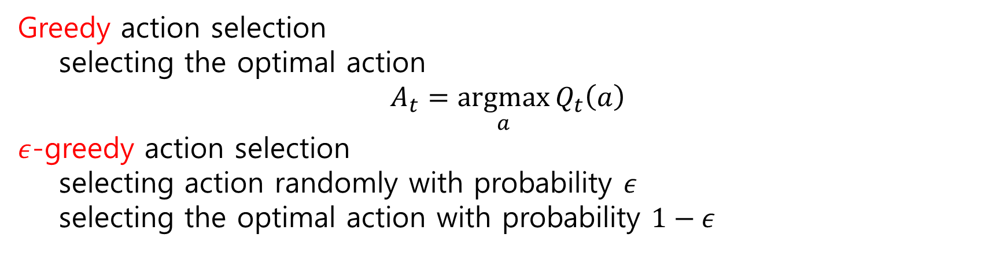
Greedy action selection
selecting the optimal action
$$A_{t}=\underset{a}{argmax}{Q_{t}\left(a\right)}$$
$ε$-greedy action selection
selecting action randomly with probability $ε$
selecting the optimal action with probability $1−ε$

Slide 8
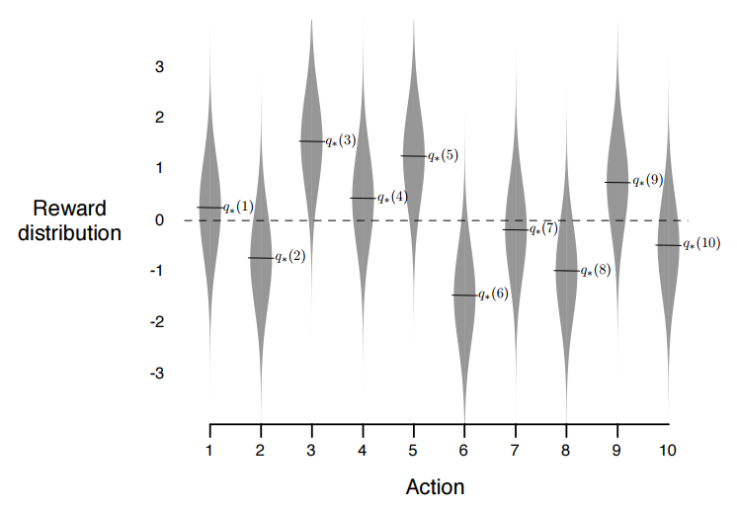

2.3 The 10-armed Testbed
A 10-armed bandit problem
$q_{∗}\left(a\right)\sim 𝒩\left(0,1\right)$
$R_{t}\left(A_{t}\right)\sim 𝒩\left(q_{∗}\left(A_{t}\right),1\right)$

Slide 9
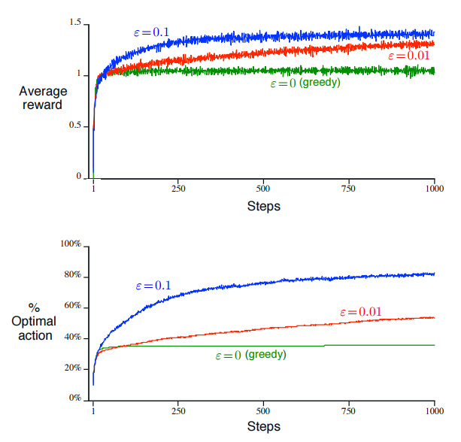
2000 Randomly generated 10-armed bandit problems
Selecting 1000 action for each problem

Slide 10
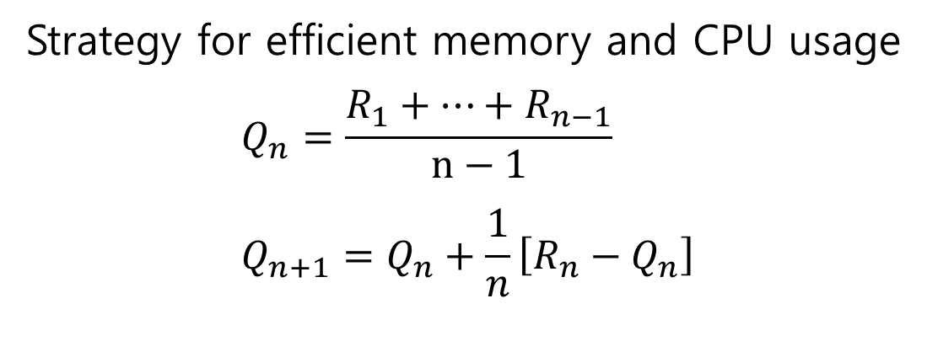
2.4 Incremental Implementation
Strategy for efficient memory and CPU usage $$Q_{n}=\frac{R_{1}+⋯+R_{n−1}}{n−1} \\ Q_{n+1}=Q_{n}+\frac{1}{n}\left[R_{n}−Q_{n}\right]$$

Slide 11
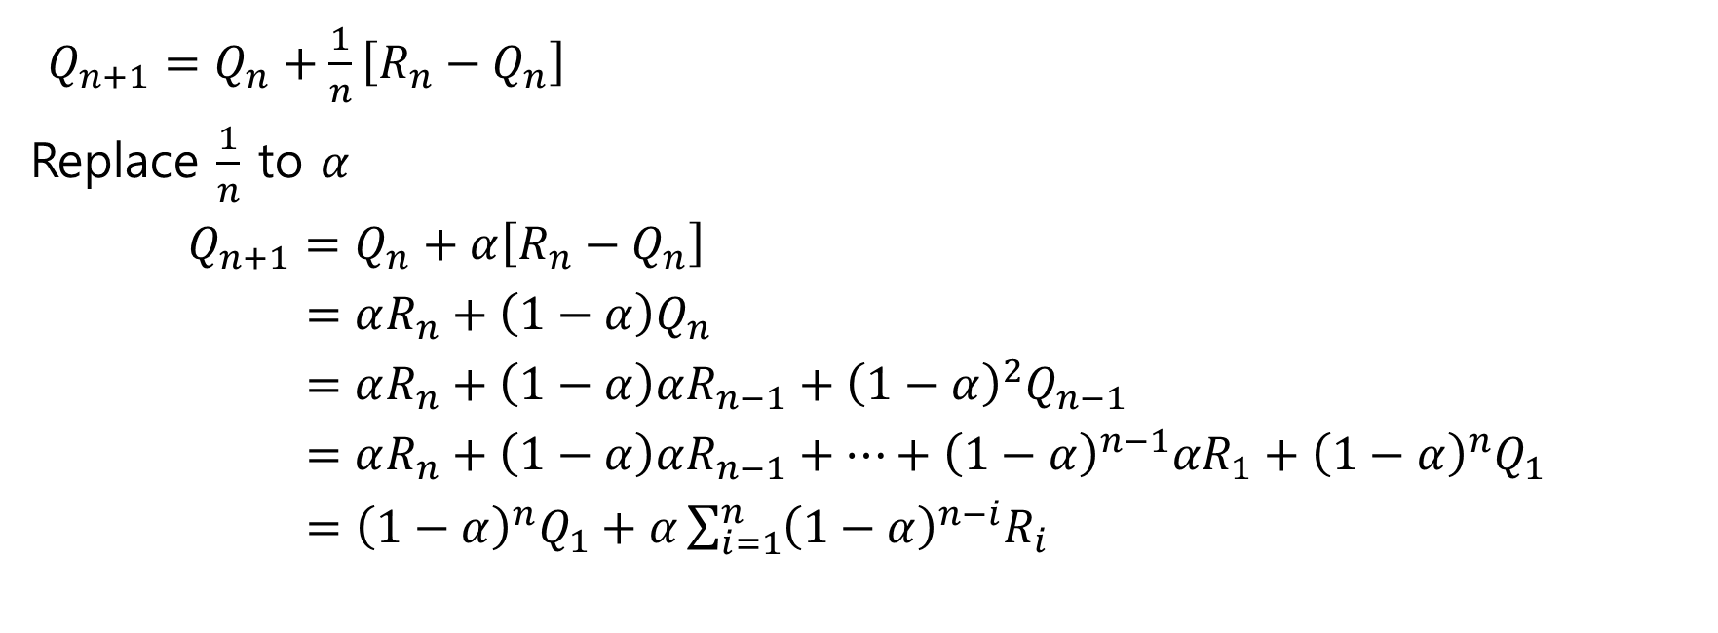
2.5 Tracking a Nonstationary Problem
$Q_{n+1}=Q_{n}+\frac{1}{n}\left[R_{n}−Q_{n}\right]$
Replace $\frac{1}{n}$ to $α$
$$Q_{n+1}=Q_{n}+α\left[R_{n}−Q_{n}\right] \\ =αR_{n}+\left(1−α\right)Q_{n} \\ =αR_{n}+\left(1−α\right)αR_{n−1}+{\left(1−α\right)}^{2}Q_{n−1} \\ =αR_{n}+\left(1−α\right)αR_{n−1}+⋯+{\left(1−α\right)}^{n−1}αR_{1}+{\left(1−α\right)}^{n}Q_{1}$$ $={\left(1−α\right)}^{n}Q_{1}+α\sum_{i=1}^{n}{{\left(1−α\right)}^{n−i}R_{i}}$

