Slide 1
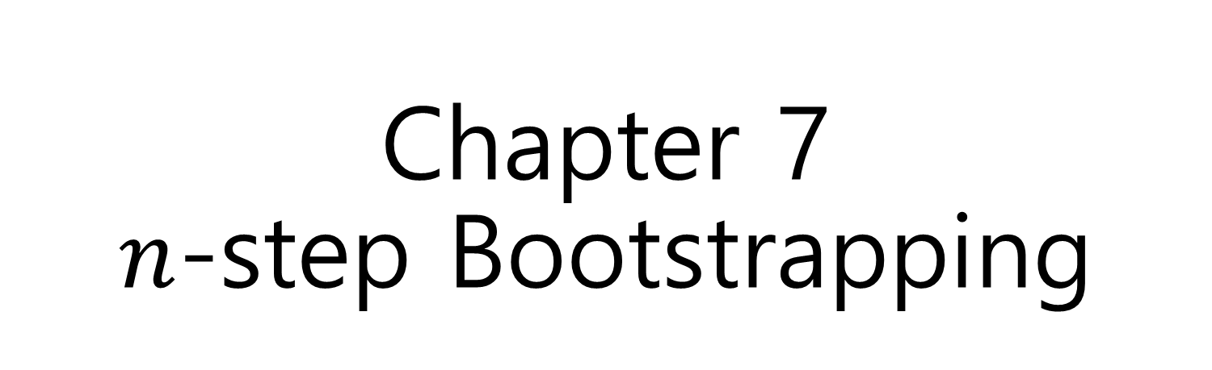
Chapter 7 $n$-step Bootstrapping

Slide 2

TD($0$), $1$-step TD method, is $1$-step bootstrapping
TD($n−1$) , $n$-step TD method, is $n$-step bootstrapping
Bootstrapping: 주어진 상황에서 어떻게든 해결한다

Slide 3
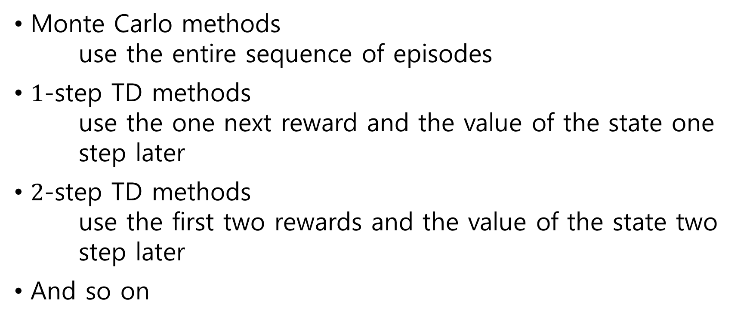
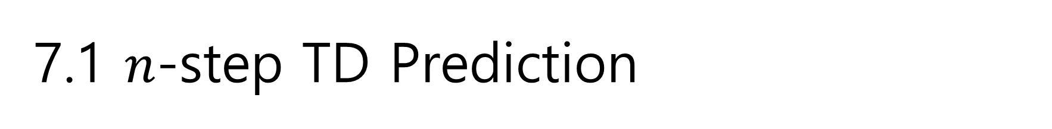
7.1 $n$-step TD Prediction
Monte Carlo methods use the entire sequence of episodes
$1$-step TD methods use the one next reward and the value of the state one step later
$2$-step TD methods use the first two rewards and the value of the state two step later
And so on

Slide 4
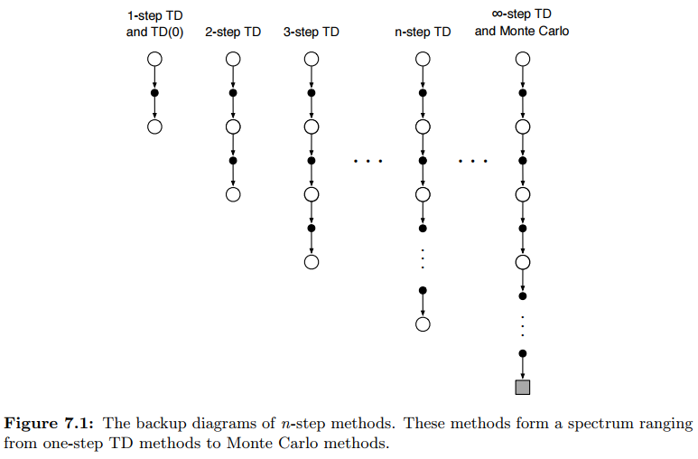



State
Action
Terminal

Slide 5
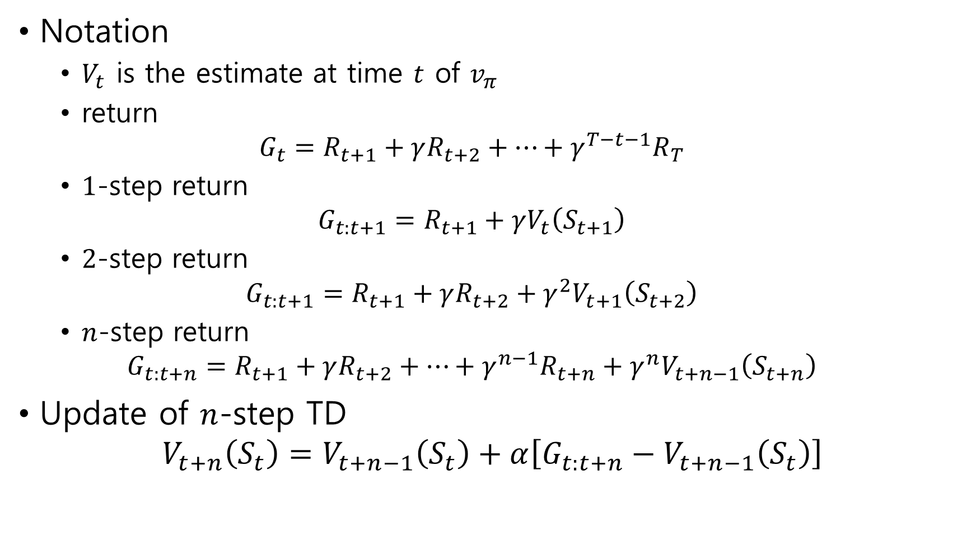
Notation
$V_{t}$ is the estimate at time $t$ of $v_{π}$
return $G_{t}=R_{t+1}+γR_{t+2}+⋯+γ^{T−t−1}R_{T}$
$1$-step return $G_{t:t+1}=R_{t+1}+γV_{t}\left(S_{t+1}\right)$
$2$-step return $G_{t:t+1}=R_{t+1}+γR_{t+2}+γ^{2}V_{t+1}\left(S_{t+2}\right)$
$n$-step return $G_{t:t+n}=R_{t+1}+γR_{t+2}+⋯+γ^{n−1}R_{t+n}+γ^{n}V_{t+n−1}\left(S_{t+n}\right)$
Update of $n$-step TD $V_{t+n}\left(S_{t}\right)=V_{t+n−1}\left(S_{t}\right)+α\left[G_{t:t+n}−V_{t+n−1}\left(S_{t}\right)\right]$

Slide 6
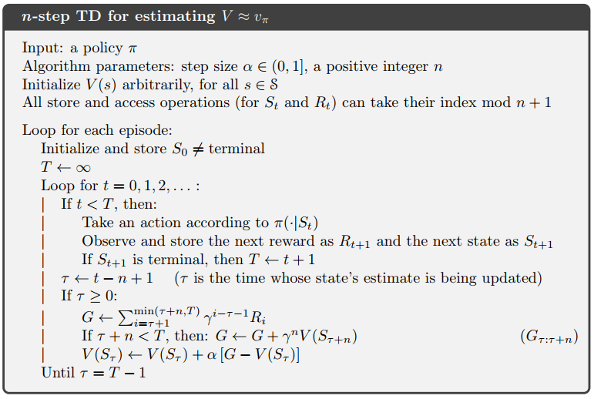

Slide 7
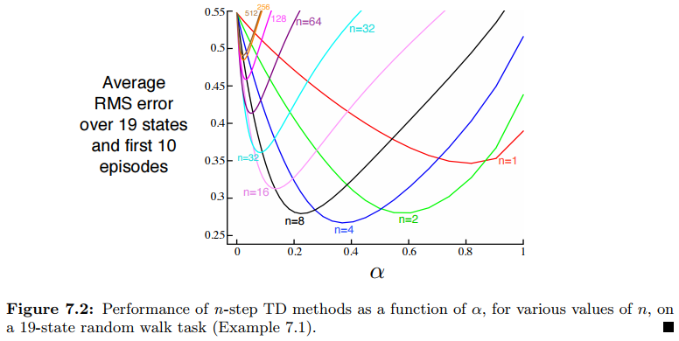

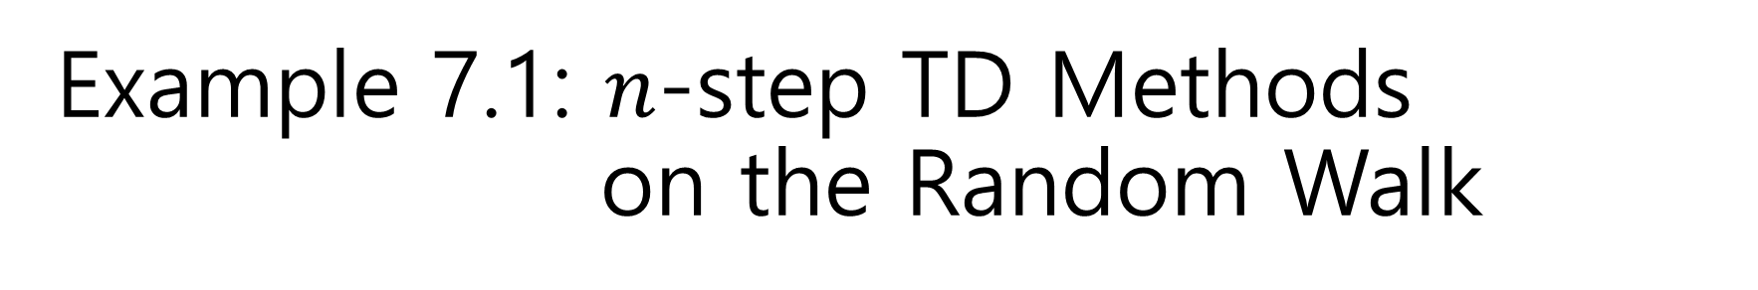
Example 7.1: $n$-step TD Methods on the Random Walk
5-state random walk

Slide 8

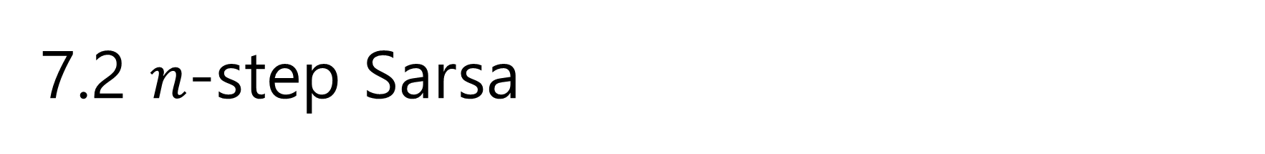
7.2 $n$-step Sarsa
Notation
$n$-step return $G_{t:t+n}=R_{t+1}+γR_{t+2}+⋯+γ^{n−1}R_{t+n}+γ^{n}Q_{t+n−1}\left(S_{t+n},A_{t+n}\right)$
$n$-step Sarsa, Sarsa(n-1) $Q_{t+n}\left(S_{t},A_{t}\right)=Q_{t+n−1}\left(S_{t},A_{t}\right)+α\left[G_{t:t+n}−Q_{t+n−1}\left(S_{t},A_{t}\right)\right]$

Slide 9
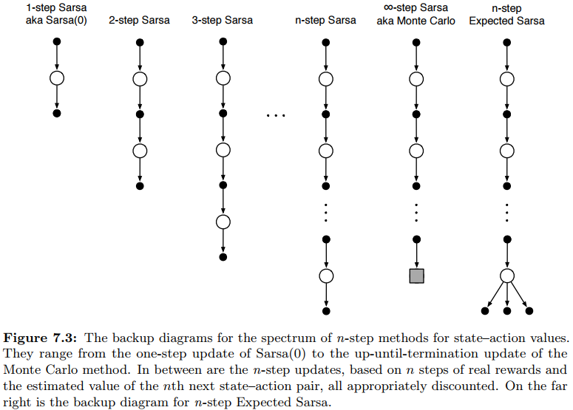
State
Action
Terminal

Slide 10
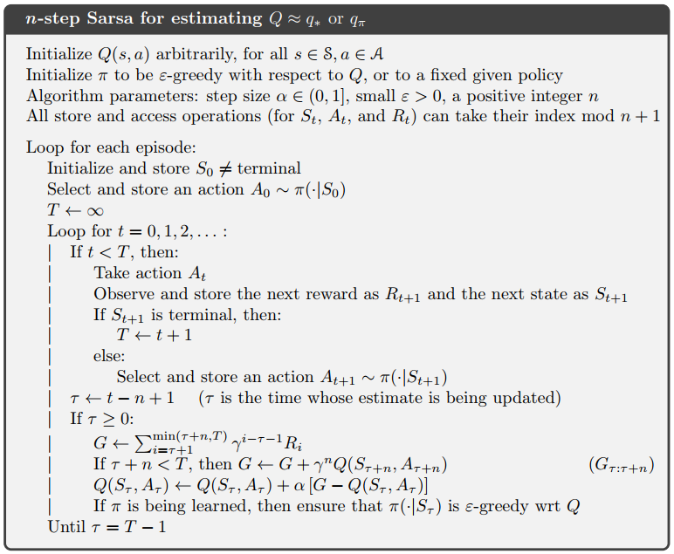

Slide 11
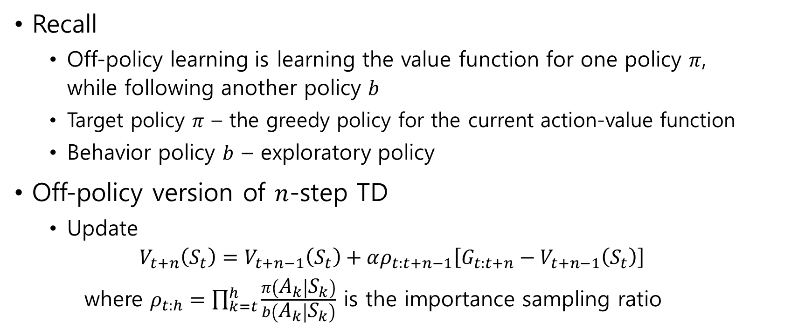
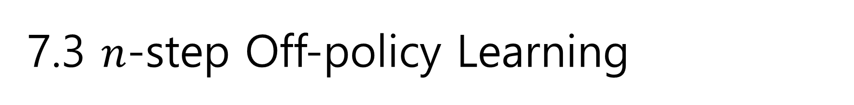
7.3 $n$-step Off-policy Learning
Recall
Off-policy learning is learning the value function for one policy $π$, while following another policy $b$
Target policy $π$ – the greedy policy for the current action-value function
Behavior policy $b$ – exploratory policy
Off-policy version of $n$-step TD
Update $V_{t+n}\left(S_{t}\right)=V_{t+n−1}\left(S_{t}\right)+αρ_{t:t+n−1}\left[G_{t:t+n}−V_{t+n−1}\left(S_{t}\right)\right]$ where $ρ_{t:h}=\prod_{k=t}^{h}{\frac{π\left(A_{k} | S_{k}\right)}{b\left(A_{k} | S_{k}\right)}}$ is the importance sampling ratio

Slide 12

Off-policy version of $n$-step TD
Update $Q_{t+n}\left(S_{t},A_{t}\right)=Q_{t+n−1}\left(S_{t},A_{t}\right)+αρ_{t+1:t+n}\left[G_{t:t+n}−Q_{t+n−1}\left(S_{t},A_{t}\right)\right]$

Slide 13
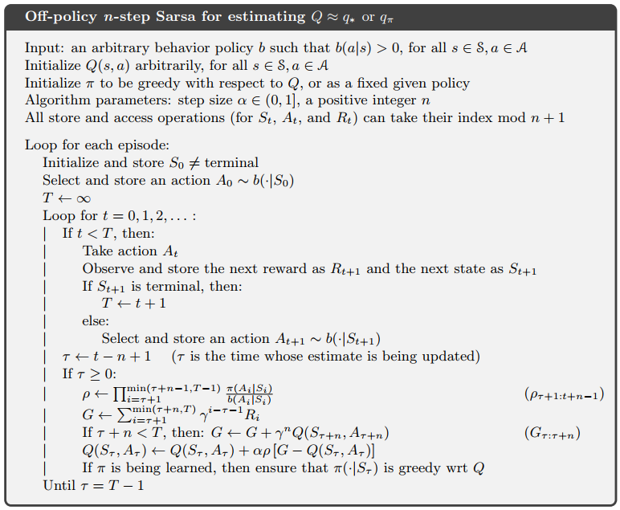

Slide 14
7.4 *Per-decision Methods with Control Variates

Slide 15
7.5 Off-policy Learning Without Importance Sampling: The n-step Tree Backup Algorithm

Slide 16
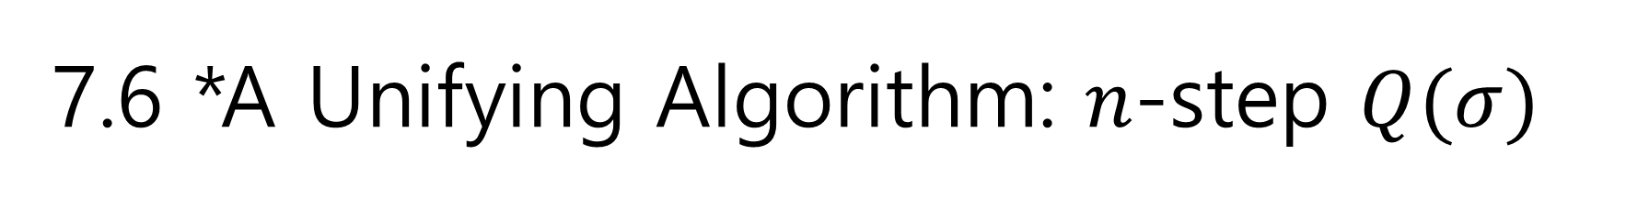
7.6 *A Unifying Algorithm: $n$-step $Q(σ)$

