Slide 1
Chapter 1 Feed-Forward Neural Nets

Slide 2
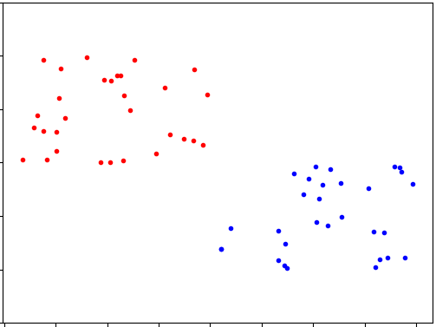
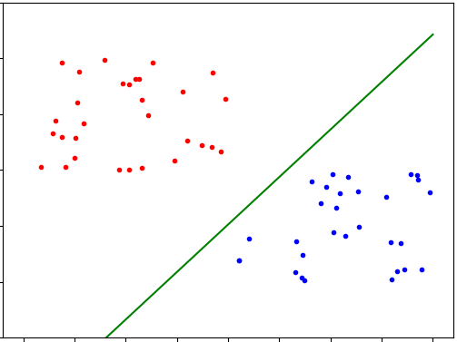
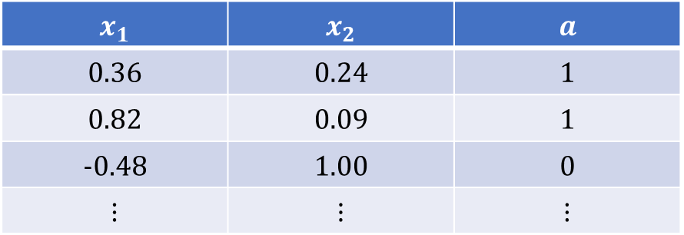
1.1 Perceptrons
Find a line that separates red and blue
$$x_{1}$$ | $$x_{2}$$ | $$a$$
$$0.36$$ | $$0.24$$ | $$1$$
$$0.82$$ | $$0.09$$ | $$1$$
$$-0.48$$ | $$1.00$$ | $$0$$
$$⋮$$ | $$⋮$$ | $$⋮$$

Slide 3




$Φ=\left\{w∪b\right\}$ where $w=[w_{1}, …, w_{m}]$, $b∈ℝ$
$\begin{aligned}f_{Φ}\left(x\right)=\#\left\{\begin{matrix}1 & if b+w⋅x>0 \\ 0 & otherwise \end{matrix}\right.\end{aligned}$
$$x$$
$$Σ$$
$$f_{Φ}\left(x\right)$$

Slide 4
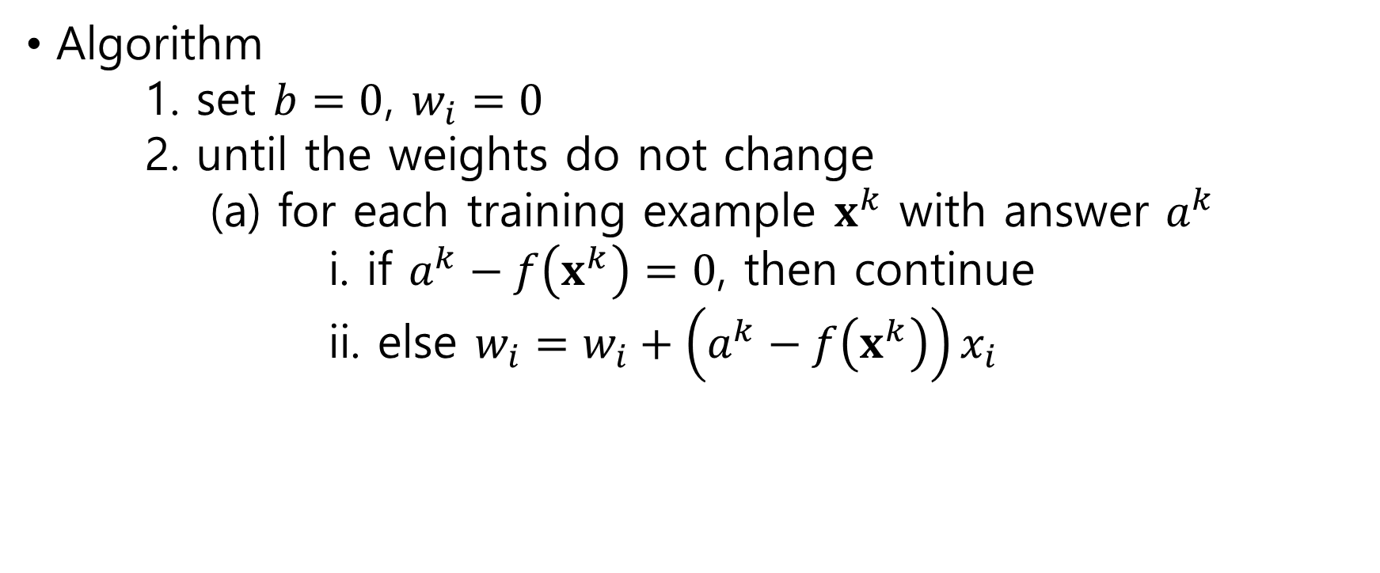
Algorithm 1. set $b=0$, $w_{i}=0$ 2. until the weights do not change (a) for each training example $x^{k}$ with answer $a^{k}$ i. if $a^{k}−f\left(x^{k}\right)=0$, then continue ii. else $w_{i}=w_{i}+\left(a^{k}−f\left(x^{k}\right)\right)x_{i}$

Slide 5





Multiclass Decision Problem
$$x$$
$$Σ$$
$$Σ$$
$$Σ$$
$$Σ$$

Slide 6
1.2 Cross-entropy Loss Functions for Nerual Nets

Slide 7

Softmax
Definition: $σ{\left(x\right)}_{j}=\frac{e^{x_{j}}}{\sum_{i}{e^{x_{i}}}}$ $σ\left(x_{1},…,x_{m}\right)=\left(\frac{e^{x_{1}}}{\sum_{i}{e^{x_{i}}}},…,\frac{e^{x_{m}}}{\sum_{i}{e^{x_{i}}}}\right)$

Slide 8

Cross-entropy
Definition: $H\left(p,q\right)=\sum_{i}{p_{i}\log{q_{i}}}$

Slide 9

Cross-entropy loss
Definition: $X\left(Φ,x\right)=−\ln{p_{Φ}\left(a_{x}\right)}$ where $p_{Φ}(a_{x})$ is the probability assigned to $x$’s label

Slide 10

1.3 Derivatives and Stochastic Gradient Descent
Equations: $X\left(Φ,x\right)=−\ln{p\left(a\right)}$ $p\left(a\right)=σ_{a}\left(l\right)=\frac{e^{l_{a}}}{\sum_{i}{e^{l_{i}}}}$ $l_{j}=b_{j}+x⋅w_{j}$ where $l=(l_{1},…,l_{m})$

Slide 11
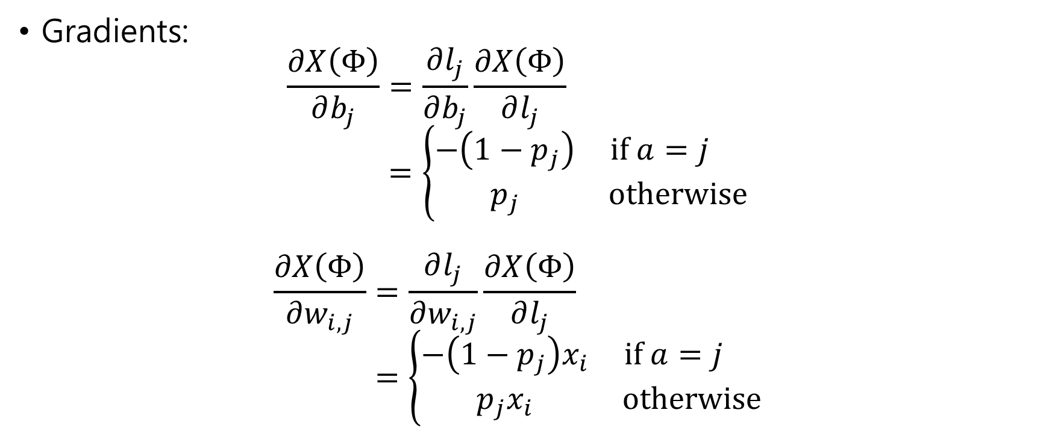
Gradients: $\frac{∂X\left(Φ\right)}{∂b_{j}}=\frac{∂l_{j}}{∂b_{j}}\frac{∂X\left(Φ\right)}{∂l_{j}}$ $=\left\{\begin{matrix}−\left(1−p_{j}\right) & if a=j \\ p_{j} & otherwise\end{matrix}\right.$ $\frac{∂X\left(Φ\right)}{∂w_{i,j}}=\frac{∂l_{j}}{∂w_{i,j}}\frac{∂X\left(Φ\right)}{∂l_{j}}$ $=\left\{\begin{matrix}−\left(1−p_{j}\right)x_{i} & if a=j \\ p_{j}x_{i} & otherwise\end{matrix}\right.$

Slide 12

Update: For learning rate $ℒ$ $b_{j}=b_{j}−ℒ\frac{∂X\left(Φ\right)}{∂b_{j}}$ $w_{i,j}=w_{i,j}−ℒ\frac{∂X\left(Φ\right)}{∂w_{i,j}}$

Slide 13

1.4 Writing Our Program
Data Normalization
$−1≤x_{i}≤1$
Learning Rate
0.0001 in MNIST
Weights and Bias
[-0.1, 0.1]

Slide 14
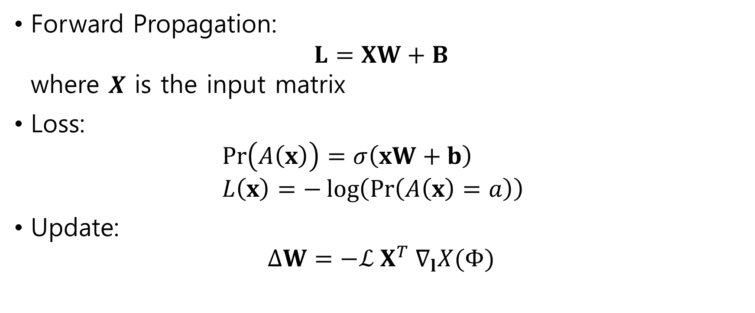
1.5 Matrix Representation of Neural Nets
Forward Propagation: $L=XW+B$ where $X$ is the input matrix
Loss: $\operatorname{Pr}\left(A\left(x\right)\right)=σ\left(xW+b\right)$ $L\left(x\right)=−\log\left(\operatorname{Pr}\left(A\left(x\right)=a\right)\right)$
Update: $ΔW=−ℒ X^{T} ∇_{l}X(Φ)$

Slide 15
1.6 Data Independence
iid assumption

