Slide 1

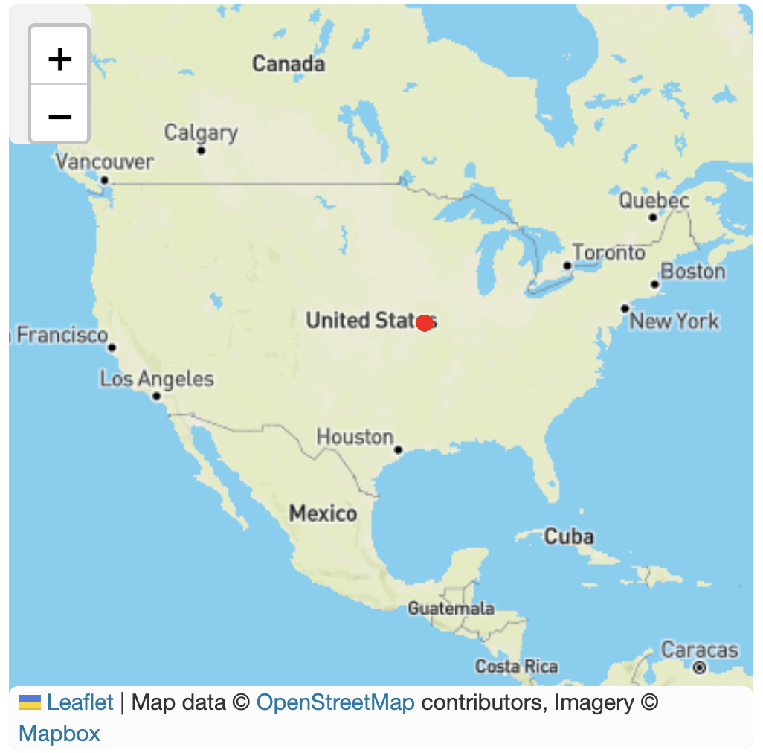
IOT Data Services Showcase
Total Sensor # 400
Sensor
Overview
Radiation
125
250
172
Water Levels
125
250
172
Wind Speeds
125
250
172
Seimic vibrations
125
250
172
Air Quality
125
250
172
noise
125
250
172
Soil contaminants
Ambient temperature
125
250
172
Notes:
https://www.fema.gov/pdf/library/remotes.pdf
https://www.sbir.gov/Sensor-technology-for-the-21st-century
Semics vibrations https://www.imv.co.jp/e/pr/seismic_monitoring/knowledge/

Slide 2
Edge Store Data Services Showcase
Total Sensor # 400
Sensor
Overview
Radiation
125
250
172
Refrigerator
125
250
172
Wind Speeds
125
250
172
Seimic vibrations
125
250
172
Air Quality
125
250
172
noise
125
250
172
Soil contaminants
Ambient temperature
125
250
172
Notes:
https://www.fema.gov/pdf/library/remotes.pdf
https://www.sbir.gov/Sensor-technology-for-the-21st-century
Semics vibrations https://www.imv.co.jp/e/pr/seismic_monitoring/knowledge/

Slide 3
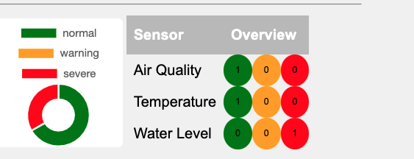
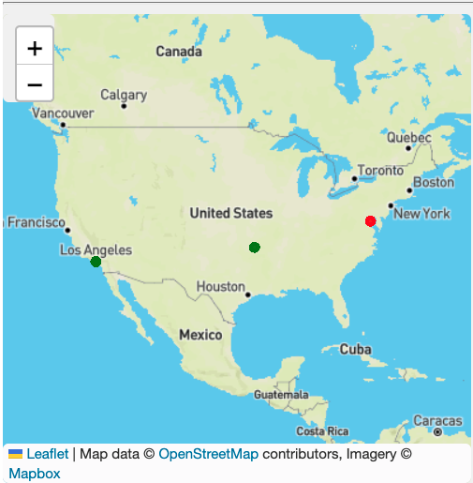
Total Alerts: 95
Sensor | Location | Alerts
Water | NY | 102
Temperature | LA
Water | WY

Slide 4
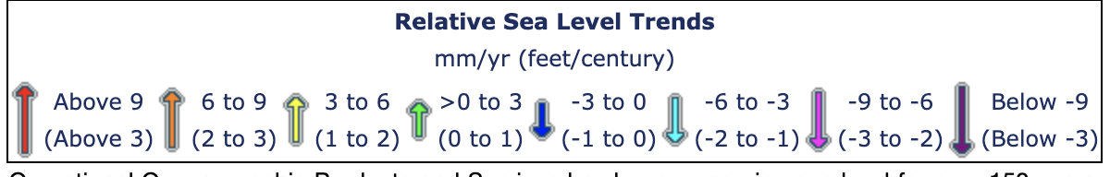
Radiation
10Gy or higher, while 4-5Gy will kill within 60 days, and less than 1.5-2Gy will not be lethal in the short term.
Water Levels
typically 0.3 to 5 meter, though a few recent ones are now equipped with 0.5~10 meter sensors
Wind Speeds
6 and 12 miles per hour
Seismic vibrations
-1000Gal = rate scale = 7
Air Quality
Index Scale ; 0 - 50. Good ; 51 - 100. Moderate ; 101 - 150. Unhealthy for Sensitive Groups (USG) ; 151 - 200. Unhealthy.
noise
normal conversation is about 60 dB, and a motorcycle engine running is about 95 dB. Noise above 70 dB over a prolonged period of time may start to damage your hearing. Loud noise above 120 dB can cause immediate harm to your ears.
Soil contaminants
6.6 or lower indicates acidic soil, 6.7 to 7.3 means neutral soil, and a reading higher than 7.3 means the soil is basic.
Ambient temperature
Average yearly temperature is 22.4 degrees Celsius, ranging from an average minimum of 12.2 degrees to a maximum of 29.9 degrees.
Notes:
https://www.fema.gov/pdf/library/remotes.pdf
https://www.sbir.gov/Sensor-technology-for-the-21st-century
Semics vibrations https://www.imv.co.jp/e/pr/seismic_monitoring/knowledge/

