Slide 1




Slide 2
Intro
What is Innovation?
Agenda
What should we innovate?
How you can innovate more
Conclusion

Slide 3
Goal
How can we understand information to make informed decisions quicker?

Slide 4

Information
Letter message content….

Slide 5
Is this information GOOD or BAD?
Is this Real?
Information
Letter message content….
Is this information dangerous?

Slide 6
Artificial
Intelligence
(AI)
Information
Letter message content….

Slide 7
What is Artificial Intelligence (AI)?
AI is technology that emulates human intelligence

Slide 8
What is Machine Learning (ML)?
ML is artificial intelligence using mathematical data algorithms

Slide 9
AI
AI
Is this information GOOD or BAD?
Sentiment Analysis
Is this Real?
Fraud Detection
Information
Letter message content….
Is this information dangerous?
Threat Detection

Slide 10
AI Algorithms - categories
Classification
Classification is a ML model algorithm to group data by a category
Anomaly
Clustering is ML model algo algorithm to identify deviation for normal trends
Regression
Regression is ML model algorithm predict outputs
Clustering
Clustering is ML model algorithm to group similar points

Slide 11
Sentiment Analysis
Classification
Classification is a ML model algorithm to group data by a category
Fraud Detection
Information
Threat Detection
Letter message content….

Slide 12
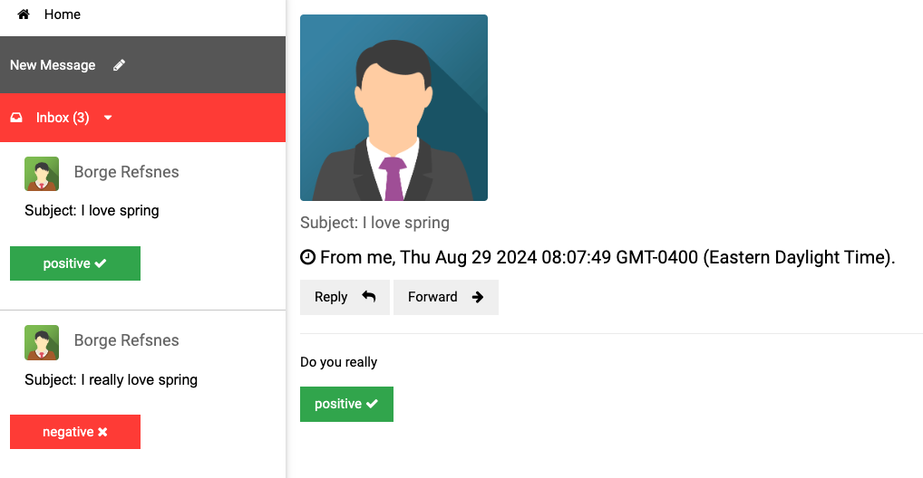
Sentiment Analysis

Slide 13
Getting started - sentiment analysis
Vector Embedding are a numerical representation of data
App(s)
=>
I love my awesome wife, she is my best friend
[ -0.5539689660072327, -0.04552192986011505, 0.2843276858329773, 0.12018735706806183, -0.4164251685142517, -0.0015744016272947192,
0.8378576636314392, -0.2455213963985443,
0.1919904500246048, 0.3389095067977905, 0.5132707357406616, -0.5949105024337769, -0.05128718167543411, 0.13099819421768188, 0.23817287385463715, 0.16531096398830414, -0.08132422715425491,,… ]

Slide 14
How are vector embeddings generated?
Model is a Machine learning trained mathematically algorithm that produces an outcome
Model
App(s)
[ -0.5539689660072327, -0.04552192986011505, 0.2843276858329773, 0.12018735706806183, -0.4164251685142517, -0.0015744016272947192,
0.8378576636314392, -0.2455213963985443,
0.1919904500246048, 0.3389095067977905, 0.5132707357406616, -0.5949105024337769, -0.05128718167543411, 0.13099819421768188, 0.23817287385463715, 0.16531096398830414, -0.08132422715425491,,… ]
=>
I love my awesome wife, she is my best friend

Slide 15



Web App

Slide 16
App(s)

Slide 17

Database – Data Service
App(s)
Historical data that is the system of record operational data store
Database

Slide 18

Cache – Data Service
App(s)
Provides fast access In-memory
most frequently used data information
Cache
Database

Slide 19
Event Broker – Data Service
App(s)
Provides reliable information event delivery
Cache
Event
Broker
Database

Slide 20
Event Processor
App
Consumer Processor App
User
App
Event
Broker
Cache
Database

Slide 21

Cache
Event
Broker
Web App
Database

Slide 22
Wh
Understand information better
Making decision fast

Slide 23
Generative
vs
Traditional
AI

Slide 25
VIDEO WILL BE HANDLED BY THE AV TEAMS AND NOT EMBEDDED INTO DECK.
PLEASE SEND DOWNLOAD LINK (NOT ACTUAL VIDEO FILE) TO ATC-TALENT@BLAVITY.COM
VIDEO HERE

Slide 26
Main Idea One
AI
AI ML
ML
The state in which every person, regardless of human difference, can access and harness the full power of digital products, without bias, harm or limitation.

Slide 29
Based on this definition, when was the last time you were innovative?

Slide 30
Section Break

Slide 31
Section Break

Slide 32

Add your a question?

Slide 33
Add your a question?

Slide 34
Title of Slide

Slide 35
“Here’s space for a good pull quote to discuss”
First Last, Title

Slide 36
“Here’s space for a good pull quote to discuss”
First Last, Title

Slide 37
Title of Slide
Main Idea One
Data is the first and best way to back-up a solutioning hypothesis and/or prove a hunch in the long run
Main Idea One
Data is the first and best way to back-up a solutioning hypothesis and/or prove a hunch in the long run
Main Idea One
Data is the first and best way to back-up a solutioning hypothesis and/or prove a hunch in the long run
Main Idea One
Data is the first and best way to back-up a solutioning hypothesis and/or prove a hunch in the long run

Slide 38
Title of Slide
Main Idea One
Data is the first and best way to back-up a solutioning hypothesis and/or prove a hunch in the long run
Main Idea One
Data is the first and best way to back-up a solutioning hypothesis and/or prove a hunch in the long run
Main Idea One
Data is the first and best way to back-up a solutioning hypothesis and/or prove a hunch in the long run
Main Idea One
Data is the first and best way to back-up a solutioning hypothesis and/or prove a hunch in the long run

Slide 39
Main Idea One
Main
Idea Goes Here
The state in which every person, regardless of human difference, can access and harness the full power of digital products, without bias, harm or limitation.

Slide 40
Main Idea One
Main
Idea Goes Here
The state in which every person, regardless of human difference, can access and harness the full power of digital products, without bias, harm or limitation.

Slide 41
The state in which every person, regardless of human difference, can access and harness the full power of digital products, without bias, harm or limitation.
Exercise 1

Slide 42
The state in which every person, regardless of human difference, can access and harness the full power of digital products, without bias, harm or limitation.
Exercise 2

Slide 43
Have you asked yourself this question?
This is a block of text that helps add context to the big impactful statement above.

Slide 44
Have you asked yourself this question?
This is a block of text that helps add context to the big impactful statement above.

Slide 45
Conclusion
A Statement goes here.
Data is the first and best way to back-up a solutioning hypothesis and/or prove a hunch in the long run
A Statement goes here.
Data is the first and best way to back-up a solutioning hypothesis and/or prove a hunch in the long run
A Statement goes here.
Data is the first and best way to back-up a solutioning hypothesis and/or prove a hunch in the long run

