Slide 1



Unlock Real-Time AI-ML
Event Streaming
with Spring and Cloud Native Data Services

Slide 2
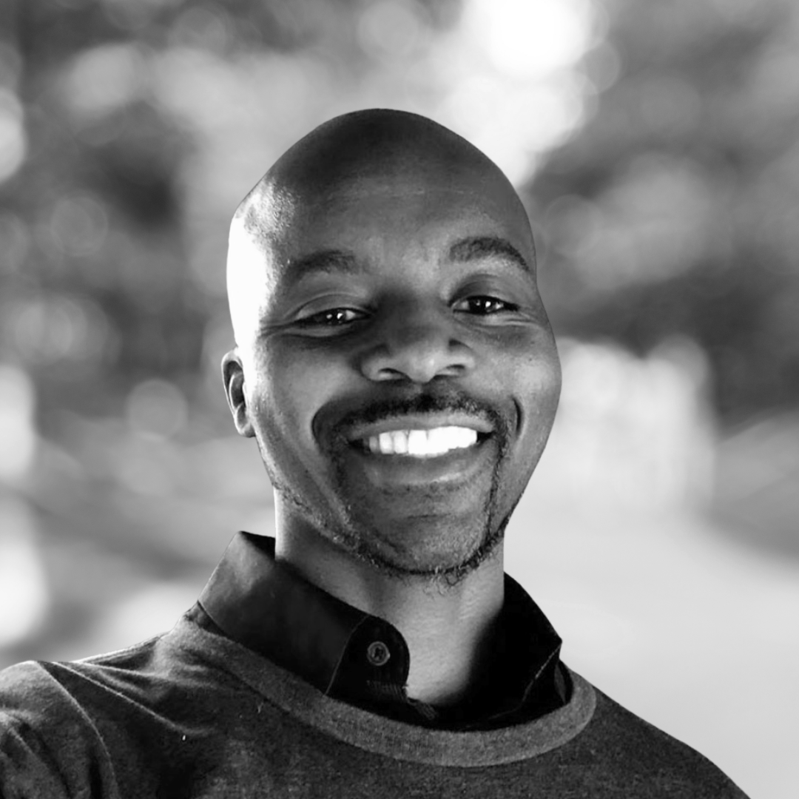
introduction
Gregory Green
Principal Solution Architect
VMware By Broadcom

Slide 3
Intro
What is AI/ML?
Agenda
What should we innovate?
How you can innovate more
Conclusion

Slide 4
Goal
How can we understand information to make informed decisions quicker?

Slide 5

Information
Letter message content….

Slide 6
Is this information GOOD or BAD?
Is this Real?
Information
Letter message content….
Is this information dangerous?

Slide 7
Artificial
Intelligence
(AI)
Information
Letter message content….

Slide 8
What is Artificial Intelligence (AI)?
AI is technology that emulates human intelligence

Slide 9
What is Machine Learning (ML)?
ML is artificial intelligence using mathematical data algorithms

Slide 10
AI
AI
Is this information GOOD or BAD?
Sentiment Analysis
Is this Real?
Fraud Detection
Information
Letter message content….
Is this information dangerous?
Threat Detection

Slide 11
Main Idea
AI
AI/ML can help humans to understand information to make informed decisions quicker using Models
ML

Slide 12
What is a Model?
Model is a Machine learning trained mathematically algorithm that produces an outcome
Model

Slide 13
AI Models - categories
Classification
Classification is a ML model algorithm to group data by a category
Anomaly
Clustering is ML model algo algorithm to identify deviation for normal trends
Regression
Regression is ML model algorithm predict outputs
Clustering
Clustering is ML model algorithm to group similar points

Slide 14
Sentiment Analysis
Classification
Classification is a ML model algorithm to group data by a category
Fraud Detection
Information
Threat Detection
Letter message content….

Slide 15
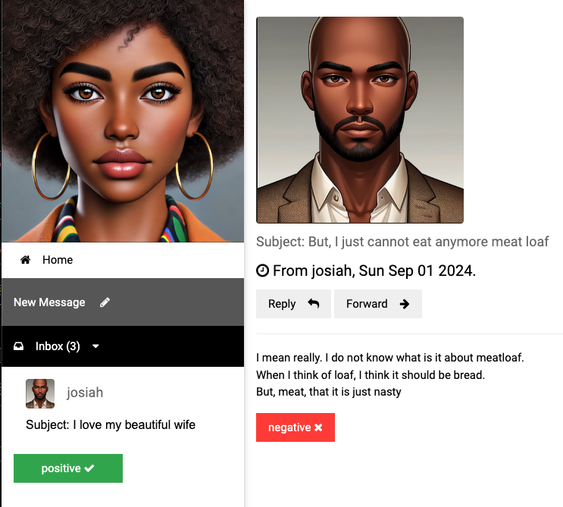
Sentiment Analysis

Slide 16
Getting started with AI/ML
Vector Embedding are a numerical representation of data
App(s)
=>
I love my awesome wife, she is my best friend
[ -0.5539689660072327, -0.04552192986011505, 0.2843276858329773, 0.12018735706806183, -0.4164251685142517, -0.0015744016272947192,
0.8378576636314392, -0.2455213963985443,
0.1919904500246048, 0.3389095067977905, 0.5132707357406616, -0.5949105024337769, -0.05128718167543411, 0.13099819421768188, 0.23817287385463715, 0.16531096398830414, -0.08132422715425491,,… ]

Slide 17
How are vector embeddings generated?
Text Embedding produces vector embedding based on text input
Model
<text-embedding>
App(s)
[ -0.5539689660072327, -0.04552192986011505, 0.2843276858329773, 0.12018735706806183, -0.4164251685142517, -0.0015744016272947192,
0.8378576636314392, -0.2455213963985443,
0.1919904500246048, 0.3389095067977905, 0.5132707357406616, -0.5949105024337769, -0.05128718167543411, 0.13099819421768188, 0.23817287385463715, 0.16531096398830414, -0.08132422715425491,,… ]
=>
I love my awesome wife, she is my best friend

Slide 18
How to perform sentiment analysis?
Model
<text-classification>
Model
<embedding>
App(s)
Text classification determine sentiment such as
VERY_NEGATIVE, NEGATIVE, NEUTRAL, POSITIVE VERY_POSTIVE
Vector embedding
[ -0.5539689660072327, -0.04552192986011505, 0.2843276858329773, 0.12018735706806183, -0.4164251685142517, -0.0015744016272947192,
0.8378576636314392, -0.2455213963985443,
0.1919904500246048, 0.3389095067977905, 0.5132707357406616, -0.5949105024337769, -0.05128718167543411, 0.13099819421768188, 0.23817287385463715, 0.16531096398830414, -0.08132422715425491,,… ]
=>
=>
I love my awesome wife, she is my best friend

Slide 19


How to perform sentiment analysis?
Models
App(s)
I love my wife

Slide 20


Event Broker – Data Service
Provides real-time reliable information event delivery
Event
Broker

Slide 21


Database – Data Service
Historical data that is the system of record operational data store
Database

Slide 22

Cache – Data Service
Provides fast access In-memory
most frequently used data information
Cache

Slide 23



Models
Models
Consumer Sink App
User
App
Event Processor
App
RabbitMQ
ValKey
PostgresML
Postgres

Slide 24

Cache
Event
Broker
Web App
Database

Slide 25
Why
Understand information better
Making decision fast

Slide 26
Generative
vs
Traditional
AI

Slide 28
VIDEO WILL BE HANDLED BY THE AV TEAMS AND NOT EMBEDDED INTO DECK.
PLEASE SEND DOWNLOAD LINK (NOT ACTUAL VIDEO FILE) TO ATC-TALENT@BLAVITY.COM
VIDEO HERE

Slide 31
Based on this definition, when was the last time you were innovative?

Slide 32
Section Break

Slide 33
Section Break

Slide 34

Add your a question?

Slide 35
Add your a question?

Slide 36
Title of Slide

Slide 37
“Here’s space for a good pull quote to discuss”
First Last, Title

Slide 38
“Here’s space for a good pull quote to discuss”
First Last, Title

Slide 39
Title of Slide
Main Idea One
Data is the first and best way to back-up a solutioning hypothesis and/or prove a hunch in the long run
Main Idea One
Data is the first and best way to back-up a solutioning hypothesis and/or prove a hunch in the long run
Main Idea One
Data is the first and best way to back-up a solutioning hypothesis and/or prove a hunch in the long run
Main Idea One
Data is the first and best way to back-up a solutioning hypothesis and/or prove a hunch in the long run

Slide 40
Title of Slide
Main Idea One
Data is the first and best way to back-up a solutioning hypothesis and/or prove a hunch in the long run
Main Idea One
Data is the first and best way to back-up a solutioning hypothesis and/or prove a hunch in the long run
Main Idea One
Data is the first and best way to back-up a solutioning hypothesis and/or prove a hunch in the long run
Main Idea One
Data is the first and best way to back-up a solutioning hypothesis and/or prove a hunch in the long run

Slide 41
Main Idea One
Main
Idea Goes Here
The state in which every person, regardless of human difference, can access and harness the full power of digital products, without bias, harm or limitation.

Slide 42
Main Idea One
Main
Idea Goes Here
The state in which every person, regardless of human difference, can access and harness the full power of digital products, without bias, harm or limitation.

Slide 43
The state in which every person, regardless of human difference, can access and harness the full power of digital products, without bias, harm or limitation.
Exercise 1

Slide 44
The state in which every person, regardless of human difference, can access and harness the full power of digital products, without bias, harm or limitation.
Exercise 2

Slide 45
Have you asked yourself this question?
This is a block of text that helps add context to the big impactful statement above.

Slide 46
Have you asked yourself this question?
This is a block of text that helps add context to the big impactful statement above.

Slide 47
Conclusion
A Statement goes here.
Data is the first and best way to back-up a solutioning hypothesis and/or prove a hunch in the long run
A Statement goes here.
Data is the first and best way to back-up a solutioning hypothesis and/or prove a hunch in the long run
A Statement goes here.
Data is the first and best way to back-up a solutioning hypothesis and/or prove a hunch in the long run

