Slide 1

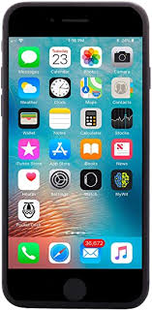

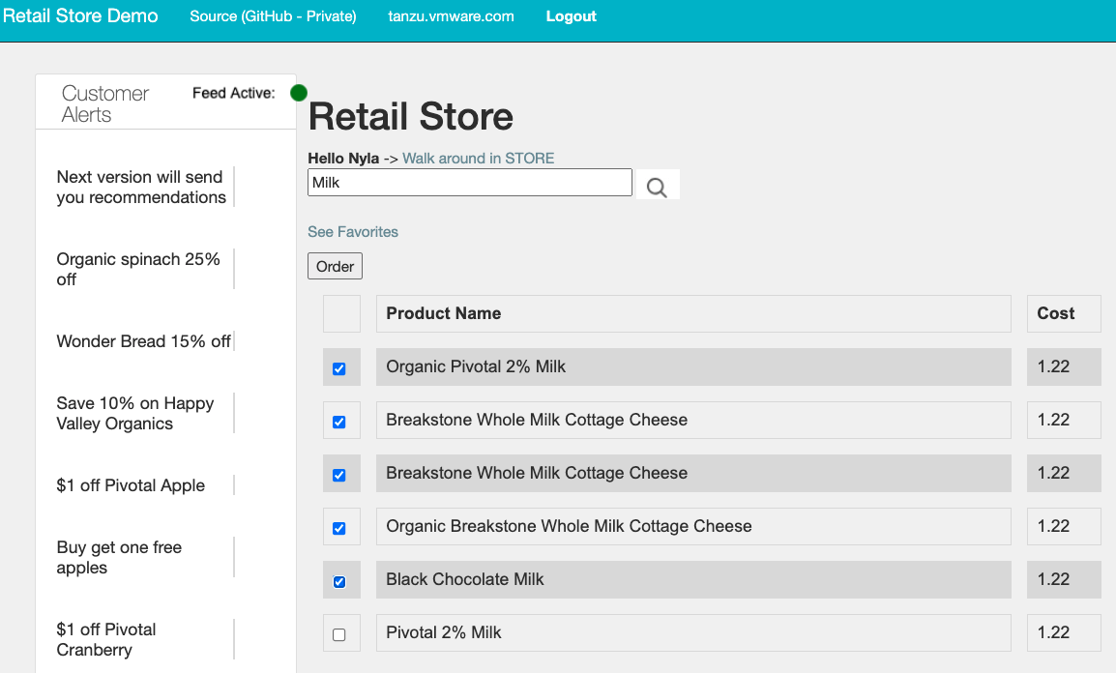








Retail Store Cloud Native Data
User Interfaces
Retail Store
GemFire
Postgres
orders.csv
"0","Joe","Smith","","","63" "0","Joe","Smith", "","","1,2,63" "0","Joe","Smith","","","3,4,26"
Retail Analytics
Order Processor
Kubernetes

Slide 2

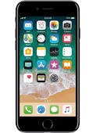

Pivotal Cloud Foundry
Cloud Native App
Beacon
request
customer
Spring Boot
favorites
promotions
favorites
Pivotal Cloud Cache
Favorites, promotions
Beacon
request
Greenplum MPP
SFDC
Spring Cloud Stream
favorites
promotions

