Slide 1

ΕΠΛ 325 Final Exercise
Gregory Gregoriades

Slide 2
Why parallelism?
Programs execute faster
Higher speed-up compared to the serial implementation
More Efficient

Slide 3
Problem
Given a range of characters from a to z
Calculate the appearances of each character in the given range from a table filled with random characters

Slide 4
How we worked
Study the theory first
Start the code implementation
Write the script that will run the program for multiple entry combinations
Execute program for each method, size and range 12 times
Collect data
Calculate Theoretical Speedup (Amdahl’s Law) and Actual Speedup
Calculate Efficiency
Represent them in graphs

Slide 5
Speedup Calculation
Compiled using gcc –S to check the assembly version of the code
Counted instructions for the serial and parallel methods
Used the instructions in Amdahl’s Law and calculate theoretical speedup
Calculate Actual Speedup by dividing average execution time for serial with average execution time for parallel
Calculate Efficiency by dividing actual speedup with theoretical speedup if asked.

Slide 6
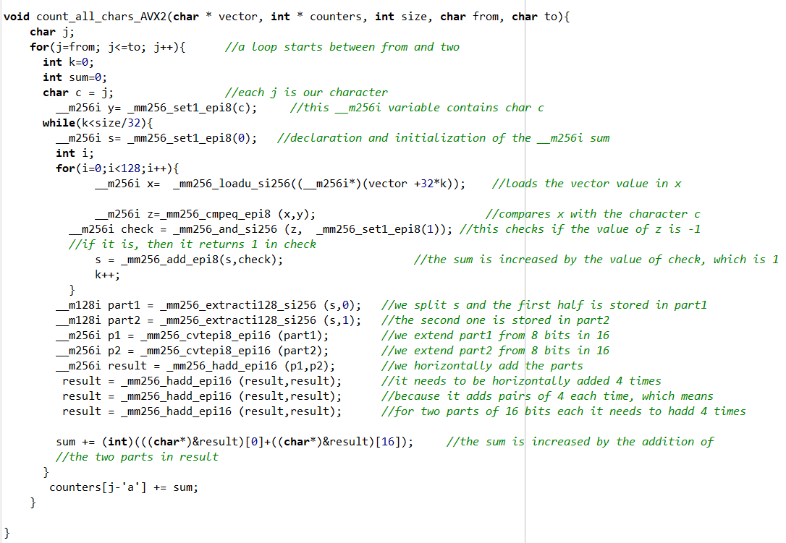
AVX2

Slide 7
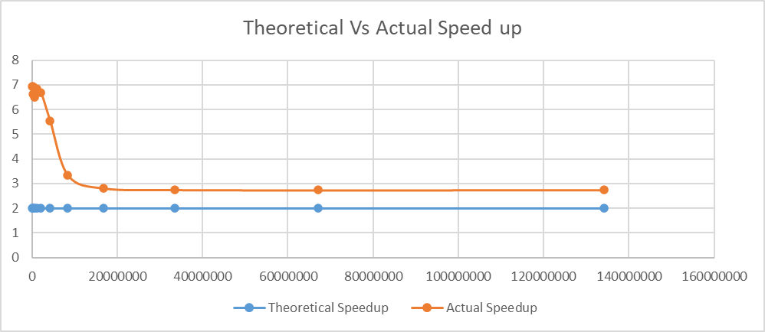
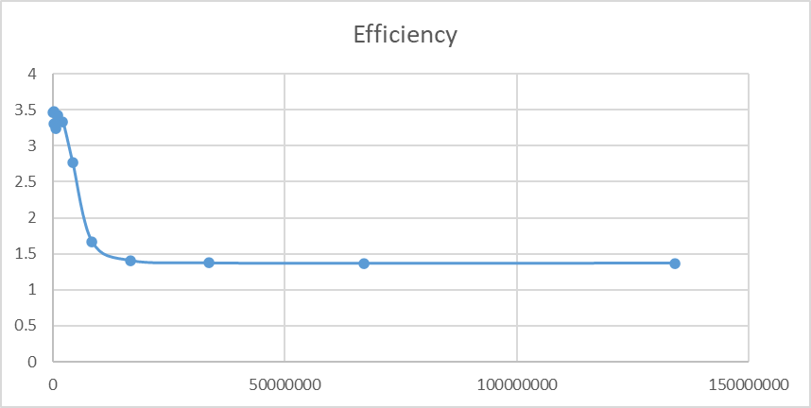
AVX2 - graphs

Slide 8
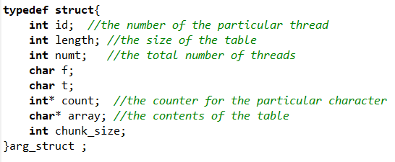
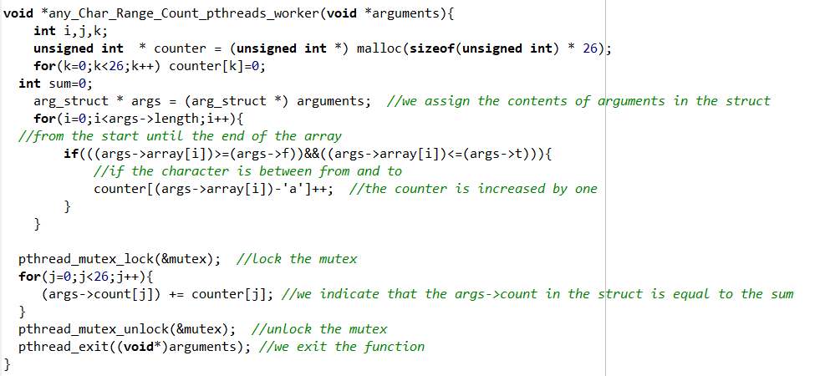
Pthreads – struct and worker

Slide 9
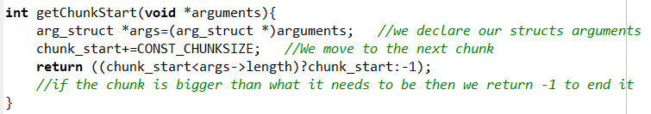
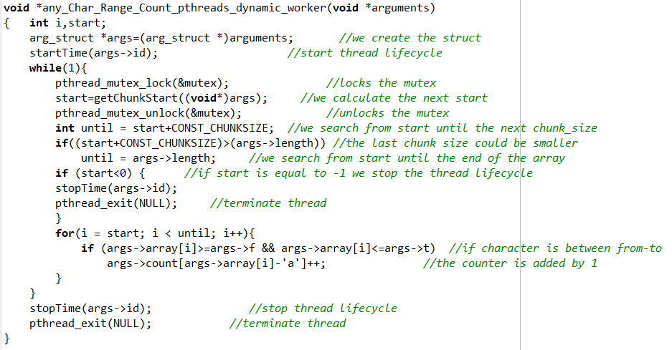
Pthreads – worker dynamic

Slide 10
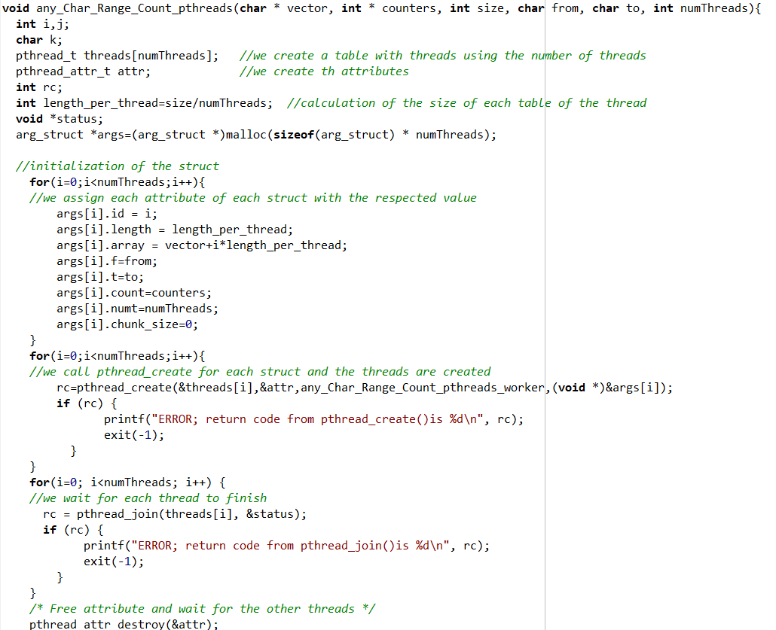
Pthreads - function

Slide 11
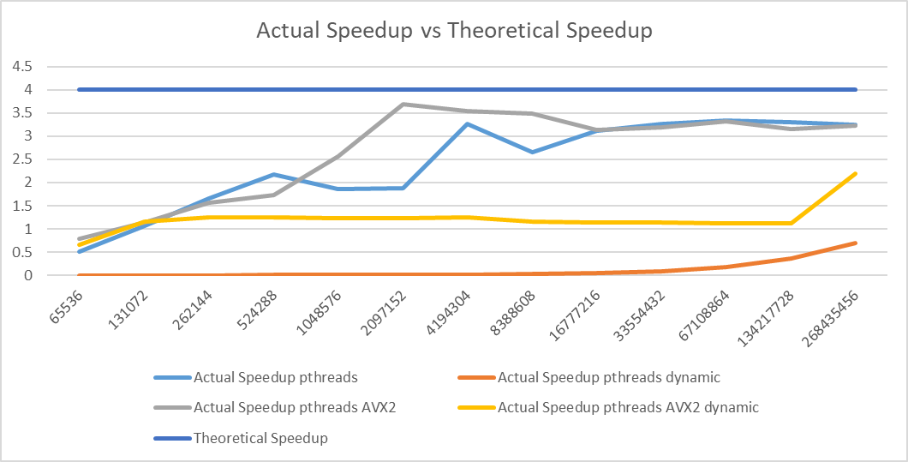
Pthreads - graphs

Slide 12
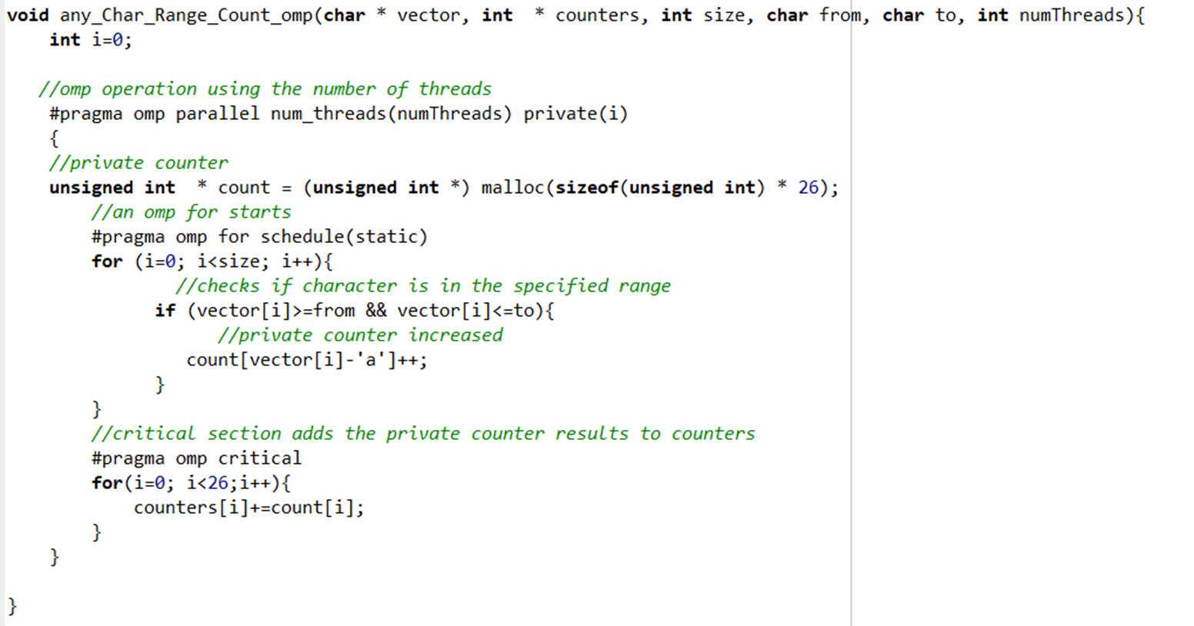
OpenMP

Slide 13
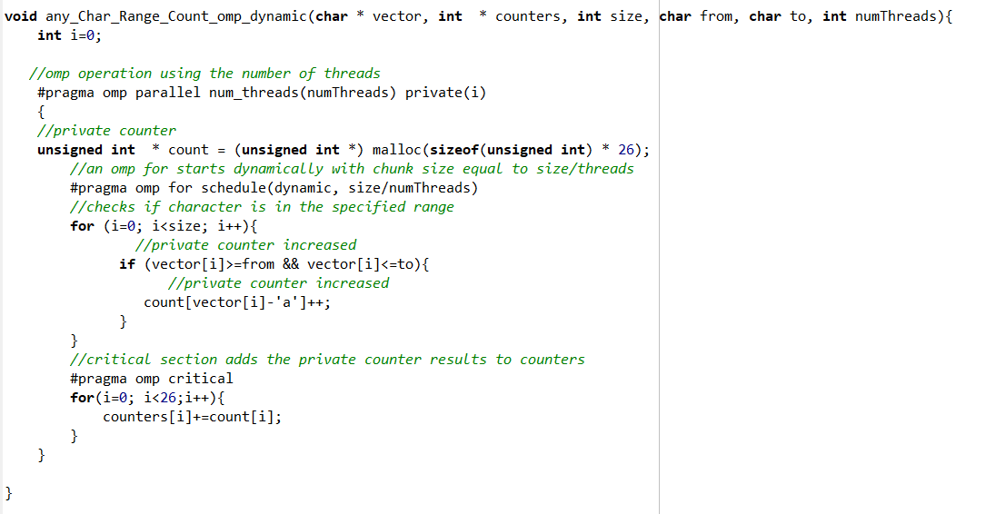
OpenMP - dynamic

Slide 14
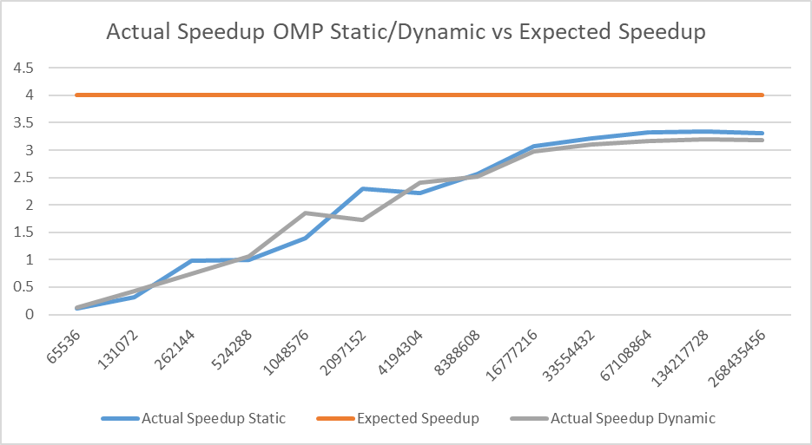
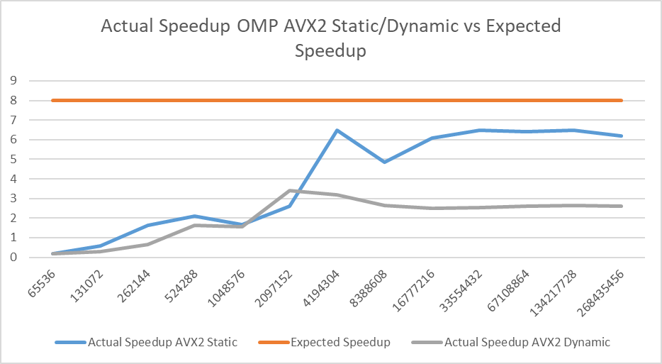
OpenMP - graphs

Slide 15
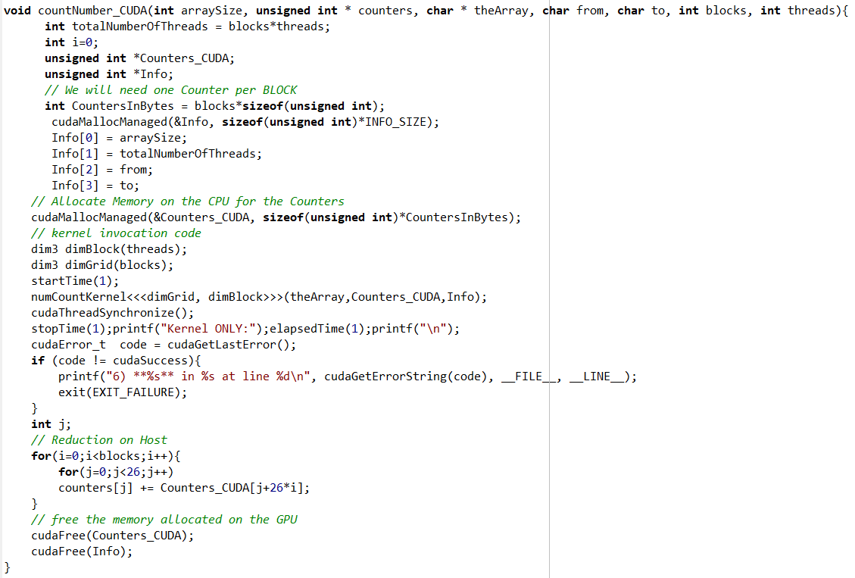
CUDA - function

Slide 16
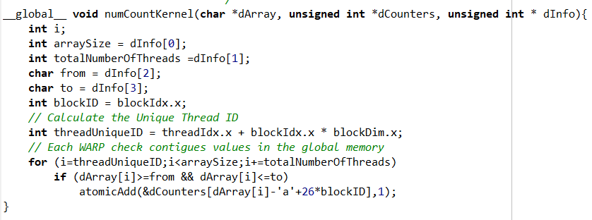
CUDA - kernel

Slide 17
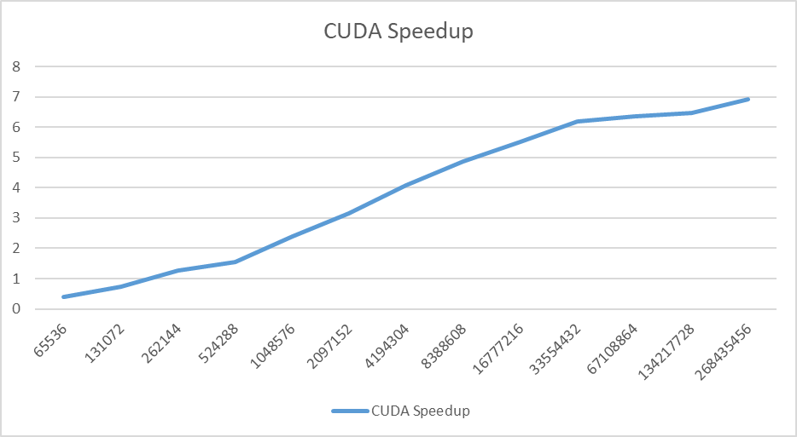
CUDA - graphs

Slide 18
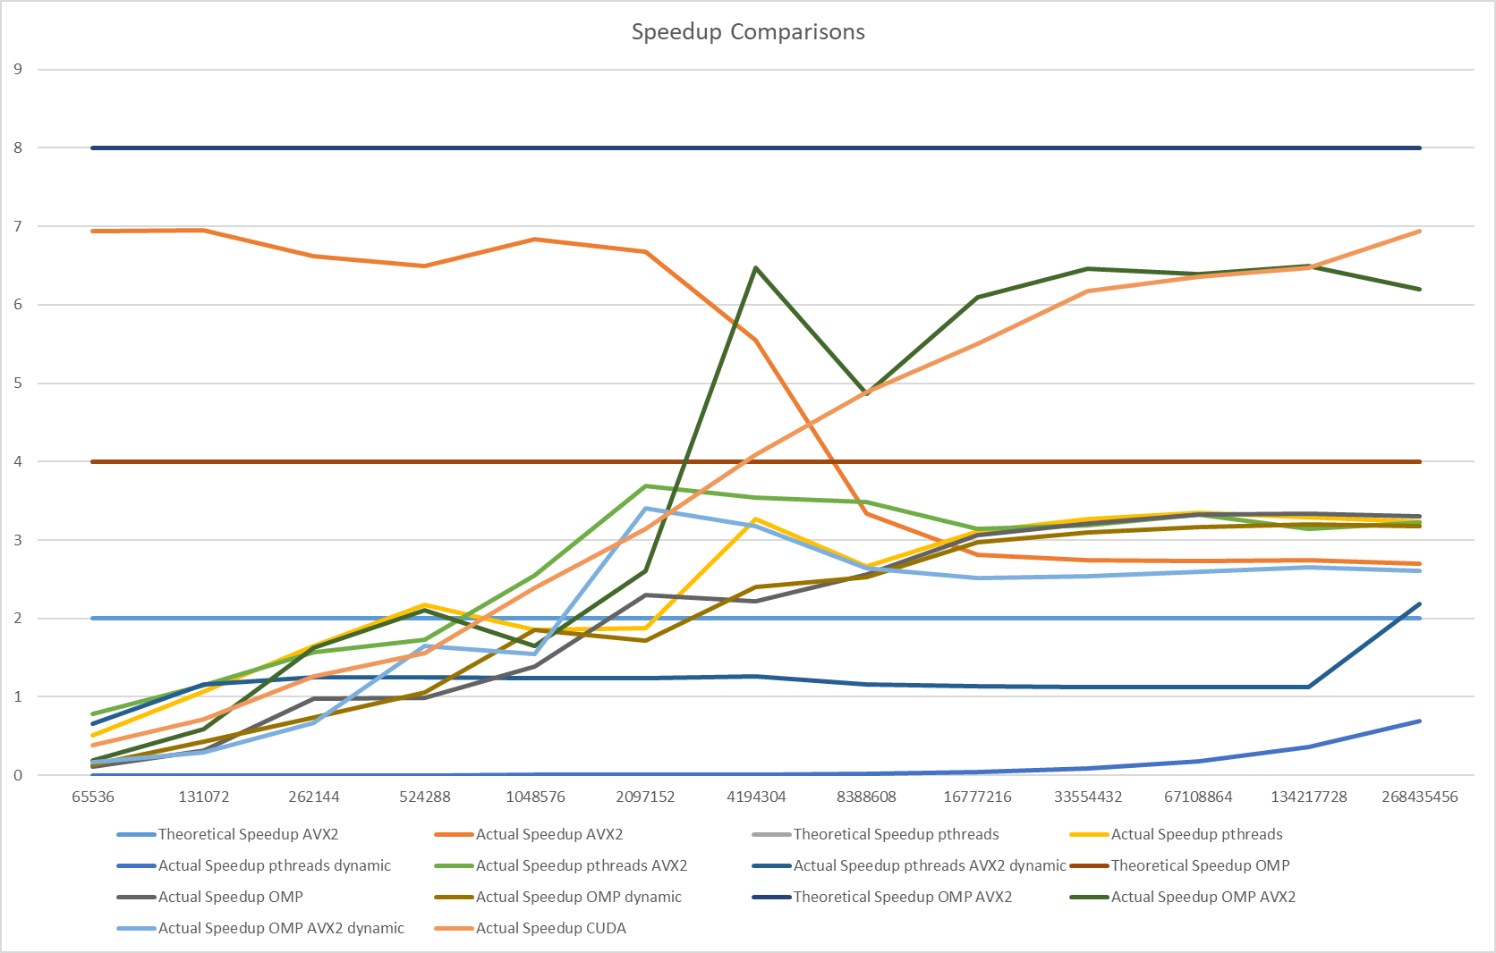
Speedup Comparisons

Slide 19
Difficulty Comparisons
Ranking the difficulty of each exercise from hardest to easiest:
  AVX2
  CUDA
  Pthreads
  OpenMP

Slide 20
Load Balancing Comparisons
Dynamic Allocation had the best load balancing
  When a thread finishes a part it takes the next chunk size
  All threads are working constantly
  But we had overhead
Static Allocation didn’t have good load balancing
  In static Allocation when a thread finished with its task it waited the other threads, doing nothing

Slide 21
Thank You

