Slide 1
GPU Parallelization of Genetic Algorithms
By: George Savin
#100766262

Slide 2
Table Of Contents
What is a Genetic Algorithm ?
The 01 Knapsack Optimization Problem
A CPU Implementation
GPU Parallelization
Improving this parallelization
Takeaways

Slide 3
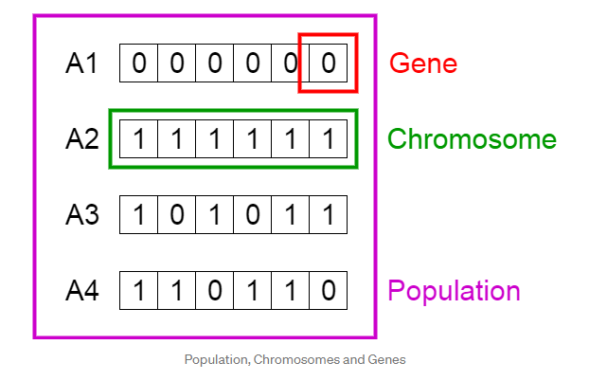
Genetic Algorithm - Overview & Encoding
What is it ? Metaheuristic
How does it work ? General Operations:
Encoding
Evaluation (usually domain specific)
Selection
Crossover
Mutation
Repeat 2-5
Notes:
There are different models, but here we stick with the general master/slave approach where you have one massive population.
Others like island models, cellular models all have their pro’s and cons
Very simplistic encoding
Genotype - Solutions in Computation Space
Phenotype - Solutions in the Real World
Random Initialization
Heuristic Initialization

Slide 4
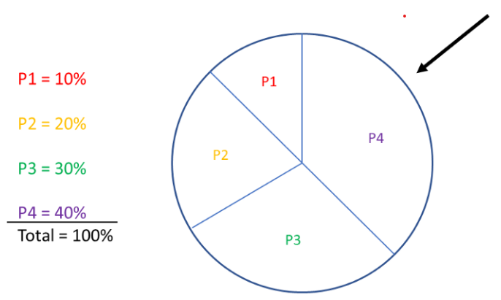
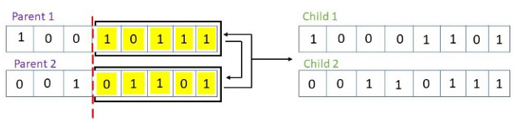
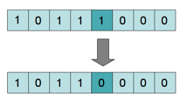
Genetic Algorithm - Selection, Crossover, Mutation
Roulette Selection
Single Point Crossover
Gene Mutation
Notes:
Different Types of Mutations, Different Types of Selection, Different Types of Crossover
Whichever type(s) you combine and pick, remember that the GPU version may need quite significant changes

Slide 5
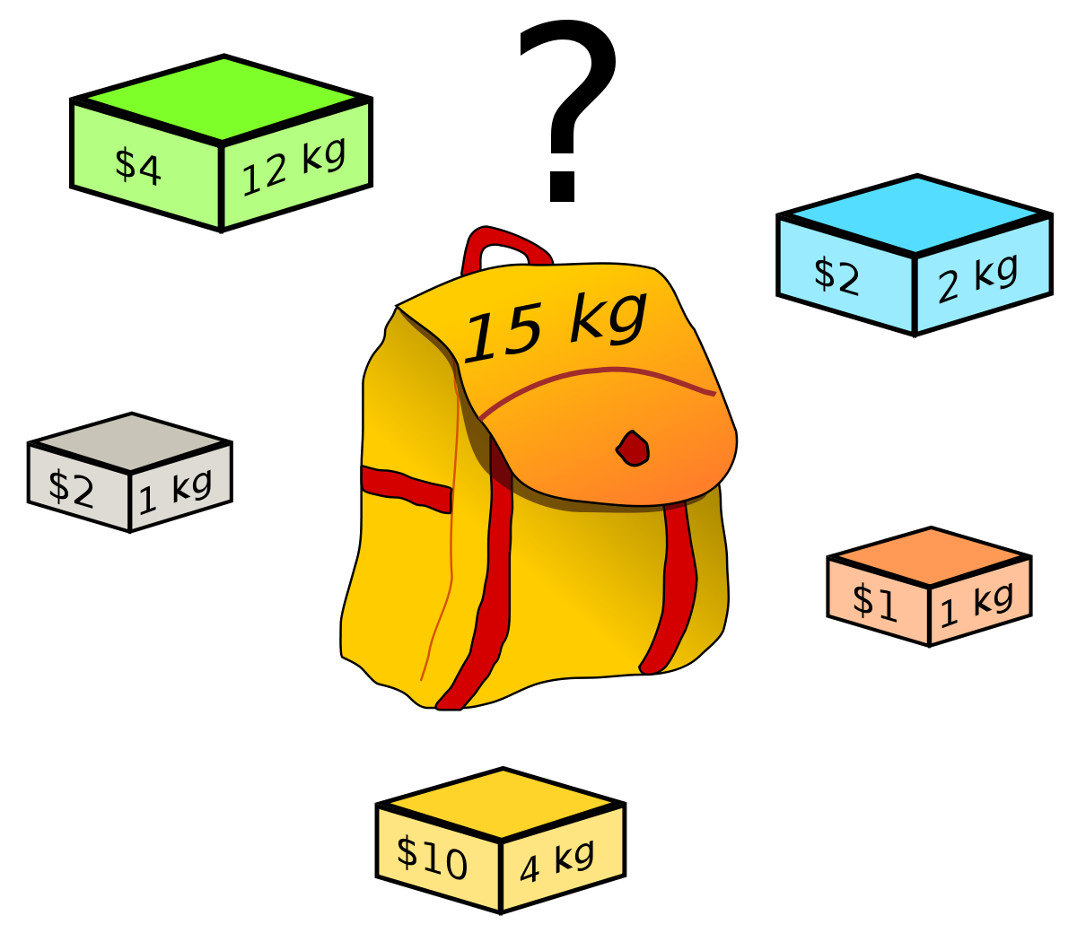
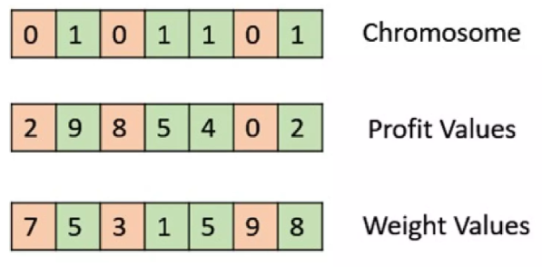
01 - Binary Knapsack Problem
What is the maximum profit/score we can get given N items, each with associated Profit and Weight values under a total weight constraint (knapsack total weight)

Slide 6
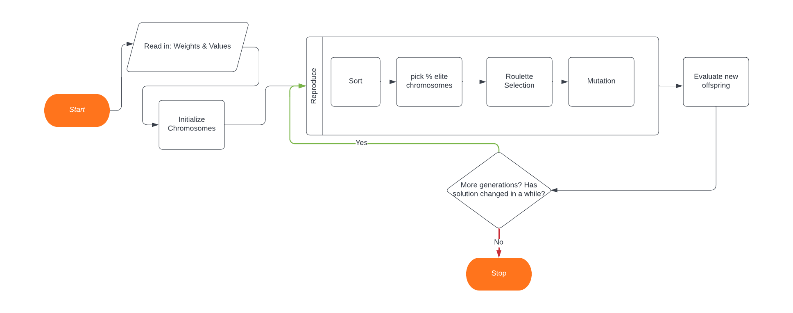
CPU Solution
mt19937 & rand()
Infeasible solutions given score of 1
Single point crossover
1/1000 Mutation chance

Slide 7
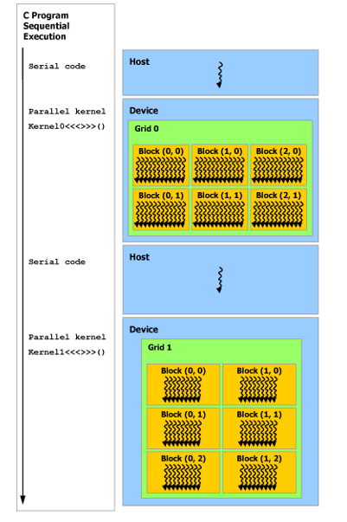
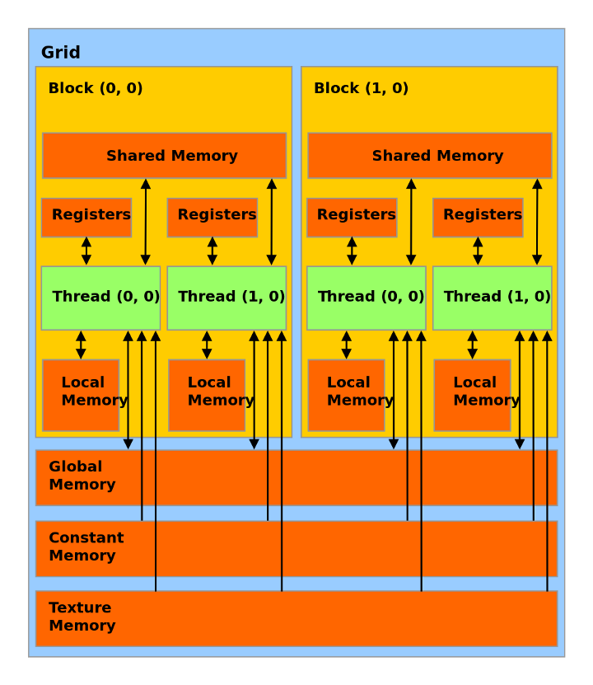
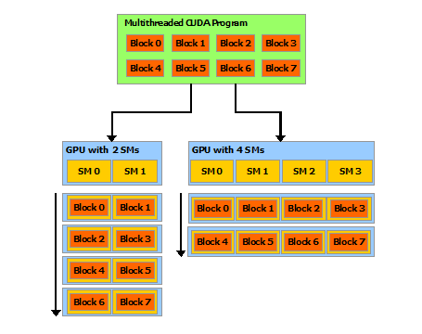
GPU Programming
Blocks scheduled on Streaming Multiprocessors (SMs)
Memory at various levels
Host/Device Execution

Slide 8
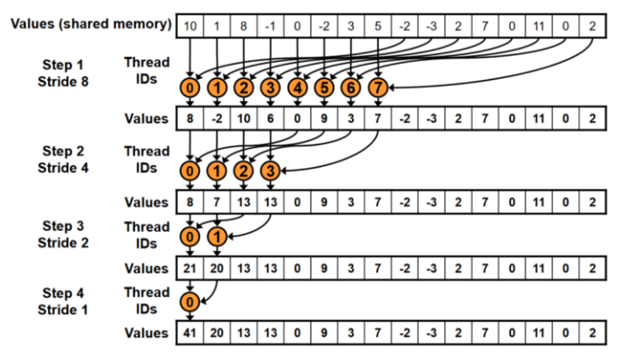
GPU Solution - First Pass
Sequential Addressing Reduction
rand() is gone! Need to use cuRAND the CUDA way.
Memory needs to be allocated and managed on both host and device
Evaluation and Reproduction require calculating totals and dot products (Reductions). Easy on CPU, Harder on GPU.
Every remaining function moved to __device__
CUDA C/C++ programming
Notes:
nitKernel() <- sets cuRAND states for each chromosome
cudaMallocManaged() <- compromise that isn’t that much slower than cudaMalloc and cudaMemcpy
reduce() kernel example copied over from
Using Libraries have their own host of problems

Slide 9
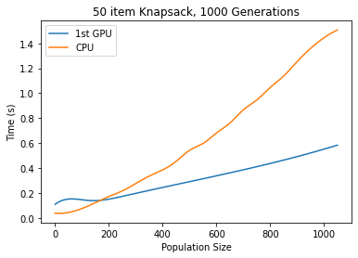
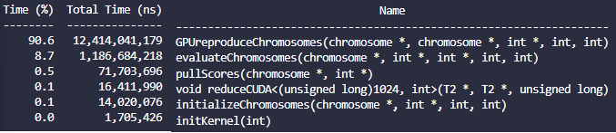
GPU Solution - First Pass - Results
1st Goal Achieved - CUDA GPU Version runs faster!
CUDA NSYS Profiling

Slide 10
GPU Solution - Optimize Everything!
CUDA Design Philosophy -> APOD Design model - (A)sses (P)arallelize (O)ptimize (D)eploy
Custom Reduce kernel that works with the chromosome struct
No more memory transfer penalty -> 15% speedup overall
Pull mutation out of Reproduce and into its own kernel with threads for each gene
Threads can all do one job, no looping. -> 50% reduction of Reproduce Kernel. Negligible runtime for mutation
Pull Offspring -> New Generation Chromosomes into its own kernel
Threads can all do one job, no looping. -> 50% reduction of Reproduce Kernel. Negligible runtime for copy
Notes:
Main Idea : Separate kernels for gene level and chromosome level
One Problem (although little time) : Kernel calls can still prove to be expensive…

Slide 11
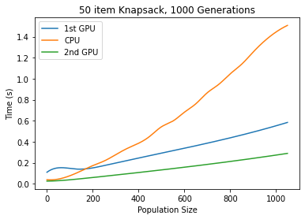
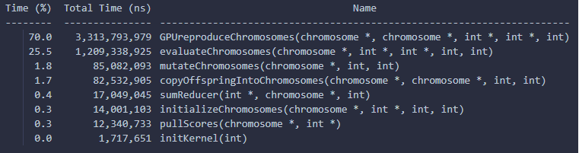
GPU Solution - Second Pass
CUDA NSYS Profiling
Notes:
Evaluate has to do a mix of chromosome and gene level stuff. Reproduce only really has crossover now
Can we make parts of evaluate and Reproduce work at the gene level? Maybe but the probem is that if our items are not multiples of 32, we could easily end up with chromosomes that are split between two blocks, making reduction much more complicated. One solution is to pad any value/weight up to multiples of 2 so that we are guaranteed a real number of chromosomes per block.
If we use atomic adds, this would probably be fine.

Slide 12
Differences with Other Work
Others : Lowering Kernel Launch by putting almost everything in a single kernel
Others : Encoding into 32-bit integer to save space and possibly speed up calculations
Problem : These do not generalize all that well given various knapsack item lists
Difference: No-one really penalized incorrect answers like we did
Others : No leveraging CUDA libraries (other than cuRAND)
Others: Some further optimizations at the warp level for reduction
Others: Focus on island model (to cap themselves to block level islands)
Difference: Focus on generalization, led to master-slave model

Slide 13
Takeaways
GPU Parallelizations turn out to be quite bespoke, and even changing a seemingly small part of your algorithm may require a complete overhaul of how you allocated memory, or even how the kernels work.
This was done on NVIDIA CUDA GPUs maximizing their hardware stack. A more general language would lose out on all the particular speed-up tricks (warps, etc…). Portability between GPUs suffer as well due to different architectures.
For GAs specifically, trade-offs existed in previous papers to ensure faster speed at the cost of simplifying GA operations and possible search power.
Notes:
Better Performance at Lower Occupancy (nvidia.com) <- More threads is not better. Max Occupancy is not the ideal
Also an idea of parallel work per thread is not explored at all (but improves throughput)

