Slide 1
Antithrombotic Pharmacology:
Anticoagulants, Thrombolytics
& Antiplatelets
Bethany Pennington, PharmD, BCPS
Associate Professor of Anesthesiology
penningtonb@wustl.edu
PollEv: fmolly

Slide 2
Pharmacology Drug Tables
What
  Table of important drug categories/classes and
  relevant details
    Organized by therapeutic category and selected
    generic drug names
    Standardized columns
    for details
      Focus on class, mechanism
      of action, common
      adverse effects
Why
  Create framework for Pharmacology integration
  Understand relationships
  Consolidate
Who/How/When
  Each module will have an associated drug table
  Students fill in details throughout the Modules (not intended to be filled fully by the end of one module)
  Tables will often be revisited in upcoming modules
  Thread lead releases the tables on Pharmacology thread page

Slide 3
Pharmacology Drug Table Contents
Therapeutic Category
Class
Generic drug name examples
Mechanism of Action
Common Adverse Effects
Notable Drug Interactions, Contraindications
Clinical Pearls/Notes

Slide 4
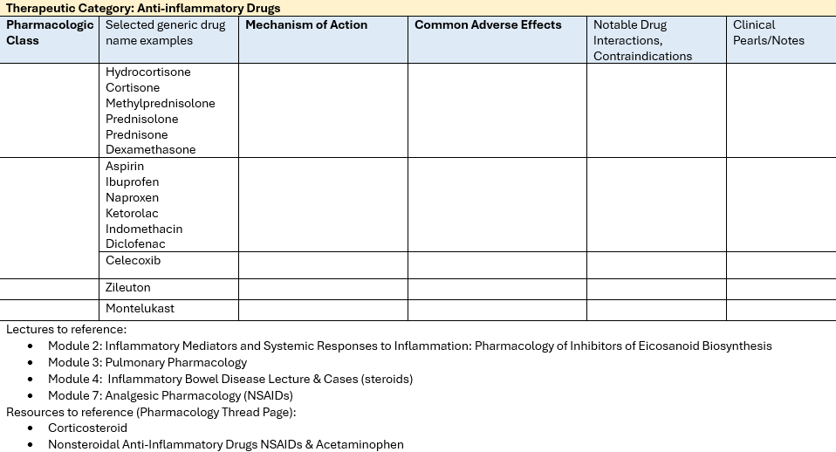
Medications Introduced in Module 2

Slide 5

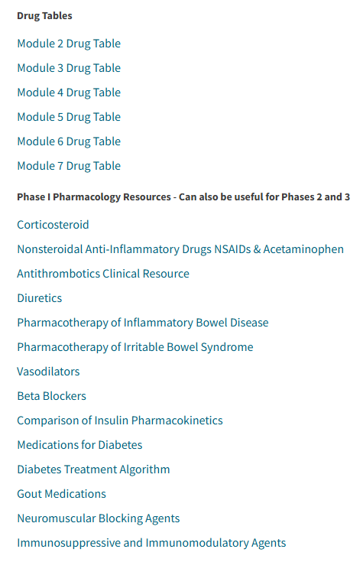
Pharmacology Thread Page
https://keystone.wustl.edu/community/phase1threads_288:thread_pages/pharmacology

Slide 6
Objectives
Describe the mechanisms of action
of common antithrombotic medications
Compare and contrast pharmacokinetic
and pharmacodynamic differences among
common antithrombotic medications
Identify common adverse effects
of antithrombotic medications

Slide 7
Importance
Antithrombotic medications are crucial components in the management of thrombosis and thromboembolic disorders.
High number of adverse events pertaining to antithrombotics →
Joint Commission’s National Patient Safety Goals→
Improve anticoagulation management
  Protocols, monitoring, reversal, perioperative management, written policies
Notes:
JC is the nations oldest and largest independent, not-for-profit organization that accredits and certifies health care organizations and programs in the US.

Slide 8
*More in Module 3*
Anticoagulants

Slide 9
Anticoagulant History
High-affinity binding
site discovered.
Fondaparinux in
development
Fondaparinux,
IV Direct Thrombin Inhibitors
Heparin
discovery
Dicumarol
discovery
Warfarin
approved
Oral Xa Inhibitors
1920
1930
1940
1950
1960
1970
1980
1990
2000
2010
2020
Cofactor
required Heparin approved
Vitamin K
mechanism
explained
Low molecular
weight heparins
(LMWH)
Oral Direct
Thrombin
Inhibitor
https://www.hematology.org/about/history/50-years/milestones-anticoagulant-drugs
Notes:
1916 Heparin discovered in dog liver by a team from The Johns Hopkins University in Baltimore, MD.
1932 U.S. clinical scientist shows that heparin requires a plasma factor (AT) for its anticoagulant action.
1920s Cattle in the northern U.S. and Canada are dying from a bleeding disease caused by a substance in moldy sweet clover.
1939 Researchers at the University of Wisconsin identify the substance in moldy clover as dicumarol. Over the next several years, warfarin, a related compound, is made in this laboratory.
1941 Dicumarol is first given to patients at the Mayo Clinic.
1950s Clinical studies with warfarin begin in the U.S., and the drug is approved for clinical use in 1954.
1970s The mechanism of action of vitamin K is explained by scientists who discover that warfarin's anticoagulant effect is caused by interference with the action of vitamin K.

Slide 10
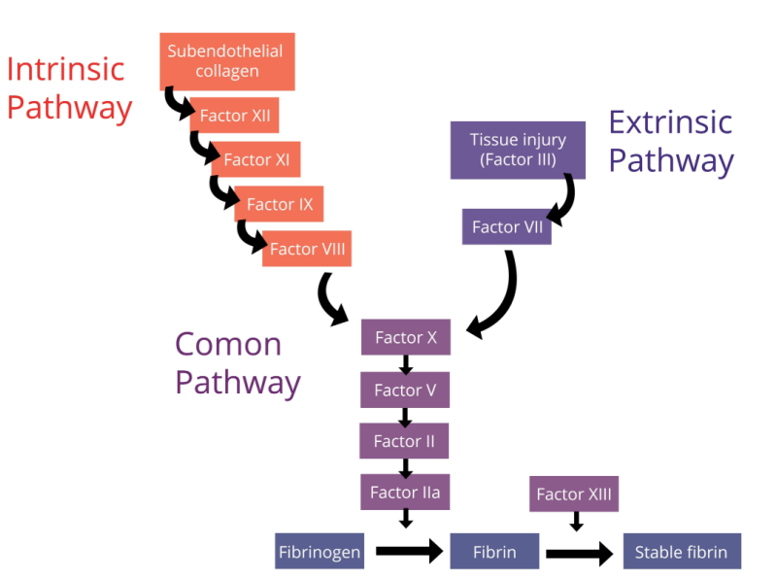
Anticoagulant Mechanisms: AT activators
Antithrombin (AT)
Inhibits IIa, Xa, IXa, XIa, XIIa, weak VIIa

Slide 11
Anticoagulant Mechanisms: AT activators
AT
Fondaparinux
Inhibits factors Xa indirectly
AT
Unfractionated
heparin (UFH)
Inhibits thrombin
(IIa), factors Xa, IXa, XIa, and XIIa indirectly
AT
Low molecular weight
heparin (LMWH)
Inhibits factor Xa indirectly & preferentially

Slide 12
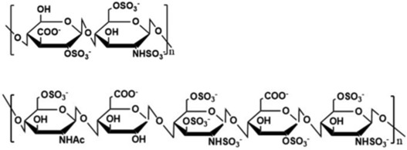
Heparin Structure
Disaccharide trisulfate and pentose sequence of heparin
Repeated disaccharide trisulfate has low affinity to AT but binds other heparin cofactors and heparin inhibitors such as platelet factor 4 (PF4)
Specific pentasaccharide sequence binds AT
Source: Qiu M, et al. Biomed Pharmacother. 2021 Jul;139:111561. doi: 10.1016/j.biopha.2021.111561.

Slide 13
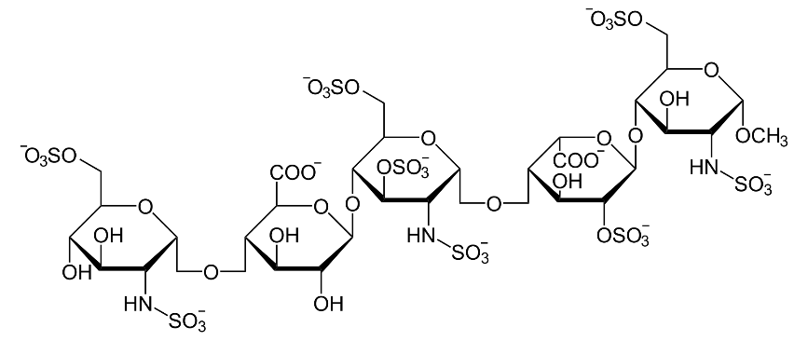
Antithrombin (AT) activators
Unfractionated Heparin (UFH)
  ~1/3 of the chains of UFH contain the pentasaccharide sequence
  average molecular weight of 15–19 kDa
Low molecular weight heparin (LMWH)
  chemical or enzymatic depolymerization of UFH to yield fragments
  ~ 1/3 the size of UFH
  average molecular weight
  of 4.5 kDa
Fondaparinux
  Synthetic derivative of LMWH
  Consists only of a pentasaccharide

Slide 14
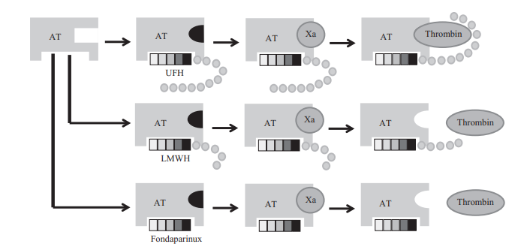
Pentasaccharide Binding to AT
Ternary complex can
be formed only by pentasaccharide-containing heparin chains composed of at least 18 saccharide units
Binding causes a conformational change in AT that makes the reactive site of this molecule more accessible to the serine protease
Molecules of LMWH are too small to form a ternary complex with thrombin & AT
Only UFH (not LMWH) has a pentasaccharide chain long enough
(>18 saccharide units) to bind to both antithrombin and thrombin.
As a result, UFH has equal activity against Factor Xa and thrombin
Source: Dager, W, et al. 2018. “Anticoagulation Therapy: A Clinical Practice Guide, Second Edition”

Slide 15
Heparins
UFH
LMWH
Prepared from bovine lung
and porcine intestinal mucosa
Half life: short (e.g. 1-2 hours)
Monitor: aPTT (Heparin primarily inhibits the intrinsic and final
common clotting pathway; therefore, PTT is prolonged) or antifactor-Xa
Binds to many cells
in the body that complicates pharmacokinetics (PK)
Prepared from standard heparin
by gel-filtration chromatography
Half life: Intermediate (e.g 4-7 hours)
Monitor: antifactor-Xa
Clearance highly dependent
on renal function
Superior PK properties compared to UFH
  Reduced binding to plasma
  proteins and cells

Slide 16
Heparins
Heparins are ideal anticoagulants for most patients
with thromboembolic disease in pregnancy; do not cross
the placenta and therefore the risk of fetal bleeding
or teratogenicity is low. Low molecular weight heparin
(e.g., enoxaparin) is the preferred therapy.
Heparins are highly negatively charged and cannot cross the epithelial cell layer of the GI tract. Hence, they administered parenterally, via intravenous or subcutaneous routes.

Slide 17
Heparin Adverse Effects
Immune-mediated platelet activation:
heparin induced thrombocytopenia
Effects on bone metabolism (decreased
bone formation, drug induced osteoporosis)
Hyperkalemia (decreased aldosterone synthesis)
Skin reactions
Hypersensitivity

Slide 18
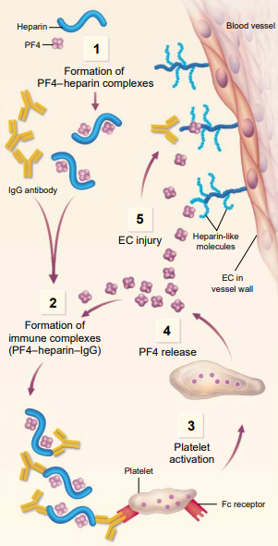
Heparin-induced thrombocytopenia (HIT)
Antibody development to heparin-PF4 complex
Platelets will ↓<150,000 or 50% from
baseline within 5-14 days​
Thrombocytopenia, Timing, Thrombosis, oTher
38-76% of patients develop thrombosis if untreated​
22-28% mortality rate in patients with HIT + thrombosis not treated with ​alternative anticoagulation​
Source: N Engl J Med 1995; 332:1374-1376; Arch Intern Med 2004;164:361-9.

Slide 19

Question 1
JT was recently started on a continuous heparin infusion in the hospital to help treat a new deep vein thrombosis. In reviewing two consecutive aPTT assay results (one at 12 hours post infusion and one at 24 hours post infusion), it does not appear that heparin is effectively thinning the patient’s blood despite a
higher than normal dose.
What could be contributing to this finding?

Slide 20
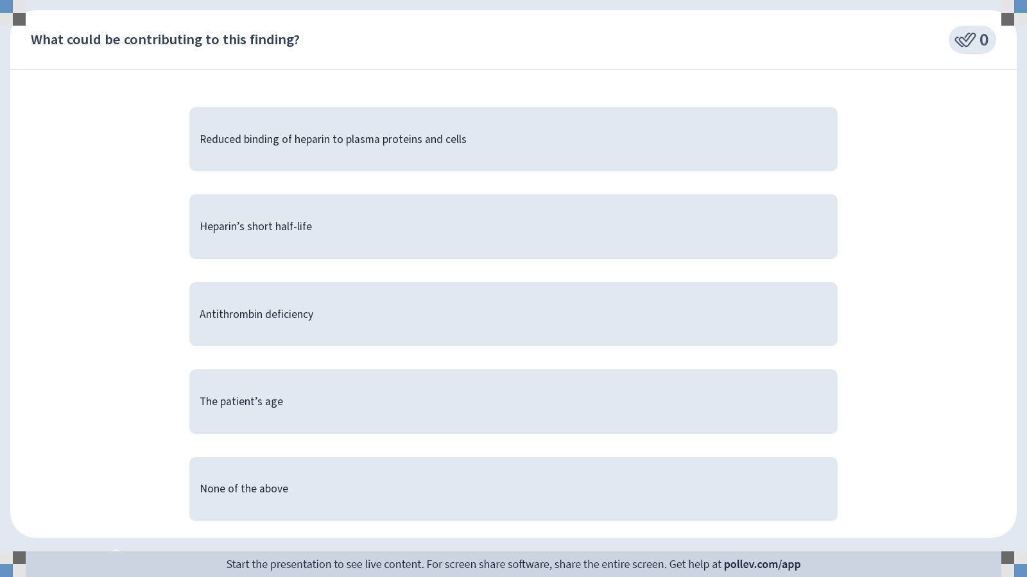
Notes:
Poll Title: Do not modify the notes in this section to avoid tampering with the Poll Everywhere activity.
More info at polleverywhere.com/support
What could be contributing to this finding?
https://www.polleverywhere.com/multiple_choice_polls/wlFXNp5u4dHMyJgtpxJp4?display_state=instructions&activity_state=opened&state=opened&flow=Instructor&onscreen=persist

Slide 21
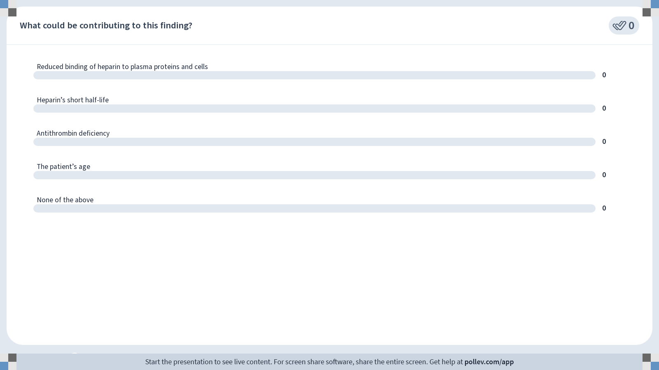
Notes:
Poll Title: Do not modify the notes in this section to avoid tampering with the Poll Everywhere activity.
More info at polleverywhere.com/support
What could be contributing to this finding?
https://www.polleverywhere.com/multiple_choice_polls/wlFXNp5u4dHMyJgtpxJp4?display_state=chart&activity_state=closed&state=closed&flow=Instructor&onscreen=persist

Slide 22
Notes:
Poll Title: Do not modify the notes in this section to avoid tampering with the Poll Everywhere activity.
More info at polleverywhere.com/support
What could be contributing to this finding?
https://www.polleverywhere.com/multiple_choice_polls/wlFXNp5u4dHMyJgtpxJp4?display_state=chart&activity_state=closed&display=correctness&state=closed&flow=Instructor&onscreen=persist

Slide 23
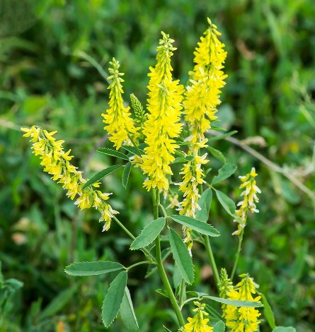
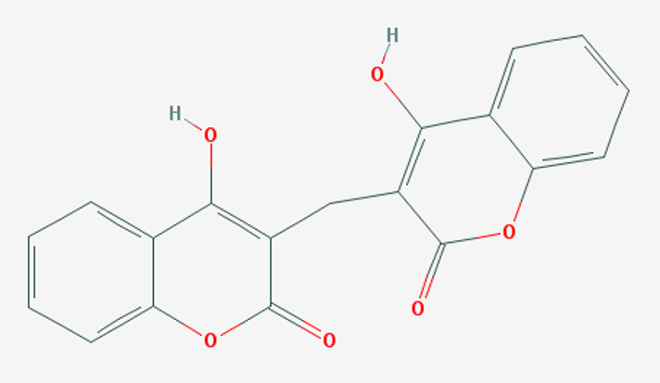
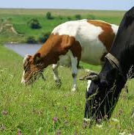
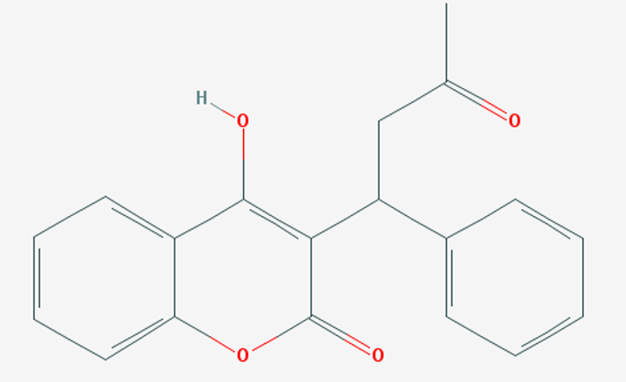
Warfarin
Derived from coumarin, a sweet-
smelling anticoagulant chemical found naturally in sweet clover and many
other plants.
1920s → fatal hemorrhagic
disease was reported in cattle eating
spoiled sweet clover
Contained the natural anticoagulant 3,3′-methylene-bis-(4-hydroxycoumarin) or dicumarol.
Dicumarol and warfarin
(a potent synthetic congener) were introduced during the 1940s as rodenticides
and as oral anticoagulants.
Dicumarol
Warfarin

Slide 24
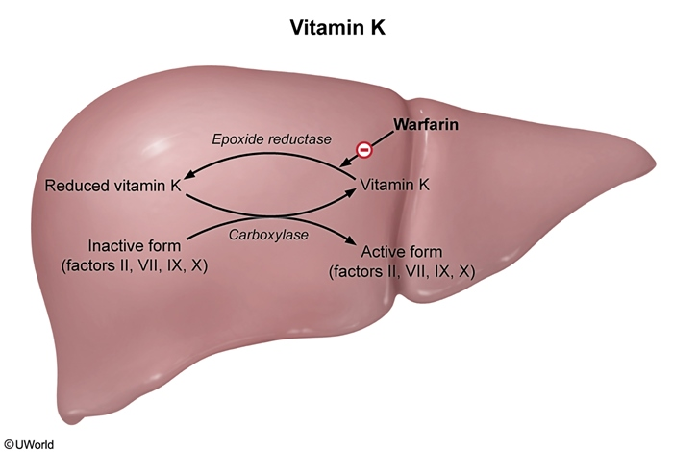
Warfarin
As you know, vitamin K is a necessary cofactor in the post-translational carboxylation of glutamate residues
on factors II, VII, IX, X, proteins C & S.
During the carboxylation reaction,
vitamin K epoxide reductase (VKORC1) converts inactive vitamin K 2,3-epoxide into the active, reduced form of vitamin K.
Warfarin competitively
inhibits VKORC1
  No effect on existing clotting factors
  Only blocks the generation
  of new clotting factors
Vitamin K

Slide 25
Warfarin
99% bound to plasma protein (albumin)
Long elimination half-life (e.g 36 hours)
Hydroxylated by the CYP-450 system, renal elimination
Monitoring: PT/INR
  The decrease in II, VII, IX, X (particularly VII) prolongs the prothrombin time (PT). The International Normalized Ratio (INR) is a ratio of the patient’s PT to a control sample.
  Although INR tends to slowly increase in the first few days due to the short
  half-life of factor VII (4-6 hours), full therapeutic effect does not typically
  occur for 3 days due to the long half-life of factor II.
Need to start an agent that works quickly (e.g., UFH or LMWH)
until full effect
Source: Jones DR, et al. Drug Metab Rev. 2010 Feb;42(1):55-61. doi: 10.3109/03602530903209395.
Notes:
Prothrombin time (PT) actually measures how quickly your blood clots. The PT results can be expressed as an INR to standardize the results.
Measurement of the PT has been standardized worldwide and is expressed as the international normalized ratio (INR) of the prothrombin time in the patient sample to that in a control sample, normalized for the international sensitivity index (ISI) of the laboratory’s thromboplastin preparation compared to the World Health Organization’s reference thromboplastin preparation.
INR tests are used instead of the PT because the INR is corrected for the strength of your blood clotting tissue. INR is also used to standardize the method used across all labs to lead to the most accurate results.
The formula used to calculate the INR is as follows: INR = [PT_{patient} / PT_{control}]^{ISI}.

Slide 26
Warfarin Pitfalls
Patient variability in dosing requirements
Genetic variation in the VKORC1 gene
  Associated with ~ 25–30% of the variance in warfarin maintenance dose
Frequent INR monitoring
Food interactions
  E.g., green leafy veggies (vitamin K): increase in dietary vitamin K increases
  the availability of vitamin K in the liver, which counters the inhibitory effect of warfarin on epoxide reductase.
Drug interactions, over-the-counter medications, alcohol
Contraindicated in pregnancy→ crosses placenta; hemorrhagic disorder in the fetus
Adverse effects: microvascular thrombosis and skin necrosis

Slide 27
Selected Drug Interactions
Drugs/supplements that affect warfarin metabolism (selected)
CYP450 Inhibitors ↑ Warfarin effect (↑ bleeding risk) | Antibiotics (e.g., metronidazole, macrolides) Azole antifungals Amiodarone Cimetidine Grapefruit juice
CYP450 Inducers ↓ Warfarin effect (↓ in efficacy) | Carbamazepine Phenytoin Phenobarbital Rifampin St. John’s wort
Antibiotics ↑ Warfarin effect (↑ bleeding risk) | Antibiotics that target gram-negative microorganisms (eg, metronidazole, macrolides, fluroquinolones) disrupt vitamin K–producing intestinal flora
You do not need to memorize specific drug names for Module 2.

Slide 28
Anticoagulant Mechanisms:
Direct Thrombin Inhibitors
Dabigatran, Argatroban, Bivalirudin
Inhibit IIa directly

Slide 29
Direct Thrombin Inhibitors
Dabigatran
  Oral administration
  Renally excreted
  Long half-life
  (e.g., 12-17 hours)
  Prodrug that is metabolized to an
  active species
Bivalirudin
  Intravenous administration
  Renally excreted
  Short half-life
  (e.g., 25 minutes)
Argatroban
  Intravenous administration
  Excreted by biliary secretion
  Short - Intermediate
  half-life
  (e.g., 45 minutes)

Slide 30
Anticoagulant Mechanisms: Direct FXa Inhibitors
Rivaroxaban, apixaban, edoxaban
Inhibit Xa directly
Reminder: *Fondaparinux also inhibits factors Xa indirectly through AT

Slide 31
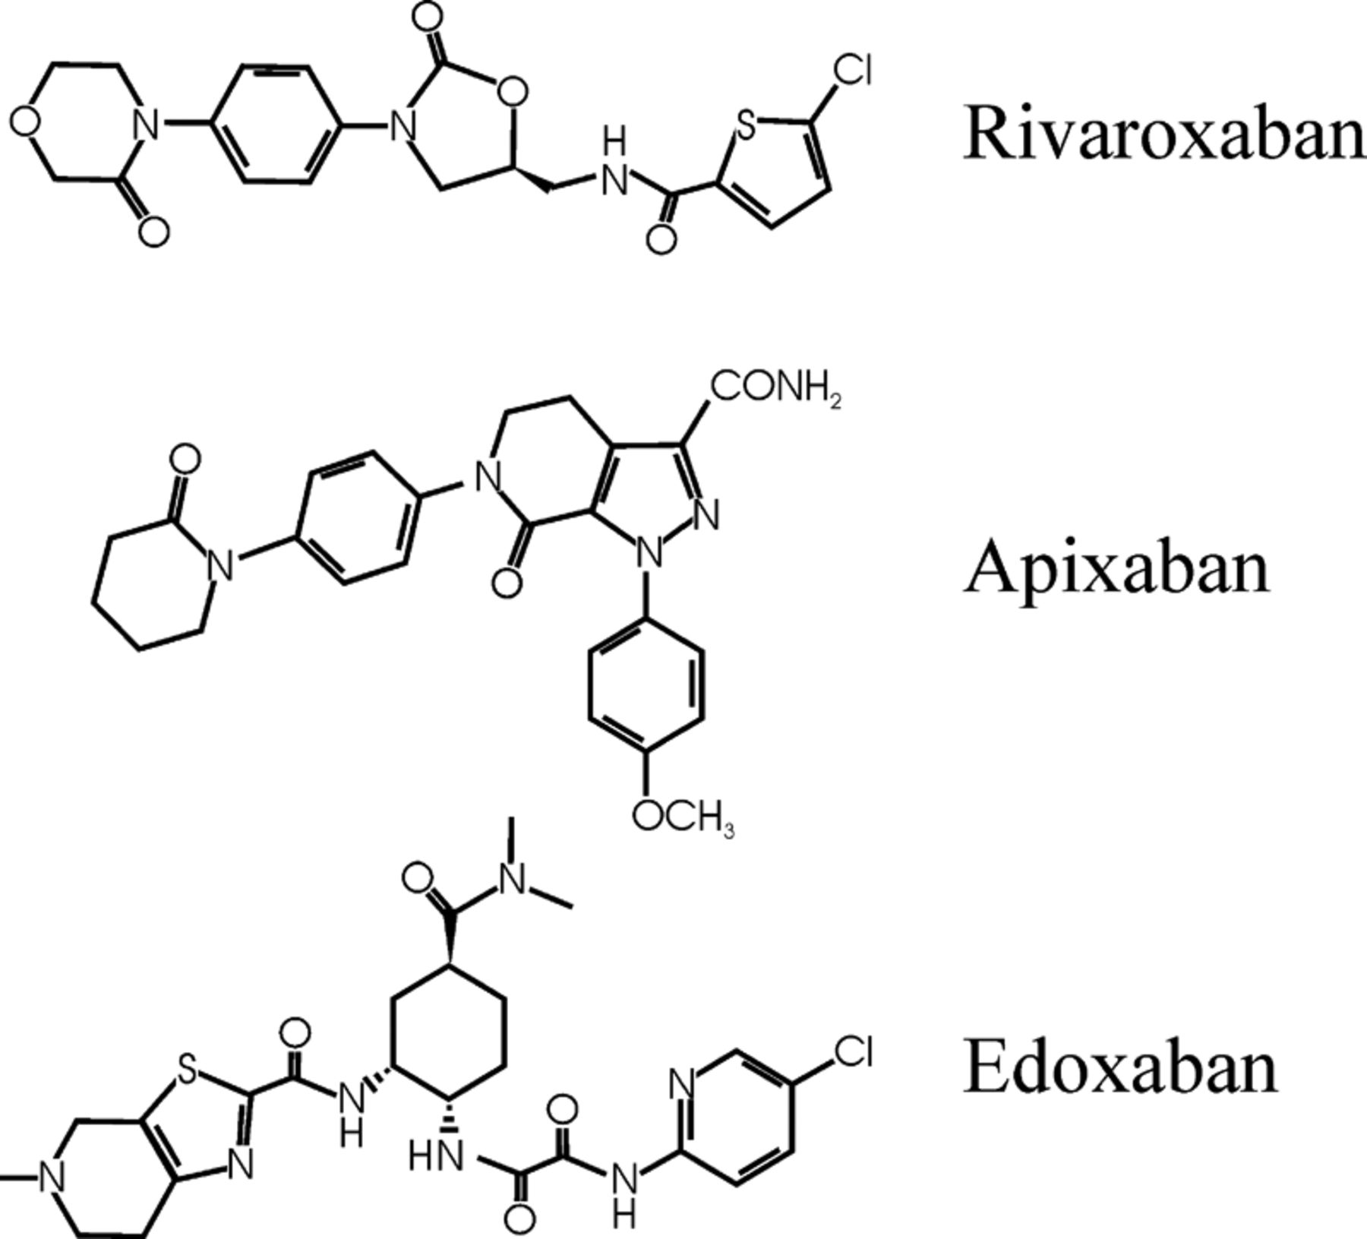
Direct Factor Xa Inhibitors
RivaroXaban, apiXaban, edoXaban
Competitively inhibit factor Xa
by binding to the active site
of the enzyme
Do not inactivate thrombin
All administered orally
Cleared by both metabolism in the liver and excretion in the kidney
*Note the general similarity

Slide 32
Direct Oral Anticoagulants (DOAC) versus Warfarin
 | DOACs | Warfarin
Dosing | >1 dose daily may be required (fixed) | Once daily (requires titration)
Dietary restrictions | None | Stable vitamin K intake required
Drug interactions | Few | Many
Required monitoring | None | INR
Comorbid conditions | Renal failure may prohibit use | Liver failure may prohibit use

Slide 33
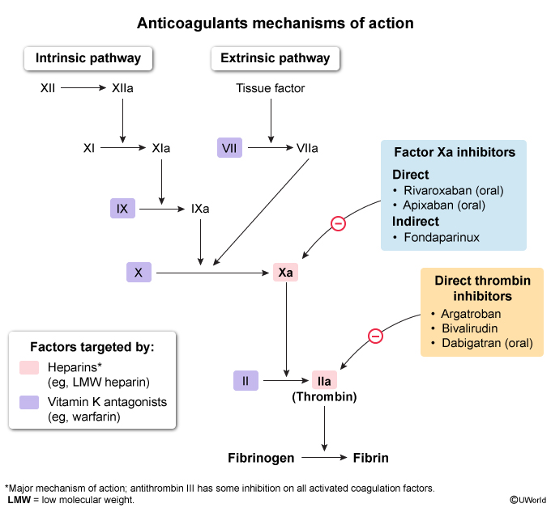
Summary of
Mechanisms

Slide 34
Question 2
A.B. is a 60-year-old male who was just diagnosed with a pulmonary embolus.
When thinking about different anticoagulant agents available, what patient factors will be important to assess before choosing a specific agent?

Slide 35
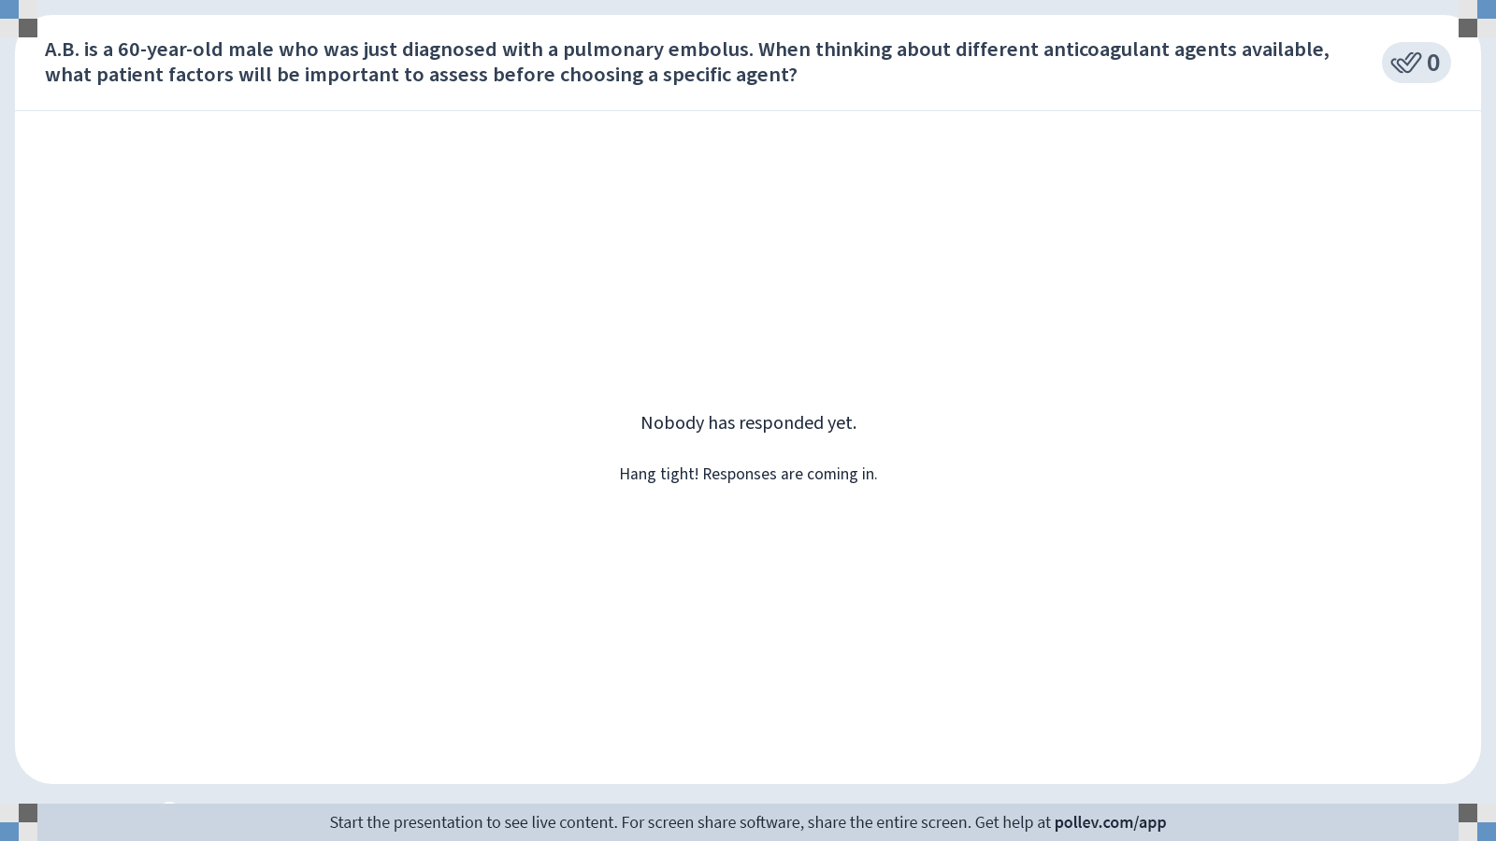
Notes:
Poll Title: Do not modify the notes in this section to avoid tampering with the Poll Everywhere activity.
More info at polleverywhere.com/support
When thinking about different anticoagulant agents available, what patient factors will be important to assess before choosing a specific agent?
https://www.polleverywhere.com/free_text_polls/liuM0lzcIfPD78wUsi4vD

Slide 36
Question 3
A 53-year-old male is admitted to the emergency department after a motor vehicle accident. He is diagnosed with a head bleed and you see in his chart that he is taking warfarin.
Thinking about warfarin’s mechanism of action, what would you consider administering to this patient to help his bleed and why?

Slide 37
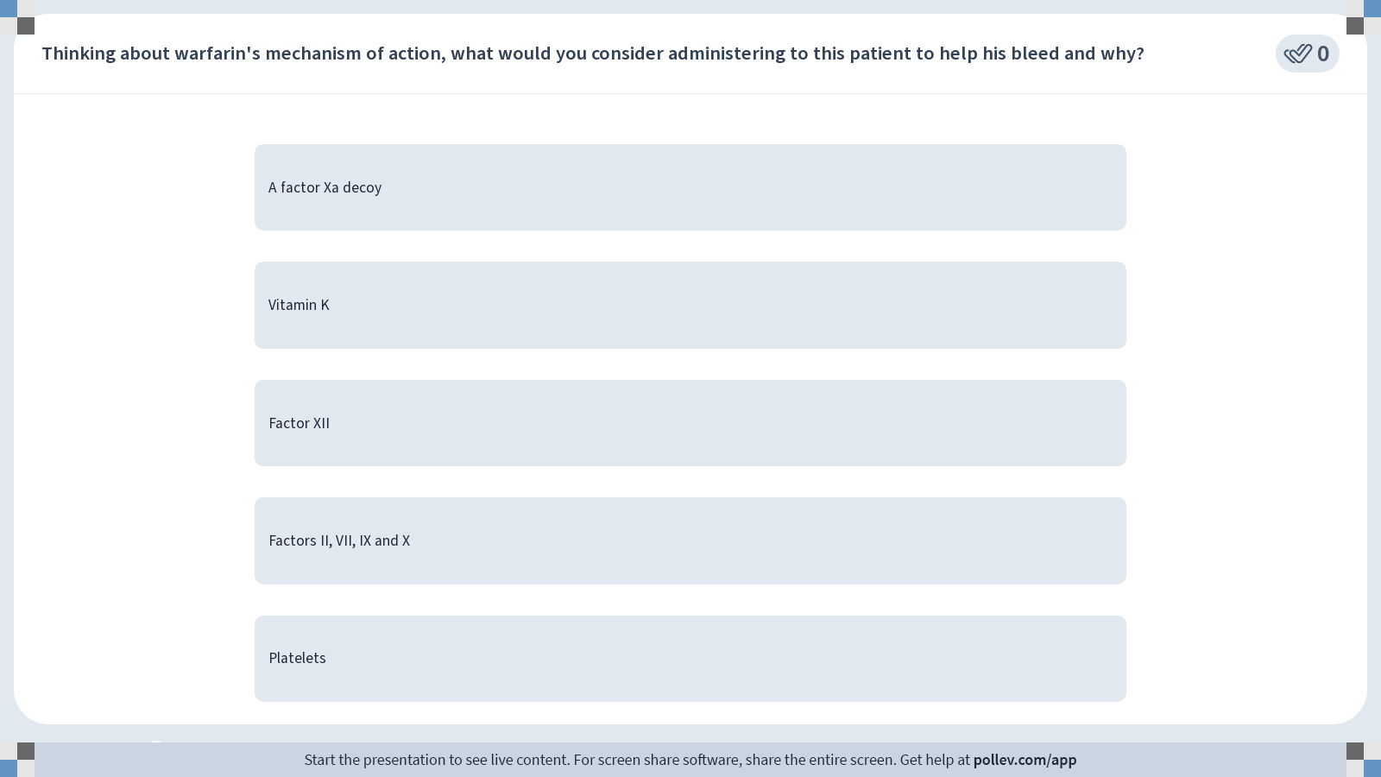
Notes:
Poll Title: Do not modify the notes in this section to avoid tampering with the Poll Everywhere activity.
More info at polleverywhere.com/support
Thinking about warfarin's mechanism of action, what would you consider administering to this patient to help his bleed and why?
https://www.polleverywhere.com/multiple_choice_polls/Vcs5Q5bG9ZHz3G433cwMq?display_state=instructions&activity_state=opened&state=opened&flow=Instructor&onscreen=persist

Slide 38
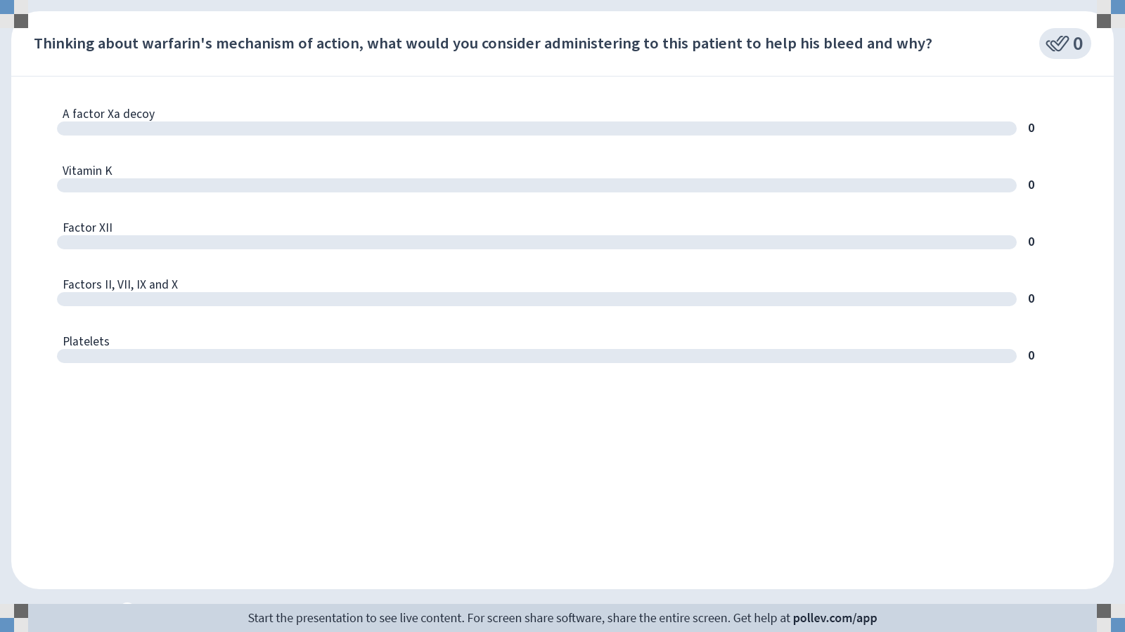
Notes:
Poll Title: Do not modify the notes in this section to avoid tampering with the Poll Everywhere activity.
More info at polleverywhere.com/support
Thinking about warfarin's mechanism of action, what would you consider administering to this patient to help his bleed and why?
https://www.polleverywhere.com/multiple_choice_polls/Vcs5Q5bG9ZHz3G433cwMq?display_state=chart&activity_state=closed&state=closed&flow=Instructor&onscreen=persist

Slide 39
Notes:
Poll Title: Do not modify the notes in this section to avoid tampering with the Poll Everywhere activity.
More info at polleverywhere.com/support
Thinking about warfarin's mechanism of action, what would you consider administering to this patient to help his bleed and why?
https://www.polleverywhere.com/multiple_choice_polls/Vcs5Q5bG9ZHz3G433cwMq?display_state=chart&activity_state=closed&display=correctness&state=closed&flow=Instructor&onscreen=persist

Slide 40
Reversal Agents
Protamine →
A low-molecular-weight polycationic
protein that is a chemical antagonist
of heparin; binds to heparin, causing chemical inactivation.
Phytonadione (vitamin K) →
Converts the inactive forms of coagulation factors
II, VII, IX, and X into their active forms; reverse
warfarin effects; vitamin K requires time for
clotting factor re-synthesis.
Prothrombin complex concentrates →
Human plasma-derived blood clotting
factors II, VII, IX and X, as well as
protein C and S; reverse warfarin
effects fast
Fresh frozen plasma →
Contains all coagulation factors except platelets, fibrinogen, albumin, protein C, protein S, antithrombin, and tissue factor pathway inhibitors; reverses warfarin
effects fast
Andexanet alfa →
A factor Xa decoy,
binds and sequester
factor Xa inhibitors
(apixaban and
rivaroxaban)
Idarucizumab →
Humanized monoclonal
antibody fragment
(Fab) that binds
to dabigatran
You do not need to memorize specific reversal agent names
or corresponding mechanisms for module 2. These are summarized in the Anticoagulation Clinical Resource on Pharm Thread Page

Slide 41
*More in Module 3*
Fibrinolytics

Slide 42
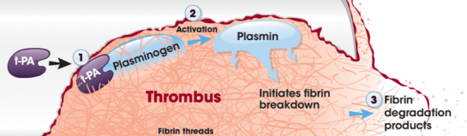
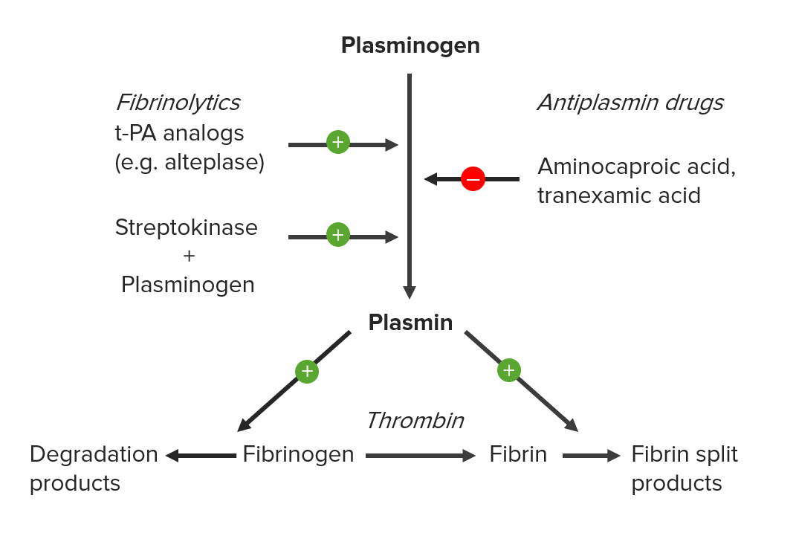
Fibrinolytics
“clot-busters”
Example of clinical use →
ischemic stroke, myocardial infarction, pulmonary embolism or deep vein thrombosis (Module 3)

Slide 43
Fibrinolytics
Recombinant biotechnology has
allowed tPA to be manufactured in labs
Synthetic products are called recombinant
Tissue Plasminogen Activators (rtPA)
Examples include alteplase, reteplase, tenecteplase
  Various modifications to amplify their PK & PD, especially prolonging their short half-life in the circulation and further increasing their fibrin specificity to prevent an unwanted fibrinolytic state.
Many factors that increase bleeding risk
must be ruled out before administration

Slide 44
Antifibrinolytics
*Because they stabilize clots, they can increase risk of thrombosis
Examples of use: Bleeding during surgery and bleeding due to trauma; postpartum hemorrhage, heavy menstrual bleeding, dental procedures in patients with bleeding disorders

Slide 45
*More in Module 3*
Antiplatelets

Slide 46
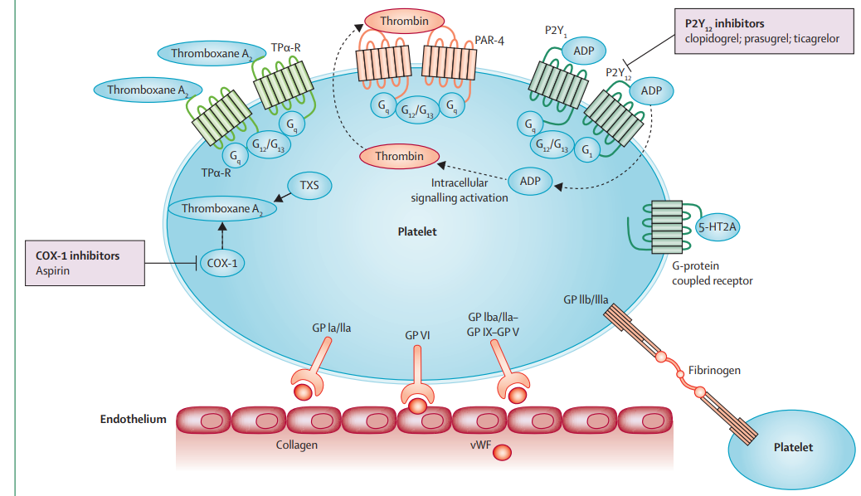
Mechanisms of Action
Glycoprotein IIb/IIIa inhibitors inhibit binding of platelet glycoprotein IIb/IIIa with fibrinogen and fibronectin. e.g abciximab, eptifibatide and tirofiban are approved for percutaneous intervention (PCI) acute coronary syndrome.
*More in M3
Source: Lancet 2015; 386: 281–91

Slide 47
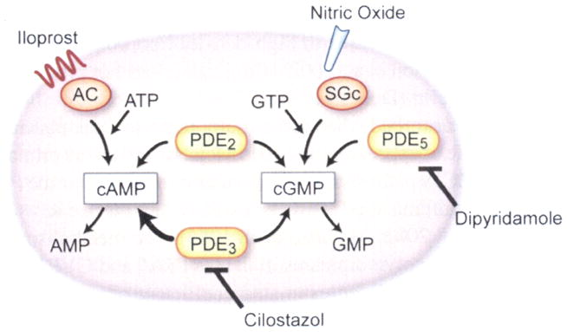
Mechanisms of Action:
Phosphodiesterase Inhibitors
*cAMP and cGMP serve as intracellular signals to suppress platelet activation and subsequent aggregation.
*dipyridamole also blocks adenosine reuptake (which
consequently increases intracellular cAMP levels)
PDE inhibitors have both antiplatelet and vasodilator properties.
Source: Rondina MT, Weyrich AS. Handbook of Experimental Pharmacology. 2012 (210):225-238.

Slide 48
Pharmacology of Oral P2Y12 Receptor Inhibitors
 | Clopidogrel | Prasugrel | Ticagrelor
Receptor Binding* | Irreversible |  | Reversible
CYP450 metabolism* | Yes
Prodrug* | Yes |  | No
PD effect dependent on 2C19 genotype* | Yes* | No
Onset of Effect# | Long (2-6 hours) | Intermediate (30 min- 4 hours)
Duration of Effect# | Long (up to 10 days) |  | Intermediate (3-4 days)
* Revisit Foundation of Pharmacology, M1
# Do not need to memorize
specific numbers

Slide 49
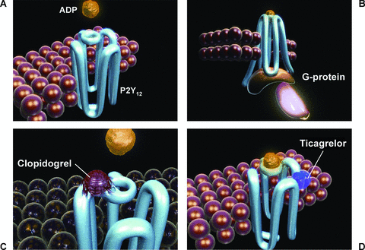
P2Y12 Receptor Inhibitors: Clopidogrel & Prasugrel
ADP binds to the P2Y₁₂ receptor, resulting in conformational change and G-protein activation
Noncompetitive, irreversible binding to the P2Y₁₂ receptor;
inhibiting ADP binding
Prodrugs: must be metabolized to active forms in the liver. Active metabolites form a covalent bond with the P2Y₁₂ receptor on platelets
Permanent inactivation of the receptor for the life of the platelet (~7–10 days)
Prasugrel
Source: Cardiovascular Therapeutics, Volume: 27, Issue: 4, Pages: 259-274, First published: 09 November 2009, DOI: (10.1111/j.1755-5922.2009.00096.x)
Notes:
Platelets are anucleate cells (they don’t have a nucleus), meaning they can't make new proteins, including surface receptors like P2Y₁₂
platelet can’t synthesize new receptors, that platelet is effectively non-functional in terms of ADP-mediated aggregation.
The body needs to generate new platelets (from megakaryocytes in the bone marrow) to replace the inactivated ones.

Slide 50
P2Y12 Receptor Inhibitor: Ticagrelor
ADP binds to the P2Y₁₂ receptor, resulting in conformational change and G-protein activation
Noncompetitive, reversible binding to an area on the P2Y₁₂ receptor that is distinct from the ADP binding site
Does not need liver activation (not a prodrug)
Negative allosteric modulator
Inhibits ADP signaling and receptor conformational
change by “locking” the receptor in an inactive state
Source: Cardiovascular Therapeutics, Volume: 27, Issue: 4, Pages: 259-274, First published: 09 November 2009, DOI: (10.1111/j.1755-5922.2009.00096.x)
Notes:
the receptor is functional after dissociation of the ticagrelor molecule.
ADP can still bind at its binding site, and the degree of receptor inhibition (and inhibition of ADP-induced signaling) is dependent on the concentration of ticagrelor.

Slide 51
Question 4
Which of the following does NOT describe
a mechanism of action of available antiplatelet agents?

Slide 52
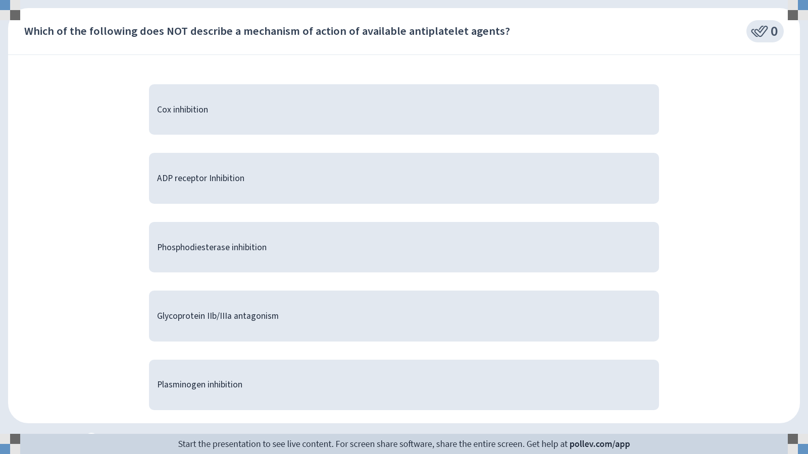
Notes:
Poll Title: Do not modify the notes in this section to avoid tampering with the Poll Everywhere activity.
More info at polleverywhere.com/support
Which of the following does NOT describe a mechanism of action of available antiplatelet agents?
https://www.polleverywhere.com/multiple_choice_polls/HGHTo4OcS1ZaRa2V7qCaN?display_state=instructions&activity_state=opened&state=opened&flow=Instructor&onscreen=persist

Slide 53
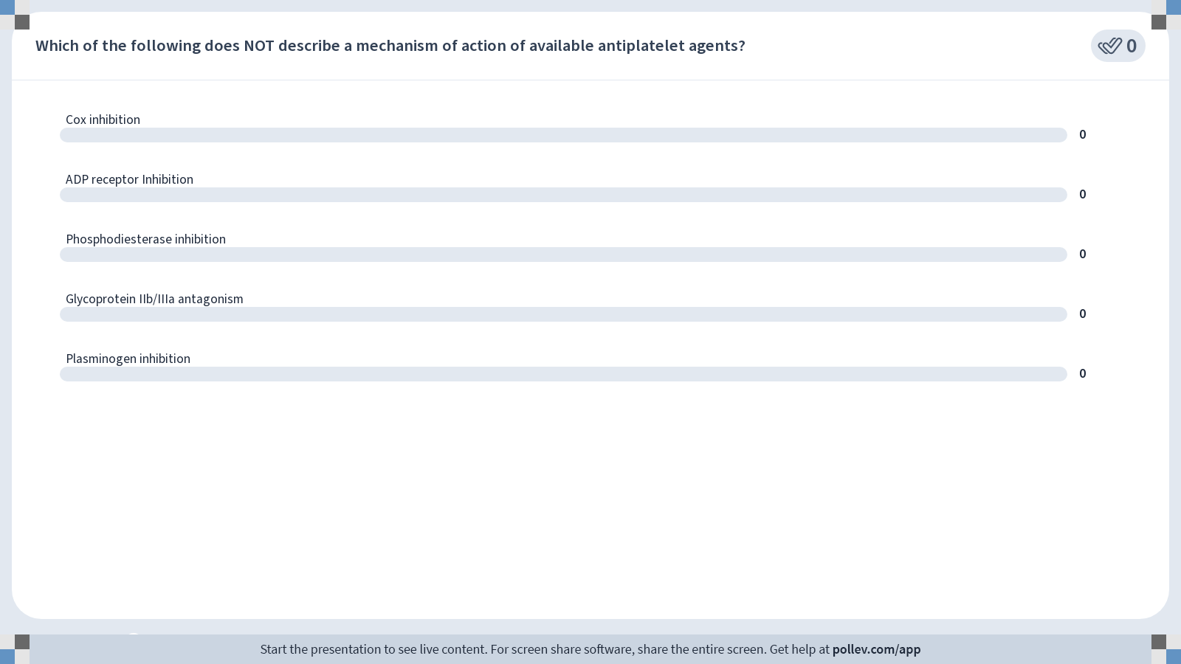
Notes:
Poll Title: Do not modify the notes in this section to avoid tampering with the Poll Everywhere activity.
More info at polleverywhere.com/support
Which of the following does NOT describe a mechanism of action of available antiplatelet agents?
https://www.polleverywhere.com/multiple_choice_polls/HGHTo4OcS1ZaRa2V7qCaN?display_state=chart&activity_state=closed&state=closed&flow=Instructor&onscreen=persist

Slide 54
Notes:
Poll Title: Do not modify the notes in this section to avoid tampering with the Poll Everywhere activity.
More info at polleverywhere.com/support
Which of the following does NOT describe a mechanism of action of available antiplatelet agents?
https://www.polleverywhere.com/multiple_choice_polls/HGHTo4OcS1ZaRa2V7qCaN?display_state=chart&activity_state=closed&display=correctness&state=closed&flow=Instructor&onscreen=persist

Slide 55
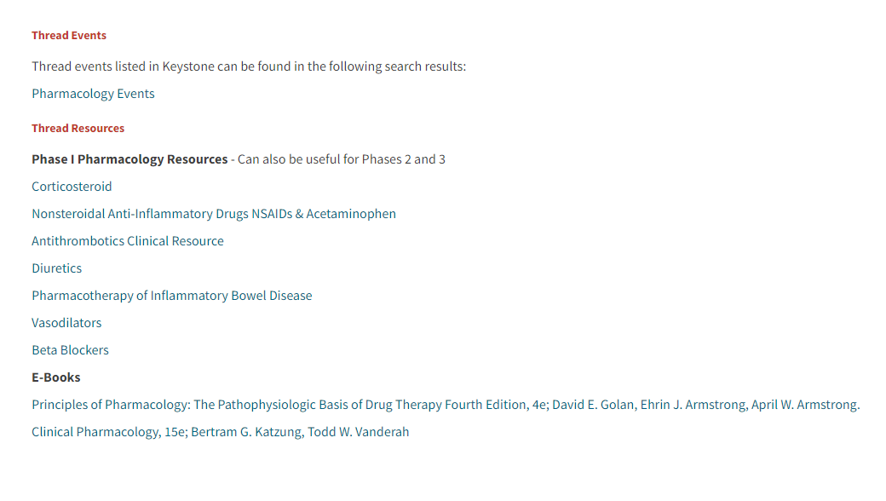
Antithrombotic Clinical Resource Page

Slide 56
Antithrombotic Pharmacology:
Anticoagulants, Thrombolytics
& Antiplatelets
Bethany Pennington, PharmD, BCPS
Associate Professor of Anesthesiology
PollEv: fmolly

