Slide 1
Computer Science
Summer Springboard

Slide 2
Day 5: Libraries

Slide 3
But first… Project 1!
It is now time for everyone to present their project 1.
Each person should take a turn presenting their project.
Show a demo of your code and your presentation.
After presenting, open the floor to questions / comments.
Good luck and have fun!

Slide 4
Try / Except Blocks

Slide 5
Wrapping Up From Last Time
Let’s wrap up our discussion of debugging and errors with Try / Except blocks.
Note that even though we are “wrapping up” this section, debugging is always a part of coding and it is something we will continue to practice.

Slide 6
Mastering Error Handling with Try / Except
There are times when certain pieces of code may be more error prone than others.
Sometimes, instead of crashing when errors occur, we want the program to do something else.
This is where try and except come in.
These are tools for gracefully handling errors, preventing crashes and managing unforeseen issues.

Slide 7
The ‘try’ Block: Testing the Waters
Wrap code that might cause an error in a try block.
Simply indent the code that you want to have inside of the try block, similar to putting code in a loop or function.
If an error occurs, the try block is exited, and Python looks for an except block to handle the error.

Slide 8
The ‘except’ Block: Catching the Errors
Use specific except blocks for different error types, like except ValueError: or except TypeError:.
This specificity helps in targeting particular kinds of errors.
You can have multiple except blocks to handle different exceptions separately, ensuring a tailored response to various error conditions.

Slide 9
Finishing Up
An optional else block can be used to execute code when the try block raises no errors.
The finally block is executed no matter what – whether an error occurs or not. It's ideal for clean-up actions, like closing files.
Also optional.

Slide 10
Best Practices in Error Handling
Avoid Generic Catches: Don’t use a bare except: as it can catch unexpected errors and hide programming mistakes.
Resource Management: Utilize finally or context managers (with statement) for reliable resource management, like file handling.
More info on with here: https://docs.python.org/3/reference/compound_stmts.html#with

Slide 11
‘try’ and ‘except’ Blocks are Like Baseball
Imagine a batter ready to hit the ball - this is like a try block in Python. The batter (your code) takes a swing (executes), not knowing if it'll be a hit or a miss (error).
If the batter hits the ball heads towards a fielder, think of the fielder as an except block. Just like the fielder is prepared to catch specific types of hits, the except block is ready to catch specific errors. For example, if it's a high fly ball (a specific error like ZeroDivisionError), the outfielder (a specific except clause) is ready to catch it.
If the batter successfully hits the ball and makes it to base without the ball being caught (i.e., no errors occur), it's like the else block in Python. This block runs when the code in the try block executes without any errors, just like the batter safely reaching base signifies a
successful hit.

Slide 12
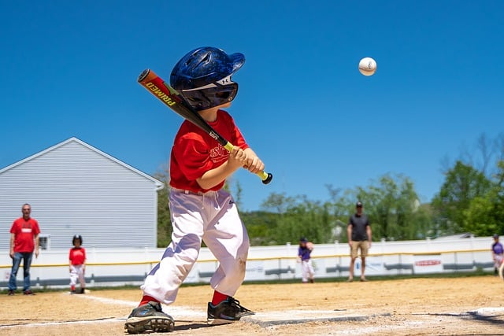
‘try’ and ‘except’ Blocks are Like Baseball (Cont’d)
Regardless of whether the batter hits the ball or not, the play eventually comes to an end. This is like the finally block in Python, which runs no matter what - whether the batter hits the ball, misses, or even if an unusual play (exception) occurs. It's the wrap-up of the play, ensuring that everything resets for the next batter, similar to how finally might be used to clean up or close resources in a program.

Slide 13
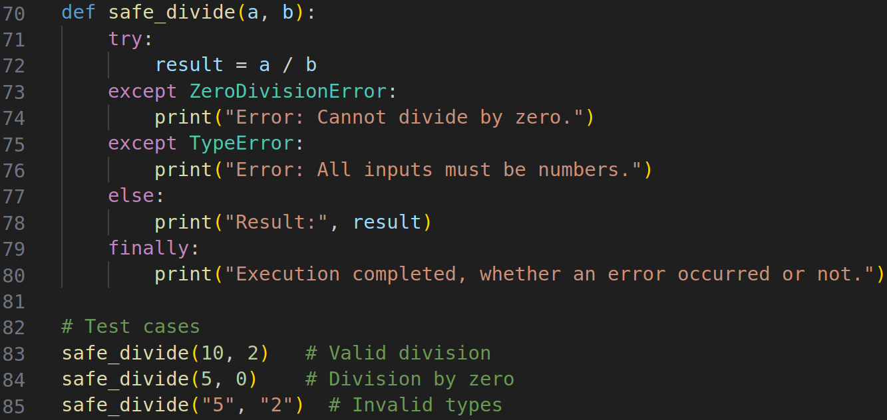
Example: Error Handling in Division
Below is a practical example of using try, except, else, and finally:

Slide 14
Example: Error Handling in Division (Cont’d)
In this example:
The try block contains the division operation, which might raise a ZeroDivisionError (if b is 0) or a TypeError (if a or b are not numbers).
The except ZeroDivisionError block catches and handles the case where division by zero is attempted.
The except TypeError block handles the case where the inputs are not numbers.
The else block executes if there are no exceptions, and it prints the result.
The finally block executes in all cases, indicating the end of the operation.
This example is included in today’s Google Colab notebook so that you can try (haha) it out on your own.

Slide 15
Enough Talk…
Let’s get into some practice problems! Navigate to today’s Google Colab notebook and work until the first “***PAUSE***”

Slide 16
Libraries

Slide 17
Introduction to Python Libraries
Just as a carpenter uses different tools for different tasks, a programmer uses various libraries for different functionalities.
Think of a Python library adding books to a physical library.
The physical library already houses a wealth of knowledge and resources, and by bringing in more books, you expand its repository of information.
Built-in Python has a lot of functionality already, but through libraries, we can do so much more
Libraries save time and energy.
If you are having difficulty working through a specific problem, chances are someone else has had that same problem before and that they have already made a library that can help in solving your problem.

Slide 18

Definition
Libraries in Python are collections of pre-written code that users can utilize to add functionality to their own programs without having to write code from scratch.

Slide 19
Types of Libraries in Python
Standard Libraries: Included with Python, like math, datetime, and os.
Third-Party Libraries: Developed by the community, such as NumPy, Pandas, and Requests.

Slide 20
Accessing Libraries
To gain access to a library, simply use the import statement to make a library’s functionality available in your code.
For example, here we import the Pandas library:

Slide 21
Importing Libraries
As we just saw, using import library_name imports the library named library_name.
What if we only want to import a specific section of a library?
To stick with our physical library example, what if we only want to add selected chapters of a book to our library?
Use the following syntax: from library_name import specific_function1, specific_function2, …
What if we want to name our library something else?
Programmers are lazy and do not always want to type out a library name, so they use a nickname / alias.
Syntax: import library_name as alias

Slide 22
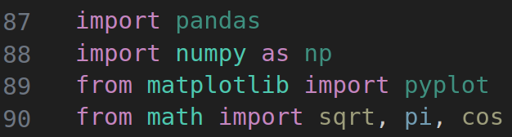
Importing Libraries Big Example
The below code snippet shows an example of everything we covered in the previous slide, using some Python libraries (don’t worry about what these specific libraries do yet).

Slide 23
Practical Library Examples
Use Pandas for data manipulation and reading / processing CSV files.
Use NumPy for scientific computing with complex mathematical operations on large datasets.
Use BeautifulSoup or Scrapy for web scraping and extracting data from web pages.
Etc etc etc the list goes on and on.

Slide 24
Exploring Library Functions
How do we know what a specific library is capable of doing?
How can we figure out what all the functions included in a library are?

Slide 25
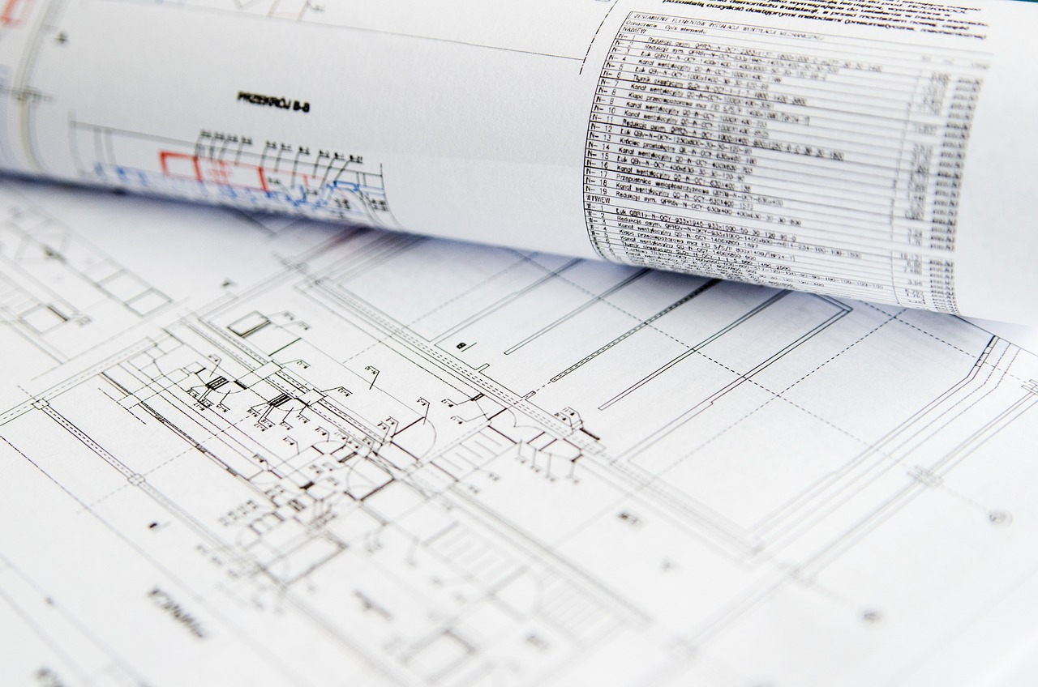
Exploring Library Functions (Cont’d)
Documentation!!!
Documentation for a piece of code is a comprehensive descriptive guide that explains functionality, usage, and other helpful information.
While documentation may seem dry and tedious to read through, it is our best friend when trying to figure out how to use a new tool.

Slide 26
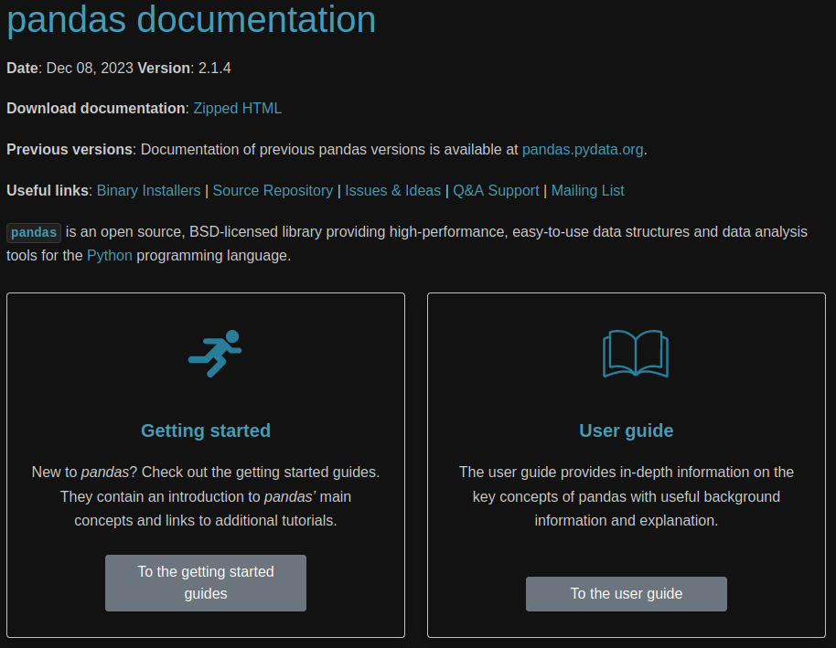
Documentation Example
Let’s take a look at an example of documentation.
This link will bring you to the documentation for the Python library Pandas: https://pandas.pydata.org/pandas-docs/stable/

Slide 27
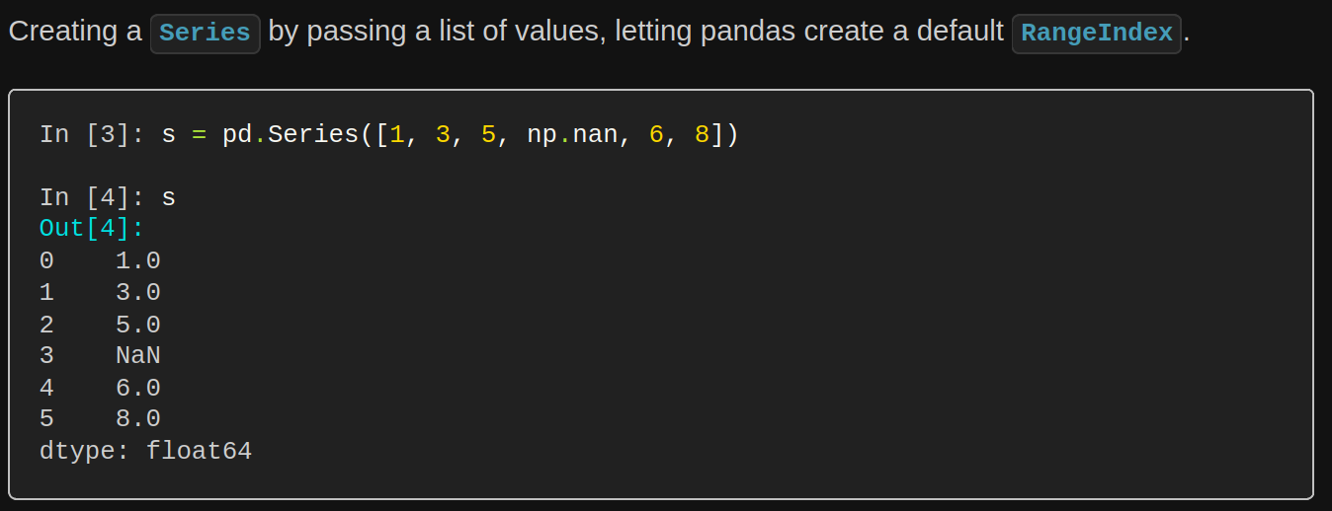
Documentation Example (Cont’d)
Here is an example of reading through part of the Pandas documentation:
This snippet walks you through how to create something called a Series in Panda
The documentation will give you examples, definitions, and walkthroughs of everything related to the library you are using.

Slide 28

Simple Library Example
Let’s start with the random library.
This library is simple and practical; it is included with Python and offers a simple way to generate random numbers, choose random elements from a list, and more.

Slide 29
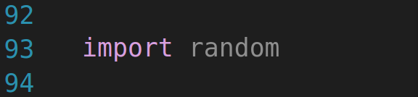
The ‘random’ Library
Let’s say you’re working on a program and at some point you want to pick a random element from a list.
With our current toolset, coming up with a decently random way of selecting an item would be difficult…
So, let’s import the random library!

Slide 30
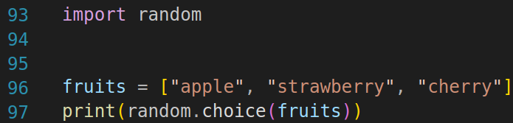
The ‘random’ Library (Cont’d)
Now, let’s make our list, fruits, and select a random item from it.
To do this, we will make use of random’s choice() function.
This piece of code will print out a random element (either apple, strawberry, or cherry) from fruits.

Slide 31


Other ‘random’ Examples
Maybe we want to shuffle a list around in a random order.
For this, we would use the shuffle() function.
For example: random.shuffle(fruits) takes our fruits list from earlier and randomly reorders the fruits that we have listed inside.

Slide 32
Other ‘random’ Examples (Cont’d)
Or maybe we simply want to choose a random number in a certain range
For this, we would use random’s randint() function.
In this case, we would write x = random.randint(1,100) to pick a random integer between 1 and 100 and store it to a variable x.
Want to learn more about what random can do?
Read the documentation :)
https://docs.python.org/3/library/random.html

Slide 33
Key Takeaways
With the random library, we have now seen how a few lines of code with a library can accomplish what would otherwise be complex to program
This is great because, as stated before, programmers are very lazy!
Libraries are powerful when it comes to simplifying coding tasks and increasing functionality.

Slide 34

I wonder what could be coming up next…
That’s right! Practice problem time!
Work through the rest of the practice problems in our Google Colab notebook.

Slide 35
Project 2 Introduction

Slide 36
Project 2
Use at least two custom functions, include try / except blocks to handle potential errors, and use at least one basic standard library (e.g. random, math, datetime, etc.).
Minimum of 30 lines of code.
Incorporate previous concepts, like collections and conditionals.
Prepare a Google Presentation showcasing your project and a Google Colab notebook to demo your code.
Include the same sections as you did for Project 1.
As with Project 1, you will present your Project 2.
Present on Monday

Slide 37
Brainstorming Time!
Take some time to brainstorm with a partner or group what you could do for this project.
One example of something that you could implement right now given your current knowledge is a game or quiz that uses the random library to generate questions or scenarios so that when different people play the game / quiz, they get different questions.
What collections would this program use?
What would the control flow look like?
How could you make useful functions for this program?

Slide 38
Final Project Introduction

Slide 39
Final Project
Since the weekend is coming up, you will hopefully have time to work on your Project 2 and get a head start on the final project.
For the final project, you will need to develop a comprehensive Python application that demonstrates your knowledge of the course material.
Here are the list of requirements:
Minimum of 50 lines of code
Ensure your project is reflective of the cumulative knowledge gained in the course
Make sure to use conditionals, loops, variables, collections, error handling, and functions
Next week, we will start to cover objects; try to fit this in, too.

Slide 40
Final Project (Cont’d)
Requirements (cont’d)
Use at least one non-standard Python library that enhances or is essential to your project
Research some libraries that may be interesting / fun to use
Read the documentation.
Watch YouTube tutorials to get a better sense of the library.
Use AI tools to help you get started or to help solve a problem you are having (do not have the AI model do everything!).
Some suggestions: Pygame, Plotly, FastAPI, Moviepy.
You can work individually OR in a group of 2.
If working in a group, make sure to put in an equal amount of effort.
Also, if working in a group, make sure to share your Google notebook together.

Slide 41
Final Project (Cont’d)
Finally, the presentation…
Prepare a Google Presentation showcasing your project and a Google Colab notebook to demo your code.
Include a title slide with your name and project title.
Have a brief description of your project and its functionality.
Tell us about your experience working on the project; what challenges did you face? What did you learn? How could you build upon your project in the future?

Slide 42
More Brainstorming Time!
Take some time to brainstorm for your final project.
What will you build?
What library might you want to use?
Some project ideas:
A data dashboard that displays trends and statistical insights from a dataset of your choosing.
A small website (running locally) using FastAPI.
A 2D platformer game using Pygame.
It is highly encouraged to make your project as visual as possible.

