Slide 1
Computer Science
Summer Springboard

Slide 2
Day 6: Deep Dives

Slide 3
We interrupt your regularly scheduled lecture…
To present project 2!
Each person should take a turn presenting their project.
Show a demo of your code and your presentation.
After presenting, open the floor to questions / comments.
Good luck and have fun!

Slide 4
What’s the goal for today?
Today, we are going to build upon what we ended on last week
We will be looking at 2 specific libraries, pandas and numpy and their features
Working with these libraries will help you out with your final project

Slide 5
NumPy

Slide 6

Case Study 1: NumPy
NumPy stands for Numerical Python
Backbone of scientific computing in Python
Gives us the power to work with high-performance arrays and matrices
Very useful for handling vast amounts of data efficiently
NumPy is also quite versatile
Good for complex mathematical problems, creating visualizations, working with AI, etc

Slide 7

Discussion Time
Take a few minutes to discuss the following questions with a partner or group:
Can you think of any real-world problems where NumPy could be useful?
Why do we care about efficiency in computing?

Slide 8
Key Functions in NumPy
Array creation - the bread and butter of NumPy
Ex: np.array([1, 2, 3]) creates an array with 3 elements
Ex: np.arrange(1, 10) creates an array of numbers from 1 to 9
Aggregations - find totals, averages, or the biggest number in your data faster than you can say “libraries are super cool!”
Ex: np.sum() sums all elements in your array, np.max() finds the maximum element in an array
Reshaping - change the shape of your arrays without altering their data
np.reshape()

Slide 9
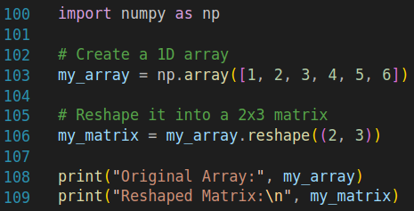
NumPy Examples
Here is an example of reshaping data; we first create a one-dimensional array of data and then shape it into a 2x3 matrix

Slide 10
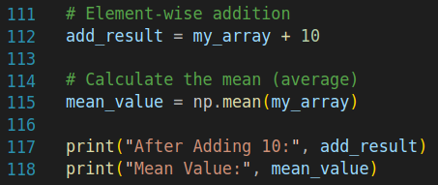
NumPy Examples (Cont’d)
Below, we see that we first do an operation on our array and then find its mean value. The addition results in the array [11, 12, 13, 14, 15, 16] and the mean value of the original array is 3.5.

Slide 11
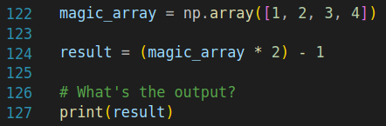
Predict the Output…
Predict the output of the following code snippets.
Snippet 1: What will be printed when we run this snippet?
A) [2, 4, 6, 8]
B) [1, 3, 5, 7]
C) [0, 1, 2, 3]
D) Error

Slide 12
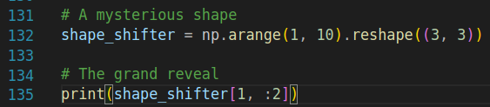
Predict the Output… (Cont’d)
Snippet 2: What will be printed when we run this snippet?
A) [4 5 6]
B) [2 3]
C) [4 5]
D) Error

Slide 13
Takeaway
With just a few lines of code, NumPy is able to efficiently manipulate and analyze data
The possibilities are endless!

Slide 14
Practice Problem Time!
Open up today’s Google Colab notebook and work until the first “***PAUSE***”

Slide 15
Pandas

Slide 16

Case Study 2: Pandas
Pandas (Panel Data) is a powerful library that makes it easy to explore, manipulate, and analyze data
Transforms raw data into something insightful
Handles data in a way that is both powerful and intuitive
Key features include:
Data manipulation: clean, transform, and merge data
Data analysis: perform complex analyses to gain insight
Flexibility: works with many forms of data, from tabular data to time series data

Slide 17
Key Concepts in Pandas
Dataframe - table with rows and columns, where each column can be of a different type
Think of this as a spreadsheet
Series - one-dimensional array that can hold any data type
Single column from a spreadsheet
Index - both dataframes and series have an index, which helps locate data

Slide 18
Working with Data in Pandas
Load data: load your data from your chosen source, like CSV files, into Pandas DataFrames
Exploring data: use commands to peek into your data, understand its structure, and start asking questions
Cleaning data: deal with missing values, duplicate data, and unwanted entries

Slide 19
Discussion Time Pt 2
Take a few minutes to discuss the following questions with a partner or group:
Can you think of any real-world problems where Pandas could be useful?
What do you think are the benefits of storing data in dataframes?

Slide 20
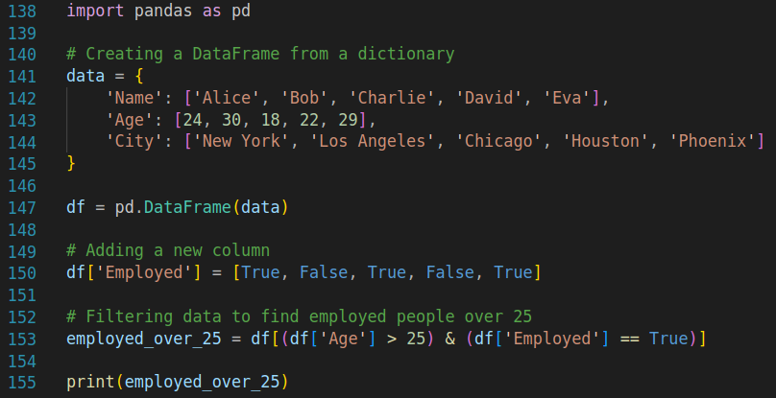
Pandas Examples
Here is an example snippet of creating and manipulating a dataframe in Pandas:

Slide 21
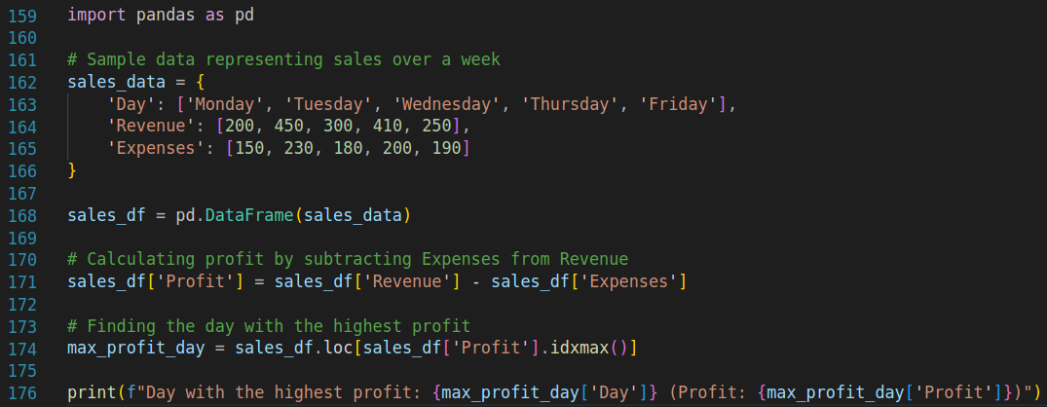
Pandas Examples (Cont’d)
Here is an example snippet of creating analyzing data in Pandas:

Slide 22
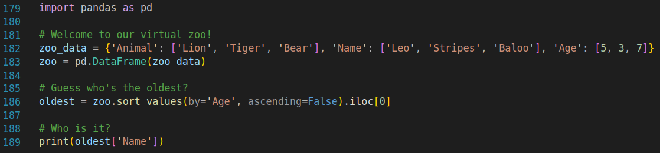
Predict the Output…
Predict the output of the following code snippets.
Snippet 1: What will be printed when we run this snippet?
A) Leo
B) Stripes
C) Baloo
D) Error

Slide 23
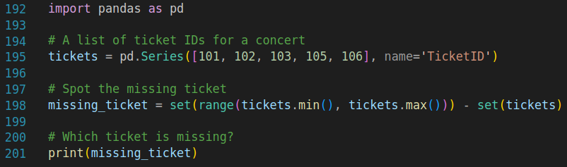
Predict the Output… (Cont’d)
Snippet 2: What will be printed when we run this snippet?
A) 104
B) 107
C) 101
D) Error

Slide 24
Takeaway
Pandas is accessible and intuitive
Despite its simplicity, Pandas is incredibly powerful, capable of handling large datasets and complex operations

Slide 25

More Practice!!!
Work through the rest of the practice problems in today’s Google Colab notebook

Slide 26
Final Project Check-In

Slide 27
Final Project Check-In
Final projects will be due soon! As we close out for the day, let’s take some time to discuss the following questions in groups or as a class:
What is your idea for your final project?
What have you been able to complete so far for your problem?
Is there anything that you have been struggling with so far?
If there is time remaining, use it to make some more progress on your project

