Slide 1
Computer Science
Summer Springboard

Slide 2
Day 7: OOP

Slide 3
Pause: Discussion Time
Before getting into today’s content, take some time to make sure you understand the following topics by discussing them in groups or as a class (no pun intended):
Variables and data types
Functions
Imports

Slide 4
Object-Oriented Programming

Slide 5

Object-Oriented Programming
Object-Oriented Programming (OOP) is a programming paradigm that uses “objects” to model real-world or abstract features, behaviors, and interactions
OOP organizes software design around data and the methods that operate on these objects

Slide 6
Why OOP?
OOP helps manage software complexity by mimicking how we perceive things in the real world
Allows programmers to structure software in a way that is easier to understand, modify, and extend

Slide 7
Key Terminology
Class: a blueprint or template from which objects are created. Classes define the attributes and methods necessary to create objects
Object: an instance of a class. Objects have states (attributes / properties) and behaviors (methods / functions) defined by their class
Attribute: a characteristic of an object. Attributes are data stored inside an object or class
Method: a function defined inside a class that describes the behaviors of an object

Slide 8
Pillars of OOP
There are a few important pillars of OOP that make the paradigm so powerful
Encapsulation: bundling of data (attributes) and methods that operate on the data into a single unit (class) and controlling access to the properties of an object
Abstraction: hiding the complex reality while exposing only the necessary parts; allows focusing on what an object does instead of how it does it

Slide 9
Pillars of OOP (Cont’d)
These next two pillars will be covered tomorrow
Inheritance: A mechanism for one class to inherit the attributes and methods of another class
Polymorphism: The ability of different classes to respond to the same method call in different ways

Slide 10
Importance of OOP
OOP is great for reusability; code can be reused through different mechanisms like inheritance, saving time and reducing errors
OOP is also scalable; it is easier to maintain complex systems by building upon existing objects and classes
Encapsulation provides a clear modular structure for programs, making OOP good for defining abstract datatypes where implementation details are hidden
Abstraction and polymorphism increase the flexibility and efficiency of the code

Slide 11
Main Takeaway
OOP is a powerful paradigm that structures software design around data, or objects, rather than functions and logic. By understanding and applying OOP principles, you can write more organized, efficient, and scalable code.

Slide 12
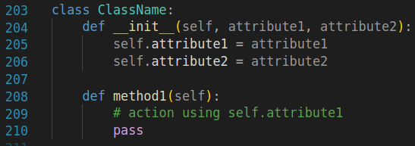
Creating a Class in Python
Use the following code structure to create classes:

Slide 13
__init__
The __init__ method is called automatically every time the class is being used to create a new object
Initializes the object’s attributes with values
You can have as many methods as you would like and they can take in whatever parameters you wish, but each method should have self as a parameter
self gives the method a way to access the attributes and other methods of the class instance
In other words, self is a way to refer to the object itself while you are doing things inside of the object

Slide 14
Creating an Object from a Class
Once a class has been defined, you can create objects (instances) of that class like so:
my_object = ClassName(“Value1”, “Value2”)
See the next slide for a more concrete example

Slide 15
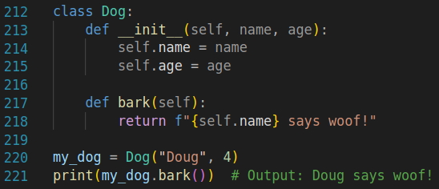
Creating an Object from a Class (Cont’d)
Here is an example of a Dog class and an instance of that class named my_dog:

Slide 16
Creating an Object from a Class (Cont’d)
In this example, we have a class named Dog, meaning that we are allowed to make Dog type objects in our code
We use this class by defining an instance of Dog which we called my_dog, which has name Doug and age 4
We then see an example of using a method by calling Dog’s bark() method, which prints a statement with the dog’s name attribute

Slide 17
Using Object Attributes and Functions
Attributes are defined within the class’s __init__ method, allowing for different instances of the same class to hold different values
Use the following syntax: object.attribute to access the attributes
For example, if we have an instance of a Car class named my_car with attributes make and model, we can say print(my_car.make) to print the make of the Car.

Slide 18
Using Object Attributes and Functions (Cont’d)
Methods, similar to attributes, are accessed using a period, but they are callable, meaning you can execute the method’s code on the object
For example, if we have an instance of a Dog class named my_dog and there is a bark() method, we can call this method by using my_dog.bark()

Slide 19
Encapsulation
Encapsulation is the bundling of data (attributes) and methods into a single unit called a class
Involved restricting access to some of the object’s components
Protects the object’s integrity by preventing - or, in Python’s case, discouraging - external code from directly accessing its internal state

Slide 20
“Private” Members in Python
Unlike some other languages, Python does not have a strict way to create private methods
If you have an attribute or method that should only be used internally within a class, prepend a single leading underscore to the attribute / method name
If you have an attribute or method that should not be used externally and also should not be used by subclasses, prepend two leading underscores to the attribute / method name
Python will use “name mangling” to make it difficult for subclasses to accidentally use the same name

Slide 21
Abstraction
This concept is certainly a bit abstract, but it is very useful, as it reduces complexity and isolates the impact of changes made to the code
Abstraction involves hiding the complex implementation details of a system and exposing only the necessary parts of it
In Python, abstraction is done through abstract classes and methods (example on next page)
Abstract classes cannot be instantiated on their own; they require subclasses (covered tomorrow)

Slide 22
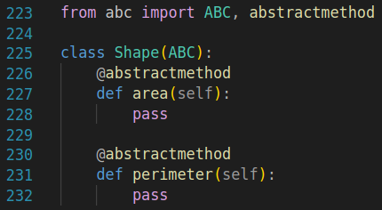
Abstraction (Cont’d)
Below is an example of an abstraction (note use of import and @ statements)
Note that it does not make sense to find the area or perimeter “Shape” on its own - in real life, you need a tangible shape to be able to find its area / perimeter; you can’t just find the perimeter of “Shape.”
However, we can grasp what a “Rectangle” or a “Circle” is and what their areas / perimeters are; “Rectangle” is a Shape and “Circle” is a Shape
More on this later with inheritance / subclasses

Slide 23
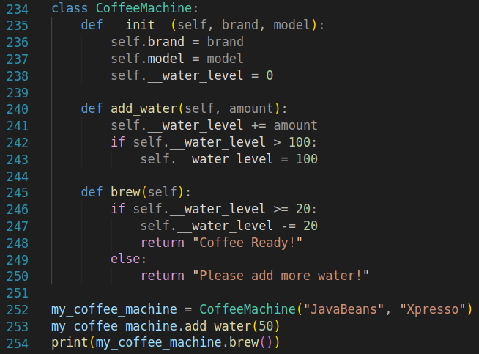
Predict the Output…
Predict the output of the following code snippets
Snippet 1: What will be printed when we run this snippet?
A) Coffee Ready!
B) Please add more water!
C) AttributeError
D) None of the above

Slide 24
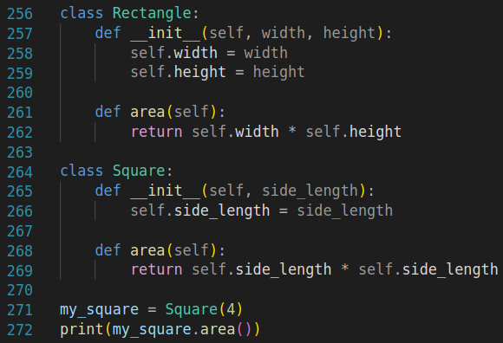
Predict the Output… (Cont’d)
Snippet 2: What will be printed when we run this snippet?
A) 8
B) 16
C) 4
D) 12

Slide 25
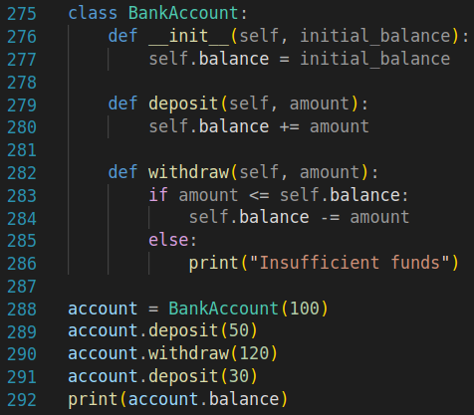
Predict the Output… (Cont’d)
Snippet 3: What will be printed when we run this snippet?
A) 60
B) 100
C) 160
D) 80

Slide 26

Practice Problems
Now it’s time to work through today’s practice problems! Complete all of the problems in the Google Colab notebook.

Slide 27
One Last Thing
Before we move on, take a few minutes as partners or groups to discuss the following questions:
What makes an object unique in OOP?
How do constructors (__init__ methods) contribute to the functionality of an object?
Discuss how creating objects from classes allows for more modular and maintainable code compared to solely using functions and global variables.

Slide 28
Final Project Development Time

Slide 29
Final Project
The final project may seem daunting (it is certainly a lot of work!), so let’s take some time to work on it
Use this time to make meaningful progress on your project and ask your professor any important questions you may have
You could also use this time to try to implement objects into your project

