Slide 1
Computer Science
Summer Springboard

Slide 2
Day 8: OOP & Real World

Slide 3
OOP Review Discussion
Before hopping into today’s content, let’s make sure we remember what was covered yesterday
In groups or as a class, discuss the following topics and their uses:
Classes
Objects
Attributes
Methods

Slide 4
OOP Continued

Slide 5
Inheritance and Polymorphism
Inheritance and polymorphism are key concepts in OOP that allow for more efficient code reuse and flexibility
Inheritance enables a new class to inherit attributes and methods from an existing class
Polymorphism allows methods to do different things based on the object it is acting upon

Slide 6
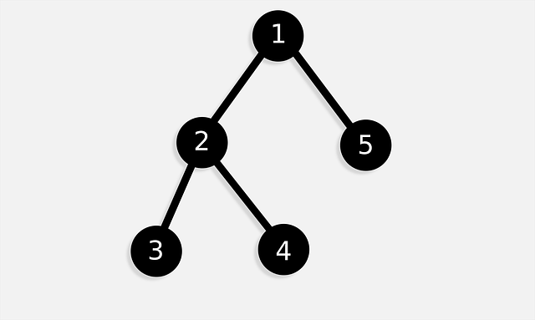
Inheritance
Inheritance allows a child / subclass to inherit attributes and methods from a parent / superclass
Think of this as different hierarchies of classes

Slide 7

Real-Life Inheritance Examples
Let’s think of a way we could use inheritance to describe a relationship between objects
One example is Fruit
Apples, Bananas, Oranges, etc are fruits
Each of the above fruits then have subtypes; for example, there are Gala Apples, Granny Smith Apples, etc
Here, Fruit is the superclass / parent and Apple, Banana, Orange, etc are subclasses / children of Fruit
Further, Gala, Granny Smith, etc are subclasses of Apple

Slide 8
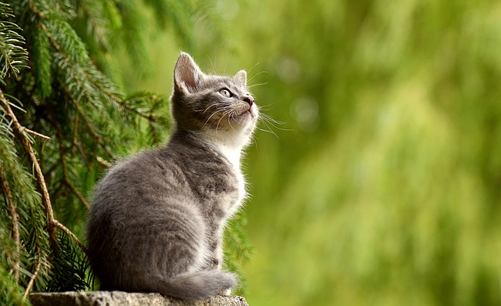
Real-Life Inheritance Examples (Cont’d)
Another example we could think of is Pet
Cats, Dogs, Snakes could be Pets
Each of the above pets then have subtypes; for example, for Dogs there are Golden Retrievers, Dalmations, Pugs, etc
Here, Pet is the superclass / parent and Cat, Dog, Snake, etc are subclasses / children of Fruit
Further, Golden Retriever, Dalmatian, Pug are subclasses of Dog

Slide 9
Real-Life Inheritance Examples (Cont’d)
Now, come up with your own ideas!
In groups or pairs, think of some real-life examples of things you could represent in a class structure with many superclasses / subclasses.

Slide 10
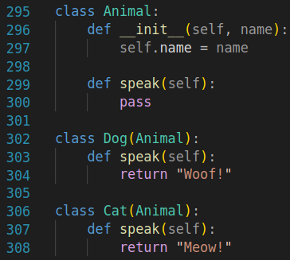
Inheritance Example
Here is a code example of inheritance using an Animal class
Note that the first parameter for Dog and Cat is Animal, meaning that both Dog and Cat inherit properties from Animal

Slide 11
Inheritance Example (Cont’d)
What properties are inherited exactly?
Well, in our Animal example, Dog and Cat inherit the speak() method from Animal
Animals do not all sound the same, so this method is not defined in the Animal class itself; rather, the subclasses define it as needed

Slide 12
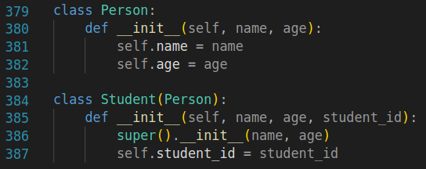
Adding an Attribute
Below is an example of adding an attribute to a subclass
Note that we access the superclass with super()

Slide 13
Inheritance Key Points
Subclasses can override or extend the functionalities of the superclass
Python supports multiple inheritance, meaning that a child class can inherit from more than one parent class (example on next page!)

Slide 14
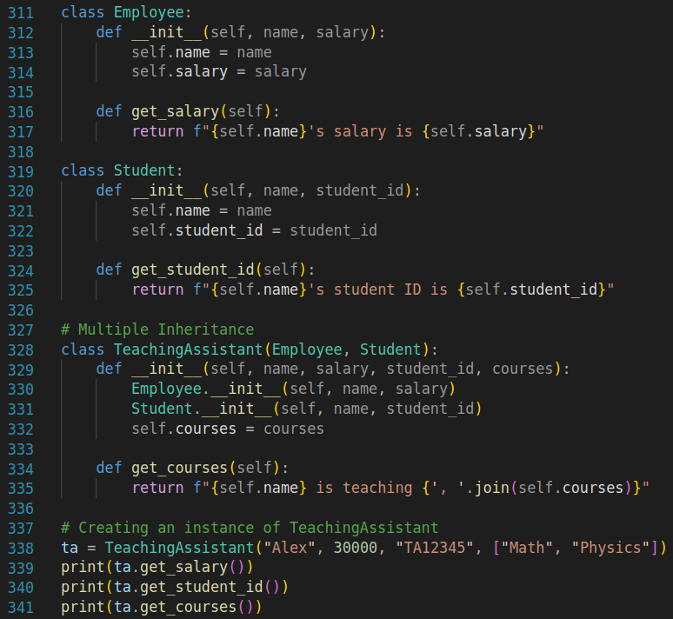
Multiple Inheritance Example

Slide 15
Inheritance Wrap-up
As we have seen, inheritance is super cool!
We can use it to model real-world relationships, while keeping our code cleaner and more reusable
This coding practice is widely used and is useful in many applications

Slide 16

Inheritance Practice Problems
Navigate to today’s Google Colab notebook and work up to the “***PAUSE***”

Slide 17
Polymorphism
Polymorphism allows objects of different classes to be treated as objects of a common superclass
Closely related to inheritance

Slide 18
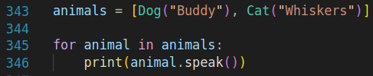
Polymorphism Examples
Below is an example of polymorphism
We create a list of Animal objects called animals
Then, we call the speak() method of each Animal object, which behaves differently depending on the object’s class

Slide 19
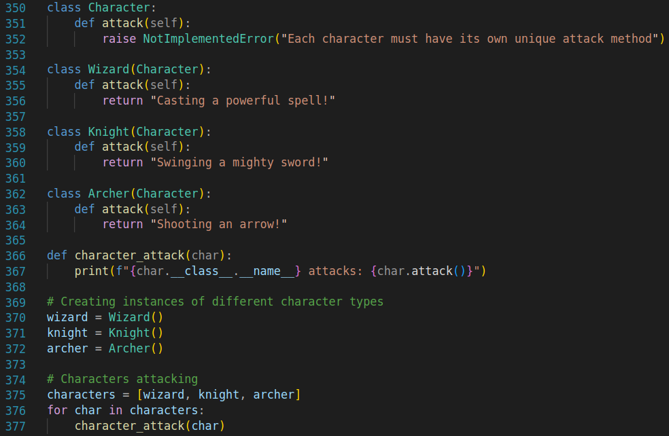
Polymorphism Examples (Cont’d)
Here is an example of polymorphism with fantasy character classes

Slide 20
Polymorphism Wrap-Up
Polymorphism promotes flexibility and integration between components
Enables the implementation of functions that can utilize objects of different classes through a common interface

Slide 21

Polymorphism Practice Problems
Now, for our last practice problem set (sad times :( very sad), navigate to today’s Google Colab notebook and work through the rest of the problems

Slide 22
Programming in the Real-World

Slide 23
Examine Real-World Applications
In this section, our goal is to explore how the programming concepts we’ve learned apply to real-world applications
The format will be as follows: a slide will be shown with a real-world application; this will be a slide for guesses and discussion. The next slide will show specific details about what the applications likely use in their code; this can also be discussed

Slide 24
Real-World Example 1
Our first example will be Ride-Sharing Apps, such as Uber and Lyft
How do you think the coding concepts we have learned show up in these apps?
Discuss in groups or as a class

Slide 25
Real-World Example 1 (Cont’d)
Here are some likely uses of coding concepts in these apps:
Variables and Data Types: Store user profiles, location data, and trip details
Conditionals and Loops: Determine the closest available driver, calculate fares based on distance and traffic conditions
Functions: Modularize tasks like fare calculation, route optimization, and payment processing
Libraries: Use mapping and payment processing libraries for geolocation services and transactions
Objects: Model users, drivers, rides, and payment information as objects with specific attributes and behaviors

Slide 26
Real-World Example 2
Our next example will be Minecraft
How do you think the coding concepts we have learned show up in Minecraft?
Discuss in groups or as a class

Slide 27
Real-World Example 2 (Cont’d)
Here are some likely uses of coding concepts in Minecraft:
Variables and Data Types: Store information about player health, inventory items, block types, and world coordinates
Conditionals: Determine the outcomes of player interactions with the environment (e.g., if a player hits water or lava)
Functions: Modularize actions such as breaking blocks, crafting items, and spawning mobs
Objects: Players, mobs, and blocks can be modeled as objects with specific attributes (health, type, position) and methods (move, attack, break).

Slide 28
Real-World Example 3
Our next example will be YouTube
How do you think the coding concepts we have learned show up in YouTube?
Discuss in groups or as a class

Slide 29
Real-World Example 3 (Cont’d)
Here are some likely uses of coding concepts in YouTube:
Variables and Data Types: Store details about videos (title, description, length), user accounts (username, preferences), and comments
Conditionals and Loops: Determine video recommendations based on user history and preferences, looping through datasets to find matches.
Functions and Libraries: Use functions for video processing, encoding, and streaming. External libraries are integrated for data analysis, machine learning for recommendations, and handling video formats.

Slide 30
Discussion - What do you want?

Slide 31
Discussion Time!
Since we are taking the time to talk about the real-world, let’s talk about our goals!
What would you like to use computer science for in the future?
What kinds of projects do you see yourself building with Python?
Where do you see yourself taking your first steps in computer science?

Slide 32
Final Project Development Time

Slide 33
Final Project
As with yesterday, let’s take some time to work on your final project while in class!
Use this time to make meaningful progress on your project and ask your professor any important questions you may have
You could also use this time to try to implement objects into your project

