Slide 1
Computer Science
Summer Springboard

Slide 2
Day 2: Basics

Slide 3
First up: Syntax vs Semantics
Just like any other language, spoken or otherwise, Python has a set of rules that need to be followed in order to be understood by others
First, we will talk about Python’s syntax (the “grammar” of Python) and then semantics (“definitions”)

Slide 4
Syntax
Syntax refers to the set of rules that dictate how Python code should be structured and written.
It deals with the proper arrangement of symbols, keywords, and punctuation in the code.
Syntax errors occur when code violates these rules, making it invalid and preventing the code from being run.

Slide 5
Semantics
Semantics refers to the meaning and interpretation of Python code.
It focuses on how statements and expressions behave and what they do when executed.
Semantics errors (logical errors) occur when code does not produce the expected or desired results, even if the syntax is correct.

Slide 6
Let’s move on
We will see examples of good / bad syntax and semantics as we go along

Slide 7
Variables

Slide 8
Variables
The first Python concept we will learn about today is… variables!
A “variable” is a symbolic name or identifier used to store and manipulate data in Python programs
They act as containers that hold values such as numbers, text, or objects

Slide 9
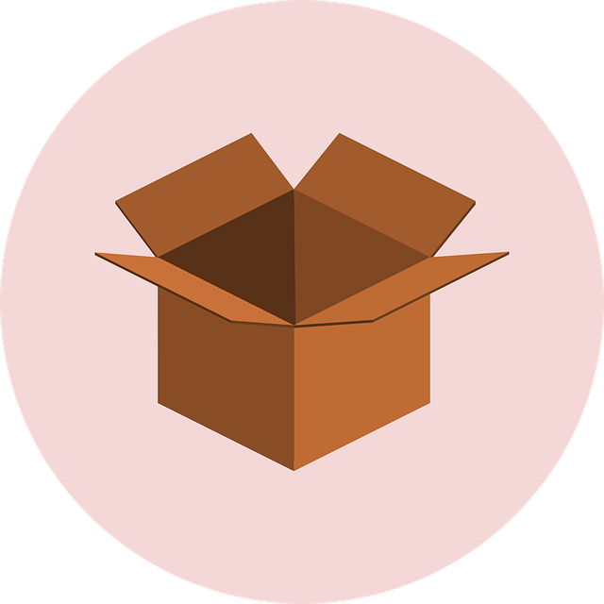
This may sound a bit abstract…
If this definition doesn’t make sense to you, just think of a variable as a box that can hold a specific type of information.
For example, maybe you have a box that can hold a number with a decimal, another box that can hold sentences, and another box that can hold either “true” or “false”

Slide 10
Anatomy of a Variable
A variable in Python has a few special parts:
Name - this should be lowercase. If there are multiple words in the name, they should be separated by underscores
Value - the object that the variable is holding
Type - the category of data that the variable falls into
Address - a place that your computer stores the variable in its memory

Slide 11
Let’s make a variable!
To make a variable, first determine what it’s name and initial value will be.
Then, put the name on the left side of an equal sign and the value on the right side of the equal sign.
For example, my_first_var = 3.14 creates a variable with name my_first_var and an initial value of 3.14
The computer will remember this as long as the variable is “in scope” (more on this later)

Slide 12
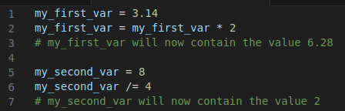
How do we use variables?
One way that we can use variables is in mathematical or logical operations.
Last lesson, we covered mathematical operations in Python, so let’s add some variables into our mathematical expressions.
Note that for a mathematical binary operation *, some_var = some_var * other_var is equivalent to some_var *= other_var

Slide 13
Data Types in Python
We’ve mentioned data types, but have not really gotten into what they are yet.
Data types define the type of data a variable can hold, such as numbers, text, or more complex types.
Python's dynamic typing means the type is set at runtime (when the program runs the line of code assigning the variable), not in advance.

Slide 14
Common Data Types
Integer (int): Represents whole numbers without a decimal. Used for counting, indexing, and more. Example: age = 30.
Floating Point (float): Handles numbers with decimals. Useful for precision in calculations. Example: temperature = 98.6
String (str): A sequence of characters, used for storing text. Can include letters, numbers, symbols. Example: name = "Alice"
Combine strings using + (this is called concatenation)
For example, “Alice” + “Bob” becomes “AliceBob”
Boolean (bool): Represents truth values. Only two possible values: True or False. Often used in conditionals. Example: is_valid = True
There are many other types, but this is all we will focus on for now.

Slide 15
Type Conversion
Changing the type of a variable is common in Python.
Example: Converting a string to an integer with int("10") means that “10” becomes 10 (an integer instead of a string)
Other commonly used type conversion functions are:
float() - converts a value to a number with a decimal
str() - converts a value to a string
bool() - converts a value to a boolean

Slide 16
Tips for Working with Data Types
Choose the right data type based on what operations or methods will be performed.
Be aware of type-related errors: trying to add a number and a string, for instance, will result in an error.
Use built-in functions like type() to check a variable's data type if unsure.

Slide 17
Let’s do some practice!
Open today’s Google Colab notebook and follow the instructions up until the line that says “***PAUSE***”

Slide 18
Booleans

Slide 19
Introduction to Booleans
A boolean is a data type that can only have one of two values: “True” or “False”
The name “boolean” comes from George Boole, who was an English mathematician.

Slide 20
Using Booleans in Python
Booleans are often used in conditional statements for decision-making
For example, is_adult = age >= 18 will result in True if age is at least 18 and False otherwise

Slide 21
Boolean Expressions
Comparisons like ==, !=, <, and > result in boolean values (either True or False)
== checks if two values are equal to each other
Note: This is different from = which assigns a value to a variable
!= checks if two values are NOT equal to each other
< checks if a value is less than another
> checks if a value is greater than another

Slide 22
Logical Operators with Booleans
Logical operators take two boolean arguments and returns either True or False.
and: both conditions must be true
or: at least one condition must be true
not: takes in only one boolean argument and inverts it
not True results in False
not False results in True

Slide 23
And Truth Table
This table shows what the output result of and is, depending on the inputs.
Input 1 | Input 2 | Output
True | True | True
True | False | False
False | True | False
False | False | False

Slide 24
Or Truth Table
This table shows what the output result of or is, depending on the inputs.
Input 1 | Input 2 | Output
True | True | True
True | False | True
False | True | True
False | False | False

Slide 25
Not Truth Table
This table shows what the output result of and is, depending on the inputs.
Input | Output
True | False
False | True

Slide 26
Real-Life Examples
We can think of logical operators and boolean expressions using real-life examples!
For example: if it is a weekday AND it is not a holiday, you should go to school
You can have a movie night if you have a movie you want to watch AND it’s not too late in the day to start it
Go grocery shopping if the fridge is empty OR you are out of essentials like milk or bread
You can sleep in if it’s not a weekday OR you’re on vacation
Think of some other examples on your own or with a group!

Slide 27
More Practice!
Go back to the Google Colab notebook and work through to the next “***PAUSE***

Slide 28
Conditionals

Slide 29
Conditionals
Conditionals are constructs in programming that allow the execution of certain pieces of code depending on whether a specific condition (or set of conditions) is met.
In simple terms, they let your program make decisions.
In English, we see this in sentences like: If (some condition) then (do this thing) else (do this other thing)
For example, If it is cold outside, then wear a jacket. Else, don’t wear a jacket.

Slide 30

If
The if statement is the most basic form of conditional. It executes a block of code if a condition (boolean expression) is True.
Make sure to indent the line of code that you want to be run if the condition is met
Put a colon at the end of the line to let the computer know that the block you want to run if the condition is met is coming up next

Slide 31

Elif
The elif statement stands for “else if.” This is used to check if multiple conditions, one after another.
You can have as many elif statements as you want, but there must be an if statement before them.
Put a colon at the end of the line to let the computer know that the block you want to run if the condition is met is coming up next

Slide 32
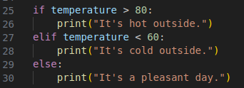
Else
The else statement catches anything which isn’t caught by the preceding conditions.
There is no condition checked in the else block.
You do not need elif statements before the else block, but you at least need an if statement.
There should be no other conditional statements after else.
Put a colon at the end of the line to let the computer know that the block you want to run if the condition is met is coming up next

Slide 33
Anatomy of an if block
So, the overall syntax for an if block is as follows:
if (condition):
do_something
elif (other_condition):
do_something_else
else:
do_this_instead
Make special note of where the colons are, the indentation, and the order of if, elif, and else.

Slide 34
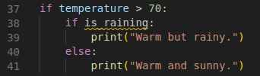
Nested Conditionals
Conditionals can be nested within each other for more complex logic.

Slide 35
Let’s see an animation!
Check out this animation to see how the computer runs conditionals. The arrow represents the line of code that the computer is currently running.

Slide 36
Animation with Different Values
Here is an animation showing the same code running, but with different values.

Slide 37
Scratch
To give us further insight, let’s use Scratch to visualize what our code will look like.
Scratch is a cool tool that allows us to create code using code blocks; you can drag and drop blocks to make different things happen and everything is color-coordinated.
Using this website can make coding easier because it gives you a better visual idea of what code is doing.
Go to: https://scratch.mit.edu/projects/editor/
Drag and drop blocks so that you have the same “code” as the picture on the next slide

Slide 38
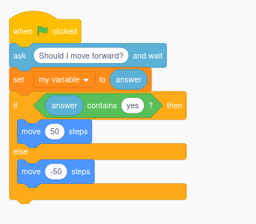
Scratch (Cont’d)
This gives us a simple visual example of a conditional; Once you press the green flag on the top right, if you type in “yes,” our cat character moves forward 50 steps. Otherwise, if you enter anything else, the cat character moves backwards 50 steps.

Slide 39
To the Notebook!
For the last part of today, let’s move onto writing code in our Google Colab notebook. Finish the rest of the exercises in the notebook.

