Slide 1
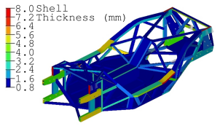
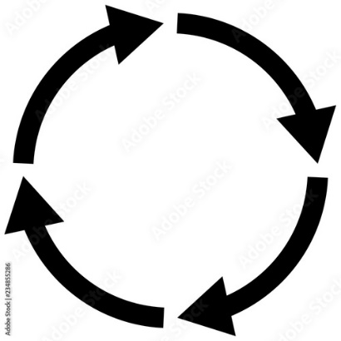

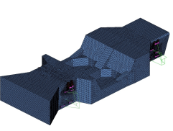
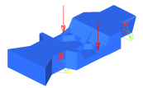
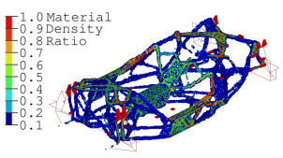

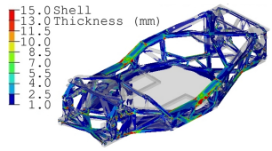
Designing Optimized Car Parts With Cyborg Systems
Reviewing “High performance automotive chassis design: a topology optimization based approach” by Cavazzuti et al.
Imagine if your car was made up of spider web looking parts like this one.
Besides the cool aesthetic, this part is optimized for material reduction.
To get cheaper products, we can rethink the design process and design with human + computer systems: cyborg systems.
DESIGN
To design the car chassis above, we start with a large piece of metal represented by a million cubes.
We define functions that evaluate whether a design meets requirements through finite element analysis (FEA).
We allow the system to cut out or reduce the density of cubes that do not contribute to safety requirements.
We allow a human designer to interpret the results and make a CAD model of the car chassis.
We give the CAD model to the system and allow it to optimize the design and repeat as desired.

