Slide 1
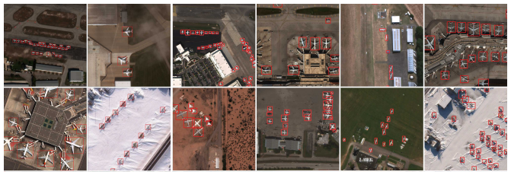
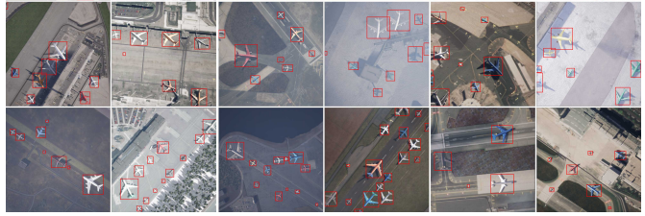

Using Synthetic Data To Train Object Detection Models
Reviewing “RarePlanes: Synthetic Data Takes Flight” by Shermeyer et al.
Motivation: Object detection models for aircraft identification from overhead satellite imagery are essential for air traffic control. Traditionally these types of models are trained with hand-annotated datasets. However, hand-annotation is expensive, so this paper attempts to evaluate the effectiveness of using synthetic data to train object detection models for aircraft identification through their dataset RarePlanes.
The open-source RarePlanes dataset has 14,700 hand-annotated aircraft from 253 WorldView-3 satellite scenes.
RarePlanes also has 630,000 automated annotated aircraft from 50,000 AI.Reverie satellite images.
Challenges: Overhead object detection has the challenge of detecting small heterogeneous objects at varying angles and lighting conditions with different geographies that are prone to seasonal variability and weather patterns. Successful object detection models generally require the datasets they are trained on to be diverse and representative of this variety.
Hand-Annotation Approach: The team hired a professional labeling service to hand-annotate the images in a diamond style with the nose, left-wing, tail, and rightwing being labeled in successive order to avoid variability in hand-annotation.
Synthetic Data Approach: The simulator took in geospatial data from OpenStreetMap to generate building and airport terminal models. The software then generated airport ground and runways with planar shape and texture projections. Settings were configured to spawn aircraft and simulate environmental factors and biomes that simulated a broad range of real-world conditions.
Experiment: After constructing the RarePlanes dataset, the synthetic and real data were used to train object detection machine learning models. The authors trained both a Faster R-CNN and Mask R-CNN model that were both pre-trained using ImageNet weights. For the real data, scenes were split into 512x512 tiles that included at least one aircraft. For the synthetic data, random cropping of 512x512 tiles were used for training. The authors tested three different training datasets: 100% real data, 90% synthetic data with 10% real data, and 100% synthetic data.
Results: The authors found that a model trained on 90% synthetic data and 10% real data had nearly identical results for aircraft identification from overhead images as compared to the model with 100% real data. The experiments were done by using the Detectron2 framework with mean average precision (mPA), mPA50, and average recall as the metrics used.

