Slide 1

Practicum Task for Cuetessa, Inc. – Predicting Valence of Pop Songs
Giovanni Guillaume
Linkedin | Github

Slide 2
Overview

Slide 3
Task Description
Valence describes the musical positiveness of a track, e.g. ranging from sad/depressed to happy/cheerful. An automatic method of classifying the valence of pop songs is useful for playlist curation and other applications. The aim of this task is to develop a Python-based module to predict the valence of newly released pop songs.
Two approaches are to use as input
the audio data (e.g., .wav files) of songs
  Regression model trained using audio features extracted from audio files
The lyrics of songs. Publicly available datasets can be used for training and testing
  Bidirectional Encoder Representations from Transformers (BERT) model to predict valence from lyrics
Link to Project

Slide 4
Data Description
Lyrics dataset on Kaggle that contains:
full lyrics and labels of more than 150,000 songs
The label is the Spotify valence attribute, ranging from 0 to 1.
  It describes the musical positiveness conveyed by a track.
  Tracks with high valence sound more positive (happy, cheerful), while tracks with low valence sound more negative (sad, depressed).
Music attributes such as (tempo, danceability,loudness,etc) extracted and added to original dataset using Spotify’s Web API for Developers
Spotify's Web API can extract relevant song data from the Spotify music catalog
Due to lack of sufficient resources and the scale of this project:
Sample of 500 songs taken from original dataset
Audio previews for respective songs extracted for feature extraction
Link to Dataset

Slide 5
Exploratory Data Analysis

Slide 6
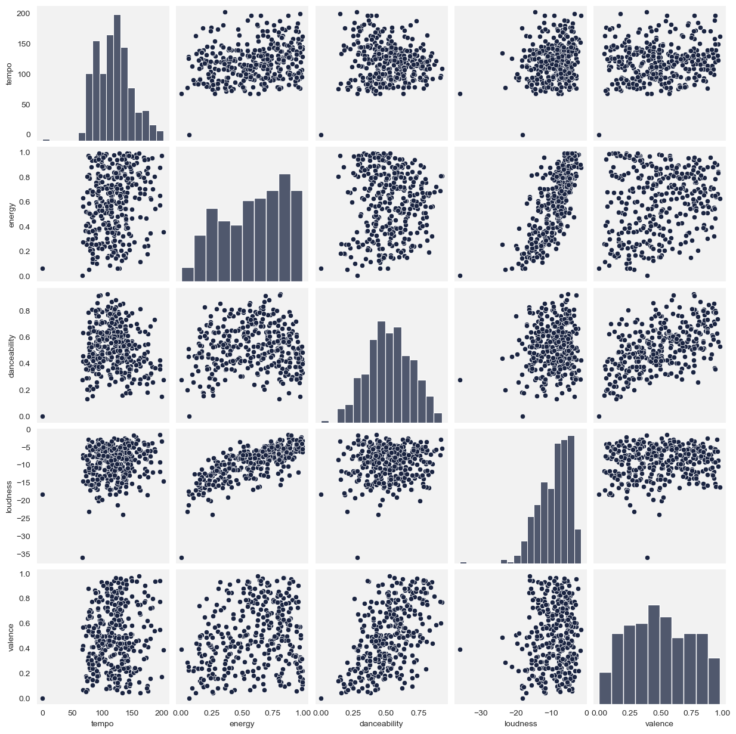
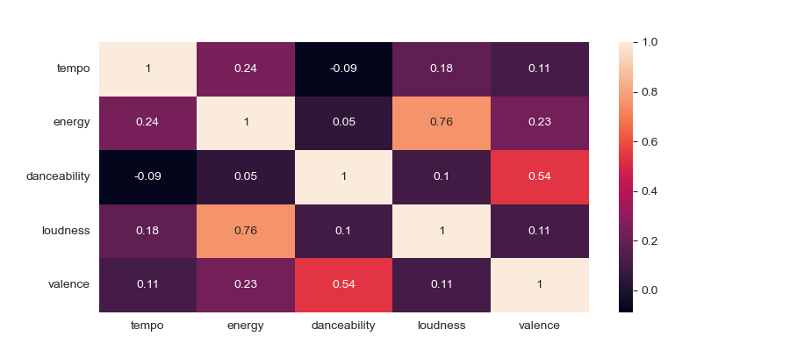
Correlation
Music attributes extracted using Spotify’s Web API
All feature values have a natural, normal distribution
The target feature, valence, is mostly correlated with with danceability and energy

Slide 7
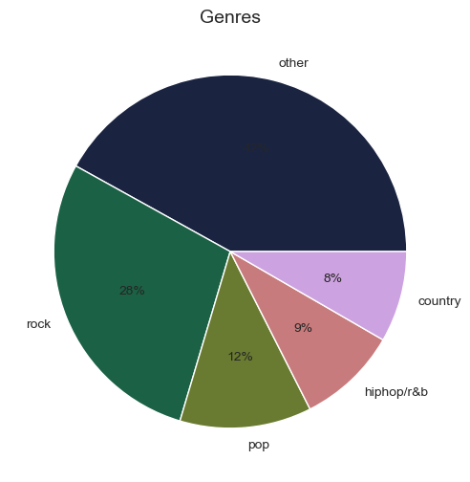
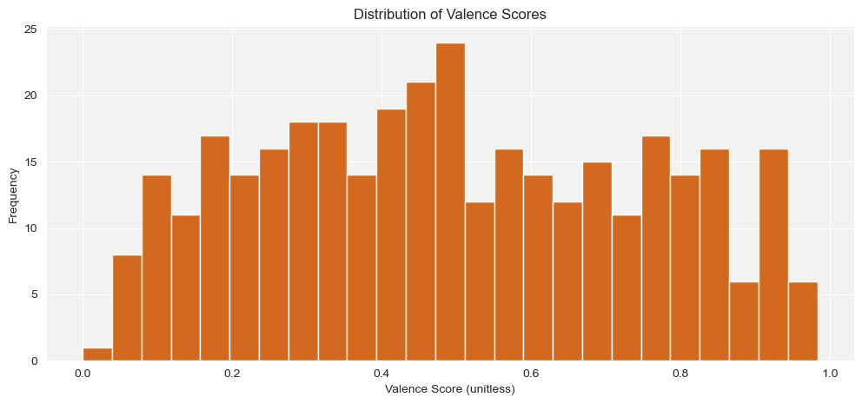
Genre & Valence Distribution
Similar genres (i.e. rock and metal) grouped and categorized using SnowballStemmer
Valence scores appear to be normally distributed

Slide 8
Methodology & Results

Slide 9
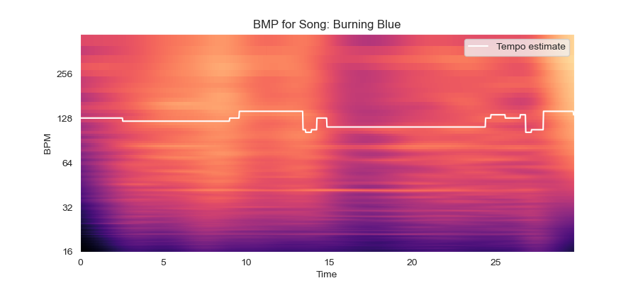
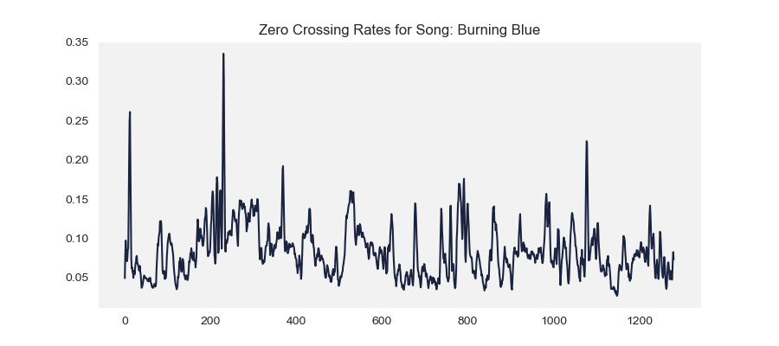
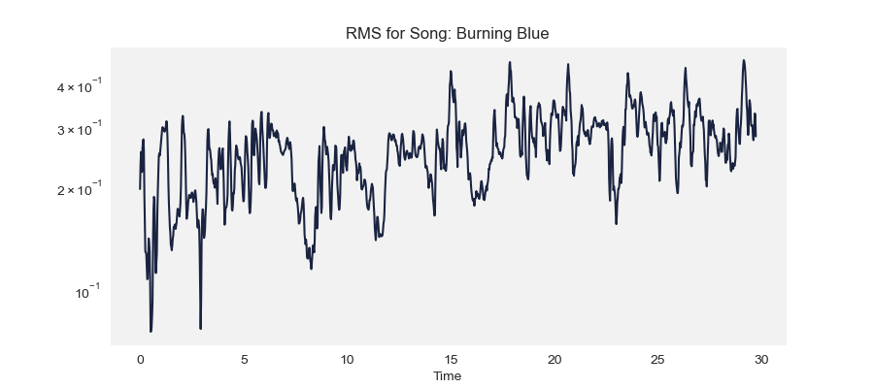
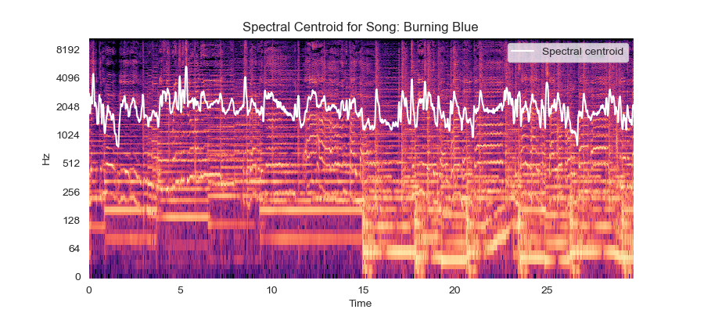
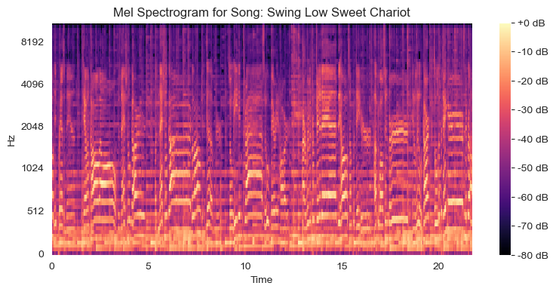
Feature Extraction
Librosa is a python package for music and audio analysis
Data provided of audio cannot be understood by machine learning models directly
  to convert them into an understandable format feature extraction is performed

Slide 10
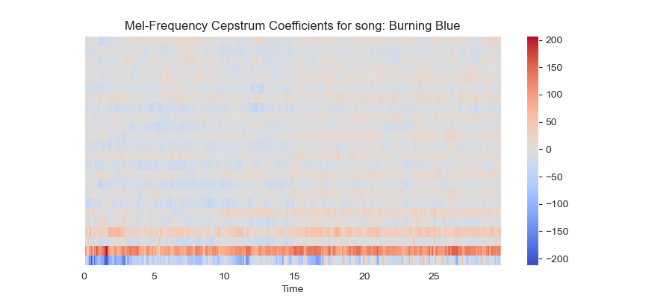
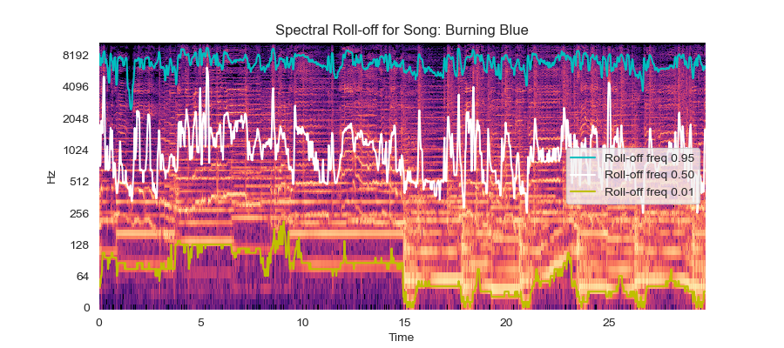
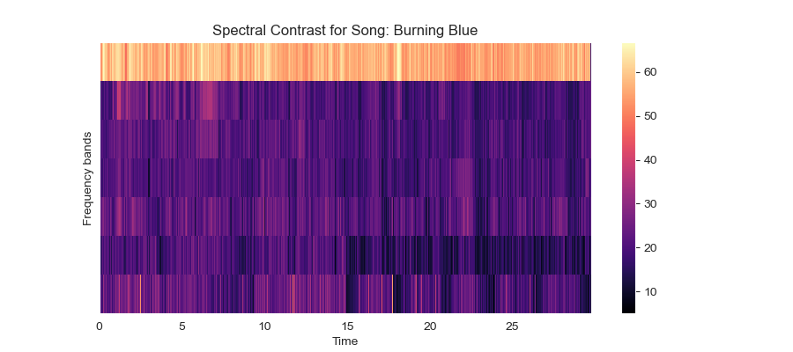
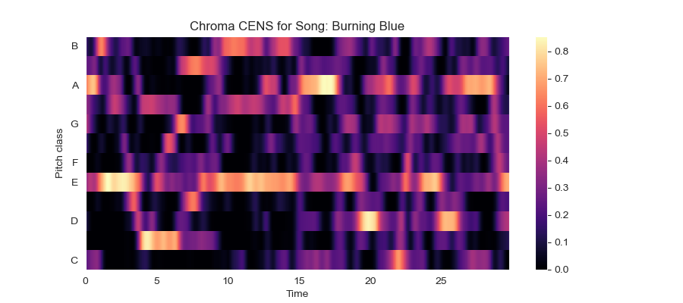
These features were extracted using librosa :
Mel Spectrogram
Spectral Centroid
Spectral Rolloff
Spectral Contrast
Mel-Frequency Cepstrum Coefficients (MFCC) — 24 coefficients
Zero Crossing Rate
Chroma Energy Normalized Statistics (CENS) — 12 chroma;
Beat Per Minute (BPM)
Root Mean Square (RMS)

Slide 11
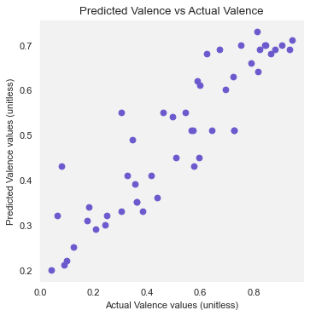
Audio Feature Regression Model
Audio Feature Extraction
Model trained using features extracted from audio files
Evaluated using r2 and mean absolute error (MAE) metrics
Machine learning models evaluated:
  Support Vector Regressor
  RandomForestRegressor
  XGBRegressor
  LGBMRegressor
RandomForest model yielded the best result on the test set albeit marginally: MAE 0.1831
Model Training
Predictive Regression
Model Testing
Final Model Evaluation

Slide 12
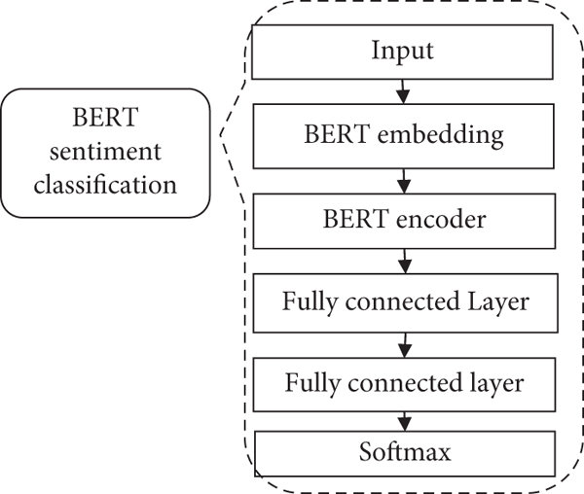
BERT Lyrics Model
Bidirectional Encoder Representations from Transformers
fine-tuned BERT model for valence prediction
text preprocessing and to generating embeddings
Evaluated using r2 and mean absolute error (MAE) metrics
RandomForestRegressor MAE: 0.2059
sentiment
regression

Slide 13
Conclusion

Slide 14
Insights
The regression model using audio features only marginally performed better than the BERT model.
Using a BERT model for text preprocessing and to generating embeddings proved to also be successful
This sample is very small and may not reflect the full dataset
Future Steps
Further training the model based on such dataset and assess if MAE is improving
Using the valence predicted by the CNN and the valence probability predicted for the songs’ lyrics by an NLP model as inputs to train a linear regression mixed model.
  Genre classification can also be completed using CNN
Building a larger dataset by hiring a third-party provider (such as Appen) to rate Spotify songs preview’s valence

