Slide 1
Resampling & Model Selection for Fuel Efficiency Prediction
An Application to the UCI Auto MPG Dataset
Riyad Abdurrahmanov • Gabil Gurbanov
Applied Machine Learning — Course Project 3 | Instructor: Dr. Samir Rustamov
github.com/ggurbanov12098/AppliedML-P3

Slide 2
Presentation Outline
00
▸ 1. Introduction & Motivation
▸ 2. Dataset & Preprocessing
▸ 3. Methodology
▸ 4. Resampling Results
▸ 5. Subset Selection
▸ 6. Shrinkage Methods (Ridge & Lasso)
▸ 7. PCA & PLS
▸ 8. Model Comparison
▸ 9. Interactive Dashboard & Demo
▸ 10. Conclusion & Key Findings

Slide 3
Introduction & Motivation
01
Why resampling and model selection matter for regression
▸ Problem: Predict vehicle fuel efficiency (MPG) from engineering specs
▸ Challenge: Overly complex models overfit; too simple models underfit
▸ Solution: Resampling methods (CV, bootstrap) give unbiased test-error estimates
▸ Goal: Systematically compare resampling, subset selection, shrinkage, and dimensionality reduction
Contributions
▸ K-fold CV (K=5, 10), LOOCV, and bootstrap on polynomial regression
▸ Exhaustive subset selection with Cp, AIC, BIC, Adj R², CV MSE
▸ Ridge & Lasso regression with bias–variance tradeoff analysis
▸ PCA and PLS for dimensionality reduction
▸ Interactive Streamlit dashboard for exploration & live prediction

Slide 4
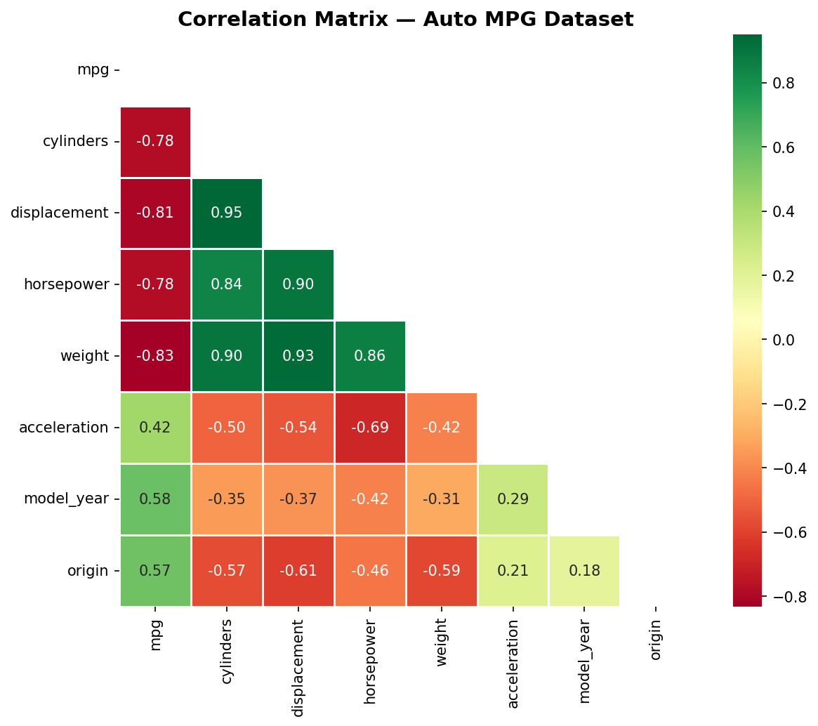
Dataset & Preprocessing
02
UCI Auto MPG — 392 samples, 7 predictors
Variable | Description
cylinders | Number of cylinders
displacement | Engine displacement (cu. in.)
horsepower | Engine horsepower
weight | Vehicle weight (lbs)
acceleration | Time 0–60 mph (seconds)
model_year | Model year (70–82)
origin | Origin (1=USA, 2=EU, 3=JP)
mpg | Target: Miles per gallon
Preprocessing: StandardScaler (zero mean, unit variance)

Slide 5
Methodology Overview
03
1
2
3
4
Resampling
Subset Selection
Shrinkage
PCA / PLS
K-fold CV (K=5, 10) LOOCV • Bootstrap Polynomial degrees 1–8
Best Subset Forward / Backward Cp, AIC, BIC, Adj R²
Ridge (L2) Lasso (L1) λ via 10-fold CV
Principal Components Partial Least Squares 1–7 components
Evaluation Metric:
MSE = (1/n) Σ(yᵢ − ŷᵢ)² | RMSE = √MSE

Slide 6
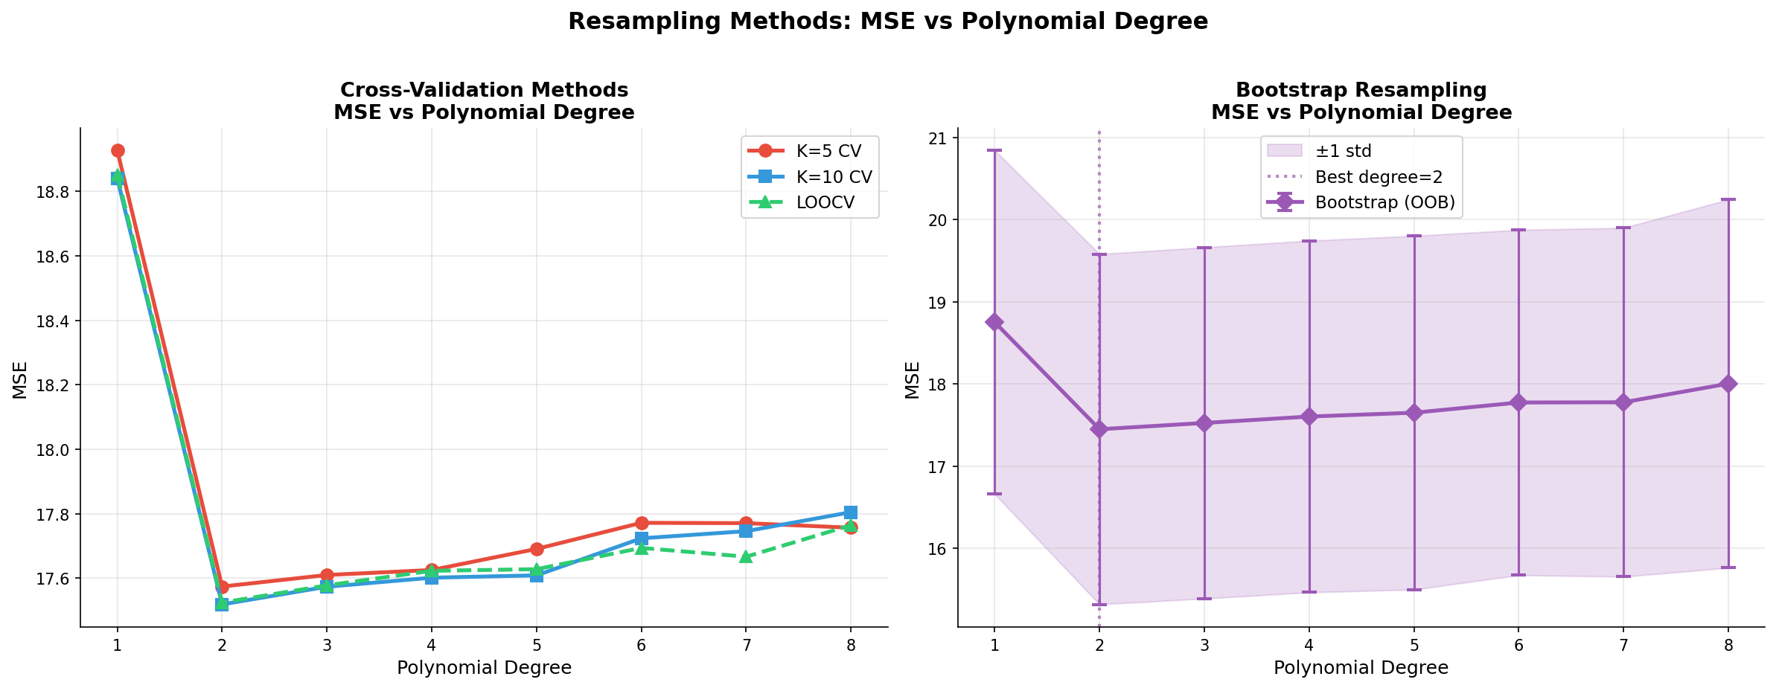
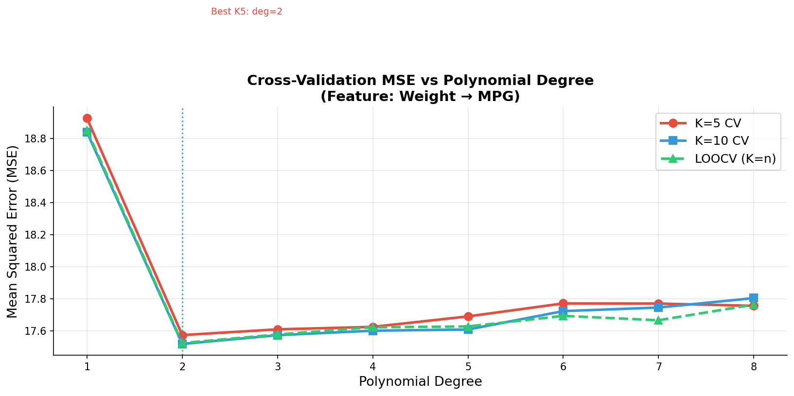
Resampling: Cross-Validation Results
04
Polynomial regression on weight (degrees 1–8)
Degree | K=5 | K=10 | LOOCV
1 | 18.93 | 18.84 | 18.85
2 ★ | 17.57 | 17.52 | 17.52
3 | 17.61 | 17.57 | 17.58
4 | 17.63 | 17.60 | 17.62
5 | 17.69 | 17.61 | 17.63
6 | 17.77 | 17.72 | 17.69
7 | 17.77 | 17.75 | 17.67
8 | 17.76 | 17.81 | 17.76
✓ All methods agree: Degree 2 is optimal

Slide 7
Resampling: Bootstrap Results
OOB bootstrap with B=200 replications
Degree | MSE | Std
1 | 18.75 | 2.09
2 ★ | 17.45 | 2.13
3 | 17.53 | 2.14
4 | 17.60 | 2.14
5 | 17.65 | 2.15
6 | 17.77 | 2.10
7 | 17.78 | 2.12
8 | 18.00 | 2.24
▸ Bootstrap confirms: Degree 2 has lowest MSE (17.45)
▸ Stability: Std dev ≈ 2.1 across all degrees — consistent
▸ Higher degrees: Complexity increases MSE → overfitting

Slide 8
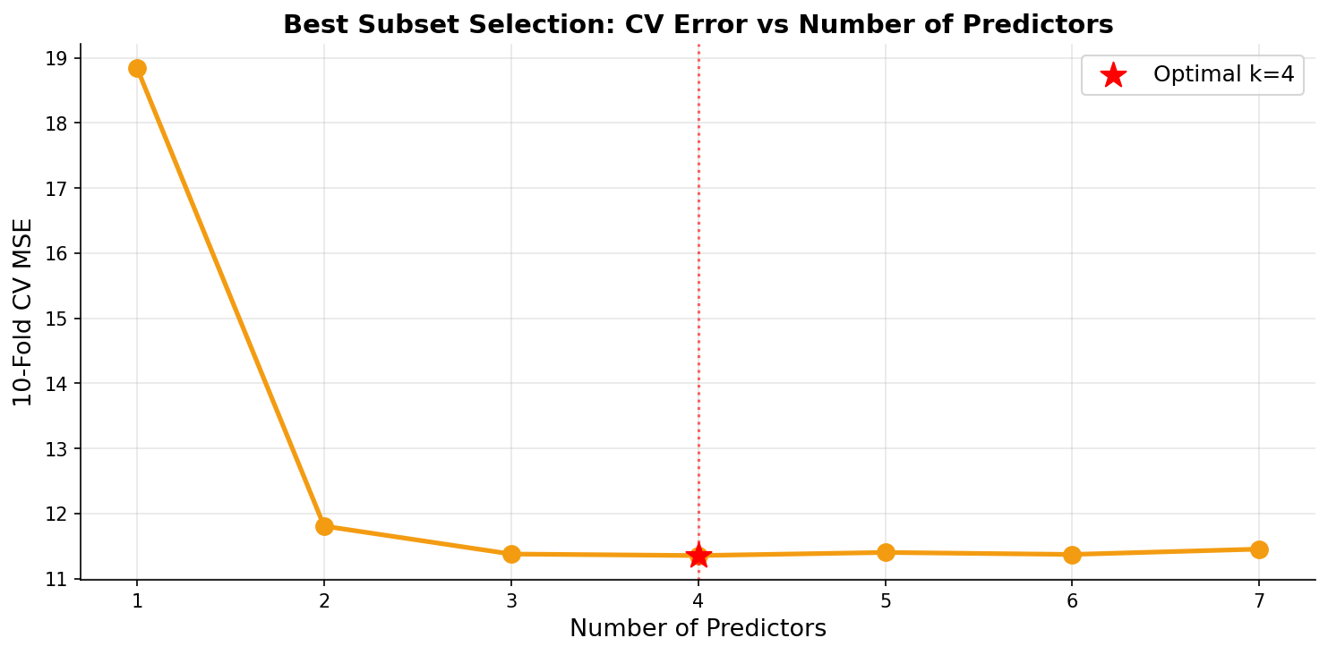
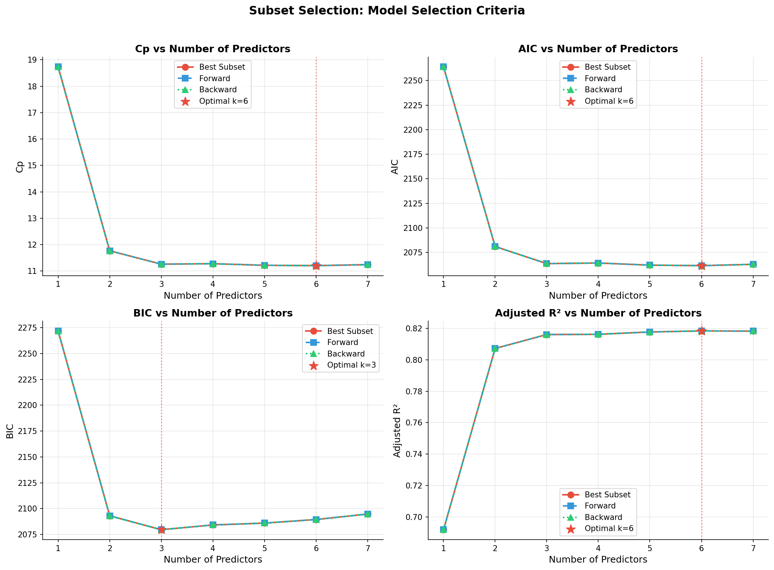
Subset Selection
05
Best subset, forward stepwise, backward stepwise
k | AIC | BIC | Cp | Adj R² | CV MSE
1 | 2263.9 | 2271.9 | 18.73 | 0.692 | 18.84
2 | 2081.1 | 2093.0 | 11.77 | 0.807 | 11.81
3 | 2063.7 | 2079.6 | 11.26 | 0.816 | 11.38
4 ★ | 2064.3 | 2084.2 | 11.28 | 0.816 | 11.35
5 | 2062.1 | 2086.0 | 11.22 | 0.818 | 11.40
6 | 2061.6 | 2089.4 | 11.21 | 0.818 | 11.37
7 | 2062.9 | 2094.7 | 11.24 | 0.818 | 11.45
Optimal k=4 features:
displacement, weight, model_year, origin CV MSE = 11.35 (vs 11.45 for full OLS)

Slide 9
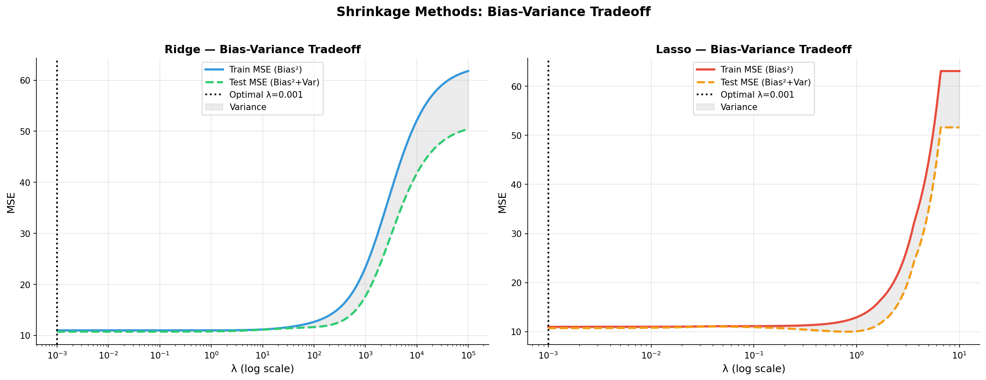
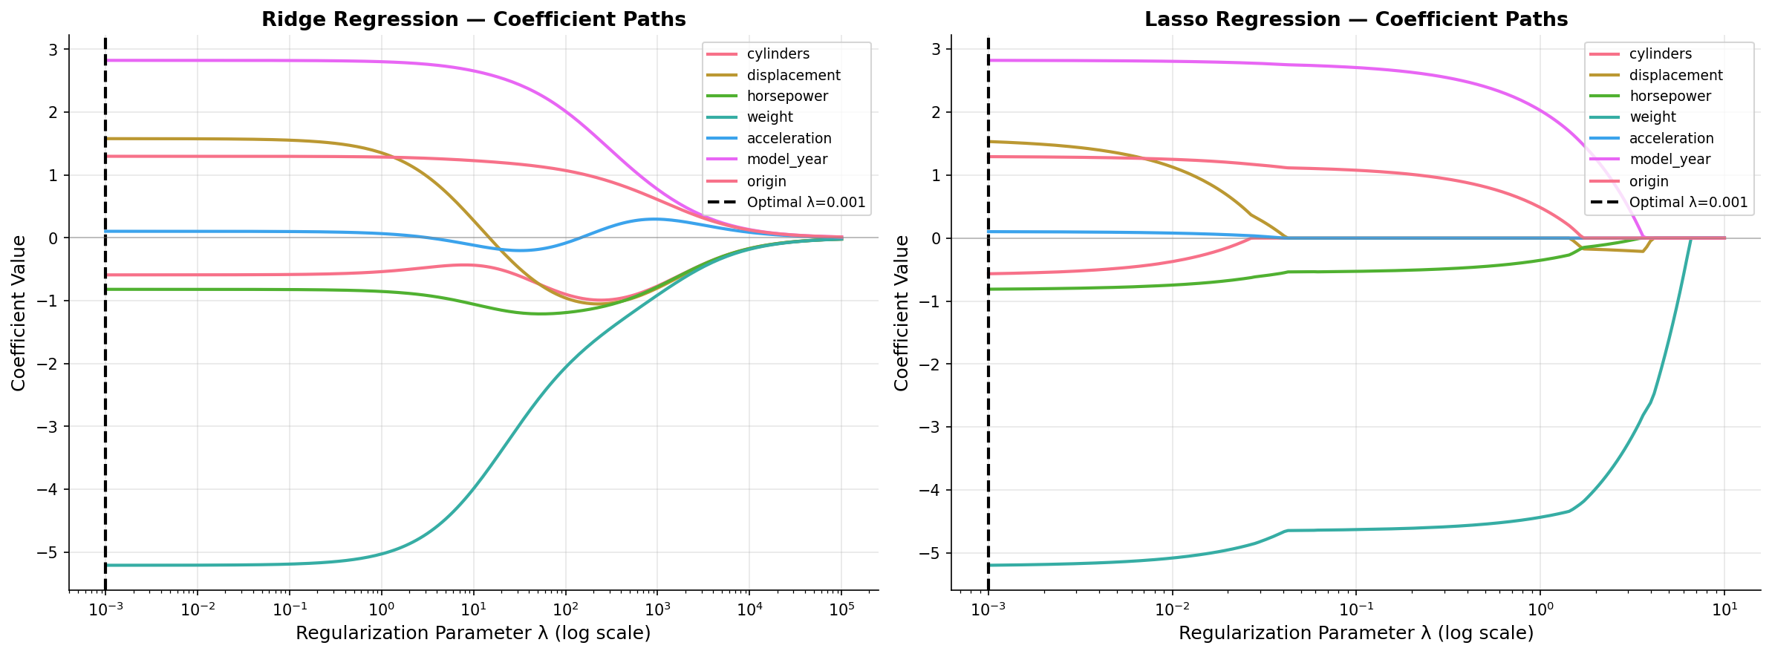
Shrinkage Methods: Ridge & Lasso
06
L2 and L1 regularization with optimal λ via 10-fold CV
Feature | OLS | Ridge | Lasso
cylinders | −0.84 | −0.84 | −0.82
displacement | 2.08 | 2.08 | 2.03
horsepower | −0.65 | −0.65 | −0.64
weight | −5.49 | −5.49 | −5.48
acceleration | 0.22 | 0.22 | 0.22
model_year | 2.76 | 2.76 | 2.76
origin | 1.15 | 1.15 | 1.14
Optimal λ = 0.001 for both Ridge and Lasso
Coefficients ≈ OLS → weak regularization sufficient Lasso slightly shrinks displacement, cylinders

Slide 10
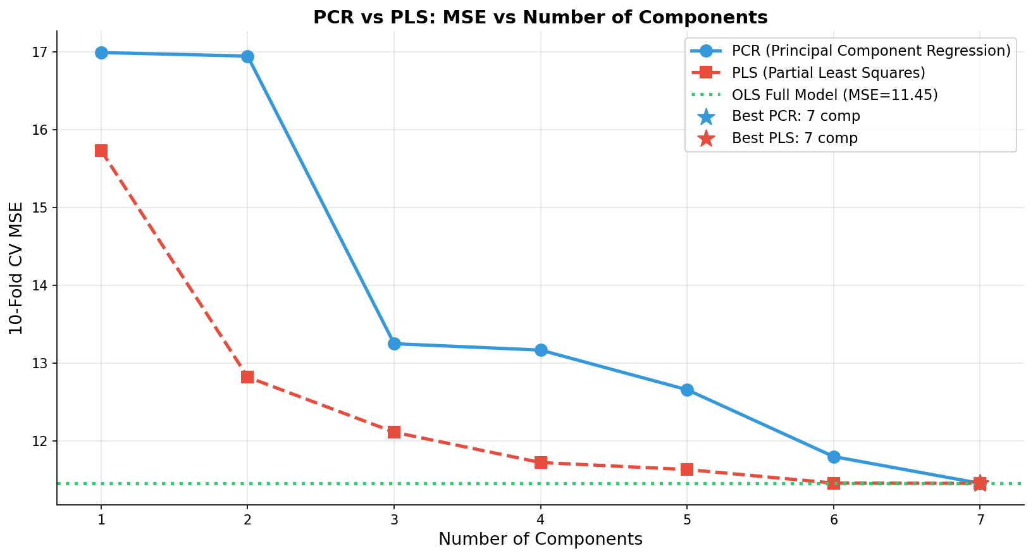
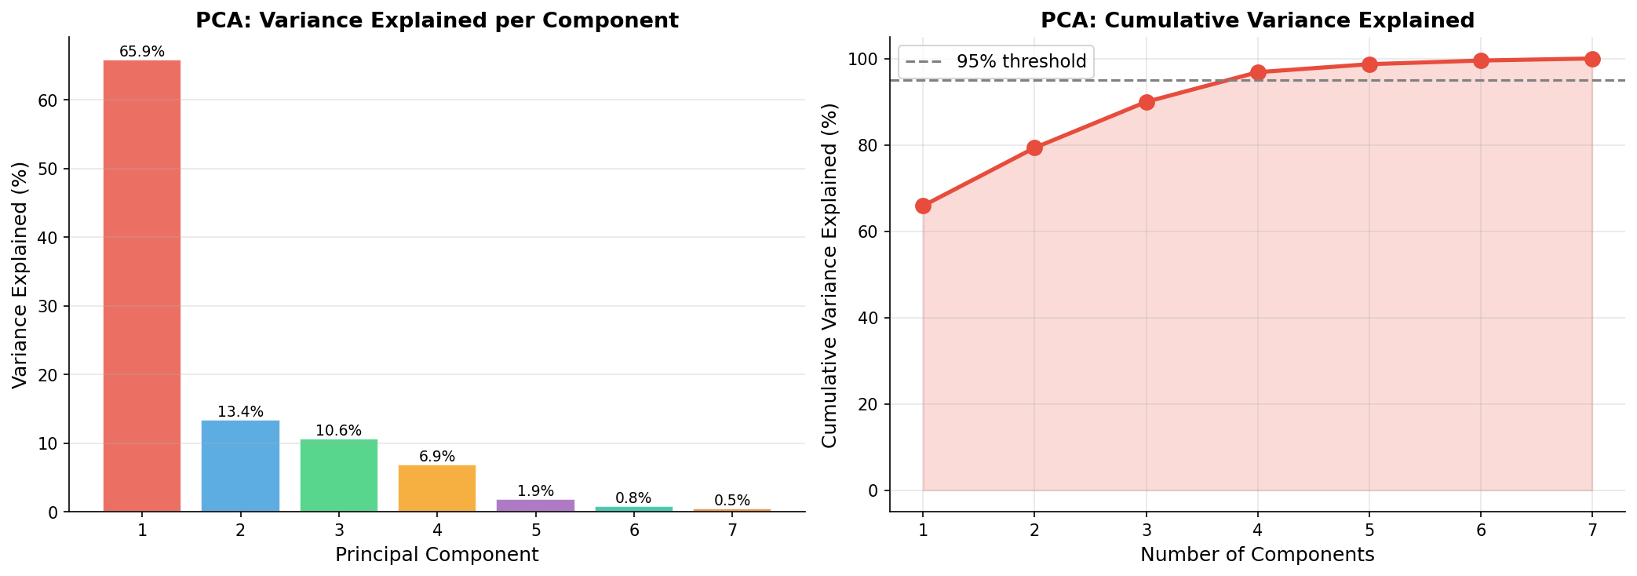
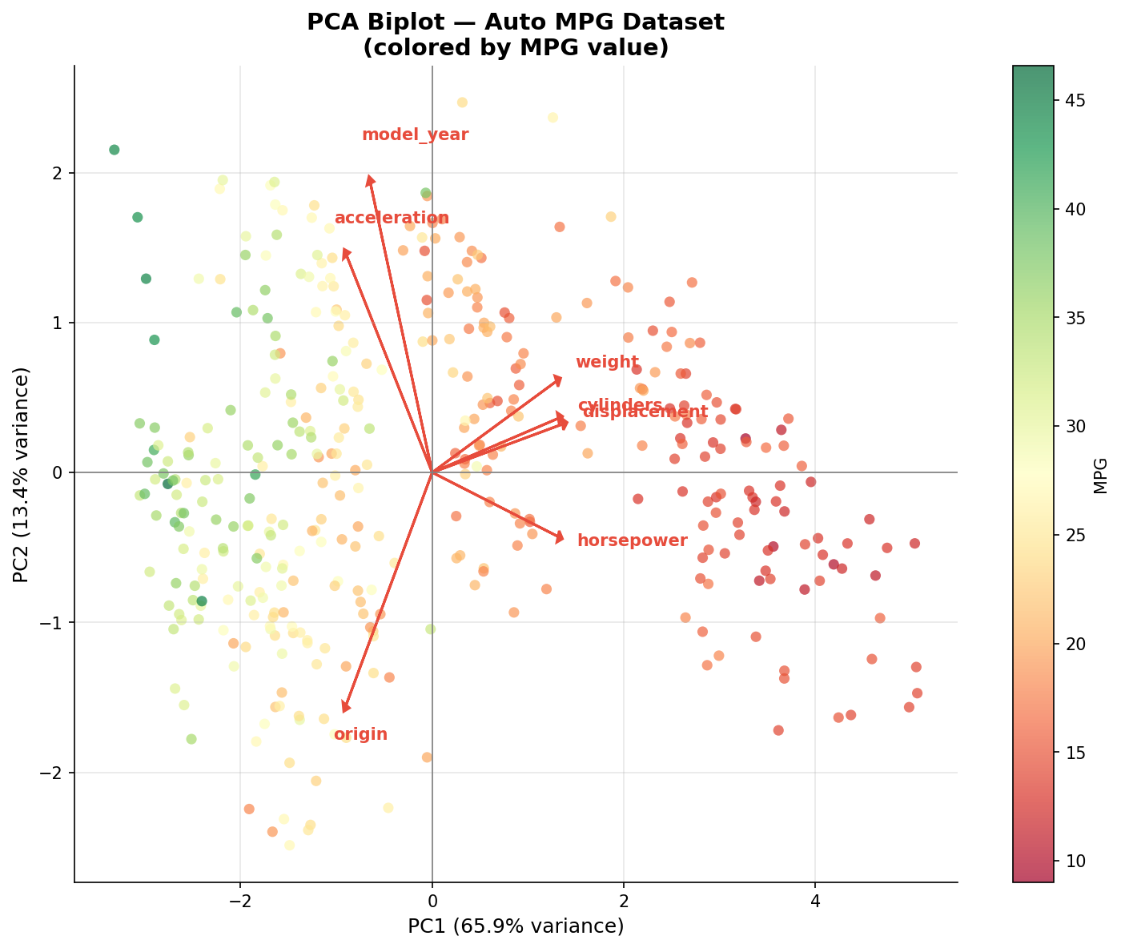
PCA & PLS: Dimensionality Reduction
07
Principal Component Regression vs Partial Least Squares
Comp. | PCR MSE | PLS MSE
1 | 16.99 | 15.73
2 | 16.94 | 12.82
3 | 13.25 | 12.11
4 | 13.16 | 11.72
5 | 12.65 | 11.63
6 | 11.80 | 11.46
7 | 11.45 | 11.45
▸ PCA Variance: PC1=65.9%, PC2=13.4%, PC3=10.6% (top 3 ≥ 95%)
▸ PLS advantage: Reaches OLS performance with fewer components
▸ At 7 components: Both PCR and PLS match OLS (MSE ≈ 11.45)

Slide 11
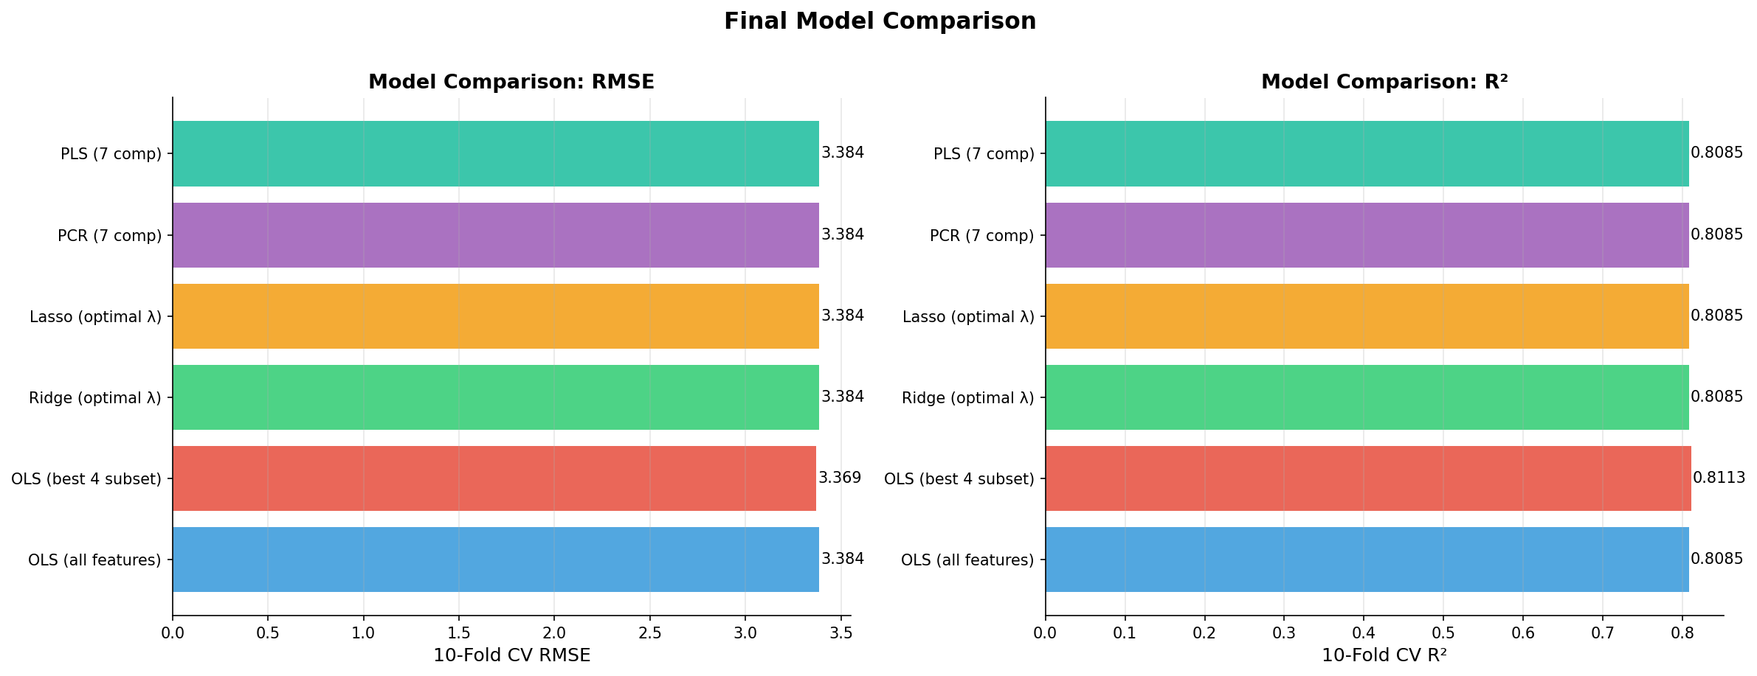
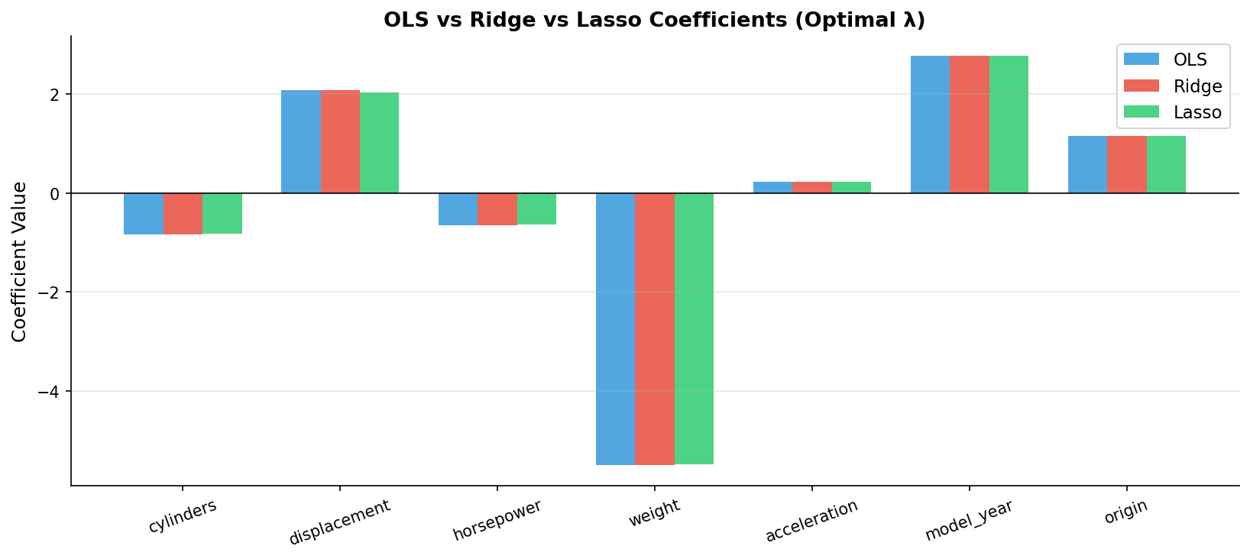
Final Model Comparison
08
10-fold cross-validation across all methods
Model | CV MSE | CV RMSE | CV R²
OLS (all features) | 11.452 | 3.384 | 0.8085
OLS (best 4 subset) ★ | 11.353 | 3.369 | 0.8113
Ridge (λ=0.001) | 11.452 | 3.384 | 0.8085
Lasso (λ=0.001) | 11.451 | 3.384 | 0.8085
PCR (7 comp) | 11.452 | 3.384 | 0.8085
PLS (7 comp) | 11.452 | 3.384 | 0.8085
★ Best Model: OLS with 4-feature subset
• RMSE = 3.369, R² = 0.8113 • Removing cylinders, horsepower, acceleration reduces noise without losing predictive power

Slide 12
Interactive Dashboard
09
Streamlit application for exploration and live prediction
▸ 📊 Resampling Explorer: Visualize CV and bootstrap for polynomial degrees
▸ 🔍 Subset Selection: Interactive best subset, forward/backward stepwise
▸ 📈 Shrinkage Analysis: Ridge & Lasso coefficient paths and bias–variance
▸ 🧩 PCA/PLS Viewer: Component analysis with variance plots
▸ 🏆 Model Comparison: Side-by-side metrics for all 6 models
▸ 🚗 Live Prediction Lab: Car presets (70s V8, 80s economy) + custom inputs
Run:
streamlit run streamlit_app.py
Source: github.com/ggurbanov12098/AppliedML-P3

Slide 13
Conclusion & Key Findings
10
▸ Resampling: Degree 2 polynomial on weight is optimal across all methods (K=5, K=10, LOOCV, bootstrap)
▸ Subset Selection: 4 predictors (displacement, weight, model_year, origin) minimize CV MSE
▸ Shrinkage: Ridge & Lasso both yield λ = 0.001; coefficients ≈ OLS → weak regularization sufficient
▸ PCA/PLS: PLS reaches full OLS performance with fewer components than PCR
▸ Best Model: OLS with 4-feature subset — RMSE = 3.369, R² = 0.8113
Future Work
▸ Non-linear models (Random Forest, Gradient Boosting, Neural Networks)
▸ Larger and more diverse datasets for generalization
▸ Advanced feature engineering strategies

Slide 14
Thank You!
Questions?
Riyad Abdurrahmanov • Gabil Gurbanov
Applied Machine Learning — Project 3
github.com/ggurbanov12098/AppliedML-P3

