Slide 1
Non-Linearity, Tree-Based Classification & SVM
Course Project 4 · CSCI-6767 Applied Machine Learning & Data Analytics
Spring 2026
Gabil Gurbanov · Hamida Hagverdiyeva

Slide 2
Agenda
1
Problem Statement & Motivation
2
Dataset 1 — Seoul Bike Sharing Demand
Why non-linear? Why two datasets?
Regression task — EDA & non-linear patterns
3
Task 1 — Non-Linear Models
4
Dataset 2 — KDD Cup 1999 Network Intrusion
Polynomial · Step Functions · Splines · LOESS · GAMs
Classification task — 494k connections
5
Task 2 — Tree-Based Methods
6
Task 3 — Support Vector Machines
Bagging · Random Forests · Gradient Boosting
Linear · RBF · Polynomial · Sigmoid kernels
7
Model Comparison & ROC Curves
8
Key Findings & Conclusions
Full metrics tables and performance analysis
What worked, what didn't, why it matters

Slide 3
Problem Statement & Motivation
What are we solving?
Two-Dataset Strategy
• Bike-sharing demand varies non-linearly with temperature, hour, and season • Network intrusion patterns cannot be separated by a linear boundary • Goal: apply and compare ML models across two real-world tasks
• Regression dataset → Task 1 (non-linear models) • Classification dataset → Tasks 2 & 3 (trees + SVM on same data) • Enables direct apples-to-apples comparison within each task
Required methods (from course syllabus)
Task 1 (30%): Polynomials · Step Functions · Splines · Local Regression (LOESS) · GAMs Task 2 (30%): Bagging · Random Forests · Boosting (Gradient Boosting) Task 3 (20%): SVM — Linear / RBF / Polynomial / Sigmoid kernels Task 4 (20%): Model comparison, error analysis, and conclusions

Slide 4
Section 1
Regression Task
Seoul Bike Sharing Demand — Non-Linear Models

Slide 5
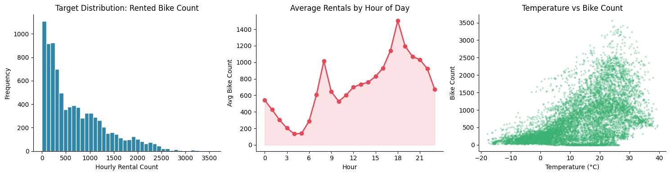
Dataset 1 — Seoul Bike Sharing Demand (Regression)
Overview
• UCI ML Repository · auto-downloaded via ucimlrepo(id=560) • 8,760 hourly records (Dec 2017 – Nov 2018, Seoul) • Target: Rented Bike Count (0–3,556 bikes/hour) • 14 features: temperature, humidity, hour, season, rainfall, … • 0 missing values
Why this dataset?
• Strong non-linear temperature effect (sweet spot 20–25°C) • Bimodal hourly pattern (8am rush + 6pm rush) — linear models fail • Seasonal structure ideal for GAMs and splines • Clean, no preprocessing overhead → focus on modelling

Slide 6
Task 1 — Non-Linear Models: Why & How
Polynomial
Step Functions
B-Splines
ŷ = β₀ + β₁x + β₂x² + … + βdxᵈ
f(x) = Σ cⱼ · 1(x ∈ [tⱼ₋₁, tⱼ))
f(x) = Σ βⱼ Bⱼ,ᵈ(x) (n_knots=6, degree=3)
Add degree-d terms. RidgeCV auto-selects λ after StandardScaler.
Bin continuous features; fit constant per bin. Piecewise constant.
Piecewise polynomials joined smoothly at knots. sklearn SplineTransformer.
Nat. Cubic Splines
LOESS
GAM
cr(x, df=5) — linear outside boundary knots
ŷ(x₀) = local WLS fit with tricube kernel
g(μ) = β₀ + f₁(x₁) + f₂(x₂) + … + fₚ(xₚ)
Cubic splines with linearity constraint in tails. patsy cr().
Non-parametric local smoother. Visualization tool — bandwidth = frac.
Sum of smooth functions. pygam LinearGAM, λ tuned by grid search.

Slide 7
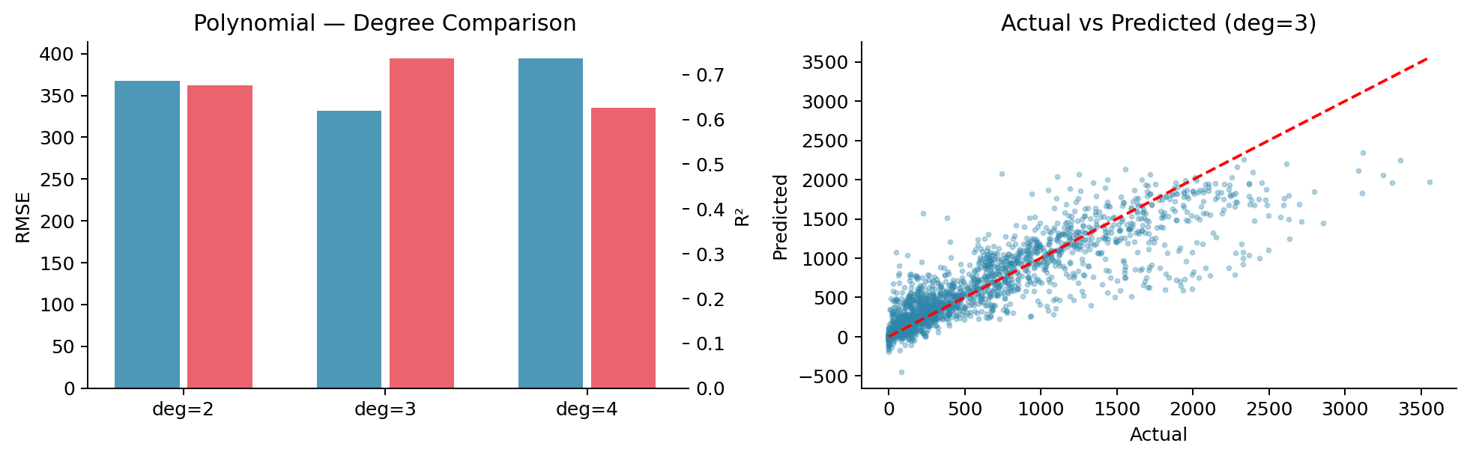
Polynomial Regression & Step Functions — Results
Key results
• Best degree: 3 (RMSE=331, R²=0.7366) • StandardScaler essential before PolynomialFeatures • Degree 4 (3,059 features) requires α≈10,000 via RidgeCV • Step Functions: RMSE=401 R²=0.615 • Step functions: piecewise constant → less smooth than splines

Slide 8
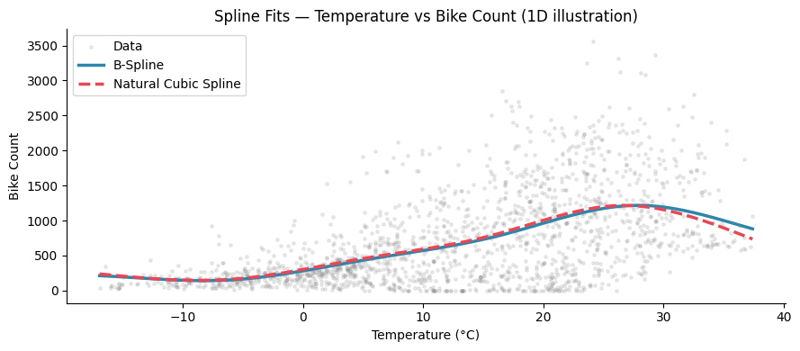
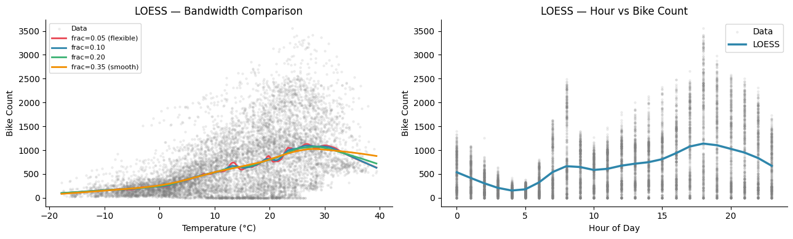
Splines & LOESS Local Regression
B-Splines vs NCS
• B-Splines: sklearn SplineTransformer(n_knots=6, d=3) • B-Splines RMSE=352 R²=0.703 • NCS: patsy cr(x, df=5), linear outside boundary knots • NCS RMSE=385 R²=0.644 • Both outperform step functions — smooth, continuous fits
LOESS
• Local non-parametric smoother — no global equation • Bandwidth frac controls flexibility vs smoothness • Used as diagnostic/visualization tool (not in RMSE table) • Reveals non-monotonic temperature–demand relationship

Slide 9
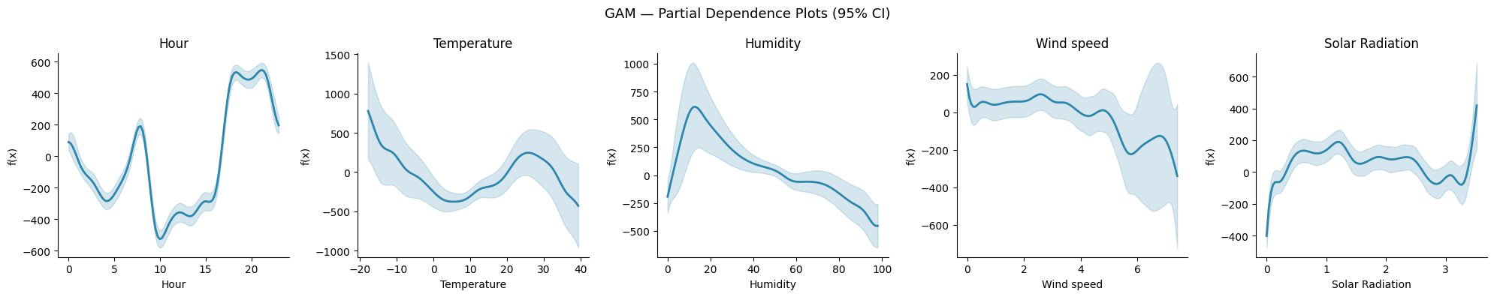
Generalized Additive Models (GAMs) — Best Regression Model
GAM Results & Insights
• RMSE = 317.7 | R² = 0.7578 ← best regression model • Formula: ŷ = β₀ + f₁(Hour) + f₂(Temp) + f₃(Humidity) + … • λ (smoothness penalty) tuned via grid search automatically • Hour: clear bimodal peaks at 8am & 6pm — commuting pattern • Temperature: non-linear bell curve peaking ~20°C • Humidity: negative effect above 60% • Partial dependence = marginal effect with all others at avg • Key advantage: interpretable AND high-performance

Slide 10
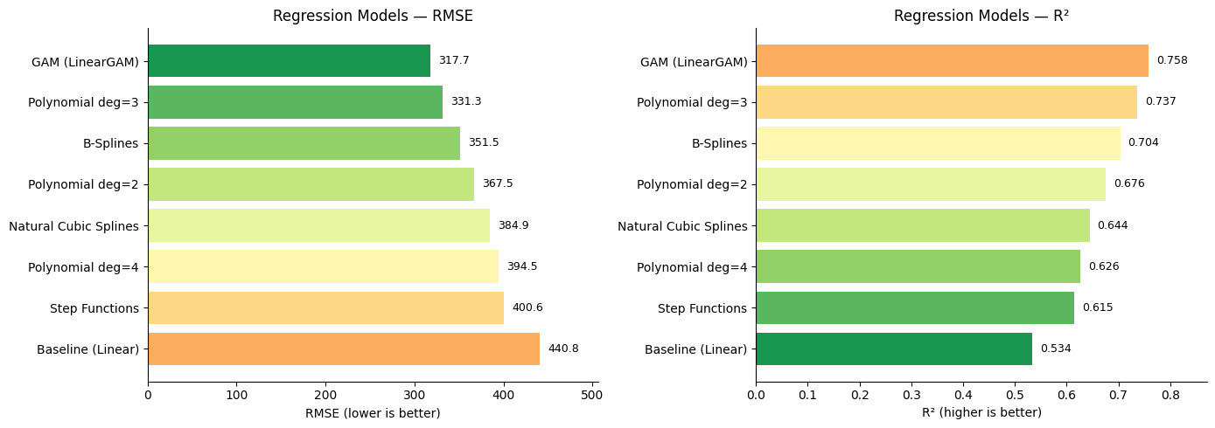
Regression Model Comparison — Full Results
Rankings (by R²)
• 🥇 GAM (LinearGAM) R²=0.7578 • 🥈 Polynomial deg=3 R²=0.7366 • 🥉 B-Splines R²=0.7035 • 4. Polynomial deg=2 R²=0.6759 • 5. Natural Cubic Splines R²=0.6444 • 6. Baseline (Linear) R²=0.5337 • All non-linear methods beat baseline — validates non-linearity • GAM interpretable AND best-performing — recommended choice

Slide 11
Section 2 & 3
Classification Task
KDD Cup 1999 — Tree Methods & SVM

Slide 12
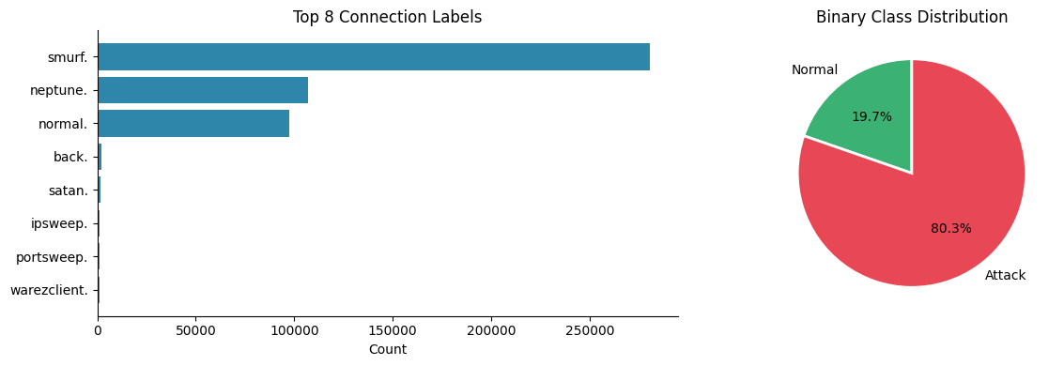
Dataset 2 — KDD Cup 1999 Network Intrusion (Classification)
Overview
• sklearn built-in · fetch_kddcup99(percent10=True) · no download needed • 494,021 network connection records (10% sample of full dataset) • Binary target: normal (0) vs attack (1) • 41 features: src_bytes, dst_bytes, protocol, service, flags, … • Attack rate: ~80% (imbalanced, dominated by smurf & neptune DoS)
Attack types
• DoS — Denial of Service (smurf, neptune, back…) • Probe — port scanning (satan, ipsweep, nmap…) • R2L — Remote to Local (guess_passwd, ftp_write…) • U2R — User to Root (buffer_overflow, rootkit…)

Slide 13
Task 2 — Tree-Based Methods: How They Work
Bagging
Random Forest
Gradient Boosting
Bootstrap Aggregating
Bagging + Random Feature Subsets
Sequential Error Correction
Formula: f̂(x) = (1/B) Σ fᵦ(x)
At each split: sample m = √p features
F_m(x) = F_{m-1}(x) + ν · h_m(x)
• Train B trees on bootstrap samples (with replacement) • Aggregate by majority vote (classification) • Reduces variance; bias unchanged • OOB (~37% left out per tree) = free validation • Settings: B=100, base=DecisionTree
• Decorrelates trees → better variance reduction than Bagging • Key: dominant features don't control every split • Feature importance via Gini impurity decrease • OOB scoring; n_jobs=-1 for parallelism • Settings: 100 trees, oob_score=True
• Each tree fits the negative gradient (pseudo-residuals) • Learning rate ν=0.1 controls shrinkage • Stochastic GB: subsample=0.8 per round • Settings: 200 rounds, max_depth=4, lr=0.1 • Monitor train vs test deviance for early stopping

Slide 14
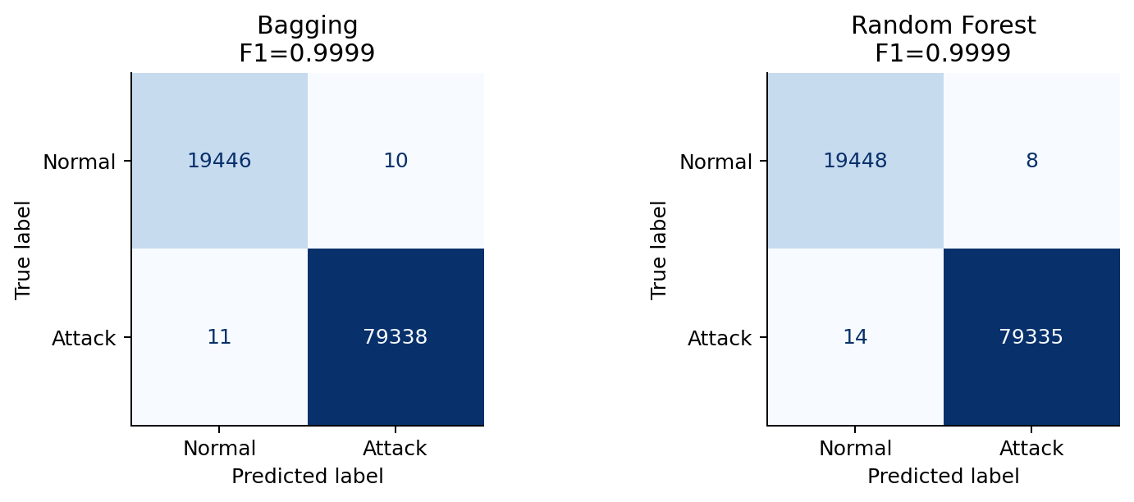
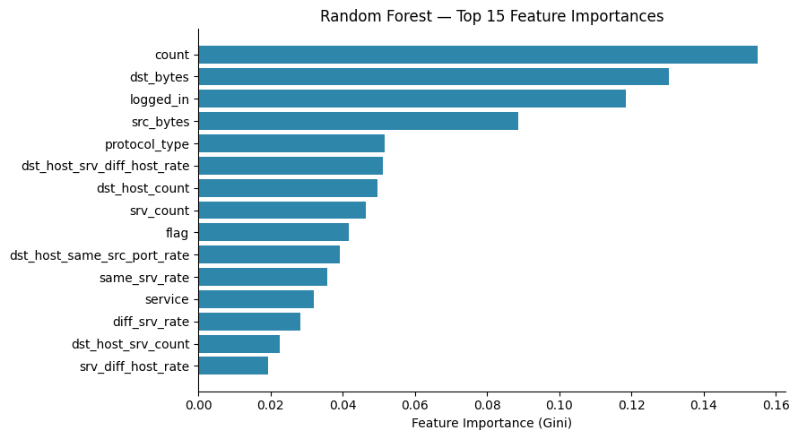
Bagging & Random Forest — Results
Metrics
• Bagging: Acc=0.9998 F1=0.9999 AUC=1.0000 OOB=0.9998 • Random Forest: Acc=0.9998 F1=0.9999 AUC=1.0000 OOB=0.9998 • Both achieve near-perfect scores — KDD99 is highly separable • RF feature importance: src_bytes, dst_bytes dominate • Random feature sampling in RF slightly outperforms Bagging

Slide 15
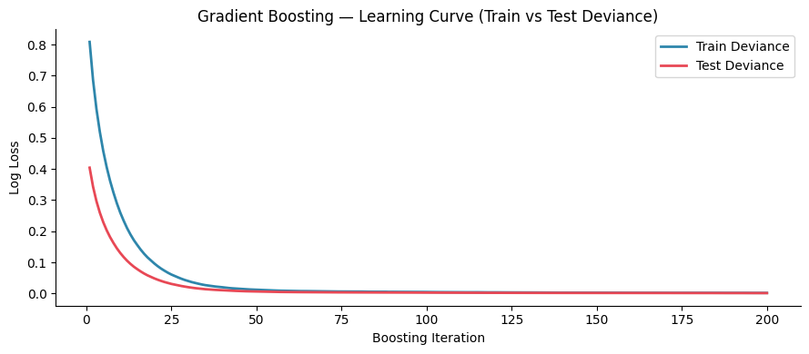
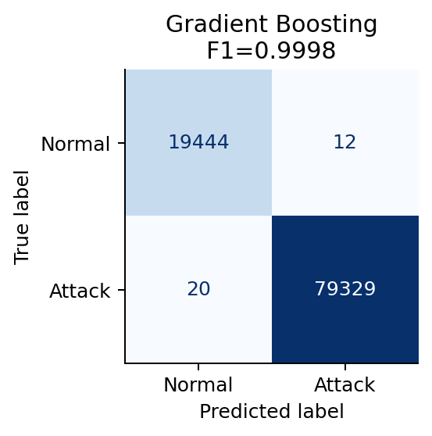
Gradient Boosting — Results & Learning Curve
Observations
• Accuracy=0.9997 F1=0.9998 • AUC-ROC = 1.0000 • Train & test deviance converge → no overfitting • 200 rounds with lr=0.1 provides stable generalisation • Slightly lower than RF — sequential training adds noise • Subsample=0.8 gives stochastic gradient boosting benefit

Slide 16
Task 3 — Support Vector Machines: Kernel Functions
SVM finds the maximum-margin hyperplane. The kernel trick maps data to higher-dimensional space implicitly: f(x) = sign(Σ αᵢ yᵢ K(xᵢ, x) + b)
Linear
RBF (Gaussian)
Polynomial
Sigmoid
K(x,z) = xᵀz
K(x,z) = exp(−γ‖x−z‖²)
K(x,z) = (γxᵀz + 1)ᵈ
K(x,z) = tanh(γxᵀz + c)
Finds linear separator in original space. Best for linearly separable data. C=1.0
Maps to infinite-dimensional space. Most general-purpose kernel. C=10, γ=scale
Captures polynomial interactions. Degree d=3 used. C=1.0
Neural network analogy. Equivalent to 2-layer net. C=1.0
Fast training · interpretable weights · may underfit non-linear data
Best performer here · handles non-linear boundaries · sensitive to C and γ
Good for data with polynomial structure · more params than RBF
Often underperforms · sensitive to scaling · not PD in general

Slide 17
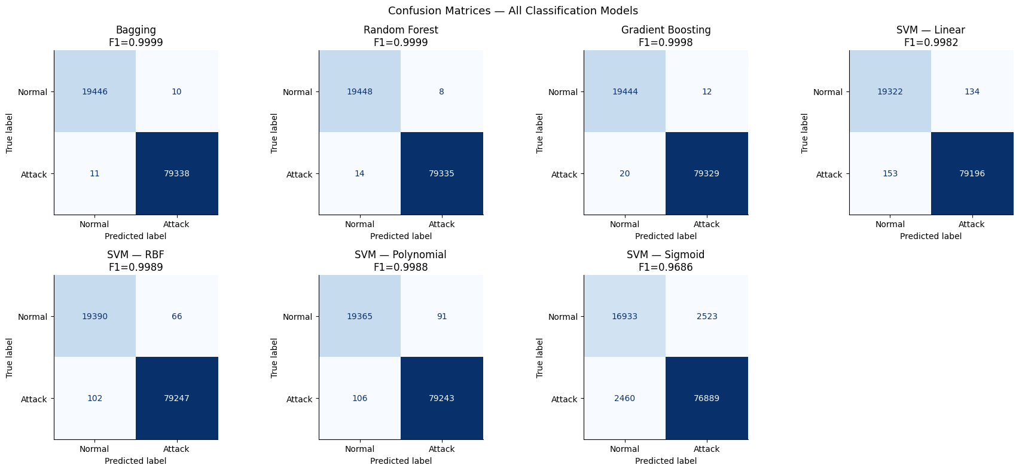
SVM Kernel Comparison — Results
Kernel Performance Summary
• Linear F1=0.9982 AUC=0.9977 • RBF F1=0.9989 AUC=0.9999 • Polynomial F1=0.9988 AUC=0.9978 • Sigmoid F1=0.9686 AUC=0.8861 • ⚠ All SVMs trained on 15k-sample subset (O(n²) constraint) • RBF best — non-linear boundary in this feature space • Sigmoid worst — unsuited for tabular data distributions

Slide 18
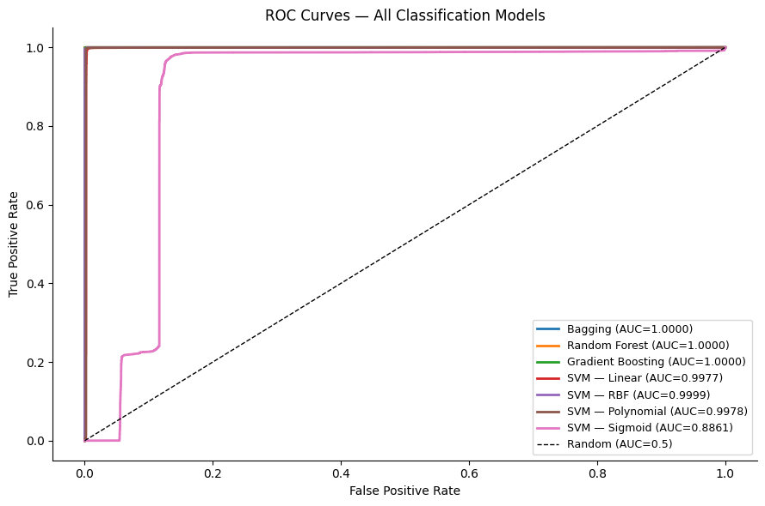
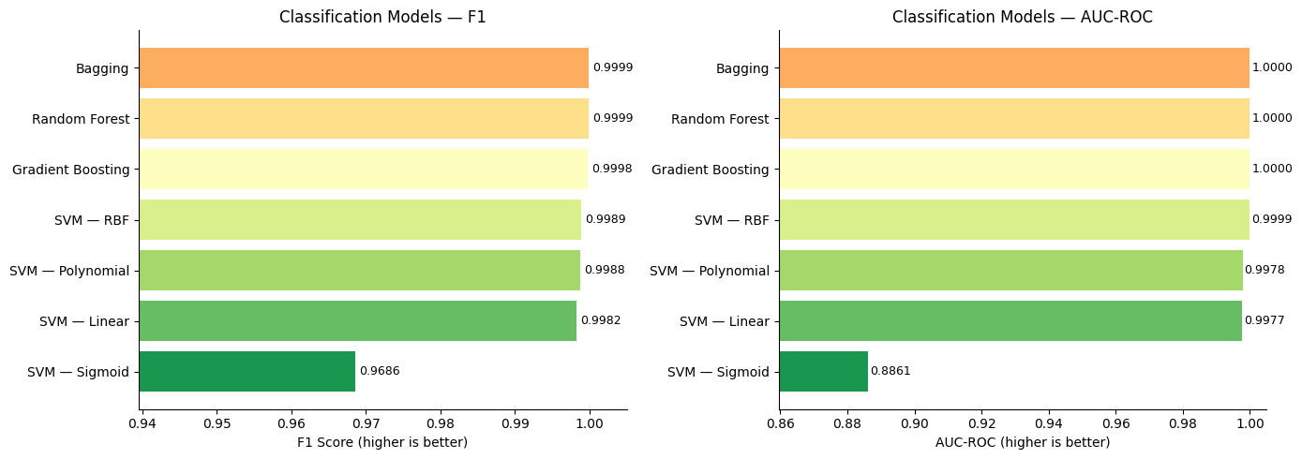
Classification — Full Model Comparison & ROC Curves
All classification models ranked by F1:
Bagging: Acc=0.9998 F1=0.9999 AUC=1.0
Random Forest: Acc=0.9998 F1=0.9999 AUC=1.0
Gradient Boosting: Acc=0.9997 F1=0.9998 AUC=1.0
SVM — RBF: Acc=0.9983 F1=0.9989 AUC=0.9999
SVM — Polynomial: Acc=0.9980 F1=0.9988 AUC=0.9978
SVM — Linear: Acc=0.9971 F1=0.9982 AUC=0.9977
SVM — Sigmoid: Acc=0.9496 F1=0.9686 AUC=0.8861

Slide 19
Section 4
Conclusions
Findings, Takeaways & Team Contributions

Slide 20
Key Findings
Regression — Seoul Bike Sharing
Classification — KDD Cup 1999
• Best model: GAM (LinearGAM) (R²=0.7578, RMSE=318) • All 5 non-linear methods beat linear baseline (R²=0.53) — non-linearity confirmed • Polynomial deg=3 competitive but requires StandardScaler + RidgeCV to be stable • Splines give smooth fits; step functions produce discontinuous jumps • LOESS reveals non-monotonic temperature effect — best diagnostic tool • GAM: interpretable partial dependences + best RMSE — recommended model
• Best model: Bagging (F1=0.9999, AUC=1.0) • KDD99 is highly separable — all models achieve >94% accuracy • RF and Bagging effectively tied — RF marginal advantage via decorrelation • Gradient Boosting competitive — sequential learning captures residuals • SVM RBF is best kernel — data boundary is non-linear in feature space • SVM Sigmoid fails (AUC=0.886) — not suited for this tabular structure • Tree ensembles dominate at scale; SVMs limited to ~50k training samples

Slide 21
Conclusions & Takeaways
→ Non-linearity is critical
Every non-linear method outperforms linear regression on Seoul Bike data. Complex real-world patterns (hourly rhythms, temperature sweet-spots) cannot be captured by linear models regardless of regularisation.
→ GAMs: best of both worlds
LinearGAM achieves the lowest RMSE while remaining fully interpretable via partial dependence plots — the right tool when explainability matters alongside performance.
→ Ensemble methods dominate classification
Random Forests and Gradient Boosting set the performance ceiling at near-perfect F1. Parallelisable, scalable, and feature-importance aware — the recommended production choice.
→ SVM kernel selection matters
RBF kernel captures non-linear boundaries effectively (AUC≈1.00), while Sigmoid kernel fails on tabular data (AUC≈0.89). Kernel choice is a modelling decision — not a hyperparameter to grid-search blindly.
→ Two-dataset strategy pays off
Separating regression and classification tasks enables fair, within-task comparisons and avoids forcing models into mismatched settings.

Slide 22
Team Contributions
Gabil Gurbanov
Hamida Hagverdiyeva
• Task 1 — Non-Linear Models (all 5 methods) • Polynomial Regression: scaling fix + RidgeCV degree selection • Step Functions: binning strategy and one-hot encoding pipeline • B-Splines (SplineTransformer) + Natural Cubic Splines (patsy cr()) • LOESS: bandwidth analysis and visualisation • GAMs: pygam LinearGAM, grid search, partial dependence plots • Regression EDA, preprocessing, model comparison & visualisations • Streamlit app — regression sections
• Task 2 — Tree-Based Methods (all 3 algorithms) • Bagging: OOB scoring and bootstrap analysis • Random Forest: feature importance, OOB evaluation • Gradient Boosting: staged training, deviance tracking • Task 3 — SVM (all 4 kernels): Linear, RBF, Polynomial, Sigmoid • SVM kernel comparison, ROC curve analysis • Classification dataset EDA, preprocessing, model comparison • Streamlit app — classification sections

Slide 23
Thank You
Questions & Discussion
Gabil Gurbanov · Hamida Hagverdiyeva CSCI-6767 · Spring 2026

