Slide 1
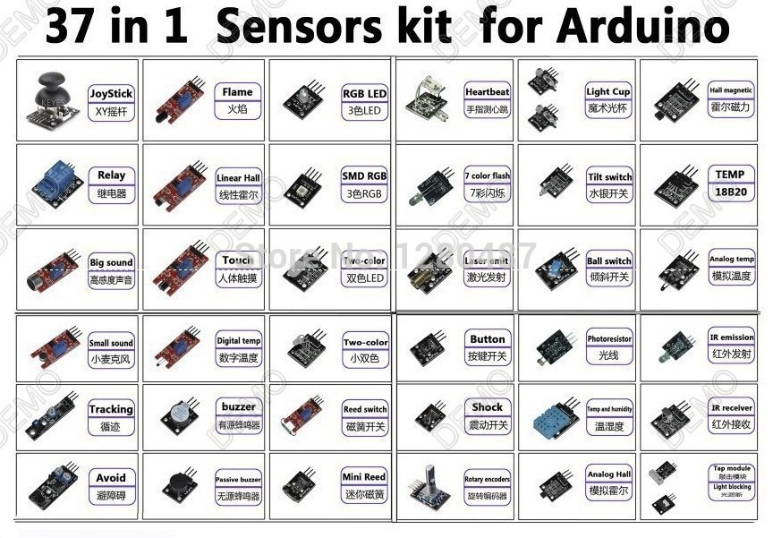
37 in 1 box Sensor Kit For Arduino Starters keyes brand in stock
Features:
KEYES Brand new 37 in 1 Sensor Kit for Arduino
Material: Circuit board
Includes basic components and sensors
Compatible with Arduino
Package Included:
1 x Small passive buzzer module KY-006
1 x 2-color LED module KY-011
1 x Hit sensor module KY-031
1 x Vibration switch module KY-002
1 x Photo resistor module KY-018
1 x Key switch module KY-004
1 x Tilt switch module KY-020
1 x 3-color full-color LED SMD modules KY-009
1 x Infrared emission sensor module KY-005
1 x 3-color LED module KY-016
1 x Mercury open optical module KY-017
1 x Yin Yi 2-color LED module 3MM KY-029
1 x Active buzzer module KY-012
1 x Temperature sensor module KY-013
1 x Automatic flashing colorful LED module KY-034
1 x Mini magnetic reed modules KY-021
1 x Hall magnetic sensor module KY-003
1 x Infrared sensor receiver module KY-022
1 x Class Bihor magnetic sensor KY-035
1 x Magic light cup module KY-027
1 x Rotary encoder module KY-040
1 x Optical broken module KY-010
1 x Detect the heartbeat module KY-039
1 x Reed module KY-025
1 x Obstacle avoidance sensor module KY-032
1 x Hunt sensor module KY-033
1 x Microphone sound sensor module KY-038
1 x Laser sensor module KY-008
1 x 5V relay module KY-019
1 x Temperature sensor module KY-001
1 x Temperature sensor module KY-028
1 x Linear magnetic Hall sensors KY-024
1 x Flame sensor module KY-026
1 x Sensitive microphone sensor module KY-037
1 x Temperature and humidity sensor module KY-015
1 x XY-axis joystick module KY-023
1 x Metal touch sensor module KY-036
KY-023
KY-026
KY-016
KY-039
KY-027
KY-003
KY-019
KY-024
KY-009
KY-034
KY-017
KY-001
KY-037
KY-036
KY-011
KY-008
KY-020
KY-013
KY-038
KY-028
KY-029
KY-004
KY-018
KY-005
KY-033
KY-012
KY-025
KY-002
KY-015
KY-022
KY-032
KY-006
KY-021
KY-040
KY-035
KY-031
KY-010

Slide 2
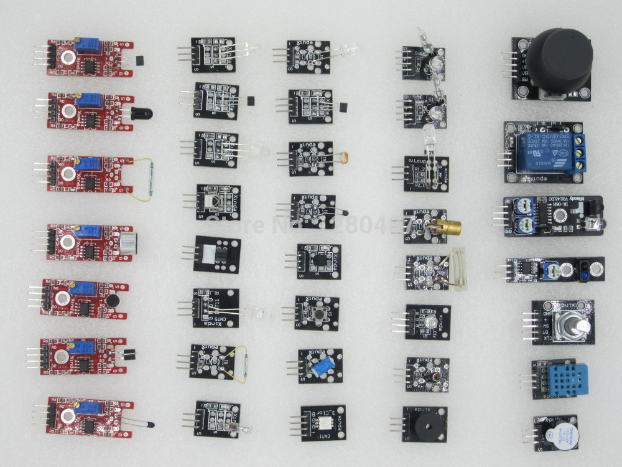
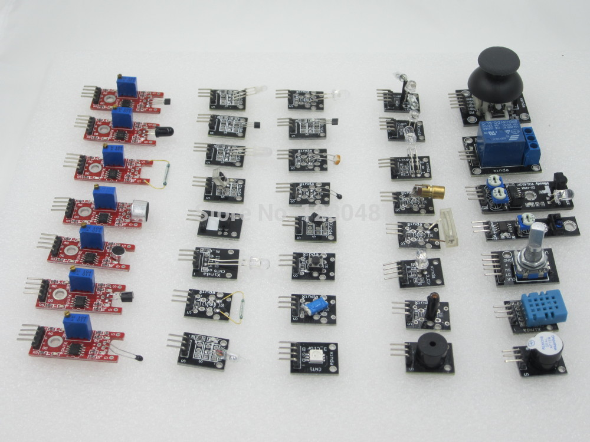
KY-024
KY-029
KY-035
KY-005
KY-027
KY-023
KY-026
KY-011
KY-003
KY-025
KY-039
KY-019
KY-022
KY-018
KY-037
KY-013
KY-008
KY-010
KY-032
KY-038
KY-034
KY-001
KY-031
KY-033
KY-036
KY-004
KY-016
KY-040
KY-021
KY-020
KY-002
KY-015
KY-028
KY-017
KY-009
KY-006
KY-012

