Slide 1
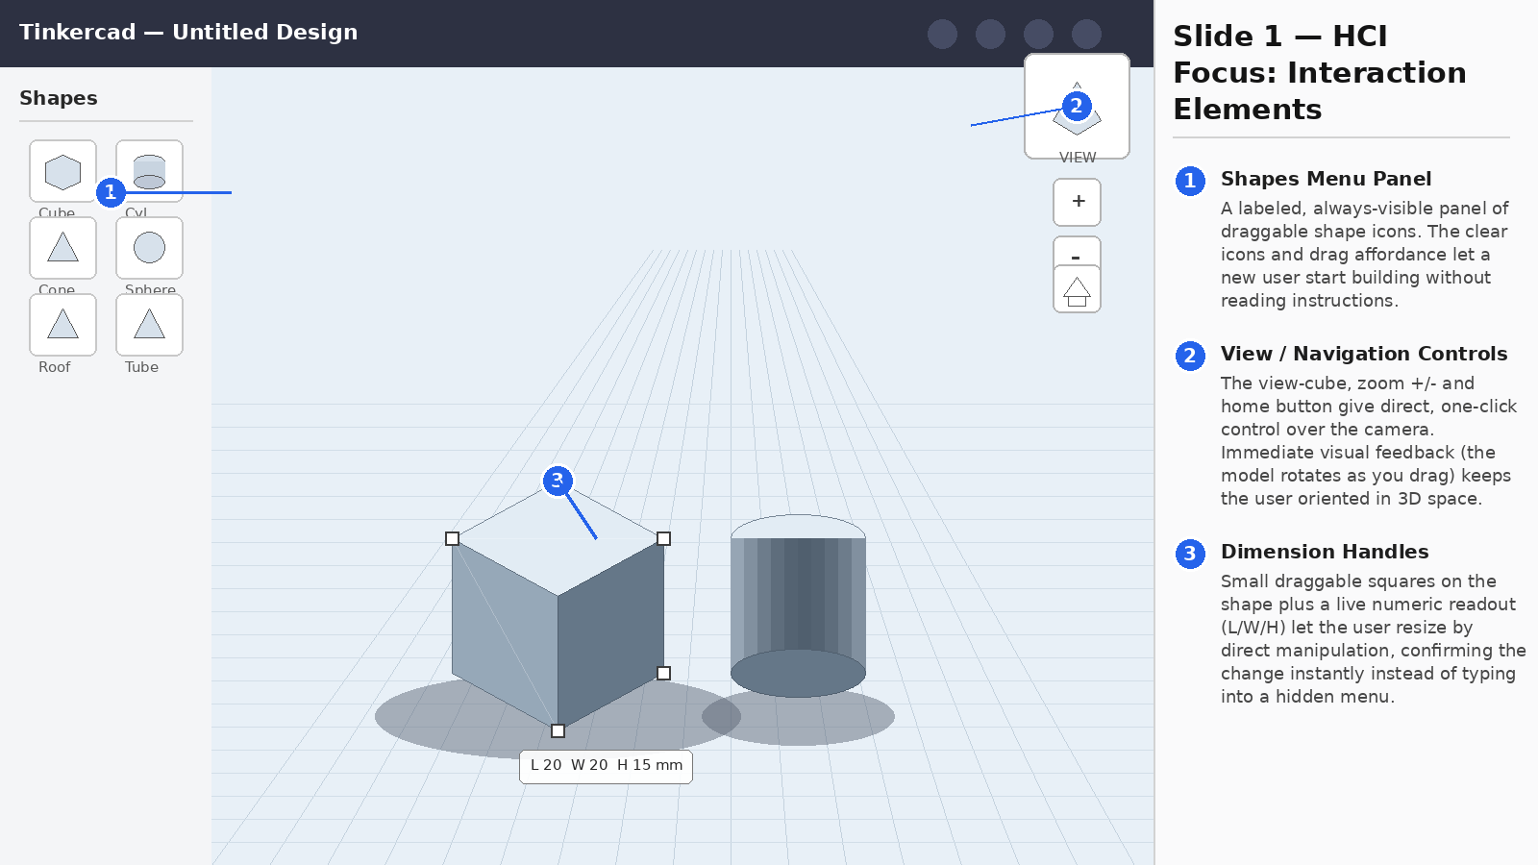
MUHAMMAD ABBAS BABAR KHAN • 2k24/CSE/89 • ASSIGNMENT: HCI VS COMPUTER GRAPHICS
Notes:
HCI focus: Tinkercad's shapes panel, view/navigation controls, and dimension handles.

Slide 2
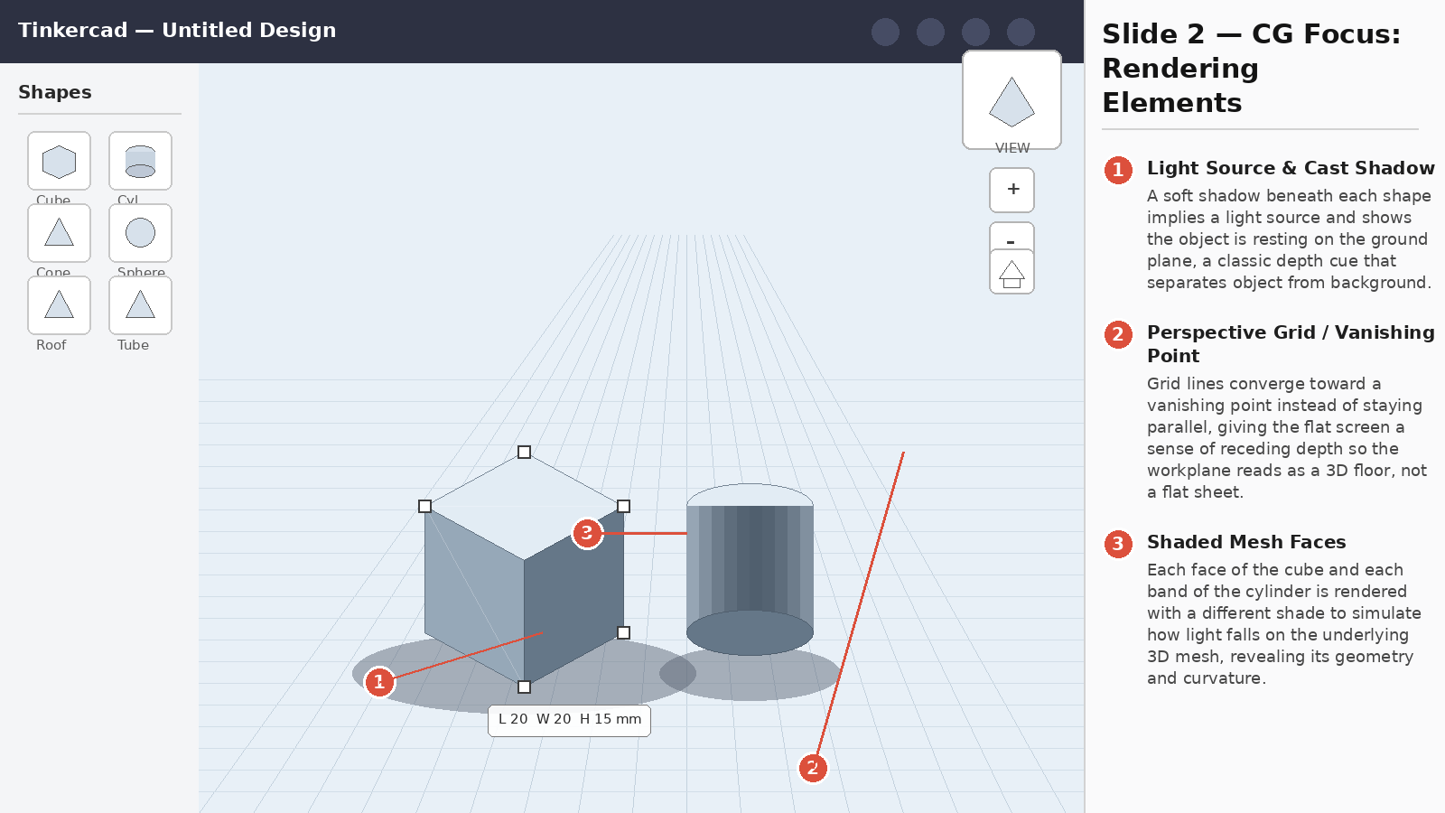
Reflection
1. Does CG quality help or hinder interaction?
2. One simple HCI change?
Tinkercad's simple shading and shadows make objects read as 3D instantly without slowing the app down, helping a beginner focus on modeling. Richer, more realistic lighting could hinder interaction by slowing rendering and making small features harder to click.
I would add a brief on-screen hint next to the view-cube (e.g. “Drag to rotate, scroll to zoom”) during a user’s first session, since the navigation icons are clear but their exact gestures aren’t obvious to first-time users.
MUHAMMAD ABBAS BABAR KHAN • 2k24/CSE/89 • ASSIGNMENT: HCI VS COMPUTER GRAPHICS
Notes:
CG focus: Tinkercad's cast shadows, perspective grid, and shaded mesh faces, plus the two reflection answers. App analyzed: Tinkercad — mockup illustrations used to represent the interface for annotation purposes.

