Slide 1




Online integrated platform for
projects taken up by the students of various universities/colleges.

Slide 2

PROBLEM STATEMENT
Objective : To develop an online integrated platform for projects taken up by the students of various universities/colleges.
Background: Innovation is the key to betterment of education and students in the Indian universities/colleges put a lot of efforts on the projects as a part of the academic requirements. If a common knowledge platform (with a facility for plagiarism) is created to bring all project works taken up at various levels by the students in Technical / Higher Educational Institutes and Universities throughout the country , then it will be a great source of knowledge and also will help the student community to take up unique/innovative project works.
Summary: An integrated platform should be developed where in all the universities/Colleges provide information about the projects done by the students. The information on this platform will help in the peer learning and this will also help in cross functional research between various universities/colleges.

Slide 3
THE SOLUTION
Our strategy strives to reach out to all learners around the country, and our mission is to empower everyone, both technical and non-technical person. For that, we have a website and a mobile app.
We embrace both software and hardware open sourcing. We want to highlight both technical and non-technical projects.
The solution facilitates project plagiarism and individual recognition, as well as user engagement (via program tab).
Organisation can keep a track on progress of the project via this solution.
We provide the project dashboard and can also publicise their initiative and engage with others in order to solicit contributions details (live link and other details) for contributions.
Colleges/universities can showcase the projects via their dashboard with features like global chat, Blogging, Facility for group project.
Solution has a searching project via domain and organisation features.

Slide 4
MARKET SIZE
Universities / Organisations
Budding Youth
Industries & Technical Startups

Slide 5

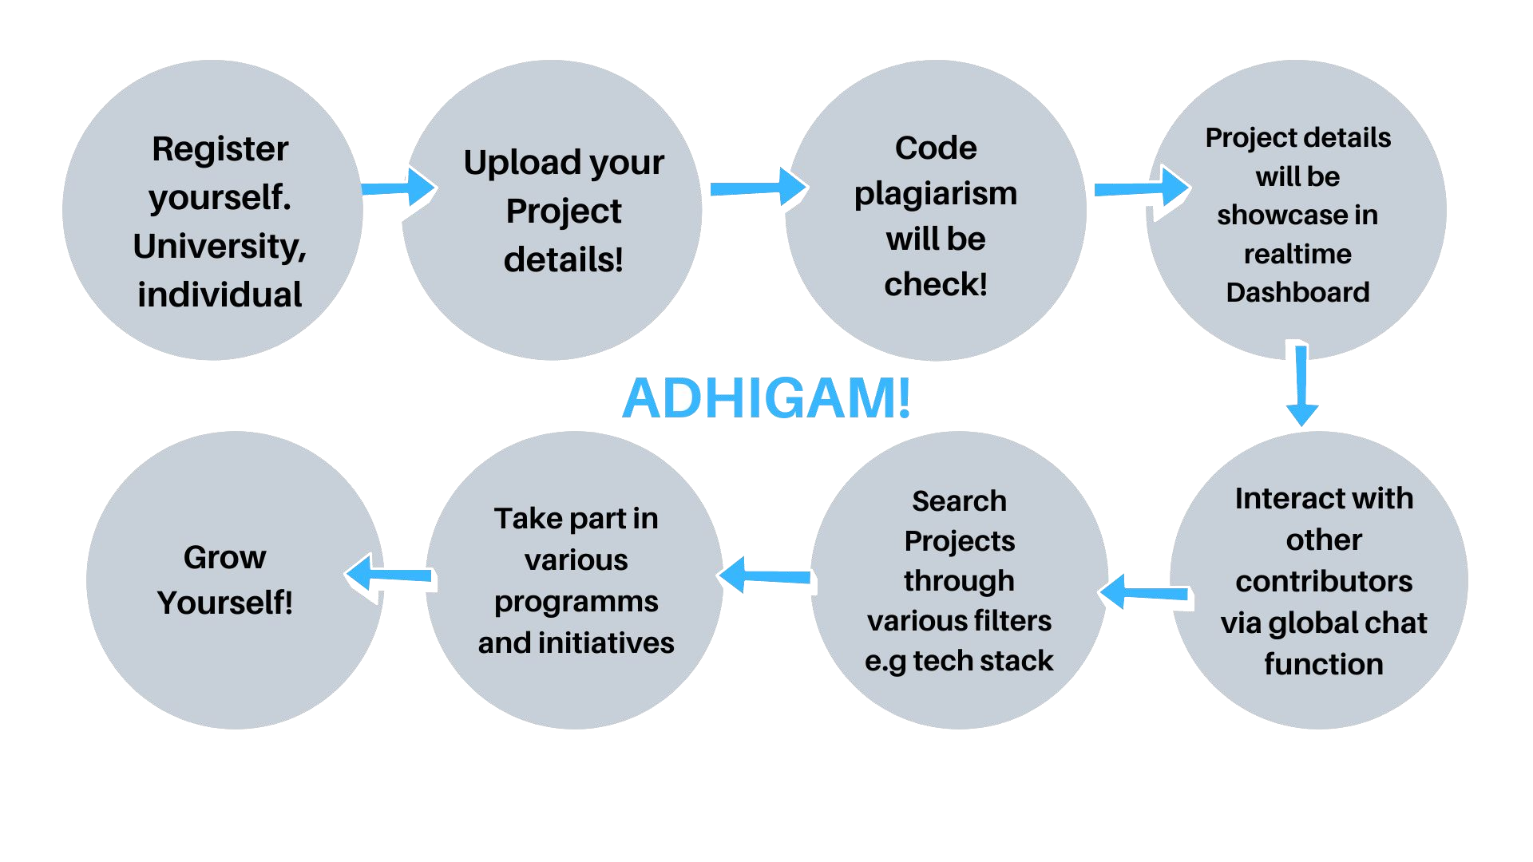
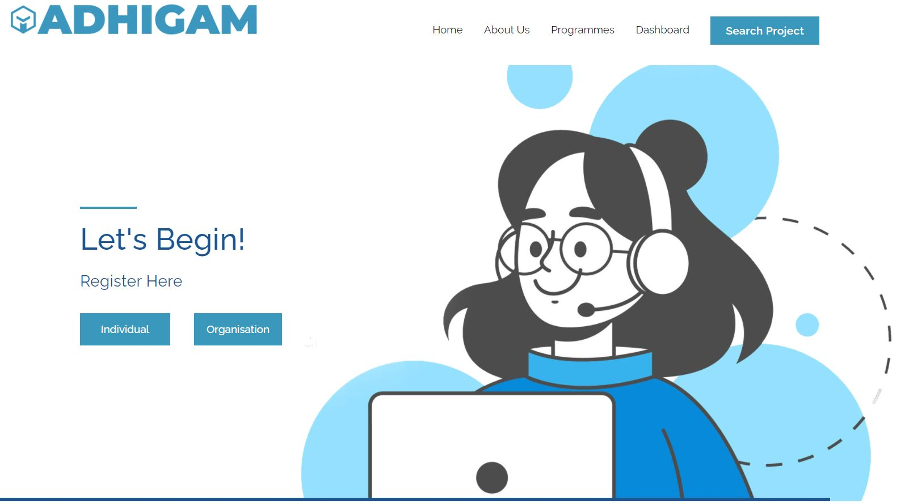
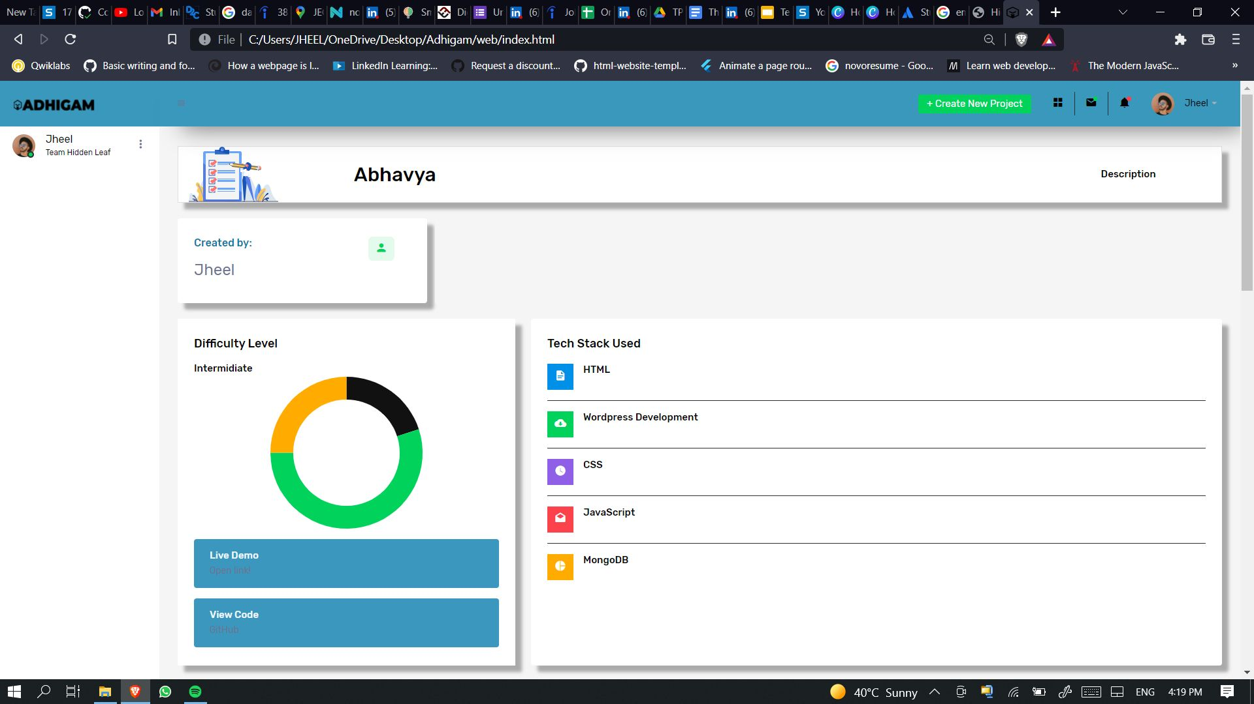
PRODUCT
Project showcase by individual and universities.
Cross-functional research among institutes.
Software and Hardware Open Sourcing
Identifying duplicate projects.

Slide 6

COMPETITION
Github and other software open-source contribution platforms
We are different because Our initiative is centred on youth.
We not only support Software Open Sourcing, but we also support Hardware Open Sourcing.
User can look for projects in his/her field and contribute.
Users can publicise their initiative and engage with others in order to solicit contributions.
We also support project plagiarism and individual recognition
We also provide user/community engagement

Slide 7


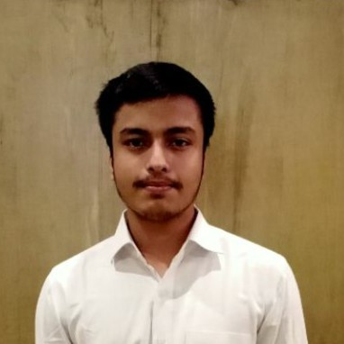
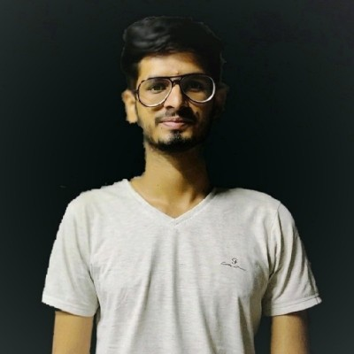

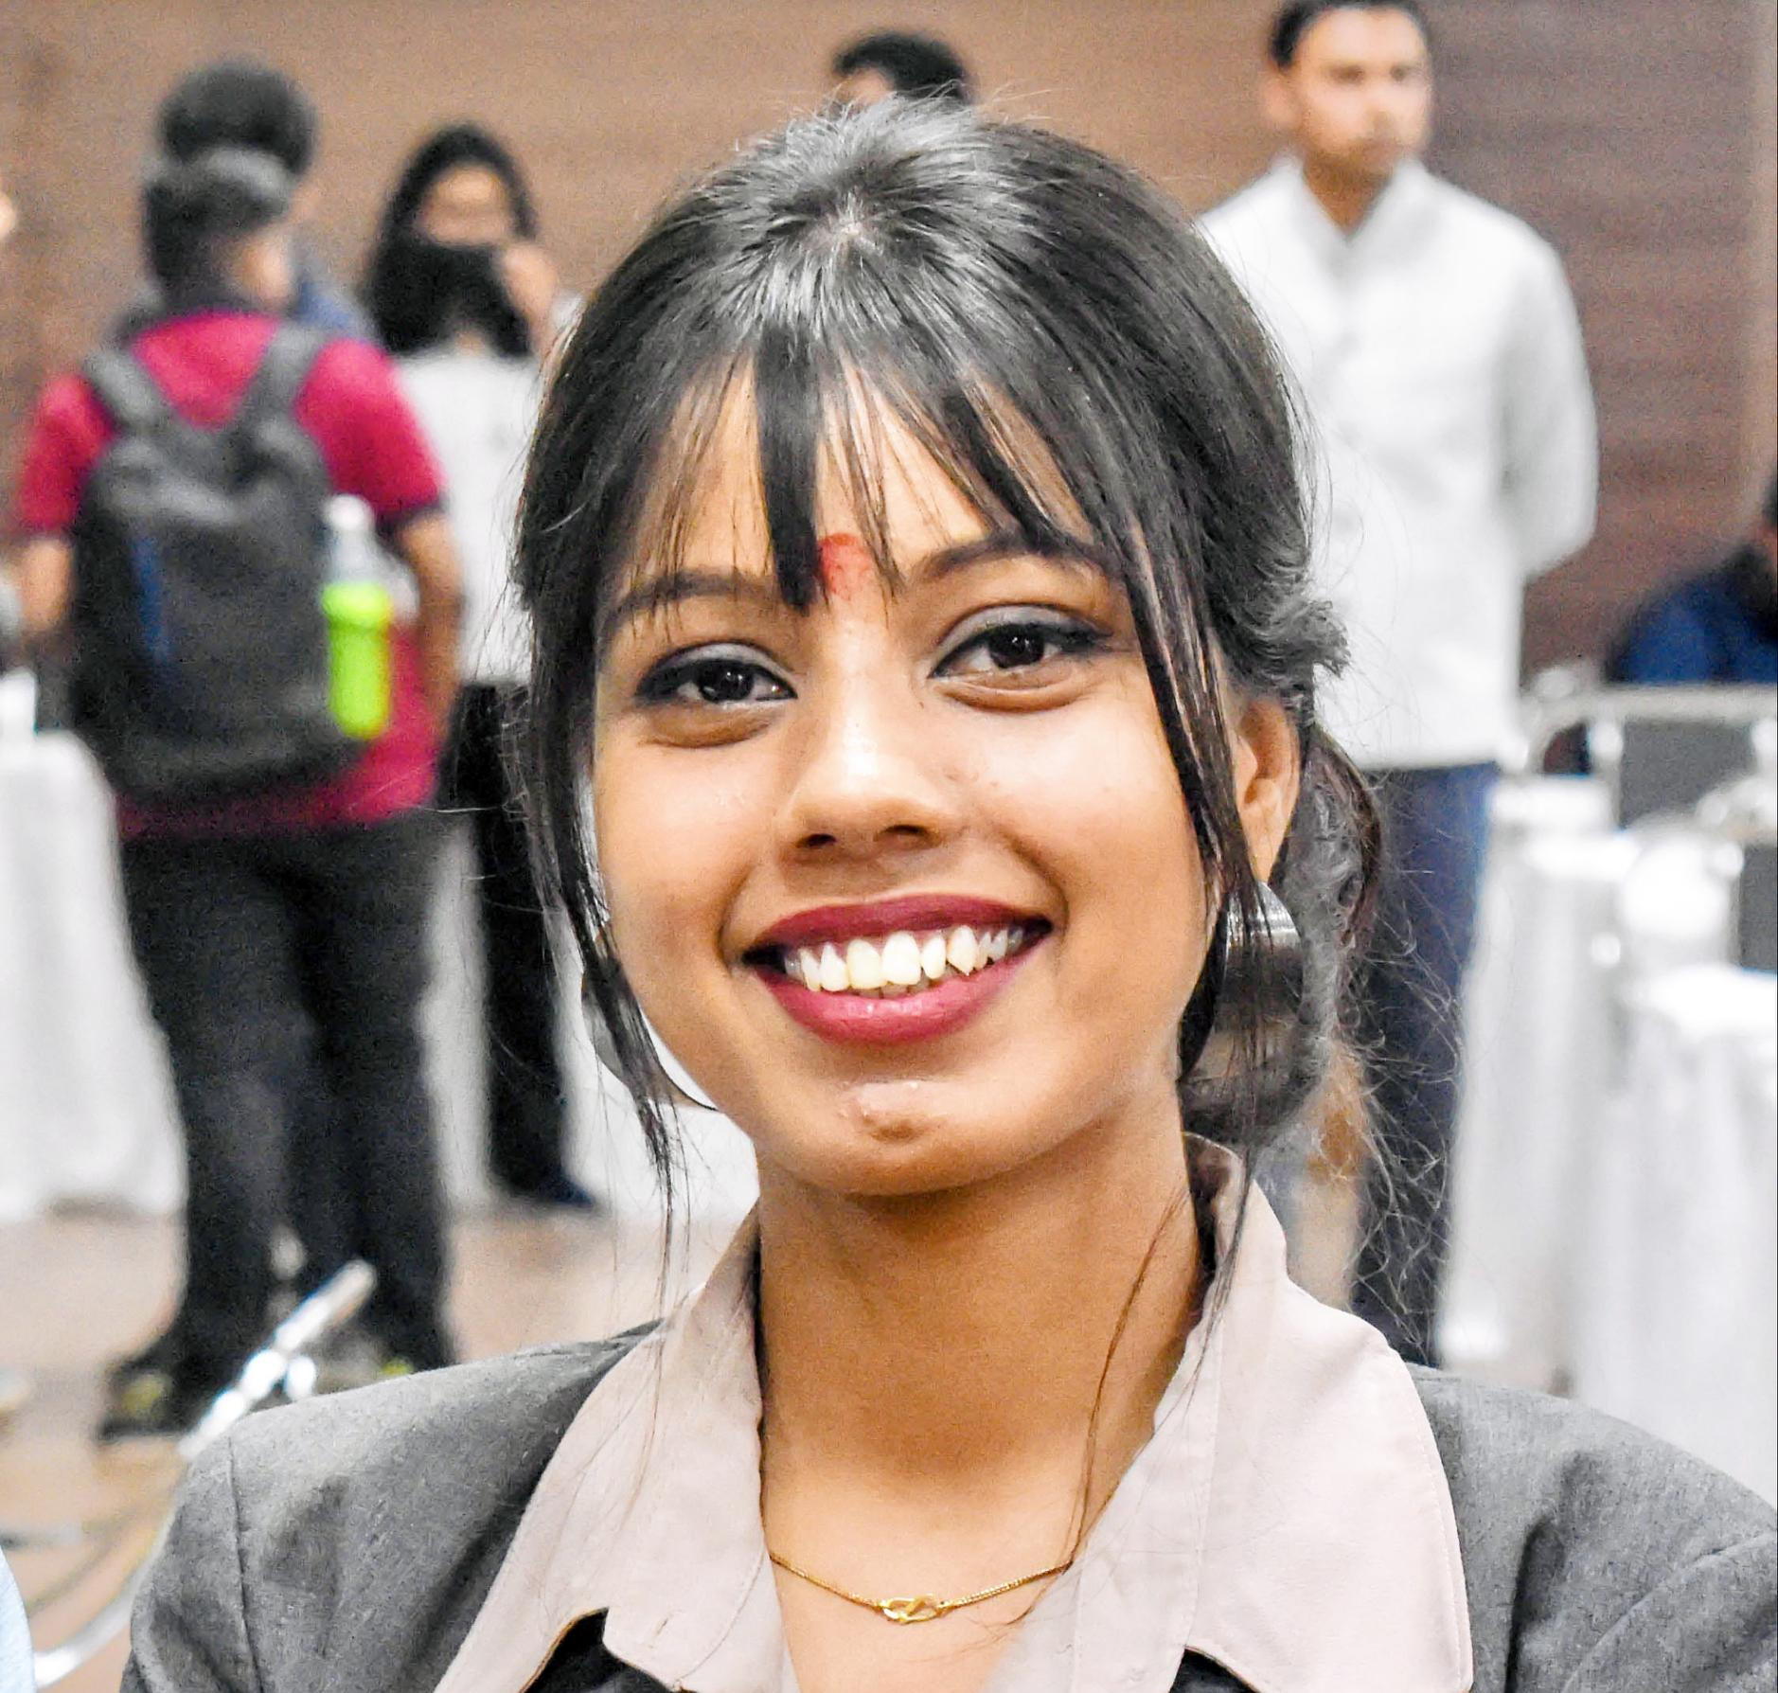
TEAM
Piyush Lakheda
B.Tech CSE
2nd Year
Harshit sharma
B.Tech CSE
2nd Year
Jheel Soni
B.Tech CSE
2nd Year
Aditya Shekhawat
B.Tech CSE
2nd Year
Vaishnavi Vaishnav
B.Tech CSE
2nd Year
Kushagra Gupta
B.Tech CSE
2nd Year

Slide 8
THANK YOU

