Slide 1

Balsa Lightweight Python Logging
https://www.turbosquid.com/3d-models/blend-balsa-wood-toy-airplane/608014
James Abel
Aug 19, 2018
j@abel.co

Slide 2
The logging module
The logging module is awesome!
Handlers – stream (console), files, sockets, HTTP, custom, … many more!
Filters
Formatters
Hierarchal
Log Levels – debug, info, warning, error, critical
logging.getLogger(name)provides the logger associated with name
Can directly access a logger from anywhere in your program with just the name string
https://docs.python.org/library/logging.html

Slide 3
logging levels
Level | When it’s used
DEBUG | Detailed information, typically of interest only when diagnosing problems.
INFO | Confirmation that things are working as expected.
WARNING | An indication that something unexpected happened, or indicative of some problem in the near future (e.g. ‘disk space low’). The software is still working as expected.
ERROR | Due to a more serious problem, the software has not been able to perform some function.
CRITICAL | A serious error, indicating that the program itself may be unable to continue running.
https://docs.python.org/howto/logging.html
Notes:
Alternate definitions:
https://www.tutorialspoint.com/log4j/log4j_logging_levels.htm

Slide 4
However, logging options and configurations can get rather involved for relatively simple apps
Log message format
Handers
Where to write log files?
Log levels for each handler
CLI vs. GUI
Options
Tracebacks
Services
Setting up logging Can Be A Significant Amount of Code

Slide 5
Balsa – Lightweight Logging
Provide useful logging with just a few lines of code
Consistent formatting and interface
appdirs for log file directory
Console, GUI, files, exception services built-in
tkinter dialog box
Sentry (raven)
Verbosity expressed by intent rather than level (e.g. verbose for development)
Error level callback
Available on PyPI
pip install balsa

Slide 6
Simple Example
from balsa import get_logger, Balsa
application_name = 'example'
log = get_logger(application_name)
def main():
balsa = Balsa(name=application_name , author='james abel')
balsa.init_logger()
log.error('my error example')
app name
function name
message
2018-08-18 20:43:33,756 - example - balsa_simple_example.py - 12 - main - ERROR - my error example
timestamp
source file name
line number
level
Also writes out a file (e.g. Windows):
C:\Users\<user>\AppData\Local\james abel\example\Logs\example.log

Slide 7
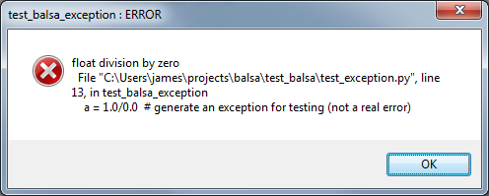
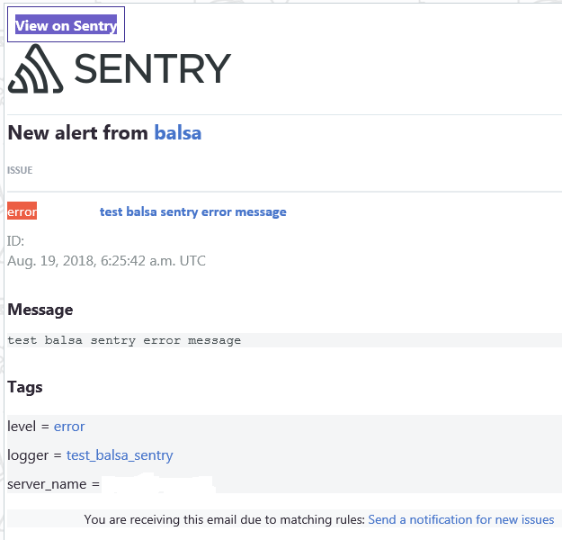
GUI messages
Sentry support
(exception service)

Slide 8
Summary and Thank You
Balsa is lightweight logging!
Try balsa!
pip install balsa
https://github.com/jamesabel/balsa
http://balsa.readthedocs.io/
Please provide feedback, issues, PRs, …
Thanks to Mark Rice (@MRice88) for testing and feedback

