Slide 1

Balsa Lightweight Python Logging
https://www.turbosquid.com/3d-models/blend-balsa-wood-toy-airplane/608014
James Abel
Dec 18, 2018
j@abel.co

Slide 2
The logging module
The logging module is awesome!
Handlers – stream (console), files, sockets, HTTP, custom, … many more!
Filters
Formatters
Hierarchal
Log Levels – debug, info, warning, error, critical
logging.getLogger(name)provides the logger associated with name
Can directly access a logger from anywhere in your program with just the name string
https://docs.python.org/library/logging.html

Slide 3
logging levels
Level | When it’s used
DEBUG | Detailed information, typically of interest only when diagnosing problems.
INFO | Confirmation that things are working as expected.
WARNING | An indication that something unexpected happened, or indicative of some problem in the near future (e.g. ‘disk space low’). The software is still working as expected.
ERROR | Due to a more serious problem, the software has not been able to perform some function.
CRITICAL | A serious error, indicating that the program itself may be unable to continue running.
https://docs.python.org/howto/logging.html
Notes:
Alternate definitions:
https://www.tutorialspoint.com/log4j/log4j_logging_levels.htm

Slide 4
However, logging options and configurations can get rather involved for relatively simple apps
Log message format
Handers
Where to write log files?
Log levels for each handler
CLI vs. GUI
Tracebacks
Exception Services
Setting up logging Can Be A Significant Amount of Code and Complexity
Use Balsa to avoid writing the same code over and over

Slide 5
Balsa – Lightweight Logging
Provide useful logging with just a few lines of code
Consistent formatting and interface
appdirs for log file directory
Console, GUI, files, exception services built-in
tkinter dialog box
Sentry (raven)
Verbosity expressed by intent rather than explicit level (e.g. verbose for development)
Error level callback
Available on PyPI
pip install balsa

Slide 6
Simple Example
from balsa import get_logger, Balsa
application_name = 'example'
log = get_logger(application_name)
def main():
balsa = Balsa(name=application_name , author='james abel')
balsa.init_logger()
log.error('my error example')
app name
function name
message
2018-08-18 20:43:33,756 - example - balsa_simple_example.py - 12 - main - ERROR - my error example
timestamp
source file name
line number
level
Also writes out a file (e.g. Windows):
C:\Users\<user>\AppData\Local\james abel\example\Logs\example.log

Slide 7
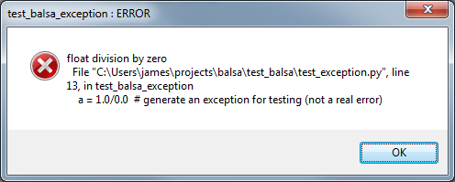
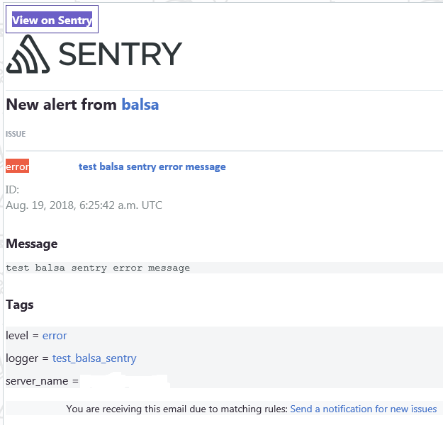
GUI messages
Sentry support
(exception service)
Notes:
If you use a different exception service, submit a PR!

Slide 8
Verbosity
default Levels
info: file, internal string buffer
warning : stdout or GUI
error : cloud services, error callback
verbose=True
debug : file
info : stdout or GUI, internal string buffer
error : cloud services, error callback

Slide 9
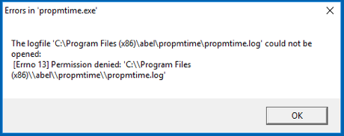
Balsa handles GUI apps
A GUI app must not write to stdout or stderr
e.g. causes an error popup in Windows and your program will probably be forcefully killed
Messages will be lost anyway
Balsa handles GUI aspects when gui=True
Uses tkinter (which is generally built-in to Python) or PyQt5
Use the Error callback to gracefully handle the issue
e.g. for Exceptions gracefully exit

Slide 10
Catch-All try/except
try:
main() # your program
except Exception as e:
# catch all exceptions
log.error(e, exc_info=True, stack_info=True)
Useful for all apps
Critical for GUI apps
Notes:
For GUI apps, it’s important that an exception doesn’t just crash and write to stdout/stderr. It’ll act like a regular program crash, but you’ll loose your exception and stack information.
Also, Balsa provides an Error callback that allows for clean program termination.
Note: Balsa doesn’t currently do this, but for some ‘consumer’ apps the developer may want to suppress the exc_info and stack_info from being presented to the user. This would be a Balsa enhancement from the current code.

Slide 11
Balsa uses attrs
balsa = Balsa(application_name, author, verbose=True)
balsa.backup_count = 20 # lots of logging!
balsa.init_logger()

Slide 12
Options!
name = attrib(default=None)
author = attrib(default=None)
verbose = attrib(default=False)
gui = attrib(default=False)
delete_existing_log_files = attrib(default=False)
max_bytes = attrib(default=100 * 1e6) # max size per log file
backup_count = attrib(default=3) # max number of log files
error_callback = attrib(default=None) # called on error or above
max_string_list_entries = attrib(default=100) # string buffer internal to Balsa
log_directory = attrib(default=None)
log_extension = attrib(default=".log")
log_formatter = attrib(default=logging.Formatter("%(asctime)s - %(name)s - %(filename)s - %(lineno)s - %(funcName)s - %(levelname)s - %(message)s"))
is_root = attrib(default=True)
propagate = attrib(default=True) # False for this logger to be independent of parent(s)
inhibit_cloud_services = attrib(default=False)
use_sentry = attrib(default=False)
sentry_dsn = attrib(default=None) # get your project DSN at https://sentry.io

Slide 13
propagate
https://docs.python.org/3/library/logging.html
If this attribute evaluates to true, events logged to this logger will be passed to the handlers of higher level (ancestor) loggers, in addition to any handlers attached to this logger. Messages are passed directly to the ancestor loggers’ handlers - neither the level nor filters of the ancestor loggers in question are considered.
If this evaluates to false, logging messages are not passed to the handlers of ancestor loggers.
Set propagate to False for independent loggers such as a log window

Slide 14
Built-in CLI support with argparse
from balsa import delete_existing_arg_string, log_dir_arg_string, verbose_arg_string
parser = argparse.ArgumentParser()
parser.add_argument("-v", f"--{verbose_arg_string}", action="store_true", help=“verbose")
parser.add_argument("-d", f"--{delete_existing_arg_string}", action="store_true", help="delete log")
parser.add_argument("-l", f"--{log_dir_arg_string}", help="log directory")
args = parser.parse_args()
balsa = Balsa(application_name, author)
balsa.init_logger_from_args(args)

Slide 15
Summary and Thank You
Balsa is lightweight logging!
Try balsa!
pip install balsa
https://github.com/jamesabel/balsa
http://balsa.readthedocs.io/
Please provide feedback, issues, PRs, …
Thanks to Mark Rice (@MRice88) for testing and feedback

Slide 16
BACKUP

Slide 17
Verbose
 | Default | Verbose
debug |  | file
info | file, string buffer | UI (stdout/stderr/GUI), string buffer
warning | UI (stdout/stderr/GUI)
error | Exception services | Exception services

