Slide 1
Tumor Fraction
Xiang Li

Slide 2
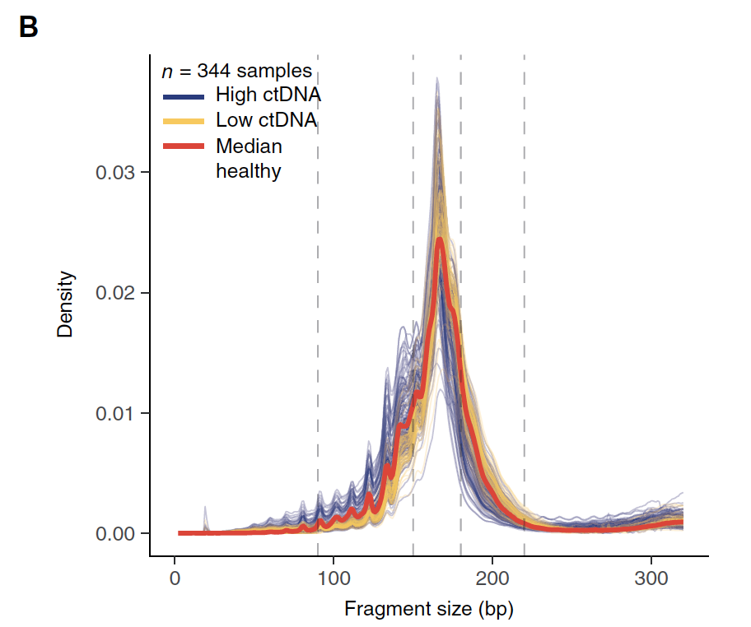
Background
Hypothesis:
1. Differences in fragment lengths of circulating DNA could be exploited to enhance sensitivity for detecting the presence of ctDNA and for noninvasive genomic analysis of cancer.
2. Fragment size analysis and selective sequencing of specific fragment sizes can boost ctDNA detection and could complement or provide an alternative to deeper sequencing of cfDNA
Ref: Enhanced detection of circulating tumor DNA by fragment size analysis. 2016 SCIENCE TRANSLATIONAL MEDICINE

Slide 3
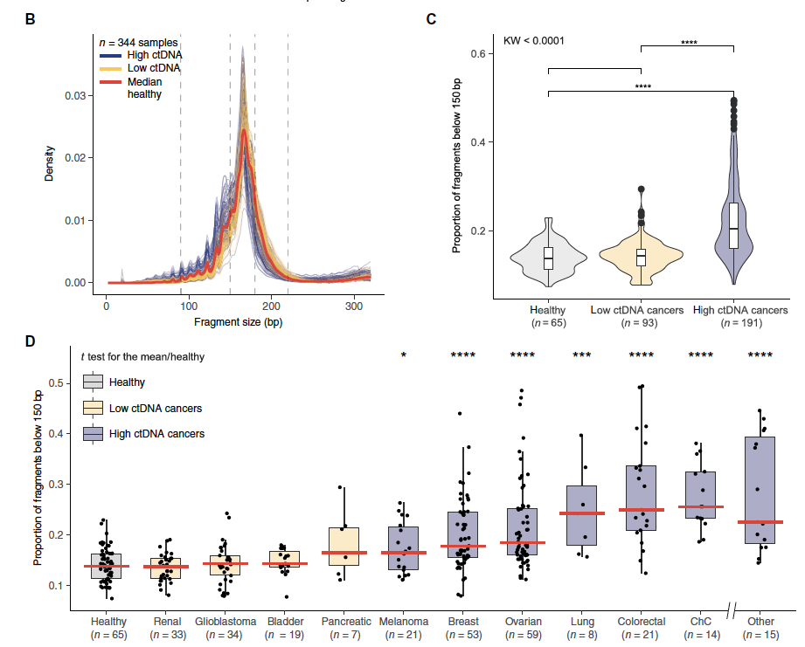

Slide 4
Plan (06/29/2021):
Generate Feature (Fragment Size):
(Done)Get a table of molecules fragment size distribution.
https://github.com/guardant/data_science/blob/master/02_DEVELOPMENT/210503_FUSION_FRAGMENTOMICS/00_prepareData.R
Now working with test data, considering switch to full data set Soon.
Run R script (row178), Where:
wg_bed_file: 29675 rows https://raw.githubusercontent.com/guardant/ghpipeline/master/parameter_sets/Omni/v1.0/Omni1.0_probes.bed?token=AHUW5C2QMF7TPB3PCJFSHEDA4R6ZC
reference_file = /ghess/shared/ref/genome.fa. (hg19)
max_size = 500 (molecule max size)
folder with molecule fiules /ghds/groups/bioinformatics/02_DEVELOPMENT/210503_FUSION_FRAGMENTOMICS/clinical_samples/molecule_counts
Data dimension reduction
Working Path:
/ghds/groups/algorithms/projects/Study_Fragment_Size/
Need samples of tumor & non-tumor
Build Predictor

Slide 5
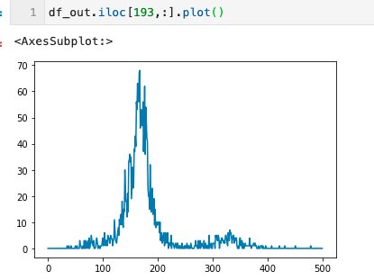
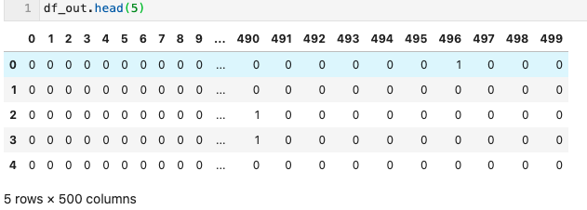
Fragment Size Distribution Test on A035043401.molecule_table.tsv
chrom | start | end | num_molecules | num_reads | mean_mapq | cg_count | bin_idx
1 | 156785323 | 156785748 | 1 | 1 | 60 | 233 | 0
1 | 156785323 | 156785752 | 1 | 2 | 60 | 236 | 0
1 | 156785323 | 156785921 | 1 | 1 | 60 | 340 | 0
1 | 156785324 | 156785765 | 1 | 1 | 60 | 242 | 0
1 | 156785349 | 156785745 | 1 | 1 | 60 | 217 | 0
1 | 156785349 | 156785879 | 1 | 1 | 60 | 301 | 0
1 | 156785351 | 156785720 | 1 | 2 | 60 | 201 | 0
1 | 156785351 | 156785761 | 1 | 2 | 60 | 226 | 0
1 | 156785365 | 156785708 | 1 | 2 | 60 | 188 | 0
From
Done

Slide 6
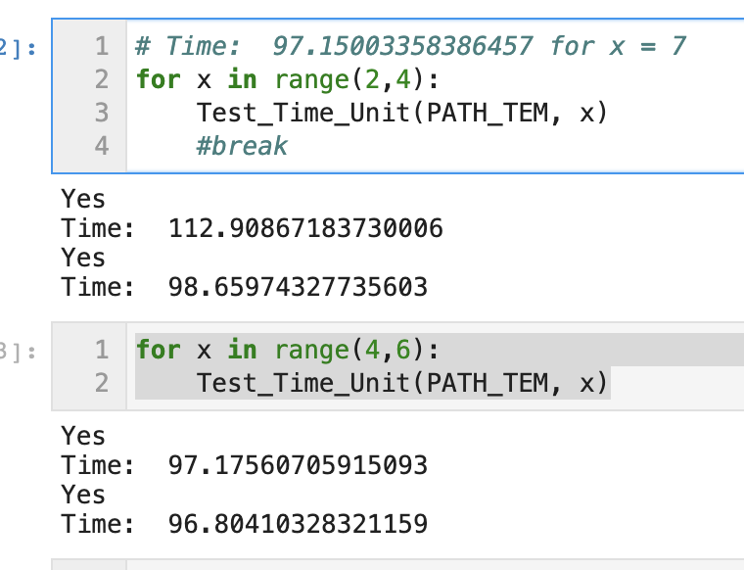
Chunksize: 10**3~10**5 no difference

Slide 7
Training Data(500 samples)
/ghds/groups/bioinformatics/02_DEVELOPMENT/200830_GHCNVWG_PIPELINE/results/210608_CLINICAL_SAMPLES_V0.5/processed_samples/List_of_testing_samples_4TF_training.210630.tsv
Column 'type' contains 2 entries:
TND (TF=0)
Clinical (TF > 0)

Slide 8
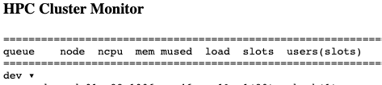

Records
Some update to share,
I solved the issues by generating these qsub *.sh through python.
And I ran 500 samples and get 491 results of molecule.table.tcv (around 700GBs). (Will take a look at the rest 9 samples and why it failed. Later. )
Then I apply the python module to extract Fragment Size distribution. (Now received around 200 samples. At least I can start to do the following predictor building. )
Some Issues here about the over load of HPC. (I received more than 400% in the load columns from HPC Cluster Monitor, then I qdel the job.)

Slide 9
Samples Failed (472 samples succussed)
5098061 | 0.51386 | A034884001 | xili | Eqw | 7/1/21 | 18:09:19
5098062 | 0.51386 | A034608701 | xili | Eqw | 7/1/21 | 18:09:19
5098063 | 0.51386 | A033165801 | xili | Eqw | 7/1/21 | 18:09:19
5098292 | 0.51386 | A034462101 | xili | Eqw | 7/1/21 | 18:09:25
5098293 | 0.51386 | A033918601 | xili | Eqw | 7/1/21 | 18:09:25
5098302 | 0.51386 | A034337201 | xili | Eqw | 7/1/21 | 18:09:25
5098303 | 0.51386 | A034931601 | xili | Eqw | 7/1/21 | 18:09:25
5098304 | 0.51386 | A035291401 | xili | Eqw | 7/1/21 | 18:09:25
5098305 | 0.51386 | A033376101 | xili | Eqw | 7/1/21 | 18:09:25
5098306 | 0.51386 | A033657201 | xili | Eqw | 7/1/21 | 18:09:25
5098307 | 0.51386 | A034793101 | xili | Eqw | 7/1/21 | 18:09:25
5098308 | 0.51386 | A034377101 | xili | Eqw | 7/1/21 | 18:09:25
5098309 | 0.51386 | A035149201 | xili | Eqw | 7/1/21 | 18:09:25
5098310 | 0.51386 | A033880001 | xili | Eqw | 7/1/21 | 18:09:25
5098311 | 0.51386 | A033920601 | xili | Eqw | 7/1/21 | 18:09:25
5098312 | 0.51386 | A034580801 | xili | Eqw | 7/1/21 | 18:09:25
5098313 | 0.51386 | A035051101 | xili | Eqw | 7/1/21 | 18:09:25
5098314 | 0.51386 | A034441701 | xili | Eqw | 7/1/21 | 18:09:25
Notes:
.libPaths( c("/ghds/groups/algorithms/scratch/xili", .libPaths()) )

Slide 10
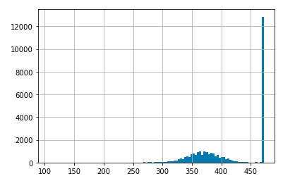
For Probes How many samples(out of 472) have a fragment count
ghcnv_qc table in ghdb
Column diversity in ghcnv_qc > 700
#_probes
#_samples (max 472)
For example, there are 12,758 probes that
has counts from 472 samples.

Slide 11
Predictor in tensorflow
pip3 install --user --upgrade tensorflow # install in $HOME
python3 -c "import tensorflow as tf; print(tf.reduce_sum(tf.random.normal([1000, 1000])))"
Notes:
https://www.tensorflow.org/install/pip#system-install

Slide 12
Treat data like 480 images 12,758*500
we load the training data set and testing data set in the variables (x_train,y_train) and (x_test,y_test)
Flatten the pixel values or features into a 1-D array of size 12,758*500 using the reshape method. We also normalize the pixel intensities to make sure their values are between 0 to 1.

Slide 13
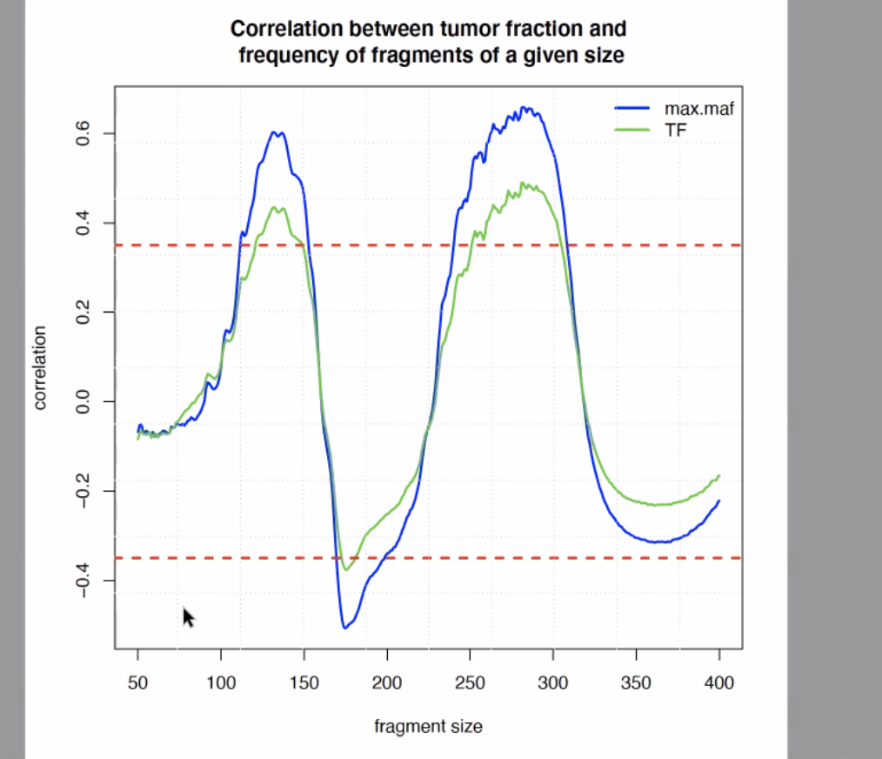
Predicted TF vs MAF

Slide 14
/ghds/groups/bioinformatics/02_DEVELOPMENT/200830_GHCNVWG_PIPELINE/results/210608_CLINICAL_SAMPLES_V0.5/processed_samples/List_of_samples_4TF_testing.210708.tsv

