Slide 1
Xiang Li, 07/02/2021

Slide 2
Background (06/17/2021):
Motivation
Contamination found from non-human DNA in AV Samples. (Ref: https://guardanthealth.atlassian.net/wiki/spaces/OM/pages/2189001914/Contamination+from+non-human+DNA+in+AV+Samples)
Mission
Detect what percentage of sample reads that better align to non-human genome? (%)
Plan
Map 9~10 sample reads(from excel sheet) to cumstomized genome, count "better mapping" reads.
Summary and report the mapping statistics.

Slide 3
Selection of Genomes
Genome | File name (.fa.gz) | Size (Mb)
human | Hg38 | 938
Cow | bosTau9 | 842
mouse | mm39 | 831
Rat | rn7 | 820
Rabbit | oryCun2 | 815
Sheep | oviAri4 | 813
Horse | equCab3 | 791
Cat | felCat9 | 775
Pig | susScr11 | 774
Dog | canFam5 | 734
Chicken | galGal6 | 332
Nile Tilapia fish | oreNil2 | 267
Atlantic cod fish | gadMor1 | 198
dm6 # fruit fly 44M sacCer3 # Yeast. 3.7
QC Strategy
•Extract all reads supporting variants with MAF < X% (ideally, X ~ 1%)
•Map the reads to a set of common contaminant genomes
•Flag variants that indicate non-human origin
•Either flag the sample or selectively exclude the flagged variants from somatic reporting
Analysis of previously flagged samples
•What fraction of total reads support the contamination call?
•Are the selected genomes sufficient to identify the contamination?
•Computational feasibility of mapping all of the reads to these genomes
8978 Mb of compressed genomes.
Notes:
Human bwa index: /ghds/shared/ref/
Second genome: /ghds/groups/algorithms/ref/non_human_contaminants/raw_genomes/Genomev3/All_16genomes

Slide 4
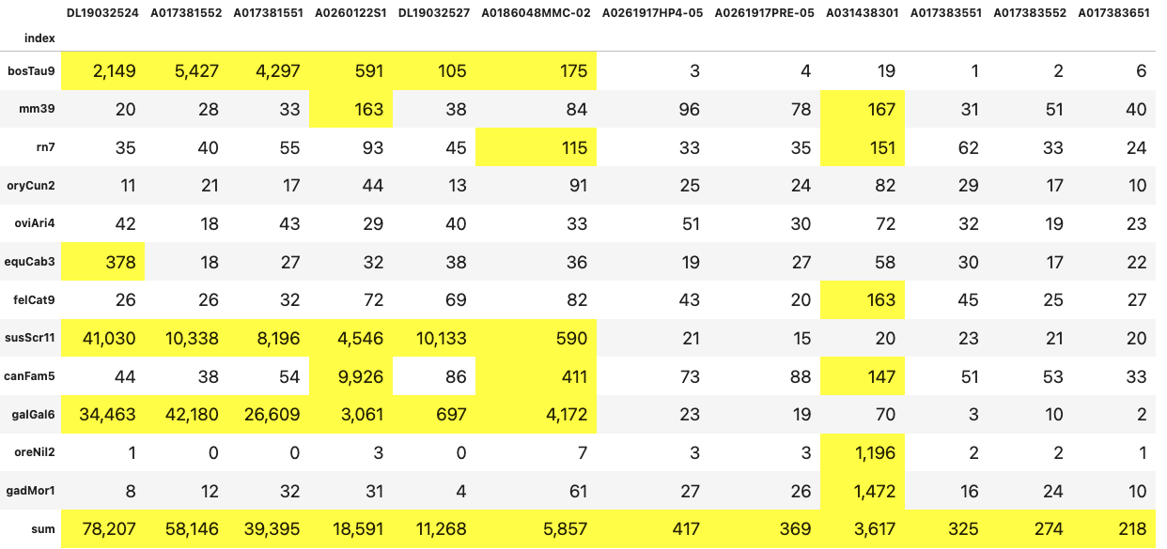
STATS of better mapping reads with MAPQ=60
Major source of contamination:
Genome
Cow
mouse
Rat
Rabbit
Sheep
Horse
Cat
Pig
Dog
Chicken
Nile Tilapia fish
Atlantic cod fish
Sum
Turkey, Chicken
Dog
Pig
Chicken
Mice
Salmon
Random
# of reads > 100 are highlighted
Notes:
SalmondSalmon

Slide 5
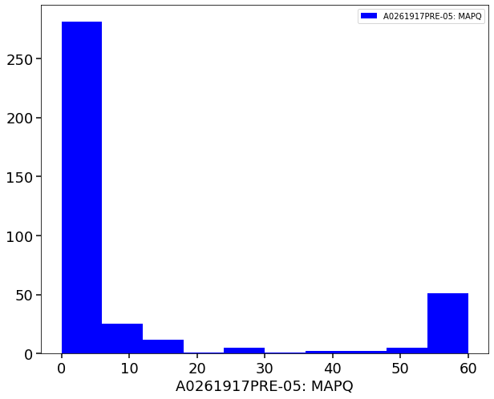
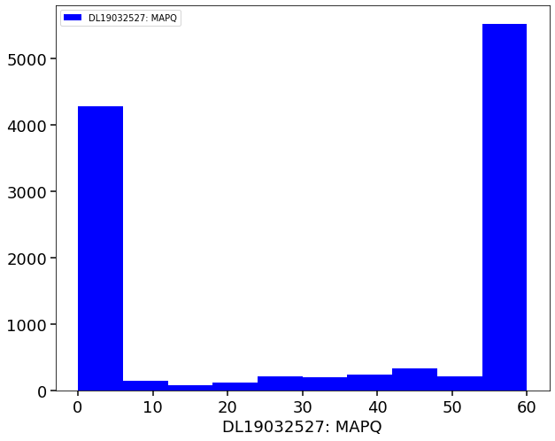
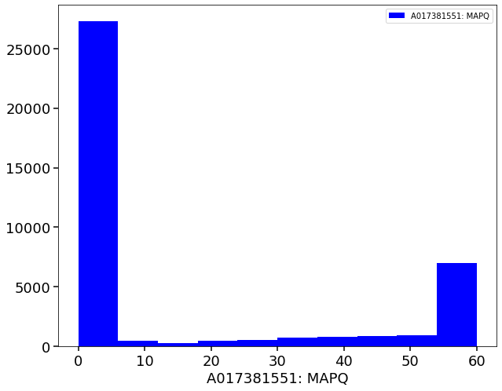
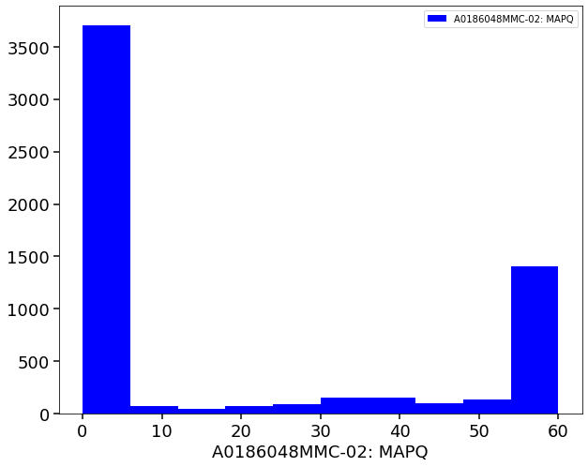
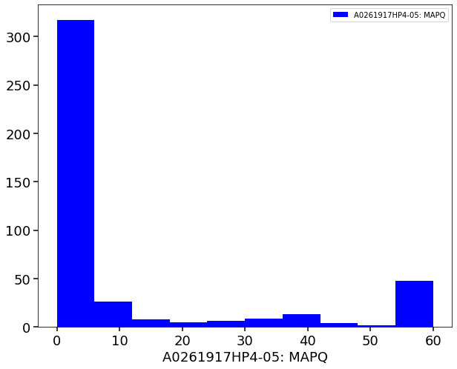
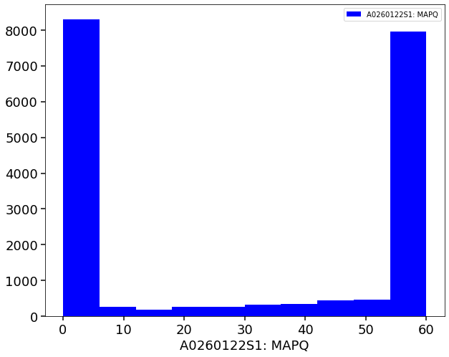
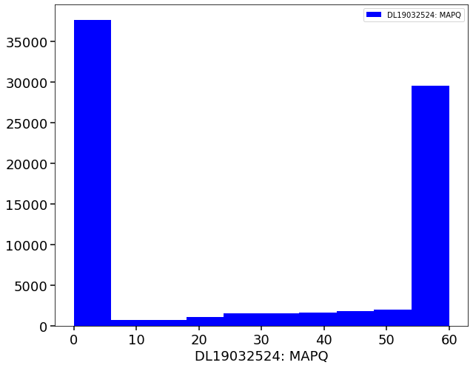
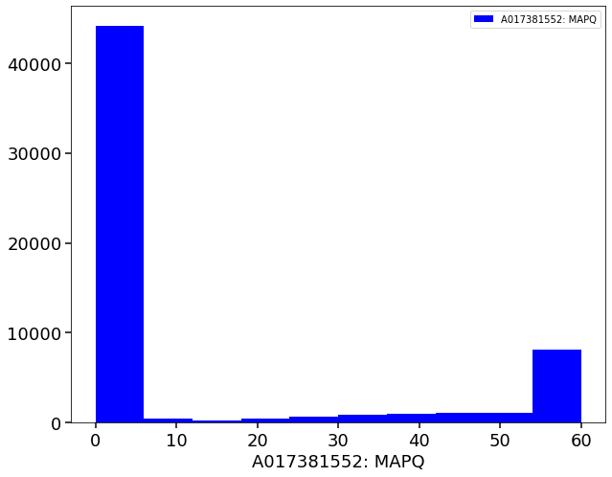
Non-hg reads(mapQ=60) map to hg
index | A0261917PRE-05 | A0261917HP4-05 | DL19032527 | A0260122S1 | A017381551 | DL19032524 | A0186048MMC-02 | A017381552
# of reads | 369 | 417 | 11268 | 18591 | 39395 | 78208 | 5857 | 58147
369
39395
5857
11268
417
18591
78208
58147

Slide 6
Further Exploration
Include these metrics in tables:
% of total reads mapping to non-human % of total reads not mapped % of original on-target reads mapped to non-human % of original off-target reads mapped to non-human
Define a non-human reads filter: Goal: To flag all variants that came from non-human DNA
Requirements:
1. Computationally feasible. Should not significantly increase current BIP run time.
2. At least from some products, can’t replace the existing reference with a new reference (but this is possible for future reference.)
index | A0261917PRE-05 | A0261917HP4-05 | DL19032527 | A0260122S1 | A017381551 | DL19032524 | A0186048MMC-02 | A017381552
# of reads | 369 | 417 | 11268 | 18591 | 39395 | 78208 | 5857 | 58147

Slide 7
Reportable region bed file (REPORT= intervals are the ones that are actual reportable for snvs and indels): https://github.com/guardant/ghpipeline/blob/master/parameter_sets/Omni/v1.0/Omni1.0_annotated_reportable_regions.bed
For off/on-target, use this bed file: https://github.com/guardant/ghpipeline/blob/master/parameter_sets/Omni/v1.0/Omni1.0_panel.bed

Slide 8
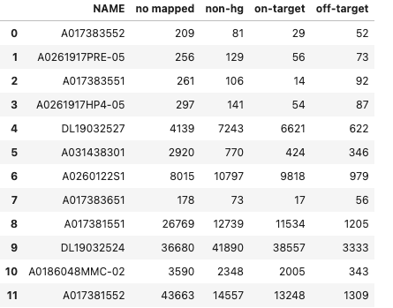
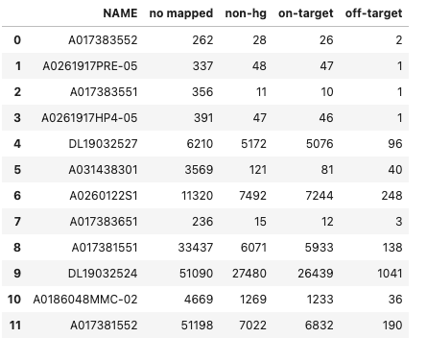
Majority mapped reads (MAPQ=60) overlap with target regions
off/on-target Omni1.0_panel.bed
Mapped == MAPQ>=60
Mapped == MAPQ>=1
@xili@guardanthealth.com Great! This shows that the probes are involved in pulling down the non-human reads

Slide 9
Discussion Points on July/02/2021
Two directions of Non-hg contaminations.
Produced a QC module for GH. (A must)
Publish a Study of jumping DNA from non-human genomes through diet.(Big Goal)
Work between July09~July13:
More genomes to be included
Count reads with mapQ>30 to hg19 (mapQ was 60)
Acquire snakemake
Improve performance of python code (extracting variant reads)

Slide 10
Standard human genome in GH
head /ghds/shared/ref/genome.fa
>1 dna:chromosome chromosome:GRCh37:1:1:249250621:1 REF
Directly download from UCSC
>chr1
NNNNNNNNNNNNNNNNNNNNNNNNNNNNNNNNNNNNNNNNNNNNNNNNNN
Cat | Tail return is not the same.

Slide 11
Further
Running 900 samples in mystic (Fine)
for oldt_set1 several contaminations
One of the samples that takes a really long time: A033637501 in oldt_set1
/ghess/groups/algorithms/projects/non_human_contamination/results/oldt_set1/A033637501_qsub.sh

Slide 12
working version to git (Ravi):
https://github.com/guardant/ccbi/tree/non_human/src/python/non_human
Currently processing a set of 256 samples. The outputs will go here:
/ghess/groups/algorithms/projects/non_human_contamination/results/av_set1
Some issues bwa with *.fastq.gz: Done
PG ID:bwa PN:bwa VN:0.7.15-r1140 CL:bwa mem -t 5 -M /ghds/groups/algorithms/ref/non_human_contaminants/raw_genomes/Genomev3/All_16_genomes.fa.gz -v 3 ./A017381551.mutant.fastq.gz
No issue detected

Slide 13
Module tamplate: /ghess/groups/lunar/scratch/bip40/modules
1.) Pipeline logistics - BIP/snakemake, and putting together the pipeline that can run locally or on AWS, how to make it run faster, etc
2)Algorithm development - what MAPQ threshold to use, how to incorporate indels, what are the mouse contamination samples, etc.
A034621401
A03367501
Notes:
export ARTIFACTORY_USERNAME=ghbi_service
export ARTIFACTORY_PASSWORD=Password123

Slide 14
Reference: Build a module
How to:
https://guardanthealth.atlassian.net/wiki/spaces/BIP40/pages/1329008395/How+to+create+a+new+module
https://guardanthealth.atlassian.net/wiki/spaces/~698448339/pages/2215479869/BIP4+tutorial+and+tips
https://guardanthealth.atlassian.net/wiki/spaces/BIP40/pages/1329139699/BIP+4.0+dev+resources+and+how-tos
https://guardanthealth.atlassian.net/wiki/spaces/~698448339/pages/2215479869/BIP4+tutorial+and+tips

Slide 15
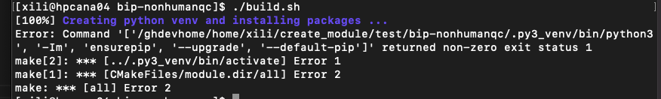
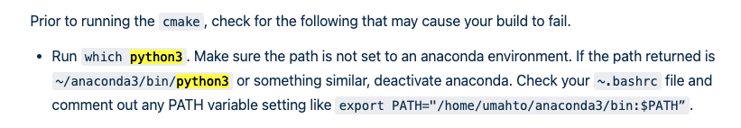
Template & Issues
1.
ARTIFACTORY_USERNAME=ghbi_service ARTIFACTORY_PASSWORD=Password123
lrwxrwxrwx 1 xili domain users 7 Jul 15 21:34 python -> python3
lrwxrwxrwx 1 xili domain users 28 Jul 15 21:34 python3 -> /home/xili/enter/bin/python3
Notes:
ARTIFACTORY_USERNAME=ghbi_service ARTIFACTORY_PASSWORD=Password123

Slide 16
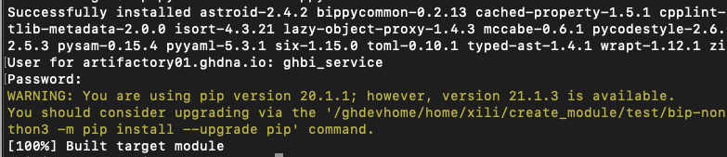

Tricky Thing for Python3
/ghdevhome/home/xili/create_module/test/bip-nonhumanqc/build
Add “module load python/3.6.8” to .bashrc
Pandas = 1.1.5 will lead an error of python module : _bz2
Try with pandas ==0.25.0. worked
https://stackoverflow.com/questions/12806122/missing-python-bz2-module

Slide 17
VCF
/ghess/groups/algorithms/scratch/rvijaya-satya/code/ivd_analysis/OMNI/IncaRose/AV/210210_Broad_Pilot_Analysis/load_broad_vcfs.py
https://pyvcf.readthedocs.io/en/latest/

Slide 18
Run module
./bip-nonhumanqc/module_entry ext_mut --in-fc_path /ghdevhome/home/xili/create_module/test_data --output-dir /ghdevhome/home/xili/create_module/Output_Test --sample-id A033144201 --parameter-set 1

Slide 19
tutorial for bip4.0.
https://guardanthealth.atlassian.net/wiki/spaces/BIP40/pages/2501672967/By+steps+Build+BIP4.0+module

Slide 20
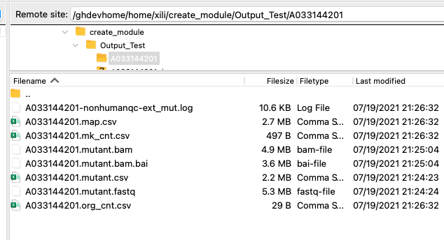
Results From Module
PATH_bip-nonhumanqc= “/ghdevhome/home/xili/create_module/bip-nonhumanqc”

Slide 21
Jenkins
I am working on building a new module called bip-nonhumanqc and prepared to integrate it into BIP4.0. Shall I get this access in order to upload module to Jenkins for testing?

Slide 22
