Slide 1
Tumor Fraction
Xiang Li,

Slide 2
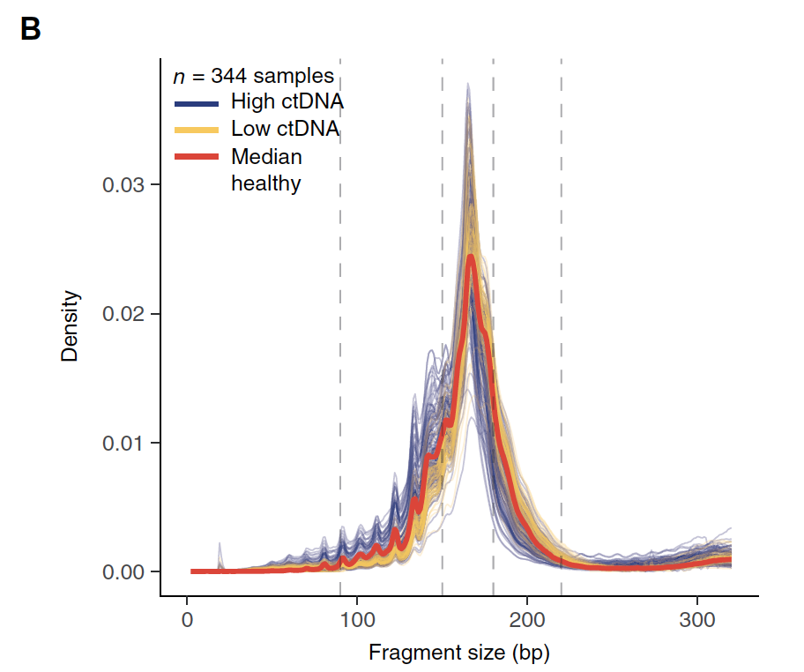
Notes:
Ref: Enhanced detection of circulating tumor DNA by fragment size analysis. SCIENCE TRANSLATIONAL MEDICINE

Slide 3
Background (06/17/2021):
Motivation
Contamination found from non-human DNA in AV Samples. (Ref: https://guardanthealth.atlassian.net/wiki/spaces/OM/pages/2189001914/Contamination+from+non-human+DNA+in+AV+Samples)
Mission
Detect what percentage of sample reads that better align to non-human genome? (%)
Plan
Map 9~10 sample reads(from excel sheet) to cumstomized genome, count "better mapping" reads.
Summary and report the mapping statistics.

Slide 4
Selection of Genomes
Genome | File name (.fa.gz) | Size (Mb)
human | Hg38 | 938
Cow | bosTau9 | 842
mouse | mm39 | 831
Rat | rn7 | 820
Rabbit | oryCun2 | 815
Sheep | oviAri4 | 813
Horse | equCab3 | 791
Cat | felCat9 | 775
Pig | susScr11 | 774
Dog | canFam5 | 734
Chicken | galGal6 | 332
Nile Tilapia fish | oreNil2 | 267
Atlantic cod fish | gadMor1 | 198
dm6 # fruit fly 44M sacCer3 # Yeast. 3.7
QC Strategy
•Extract all reads supporting variants with MAF < X% (ideally, X ~ 1%)
•Map the reads to a set of common contaminant genomes
•Flag variants that indicate non-human origin
•Either flag the sample or selectively exclude the flagged variants from somatic reporting
Analysis of previously flagged samples
•What fraction of total reads support the contamination call?
•Are the selected genomes sufficient to identify the contamination?
•Computational feasibility of mapping all of the reads to these genomes
8978 Mb of compressed genomes.
Notes:
Human bwa index: /ghds/shared/ref/
Second genome: /ghds/groups/algorithms/ref/non_human_contaminants/raw_genomes/Genomev3/All_16genomes

Slide 5
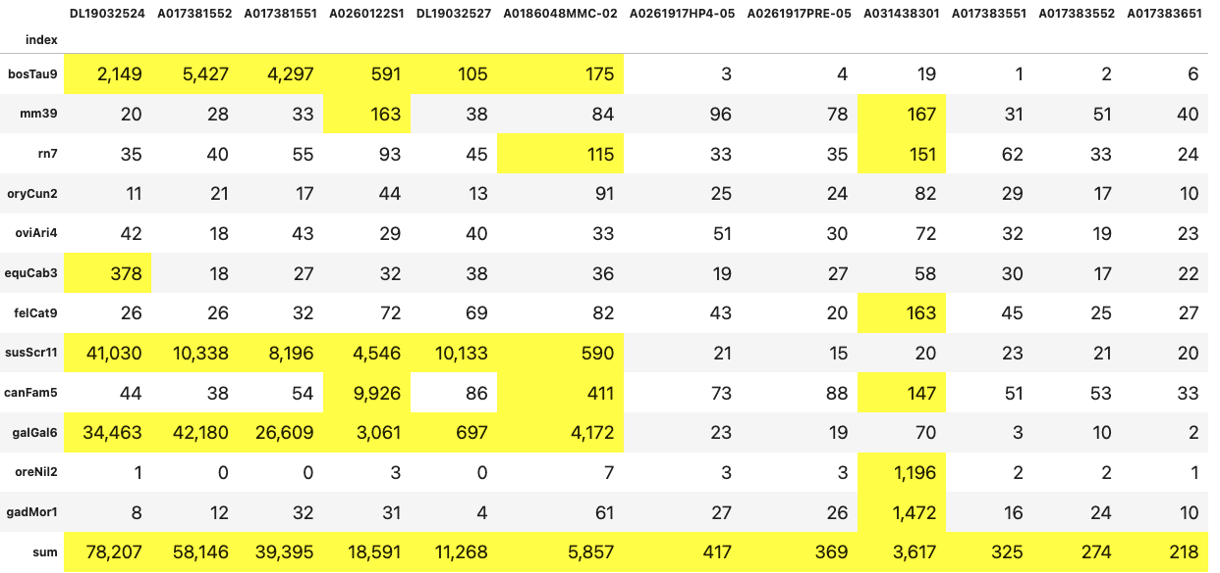
STATS of better mapping reads with MAPQ=60
Major source of contamination:
Genome
Cow
mouse
Rat
Rabbit
Sheep
Horse
Cat
Pig
Dog
Chicken
Nile Tilapia fish
Atlantic cod fish
Sum
Turkey, Chicken
Dog
Pig
Chicken
Mice
Salmon
Random
# of reads > 100 are highlighted
Notes:
SalmondSalmon

Slide 6
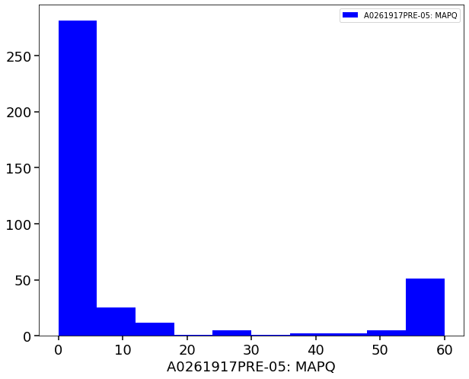
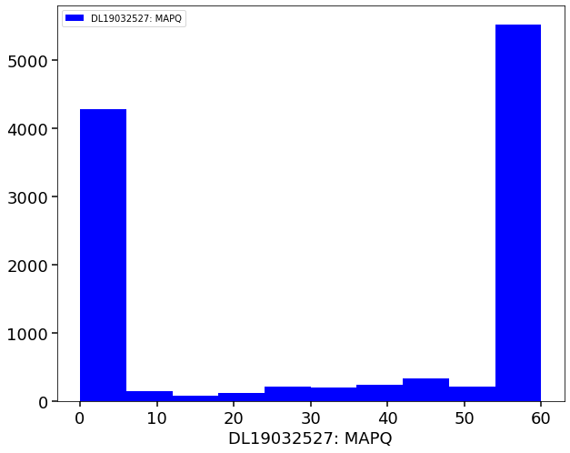
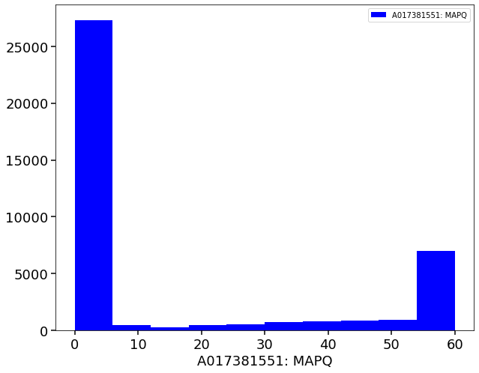
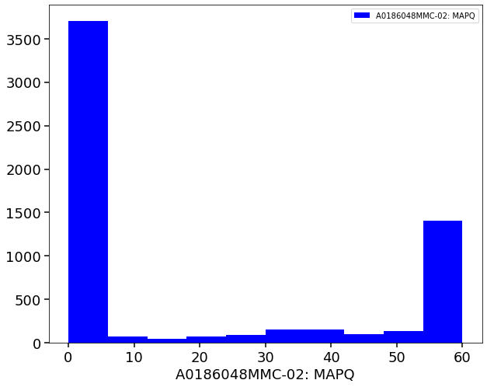
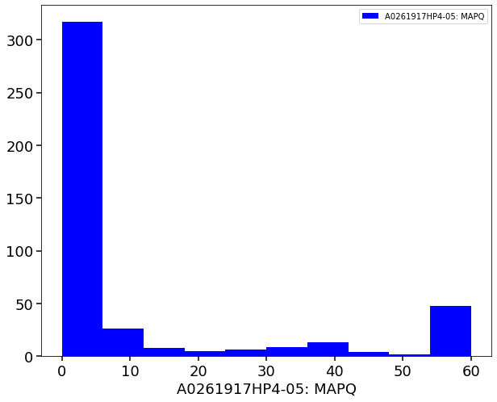
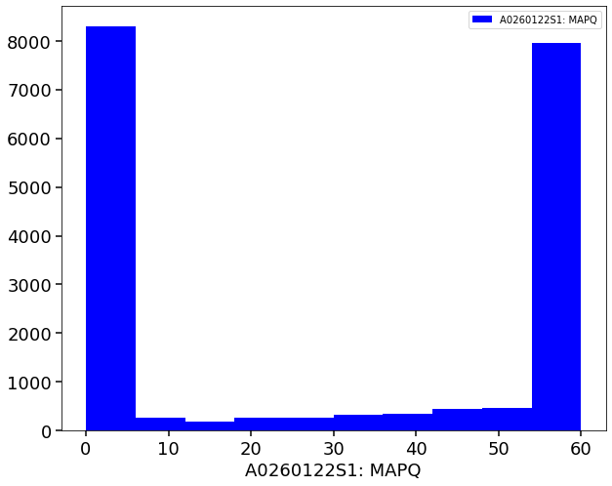
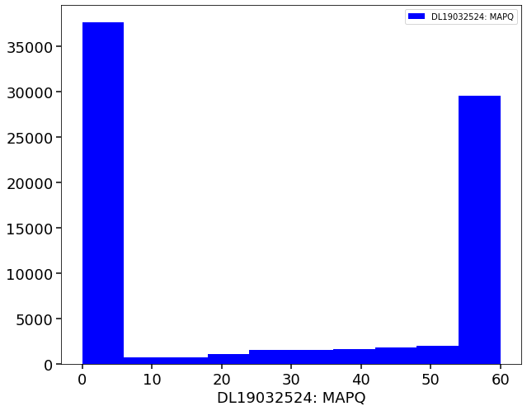
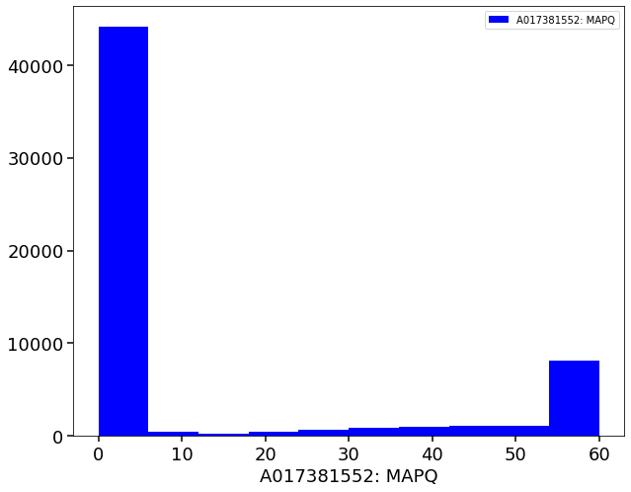
Non-hg reads(mapQ=60) map to hg
index | A0261917PRE-05 | A0261917HP4-05 | DL19032527 | A0260122S1 | A017381551 | DL19032524 | A0186048MMC-02 | A017381552
# of reads | 369 | 417 | 11268 | 18591 | 39395 | 78208 | 5857 | 58147
369
39395
5857
11268
417
18591
78208
58147

Slide 7
Further Exploration
Include these metrics in tables:
% of total reads mapping to non-human % of total reads not mapped % of original on-target reads mapped to non-human % of original off-target reads mapped to non-human
Define a non-human reads filter: Goal: To flag all variants that came from non-human DNA
Requirements:
1. Computationally feasible. Should not significantly increase current BIP run time.
2. At least from some products, can’t replace the existing reference with a new reference (but this is possible for future reference.)
index | A0261917PRE-05 | A0261917HP4-05 | DL19032527 | A0260122S1 | A017381551 | DL19032524 | A0186048MMC-02 | A017381552
# of reads | 369 | 417 | 11268 | 18591 | 39395 | 78208 | 5857 | 58147

Slide 8
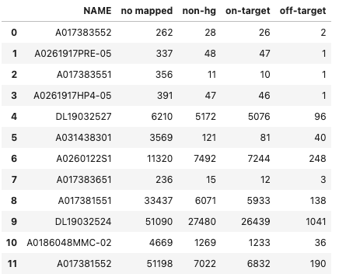
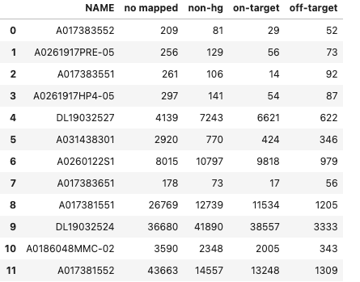
Majority mapped reads (MAPQ=60) overlap with target regions
off/on-target Omni1.0_panel.bed
Mapped == MAPQ>=60
Mapped == MAPQ>=1

Slide 9
Reportable region bed file (REPORT= intervals are the ones that are actual reportable for snvs and indels): https://github.com/guardant/ghpipeline/blob/master/parameter_sets/Omni/v1.0/Omni1.0_annotated_reportable_regions.bed
For off/on-target, use this bed file: https://github.com/guardant/ghpipeline/blob/master/parameter_sets/Omni/v1.0/Omni1.0_panel.bed

