Slide 1

Sprint 4
Michael, Stirling, Hassan

Slide 2
The Challenge
Given a Sphero robot
Must complete a Triathlon consisting of three parts
Endurance(Circumnavigation)
Speed(Figure 8)
Agility(Obstacle Course)
Must complete each course close, if not 100% perfect

Slide 3
The Roles We Played Throughout Development
Stirling-Lead Programmer
Hassan-Manager
Michael-Programmer

Slide 4
Challenges Faced Throughout Testing
Pretty much everything
Robot not going straight
Going too slow over obstacles
Going too fast over the taped-up path

Slide 5
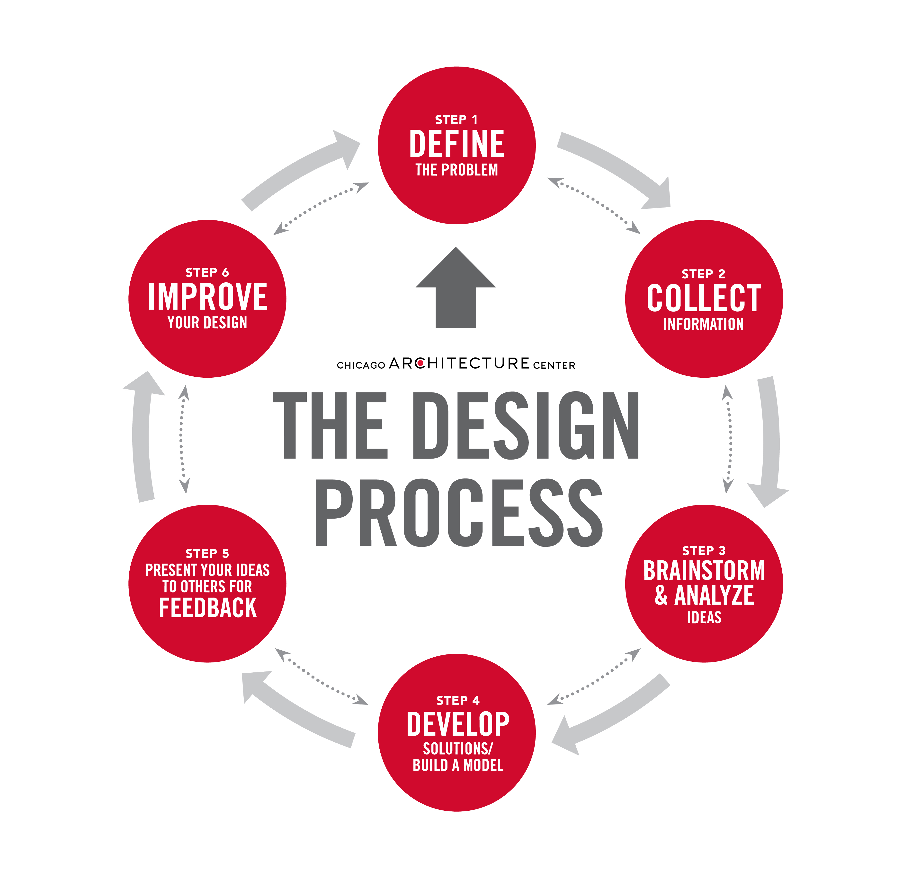
What We Have Learned About Software Engineering

Slide 6
What We Learned About Software Engineering Continued
What goes into the design process
The overall basics of actual coding
How to handle trial/error
Collaborating with one another
Keeping to the deadlines

Slide 7
What Could Be Done Differently
Time Management
Speed Management
Organization

Slide 8
Part of Our Sprint 3 Code

