Slide 1
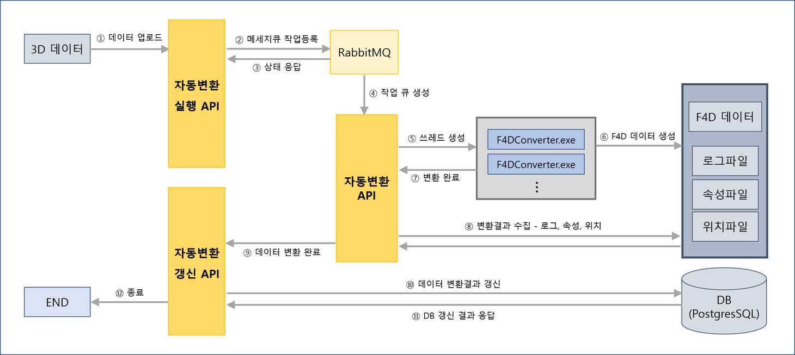
Upload Data
Register Message Queuing
3D Data
Status Response
Operation API of Auto-Conversion
Create Queuing
F4D Data
Create Threads
Create F4D Data
Log files
Auto-Conversion API
Conversion Done
Attributes files
⑧ Collect Conversion Results: Logs, Attributes, Locations
Location files
Update API of Auto-Conversion
Data Conversion Done
Finish
Update Data Conversion Results
DB Update Results Response

