Slide 1
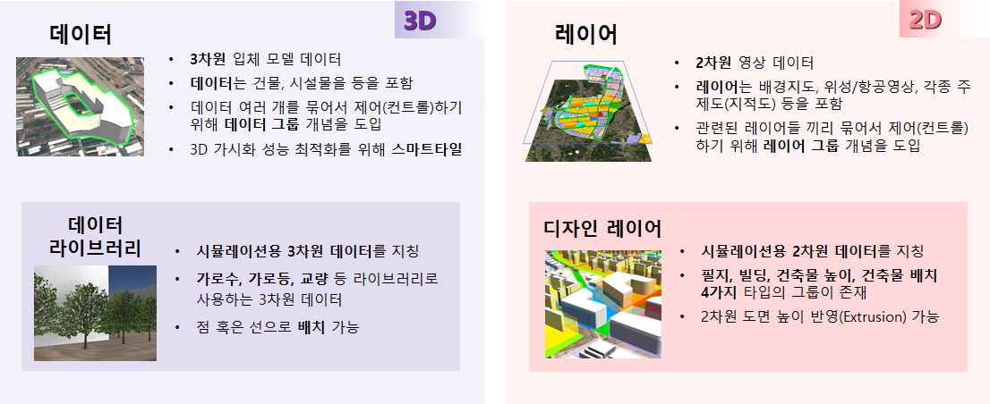
Data
Layer
3D model data
Including buildings, facilities, etc.
Introducing data group concept for controlling a number of data together
Smart Tiles for optimizing 3D visualization performance
2D image data
Layers including background maps, satellite imageries / aerophotos, various thematic maps (cadastral maps), etc.
Introducing layer group concept for controlling related layers together
Data Library
Design Layer
Meaning 3D data to simulate
3D data used as libraries, such as roadside trees, streetlights, bridges, etc.
Can be placed as points or lines
Meaning 2D data to simulate
4 types of design group : lot, building, building height, building layout
Can reflects the extrusion (height property) of 2D data

