Slide 1
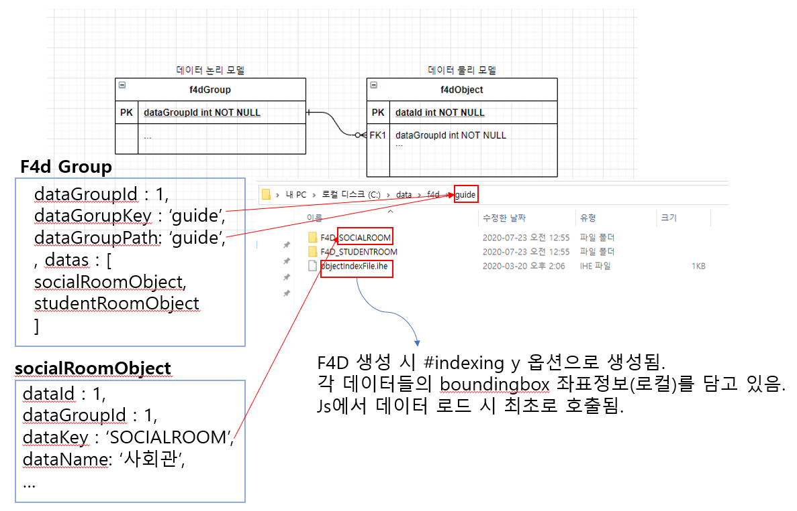
Logical data model
Physical data model
Logical data model
Physical data model
When creating F4D, it is created with #indexing_y option so that it includes (local) coordinates information of the boundingboxes of each data.
When JS loads data, these coordinates are called first.
‘The Social Room’,

