Slide 1
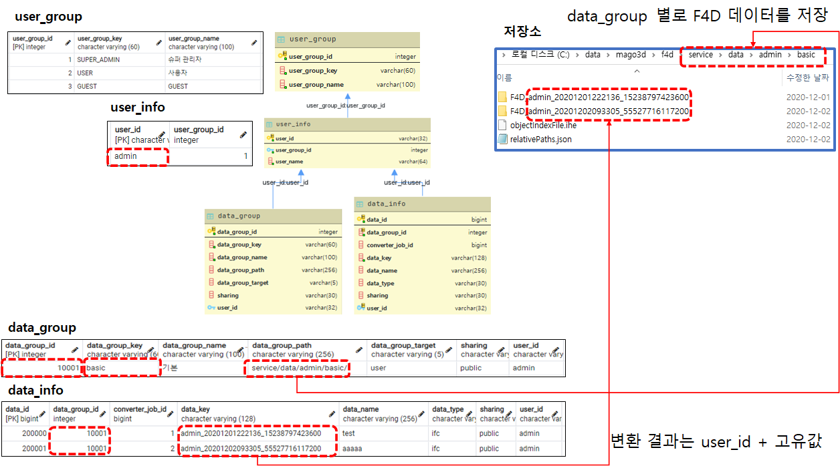
Save F4D data by data groups
Save folder
Conversion result :
user_id + unique value

