Slide 1
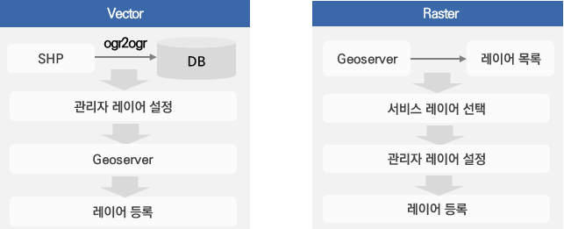
Layer lists
Admin layer configuration
Selecting service layer
Admin layer configuration
Layer registration
Layer registration

