Slide 1
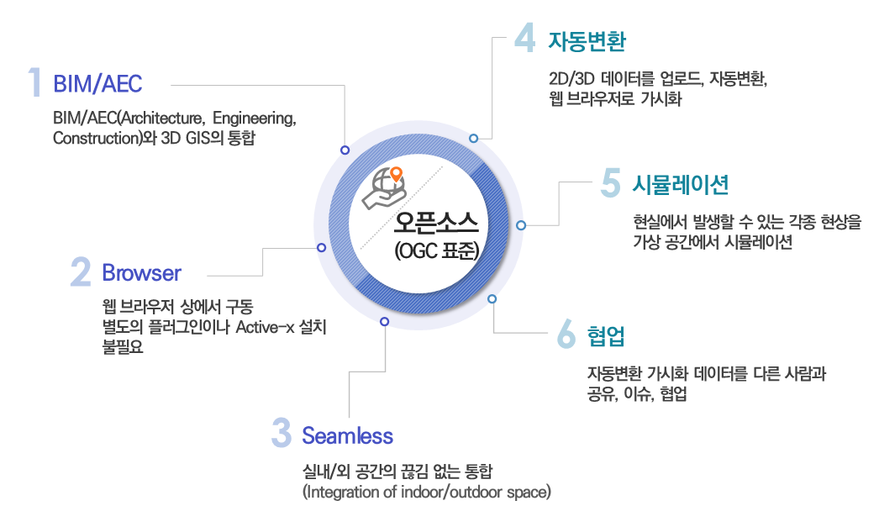
Automatic Conversion
Uploading, auto-converting, visualizing in web browsers of 2D / 3D data
Integration of 3D GIS and BIM / AEC(Architecture, Engineering, Construction)
Simulation
Simulation
Open Source
(OGC Standards)
Simulating various real world phenomena in the virtual space
Running in web browsers; no need to install any additional add-on or ActiveX
Running in web browsers; no need to install any additional add-on or ActiveX
Running in web browsers; no need to install any additional add-on or ActiveX
Collaboration
Sharing and collaborating auto-converted and visualized data with other people
Seamless integration of indoor / outdoor spaces

