Slide 1
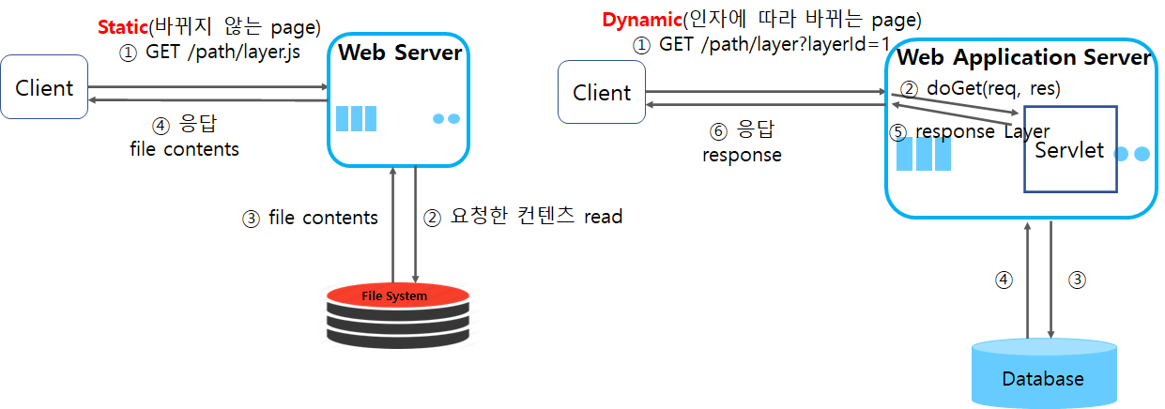
Static (the page which will not change)
Dynamic (the page which will change by factors)
Response
Response
Read the requesting contents

