Slide 1
TD Premium Migration and Personalized Loyalty Engine
Human & Simple
Team Members
Kevin Hau, Ning Zhao, Hai Nguyen, Linda
Savoia, Bhoomi Patel, Anthony D'Costa
Team Name
Human & Simple
Notes:
Today, our team is excited to walk you through our analysis of the 'Human & Simple' proposal for the TD Biz Jam. We are going to share a strategy focused on modernizing TD’s Premium Migration and creating a Personalized Loyalty Engine.“ Together, we identified a critical problem - right now, customers feel it takes too long to accumulate meaningful rewards. Traditional loyalty points feel slow and low-value. Our goal today is to show you how we can drive sustained, repeat engagement by introducing instant gratification and creating a clear path to premium tier migration.

Slide 2
First, the value is delayed—customers wait months to feel rewarded. Second, redemption is complex and lacks immediate, visible value at the checkout counter. And finally, redemption is heavily skewed toward our premium cardholders, leaving our base segment largely unactivated.
'Loyalty Value Gap.'
Notes:
We call this the 'Loyalty Value Gap.' There are three main friction points. First, the value is delayed—customers wait months to feel rewarded. Second, redemption is complex and lacks immediate, visible value at the checkout counter. And finally, redemption is heavily skewed toward our premium cardholders, leaving our base segment largely unactivated.

Slide 3
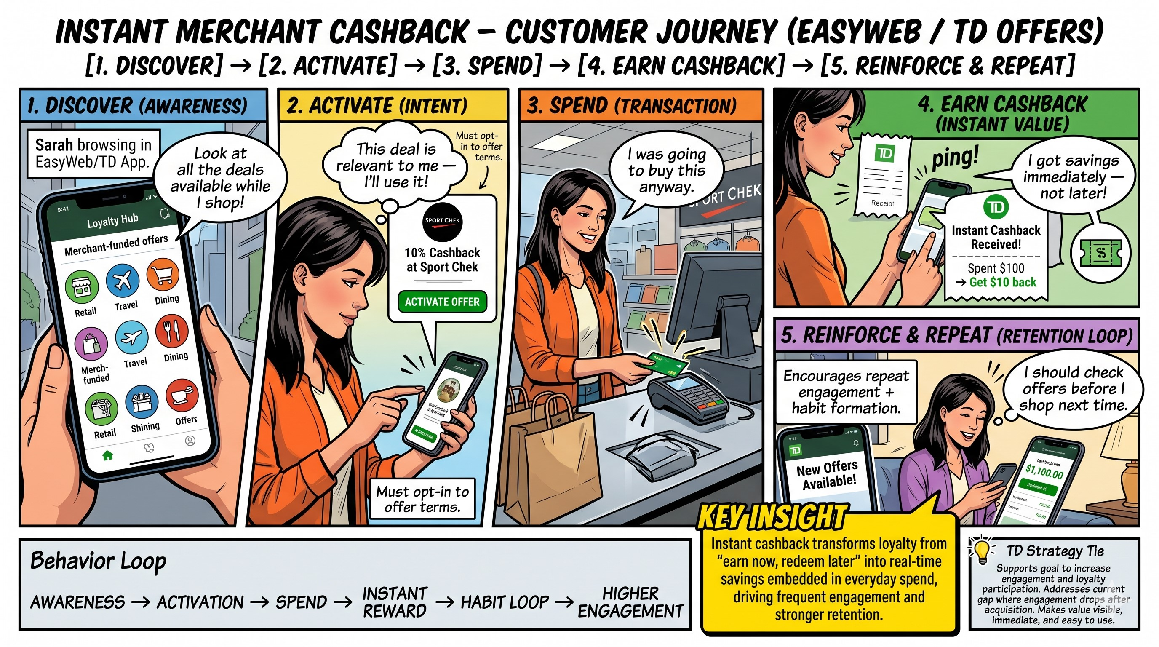
An everyday TD customer is trying to earn meaningful rewards on their daily purchases, but struggles because traditional loyalty points take too long to accumulate and the redemption process lacks immediate, visible value
Notes:
Our solution is an 'Instant Merchant Cashback' model. It’s a simple, four-step loop. Customers Discover offers from top brands right inside the TD app. They Activate the offer with a single click. They Spend at those retailers just like they normally would. And finally, they Earn instant cashback or points that show up immediately in their TD Rewards dashboard. It is effortless and immediate

Slide 4

Top Performance Snapshot ( current state )
Scale Drivers: First Class Travel ($28.7B) and Cash Back ($18.7B) drive >55% of volume.
Growth Engine: TD Low Rate achieved ~80% YoY spend expansion as a lead acquisition tool.
^{Business Travel}
^{First Class Travel}
^{Cash Back (Base)}
$6122
Sales Per Active user
$2847
Sales Per Active user
$864
Sales Per Active user
Loyalty ROI is concentrated in premium travel segments.
Loyalty is not redemption –
it is repeated usage, increased spend and long-term retention
TD Bank
Notes:
When we look at our portfolio, the numbers tell a distinct story. First Class Travel is an absolute powerhouse, driving over $28 Billion in volume. Meanwhile, our Cash Back Base is sitting at $18.7 Billion. The clear insight here is that our loyalty ROI is heavily concentrated in our premium tiers. As we developed this, we kept coming back to one central truth: Loyalty is not just redemption. True loyalty is repeated usage, increased spend, and long-term retention."Transition: "And the data proves where our biggest opportunity for that retention lies.

Slide 5
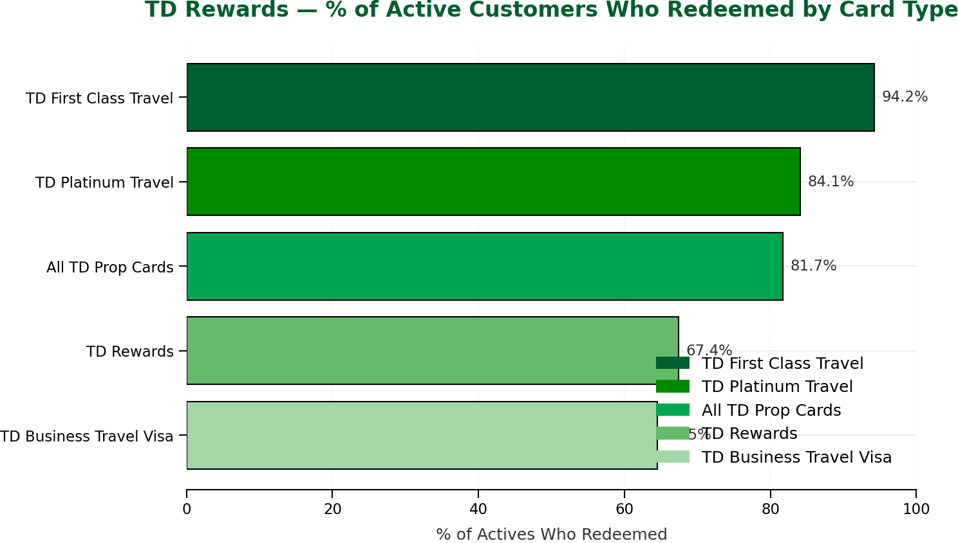
High Redemption ≠ High Value Engagement
Insights
Opportunity -> Actions
Most Valuable =
High spend + High redemption
Cost Heavy=
Low spend + High redemption
Untapped opportunity =
High spend + Low redemption
Personalized nudges Target low-engagement customers Spend-linked rewards Shift behavior from redemption-only → spend + redeem Real-time redemption prompts Drive usage at point of purchase AI-triggered moments Predict when customers are most likely to redeem
Redemption is high (~82%) but ​concentrated in premium cards (85–94%) while base segments lag (~65–67%).
Our opportunity isn’t increasing redemption — it’s shifting engagement toward high-spend, high-value segments
At first glance, redemption looks strong — over 80% of active customers are using rewards. But when we break it down, that engagement is heavily concentrated in premium cardholders. When we overlay spend behavior, it becomes clear - not all redeemers are high-value. The problem is not engagement — it’s activation.
Data Source
Notes:
We currently boast an 82% redemption rate, which sounds great—but it’s a vanity metric. It is artificially inflated by the top 15% of our premium users who engage at up to 94%. Meanwhile, our base segments are lagging in the mid-60s. The real problem isn't redemption; it's activation. We need a strategy that shifts our base users from passive earners into active 'spend-and-redeem' participants. Looking closely at engagement by card type, we see First Class Travel leading at over 94%. But look at the bottom row: TD Rewards Base at 67.4%. We don't view that 67% as a weakness; we view it as our greatest migration opportunity. These are the customers ready to be moved up the ladder.

Slide 6
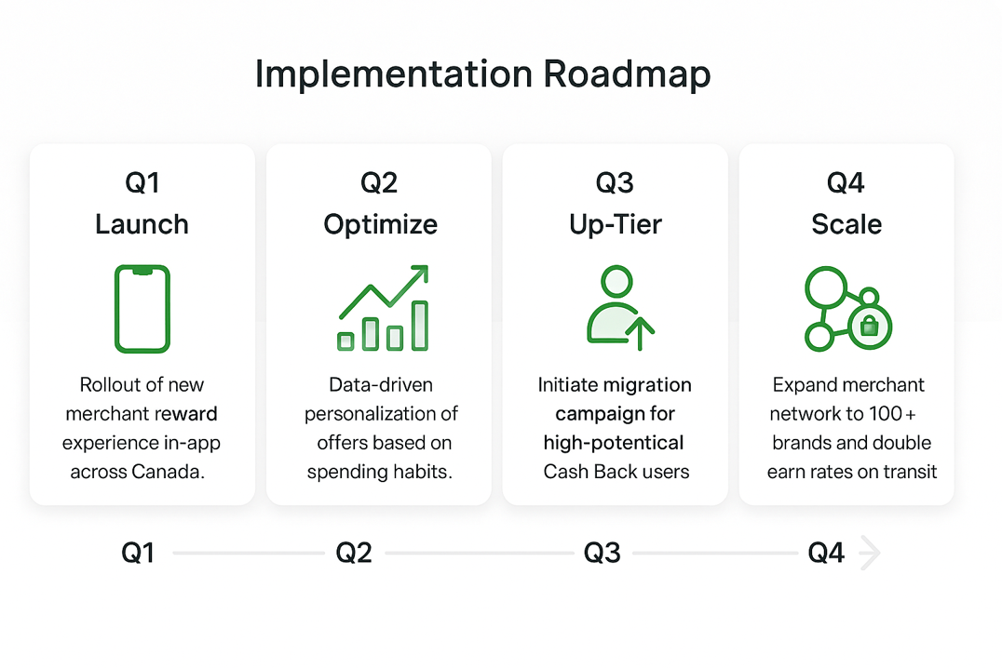
TD Rewards is TD Bank's loyalty ( points ) program tied to its credit cards in Canada – especially travel and rewards VISA cards in Canada.
 |  | Loyalty KPI | Cash Back | Infinite
 |  | Engagement (txns/active/month) | 12.38 | 21.95
 |  | Loyalty (per active/month) | $726.99 | $1751.64
2.4x
Premium user stay
~42%
Redeem annually
Three Pillars for Long-Term Loyalty?
1. In-App Discounts
New 2026 TD Rewards Experience integrates 30+ top brands (Gap, PetSmart) for instant merchant cashback within .
2. Anniversaries Retention
Driving 10% annual bonus points on birthdays / anniversaries creates a high-emotional-value touchpoint that discourages card churn.
3. Personalized Value
Moving from one-time perks to year-round relevant rewards, such as EV charging bonuses and intentional spending insights.
Notes:
First, In-App Discounts with over 30 top brands to deliver that instant value we talked about. Second, Anniversary Retention—surprising users with a 10% bonus on birthdays or anniversaries to build emotional loyalty and reduce churn. And third, Personalized Value—using AI to trigger the right offer at the right time, like EV charging bonuses based on their habits In Q1, we launch the new merchant experience right inside EasyWeb. In Q2, we let the data work for us, optimizing and personalizing those offers. By Q3, we launch our targeted up-tier campaign to migrate our most engaged base users to Infinite tiers. And in Q4, we scale the program, expanding to over 100 brands.

Slide 7
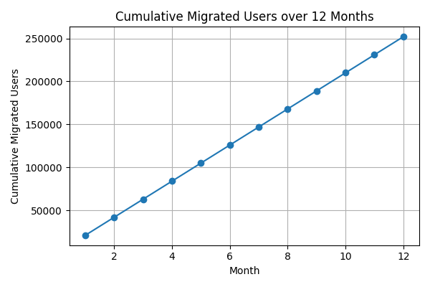
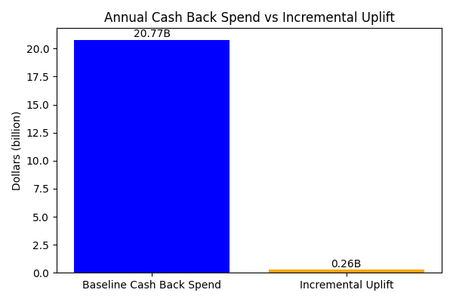
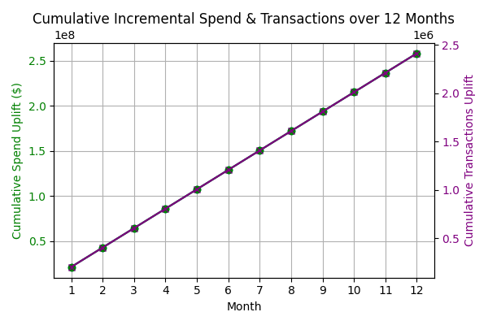
Small improvements in engagement at TD's scale translate into tens of millions in value
+20K-25K
New Monthly Cash Back Users Migrated
+~$1.68B
^{Incremental Annual Spend}
+~$33.5M
^{Additional Annual Revenue}
+~15.7M
Yearly Additional Engagement Actions
Data Source
Notes:
By making loyalty 'Human & Simple,’ we project $1.68 Billion in incremental annual spend. We will achieve this by migrating 25,000 monthly users to premium tiers, generating nearly 16 million new engagement actions a year and ultimately driving a 3x yield lift for every active user we migrate."

Slide 8

Human & Simple Kevin Hau, Ning Zhao, Hai Nguyen, Linda Savoia, Bhoomi Patel, Anthony D'Costa
Solution Title
TD Premium Migration and Personalized Loyalty Engine
Solution Overview
Strategic Insight- Premium card users stay 2.4x longer and drive significant volume ($28.7B base).
The Core Strategy- Migrate the top 10% of high-potential Cash Back users into Infinite tiers for a 3x yield lift.
Engagement Ecosystem- Integrated TD Rewards Experience in EasyWeb / TD mobile app featuring 30+ top merchant brands.
Retention Mechanics- 10% annual bonus points on birthdays / anniversaries to create high-emotional-value touchpoints.
Impact & Benefits
FINANCIAL ROI
LOYALTY & RETENTION
PORTFOLIO SCALE
Realize 3x yield lift per active user via tier migration and defend the $28.7B premium base.
Anniversary retention bonuses and TD Rewards credits decrease churn risk for high-value premium travel segments.
Converts the 70% YoY growth in Low-Rate accounts into a qualified pipeline for premium card adoption.
Notes:
To summarize our pitch today, we leave you with three key takeaways: We must actively migrate high-potential users to Infinite tiers to capture that 3x yield. We must enable real-time cashback to truly deliver on TD's 'Human & Simple' brand promise. We must utilize emotional touchpoints, like anniversaries, to secure lifelong retention.

