Slide 1
TD Premium Migration and Personalized Loyalty Engine
Human & Simple
Team Members
Kevin Hau, Ning Zhao, Hai Nguyen, Linda
Savoia, Bhoomi Patel, Anthony D'Costa
Team Name
Human & Simple
Notes:
Today, our team is excited to walk you through our analysis of the 'Human & Simple' proposal for the TD Biz Jam. We are going to share a strategy focused on modernizing TD’s Premium Migration and creating a Personalized Loyalty Engine.“ Together, we identified a critical problem - right now, customers feel it takes too long to accumulate meaningful rewards.
Traditional loyalty points feel slow and low-value.
Our goal today is to show you how we can drive sustained, repeat engagement by introducing instant gratification and creating a clear path to premium tier migration.

Slide 2

First, the value is delayed—customers wait months to feel rewarded. Second, redemption is complex and lacks immediate, visible value at the checkout counter. And finally, redemption is heavily skewed toward our premium cardholders, leaving our base segment largely inactivated.
'Loyalty Value Gap.'
Notes:
We call this the 'Loyalty Value Gap.’
There are three main friction points.
First, the value is delayed—customers wait months to feel rewarded.
Second, redemption is complex and lacks immediate, visible value at the checkout counter.
And finally, redemption is heavily skewed toward our premium cardholders, leaving our base segment largely unactivated.

Slide 3
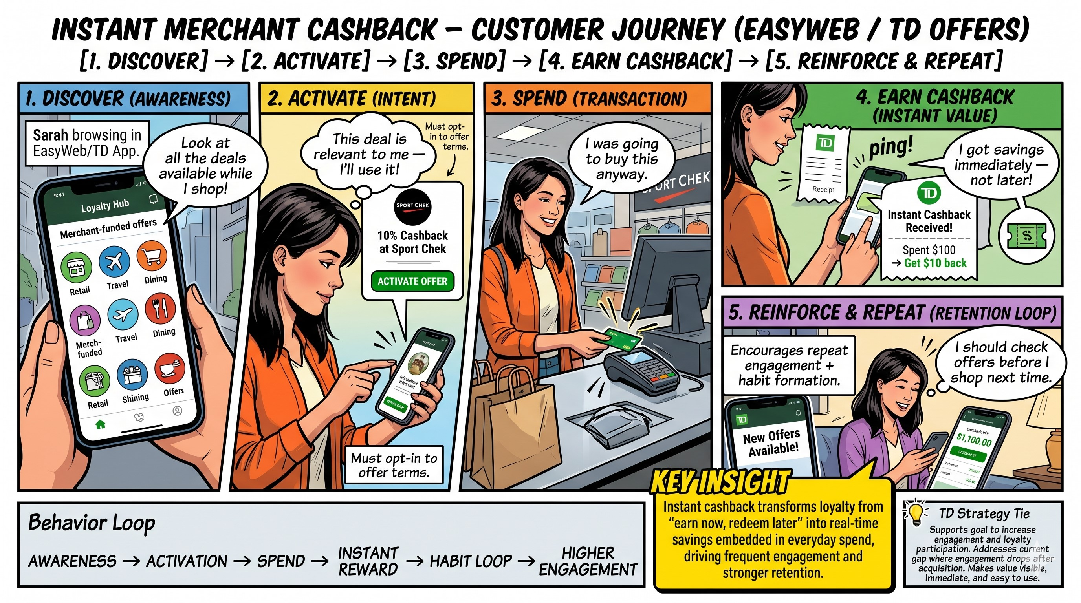
An everyday TD customer is trying to earn meaningful rewards on their daily purchases but struggles because traditional loyalty points take too long to accumulate and the redemption process lacks immediate, visible value.
Human & Simple
Notes:
Our solution is an 'Instant Merchant Cashback' model. It’s a simple, four-step loop. Customers Discover offers from top brands right inside the TD app. They Activate the offer with a single click. They Spend at those retailers just like they normally would. And finally, they Earn instant cashback or points that show up immediately in their TD Rewards dashboard. It is effortless and immediate

Slide 4







Loyalty Activation: Opportunities and Actions
Personalized Nudges
Spend-Linked Rewards
Target low-engagement customers with data-driven prompts designed to reactivate dormant accounts and increase monthly frequency.
Shift customer behavior from "Redemption-Only" profiles to high-value "Spend + Redeem" cycles, maximizing long-term profitability.
Execution Example Pushing an automated notification through the digital Loyalty Hub UI: "You haven't used your TD First Class Travel card this month. Earn 2x points on your next grocery run if you use it this weekend!"
Execution Example Gamifying the monthly statement: If a TD Cash Back user hits $1,500 in everyday spend, dynamically unlock a "Weekend Multiplier" that boosts their earn rate for the next 48 hours.
Real-Time Redemption
AI-Triggered Moments
Implement smart prompts to drive point usage at the Point of Purchase, increasing the immediate perceived value of accumulated rewards.
Leverage predictive modeling to identify high-probability redemption moments, delivering offers exactly when customers are ready to act.
Execution Example Repurposing real-time transaction pipelines—similar to those feeding TensorFlow fraud detection models—to instantly recognize an airline ticket purchase and automatically trigger a targeted offer for Expedia For TD hotel bookings.
Execution Example Utilizing low-latency cloud infrastructure to trigger an immediate SMS or app alert the second a customer swipes at Starbucks: "Use 500 TD Rewards points to cover this $5.00 purchase right now?"
Human & Simple
Notes:
To drive this activation, we need to turn our insights into actionable opportunities.
We are focusing on four key tactics –
First, we utilize Personalized Nudges. By targeting our low-engagement customers, we can send data-driven prompts—like offering double points on groceries—to quickly reactivate dormant accounts.
Second, we implement Spend-Linked Rewards. The goal here is to shift behavior away from a 'redemption-only' mindset and into a continuous 'spend and redeem' cycle, which maximizes our long-term profitability.
Third, we enable Real-Time Redemption prompts. By sending smart alerts at the exact moment of a transaction, we drive immediate point usage right at the point of purchase.
Finally, we leverage AI-Triggered Moments. By looking at transaction data in real-time, our predictive models can anticipate exactly when customers are most likely to redeem —allowing us to drop the perfect offer in front of them the second they are ready to act."

Slide 5

Top Performance Snapshot ( current state )
Most Valuable =
High spend + High redemption
Cost Heavy=
Low spend + High redemption
Untapped opportunity =
High spend + Low redemption
Scale Drivers: First Class Travel ($28.7B) and Cash Back ($18.7B) drive >55% of volume.
Growth Engine: TD Low Rate achieved ~80% YoY spend expansion as a lead acquisition tool.
^{Business Travel}
^{First Class Travel}
^{Cash Back (Base)}
$6122
Sales Per Active user
$2847
Sales Per Active user
$864
Sales Per Active user
Our opportunity isn’t increasing redemption — it’s shifting engagement toward high-spend, high-value segments
.
Loyalty is not redemption –
it is repeated usage, increased spend and long-term retention
TD Bank
Human & Simple
Notes:
When we look at our portfolio, the numbers tell a distinct story. First Class Travel is an absolute powerhouse, driving over $28 Billion in volume. Meanwhile, our Cash Back Base is sitting at $18.7 Billion. The clear insight here is that our loyalty ROI is heavily concentrated in our premium tiers. As we developed this, we kept coming back to one central truth: Loyalty is not just redemption. True loyalty is repeated usage, increased spend, and long-term retention. And the data proves where our biggest opportunity for that retention lies.

Slide 6

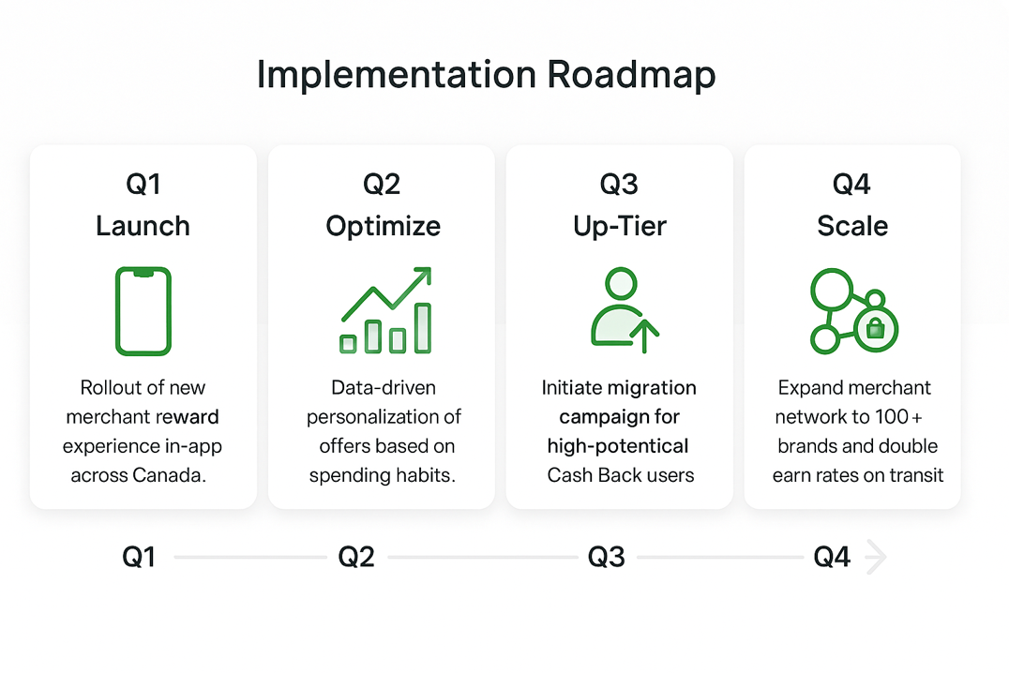
TD Rewards is TD Bank's loyalty ( points ) program tied to its credit cards in Canada – especially travel and rewards cards in Canada.
 |  | Loyalty KPI | Cash Back | Infinite
 |  | Engagement (txns/active/month) | 12.38 | 21.95
 |  | Loyalty (per active/month) | $726.99 | $1751.64
2.4x
Premium user stay
~42%
Redeem annually
Three Pillars for Long-Term Loyalty?
1. In-App Discounts
New 2026 TD Rewards Experience integrates 30+ top brands (Gap, PetSmart) for instant merchant cashback within .
2. Anniversaries Retention
Driving 10% annual bonus points on birthdays / anniversaries creates a high-emotional-value touchpoint that discourages card churn.
3. Personalized Value
Moving from one-time perks to year-round relevant rewards, such as EV charging bonuses and intentional spending insights.
Human & Simple
Notes:
First, In-App Discounts with over 30 top brands to deliver that instant value we talked about. Second, Anniversary Retention—surprising users with a 10% bonus on birthdays or anniversaries to build emotional loyalty and reduce churn. And third, Personalized Value—using AI to trigger the right offer at the right time, like EV charging bonuses based on their habits In Q1, we launch the new merchant experience right inside EasyWeb. In Q2, we let the data work for us, optimizing and personalizing those offers. By Q3, we launch our targeted up-tier campaign to migrate our most engaged base users to Infinite tiers. And in Q4, we scale the program, expanding to over 100 brands.

Slide 7
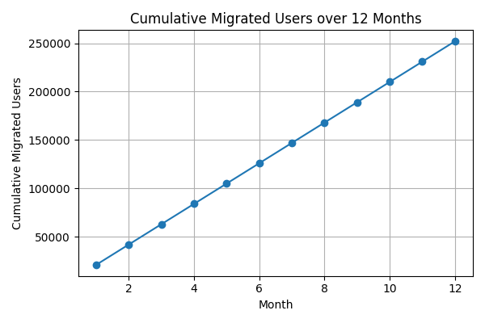
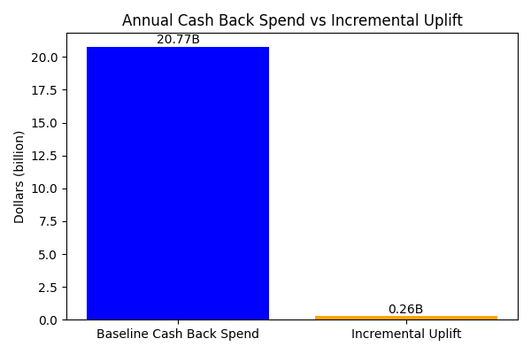
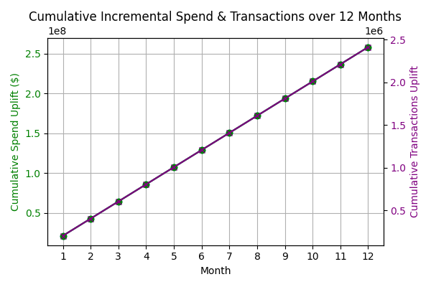
Small improvements in engagement at TD's scale translate into tens of millions in value
+20K-25K
New Monthly Cash Back Users Migrated
+~$1.68B
^{Incremental Annual Spend}
+~$33.5M
^{Additional Annual Revenue}
+~15.7M
Yearly Additional Engagement Actions
Data Source
Human & Simple
Notes:
By making loyalty 'Human & Simple,’ we project $1.68 Billion in incremental annual spend. We will achieve this by migrating 25,000 monthly users to premium tiers, generating nearly 16 million new engagement actions a year and ultimately driving a 3x yield lift for every active user we migrate."

Slide 8

Human & Simple Kevin Hau, Ning Zhao, Hai Nguyen, Linda Savoia, Bhoomi Patel, Anthony D'Costa
Solution Title
TD Premium Migration and Personalized Loyalty Engine
Solution Overview
Strategic Insight- Premium card users stay 2.4x longer and drive significant volume ($28.7B base).
The Core Strategy- Migrate the top 10% of high-potential Cash Back users into Infinite tiers for a 3x yield lift.
Engagement Ecosystem- Integrated TD Rewards Experience in EasyWeb / TD mobile app featuring 30+ top merchant brands.
Retention Mechanics- 10% annual bonus points on birthdays / anniversaries to create high-emotional-value touchpoints.
Impact & Benefits
FINANCIAL ROI
LOYALTY & RETENTION
PORTFOLIO SCALE
Realize 3x yield lift per active user via tier migration and defend the $28.7B premium base.
Anniversary retention bonuses and TD Rewards credits decrease churn risk for high-value premium travel segments.
Converts the 70% YoY growth in Low-Rate accounts into a qualified pipeline for premium card adoption.
Notes:
To summarize our pitch today, we leave you with three key takeaways: We must actively migrate high-potential users to Infinite tiers to capture that 3x yield. We must enable real-time cashback to truly deliver on TD's 'Human & Simple' brand promise. We must utilize emotional touchpoints, like anniversaries, to secure lifelong retention.

