Slide 1
Driving Sustained Loyalty
Strategic framework for building long-term engagement through TD Rewards & personalized customer benefits.
Executive Strategy Review | Q1 2026
Financial ROI
Realize 3x yield lift per active user via tier migration and defend the $28.7B First Class Travel base.

Slide 2
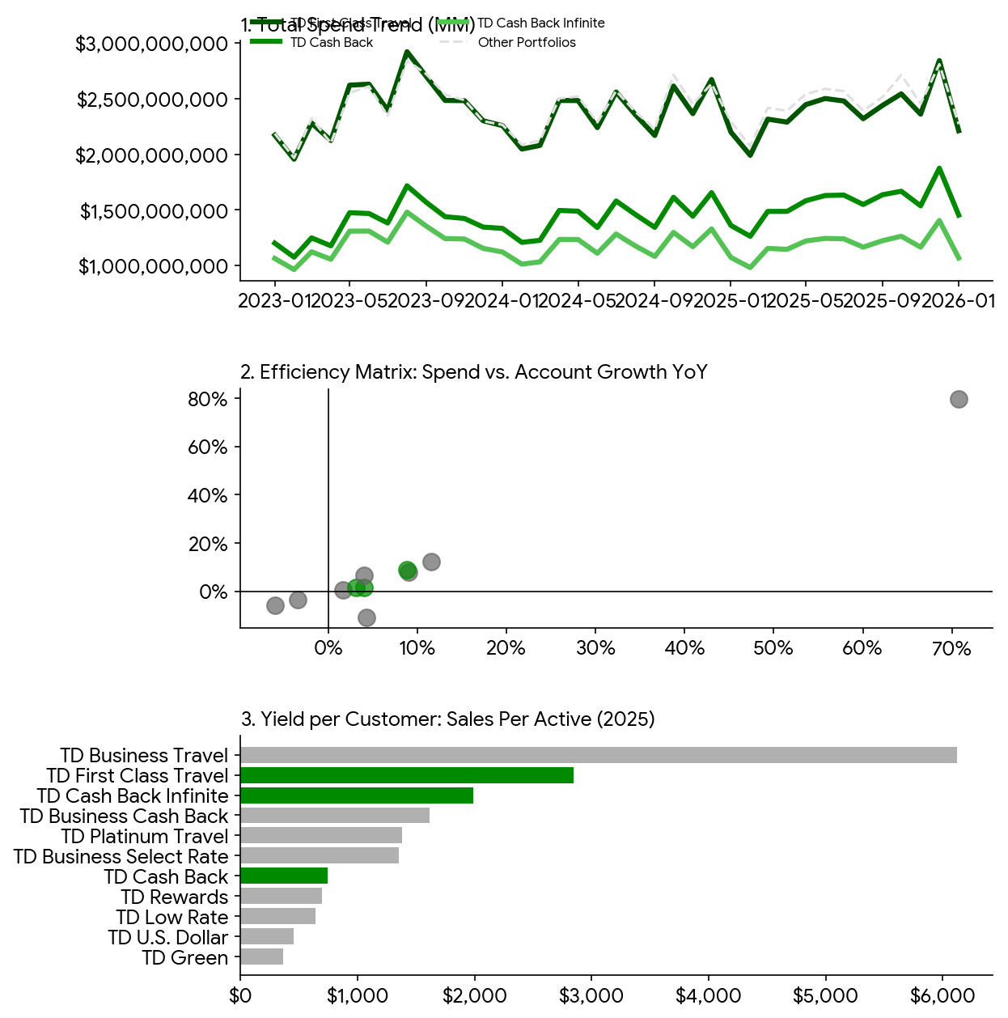
Executive Performance Dashboard
Top Performance Snapshot
• Scale Drivers: First Class Travel ($28.7B) and Cash Back ($18.7B) drive >55% of volume.
• Growth Engine: TD Low Rate achieved ~80% YoY spend expansion as a lead acquisition tool.
Long-Term Strategy
• Engagement Loop: High-yield cards (Business Travel at $6k/active) prioritize retention via concierge perks.
• Portfolio Migration: Strategy shift toward up-tiering Cash Back users into Infinite tiers for 3x yield lift.

Slide 3
Three Pillars for Long-Term Loyalty
1. In-App Discounts
New 2026 TD Rewards Experience integrates 30+ top brands (Gap, PetSmart) for instant merchant cashback within EasyWeb.
2. Birthday Retention
Driving 10% annual bonus points on birthdays creates a high-emotional-value touchpoint that discourages card churn.
3. Personalized Value
Moving from one-time perks to year-round relevant rewards, such as EV charging bonuses and intentional spending insights.

Slide 4
Yield Maximization: Premium Tier Value
Loyalty ROI is concentrated in premium travel segments:
Business Travel: $6,122 Sales Per Active (The Yield Leader)
First Class Travel: $2,847 Sales Per Active
Cash Back (Base): ~$864 Sales Per Active
Strategic Pivot
Incentivize top 10% of Cash Back users with 'Tier Migration' bonuses to move them into First Class Travel. Premium users stay 2.4x longer than entry-level cardholders.

Slide 5
Seamless Digital Benefits & Ecosystem
EasyWeb Integration
Real-time activation of merchant offers directly from the mobile app dashboard.
Expedia for TD & Aeroplan Synergy
Enhancing earn rates to 8x points per $1 spent on travel bookings and leveraging Air Canada partnerships.
Automated Redemption
Simplifying point-to-statement conversions to increase perceived value.

Slide 6
Executive Strategy: Portfolio Rebalancing
Sustained engagement requires shifting focus from pure acquisition to active portfolio management:
1. Premium Defense
Protect the high-yield travel base via NEXUS credits and lounge access enhancements.
2. Low-Rate Conversion
Utilize the 70%+ growth in Low Rate accounts to build a pipeline for credit-building to premium migration.
3. ROI Optimization
Prioritize 'Personalized Merchant Offers' for high-churn risk segments to secure long-term loyalty.

Slide 7
Implementation Roadmap: 2026 Strategy
Q1: Launch
Rollout of the new merchant reward experience in-app across Canada.
Q2: Optimize
Data-driven personalization of offers based on spending habits.
Q3: Up-Tier
Initiate migration campaign for high-potential Cash Back users.
Q4: Scale
Expand merchant network to 100+ brands and double earn rates on transit.

Slide 8
Key Takeaways
1. Sustainable Scale: Defend the First Class Travel volume base.
2. Intentional Loyalty: Focus on personalized merchant rewards.
3. Digital First: Seamless EasyWeb/App experience is key to repeat usage.

