Slide 1
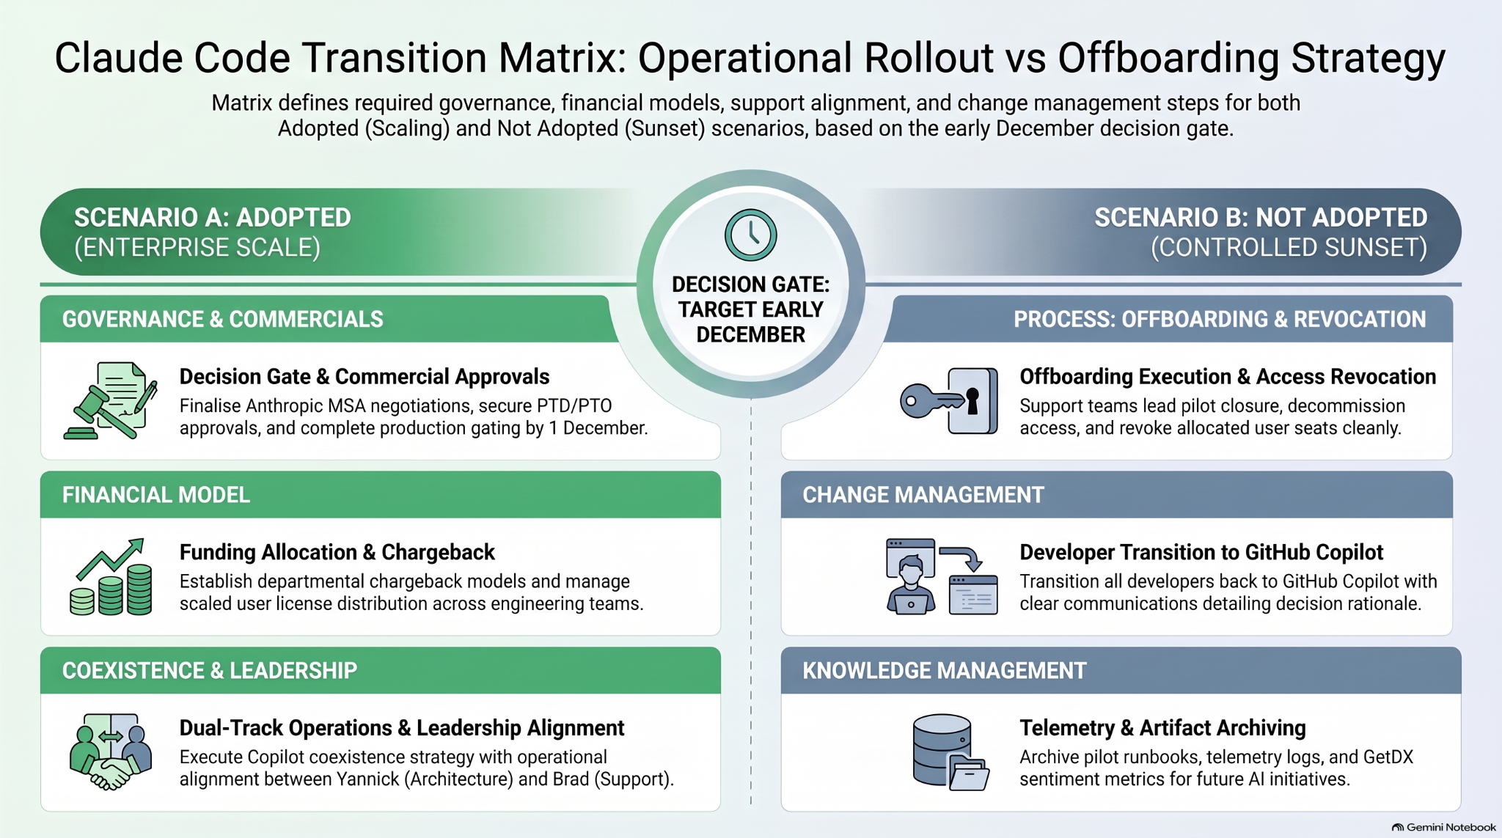

Slide 2


Claude Code Plan: Full Rollout vs. Winding Down
This chart explains what we will do if we fully adopt Claude Code or switch back, depending on our early December decision.
SCENARIO A: WE ADOPT IT (FULL ROLLOUT)
SCENARIO B: WE DON'T ADOPT IT (CLEAN SUNSET)
LEGAL & APPROVALS
OFFBOARDING PROCESS
Final Contracts & Sign-Offs
Finish contract deals with Anthropic, get team sign-offs, and complete security checks by Dec 1.
Closing Access & Winding Down
Support teams will end the trial, close user accounts, and remove user access cleanly.
DECISION DATE:
EARLY DECEMBER
BUDGET & LICENSES
TEAM TRANSITION
Budgeting & Account Setup
Set up team payment plans and hand out official user licenses to engineering teams.
Switching Back to GitHub Copilot
Move all developers back to GitHub Copilot with clear updates explaining why.
TEAM LEADERSHIP
SAVING OUR WORK
Leadership & Tool Coexistence
Run Claude alongside Copilot smoothly, with full team agreement between Yannick and Brad.
Saving Logs & Guides
Save all trial guides, system logs, and user feedback for future AI projects.
Gemini Notebook

Slide 3
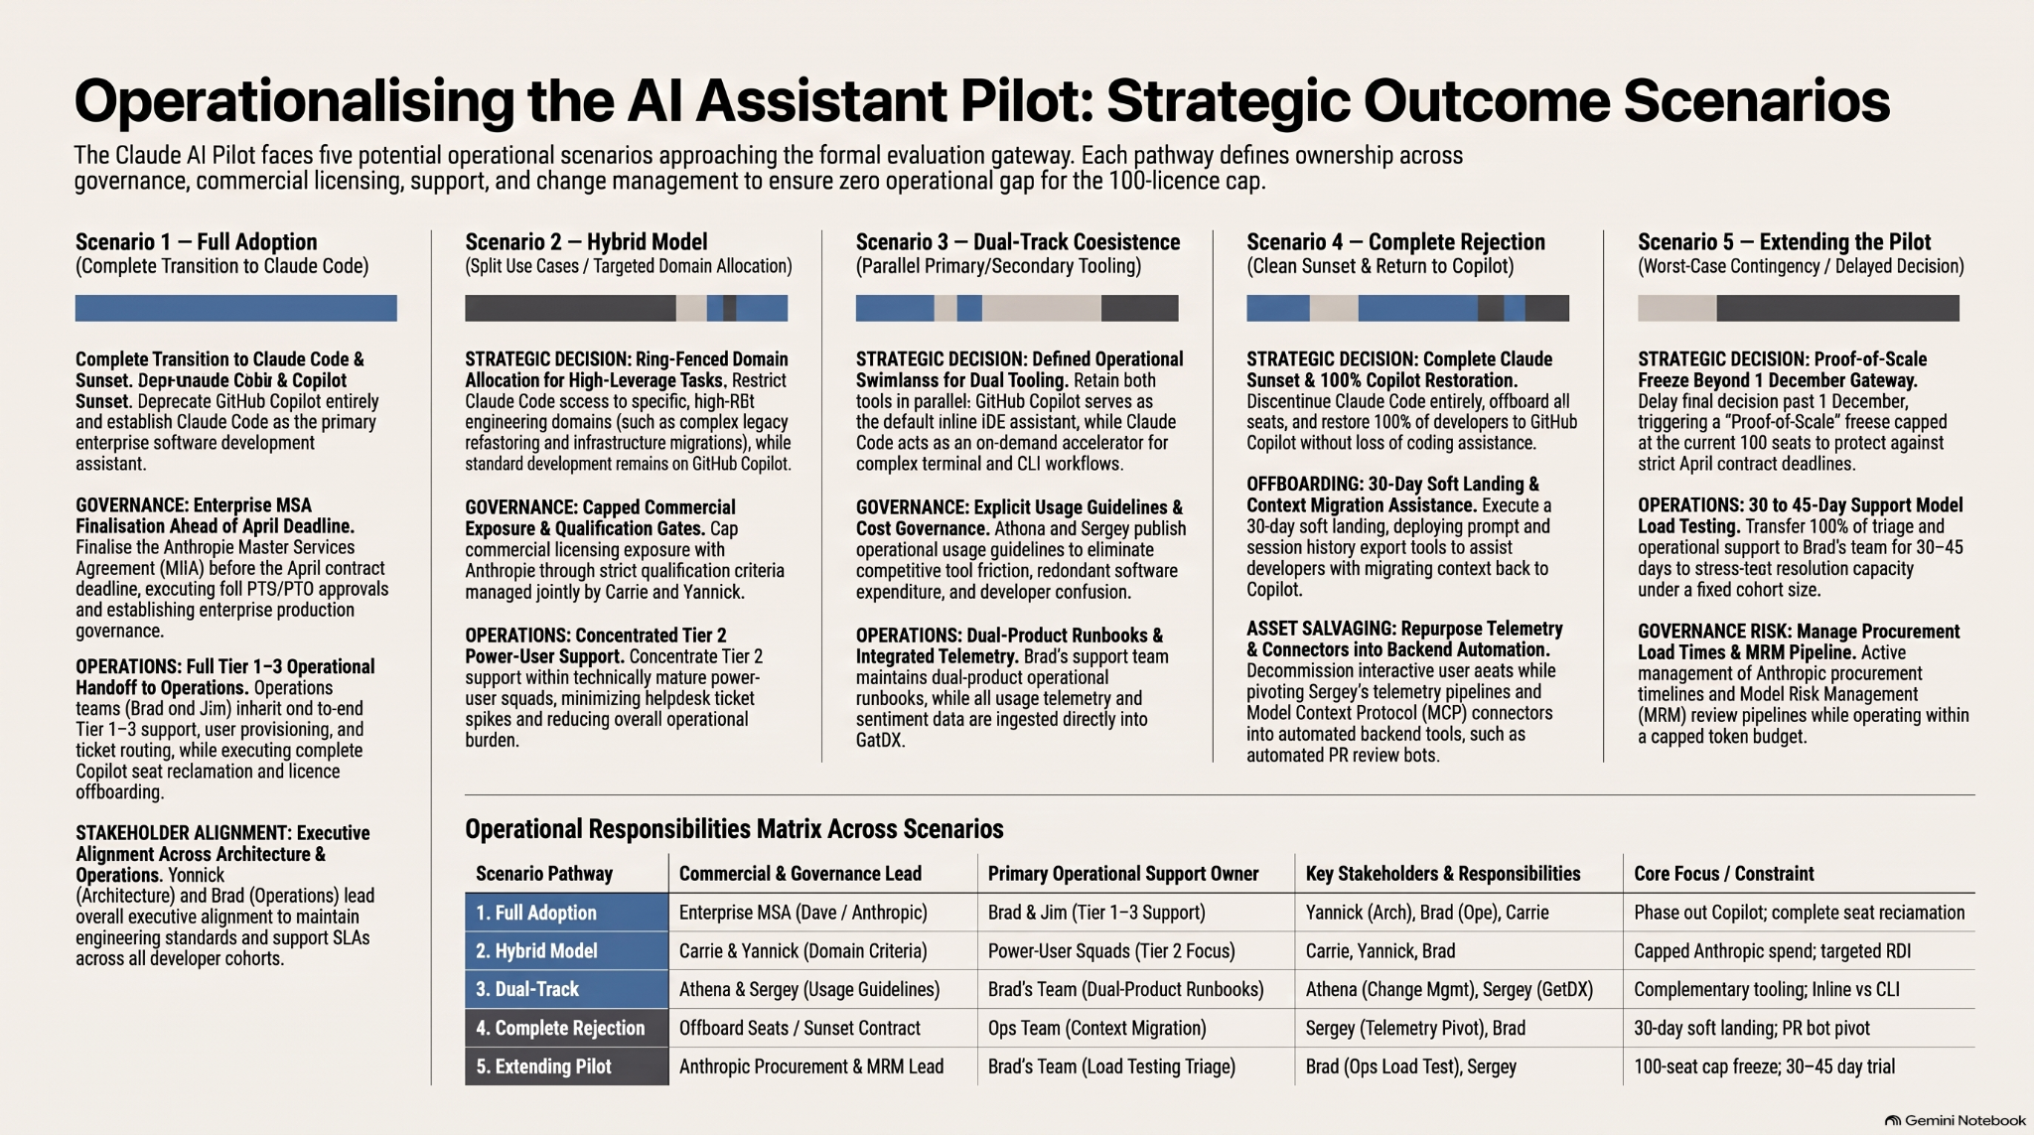

Slide 4
Operationalising the AI Assistant Pilot: Strategic Outcome Scenarios
The Claude AI Pilot faces five potential operational scenarios approaching the formal evaluation gateway. Each pathway defines ownership across governance, commercial licensing, support, and change management to ensure zero operational gap for the 100-licence cap.
1. Full Adoption
2. Hybrid Model
3. Dual-Track
4. Complete Rejection
5. Extending Pilot
Complete transition to Claude Code.
Split use cases & domain allocation.
Parallel primary & secondary tooling.
Clean sunset & return to Copilot.
Delayed decision & seat freeze.
STRATEGIC DECISION
STRATEGIC DECISION
STRATEGIC DECISION
STRATEGIC DECISION
STRATEGIC DECISION
Deprecate GitHub Copilot; establish Claude Code as primary enterprise assistant.
Restrict Claude to high-leverage tasks; standard dev stays on Copilot.
Retain both tools in parallel; defined operational swimlanes.
Discontinue Claude Code; restore 100% of developers to Copilot.
Proof-of-scale freeze capped at current 100 seats beyond Dec 1.
GOVERNANCE
GOVERNANCE
GOVERNANCE
OFFBOARDING
OPERATIONS
Finalise Anthropic Master Services Agreement ahead of April deadline.
Capped commercial exposure; qualification criteria managed by Carrie & Yannick.
Explicit usage guidelines published by Athena & Sergey.
30-day soft landing, deploying prompt export tools.
30 to 45-day support load testing under Brad's team.
OPERATIONS
OPERATIONS
OPERATIONS
ASSET SALVAGING
GOVERNANCE RISK
Full Tier 1–3 operational handoff to Brad & Jim's team.
Concentrated Tier 2 power-user support.
Dual-product runbooks & integrated telemetry.
Repurpose telemetry & MCP connectors into PR bots.
Active management of procurement & MRM review pipelines.
Operational Responsibilities Matrix Across Scenarios
Scenario Pathway
Commercial & Governance Lead
Primary Support Owner
Key Stakeholders
Core Focus / Constraint
1. Full Adoption
Enterprise MSA (Dave / Anthropic)
Brad & Jim (Tier 1–3 Support)
Yannick, Brad, Carrie
Phase out Copilot; seat reclamation
2. Hybrid Model
Carrie & Yannick (Domain Criteria)
Power-User Squads (Tier 2 Focus)
Carrie, Yannick, Brad
Capped spend; targeted RDI
3. Dual-Track
Athena & Sergey (Usage Guidelines)
Brad's Team (Dual-Product Runbooks)
Athena, Sergey (GetDX)
Complementary tooling; Inline vs CLI
4. Complete Rejection
Offboard Seats / Sunset Contract
Ops Team (Context Migration)
Sergey (Telemetry Pivot), Brad
30-day soft landing; PR bot pivot
5. Extending Pilot
Anthropic Procurement & MRM Lead
Brad's Team (Load Testing Triage)
Brad (Ops Load Test), Sergey
100-seat cap freeze; 30–45 day trial

Slide 5
AI Assistant Pilot: What Happens Next? (5 Possible Scenarios)
We are deciding the future of the Claude AI pilot. Depending on the final review, here is how team ownership, licensing, technical support, and tool changes will work across 5 potential pathways for our 100-user limit.
1. Full Adoption
2. Hybrid Model
3. Dual-Track
4. Complete Rejection
5. Extending Pilot
Switch 100% to Claude Code.
Split tools by task and team.
Keep both tools side-by-side.
Cancel Claude and return to Copilot.
Delay decision & freeze seat count.
STRATEGIC DECISION
STRATEGIC DECISION
STRATEGIC DECISION
STRATEGIC DECISION
STRATEGIC DECISION
Replace GitHub Copilot; make Claude Code our main company tool.
Use Claude for complex tasks; keep Copilot for general coding.
Keep both active; define clear rules for when to use each.
Stop Claude Code; return 100% of developers to Copilot.
Freeze user count at 100 seats past Dec 1 while evaluating.
GOVERNANCE
GOVERNANCE
GOVERNANCE
OFFBOARDING
OPERATIONS
Finalize the long-term contract with Anthropic before April.
Cap costs; Carrie & Yannick set rules for who gets Claude access.
Publish exact usage guidelines from Athena & Sergey.
Provide a 30-day graceful exit with prompt-saving tools.
Run 30 to 45 days of heavy support testing under Brad's team.
OPERATIONS
OPERATIONS
OPERATIONS
ASSET SALVAGING
GOVERNANCE RISK
Hand over all tech support to Brad & Jim's team.
Focused support for power users.
Create guides and tracking for both products.
Turn built tools and connectors into automated PR bots.
Manage purchasing and risk approval timelines closely.
Who Does What in Each Scenario
Scenario Pathway
Legal & Business Lead
Support Lead
Key People Involved
Main Goal / Limitation
1. Full Adoption
Enterprise MSA (Dave / Anthropic)
Brad & Jim (Tier 1–3 Support)
Yannick, Brad, Carrie
Phase out Copilot; reclaim licenses
2. Hybrid Model
Carrie & Yannick (Access Rules)
Power-User Squads (Tier 2 Focus)
Carrie, Yannick, Brad
Cap spending; focus on high-impact areas
3. Dual-Track
Athena & Sergey (Usage Rules)
Brad's Team (Dual-Product Runbooks)
Athena, Sergey (GetDX)
Tools complement each other; terminal vs inline
4. Complete Rejection
Account Offboarding / End Contract
Ops Team (Data Migration)
Sergey (Telemetry Pivot), Brad
30-day smooth transition; reuse tools as bots
5. Extending Pilot
Anthropic Procurement & MRM Lead
Brad's Team (Load Testing Triage)
Brad (Ops Load Test), Sergey
Freeze at 100 seats; 30–45 day extra trial

Slide 6
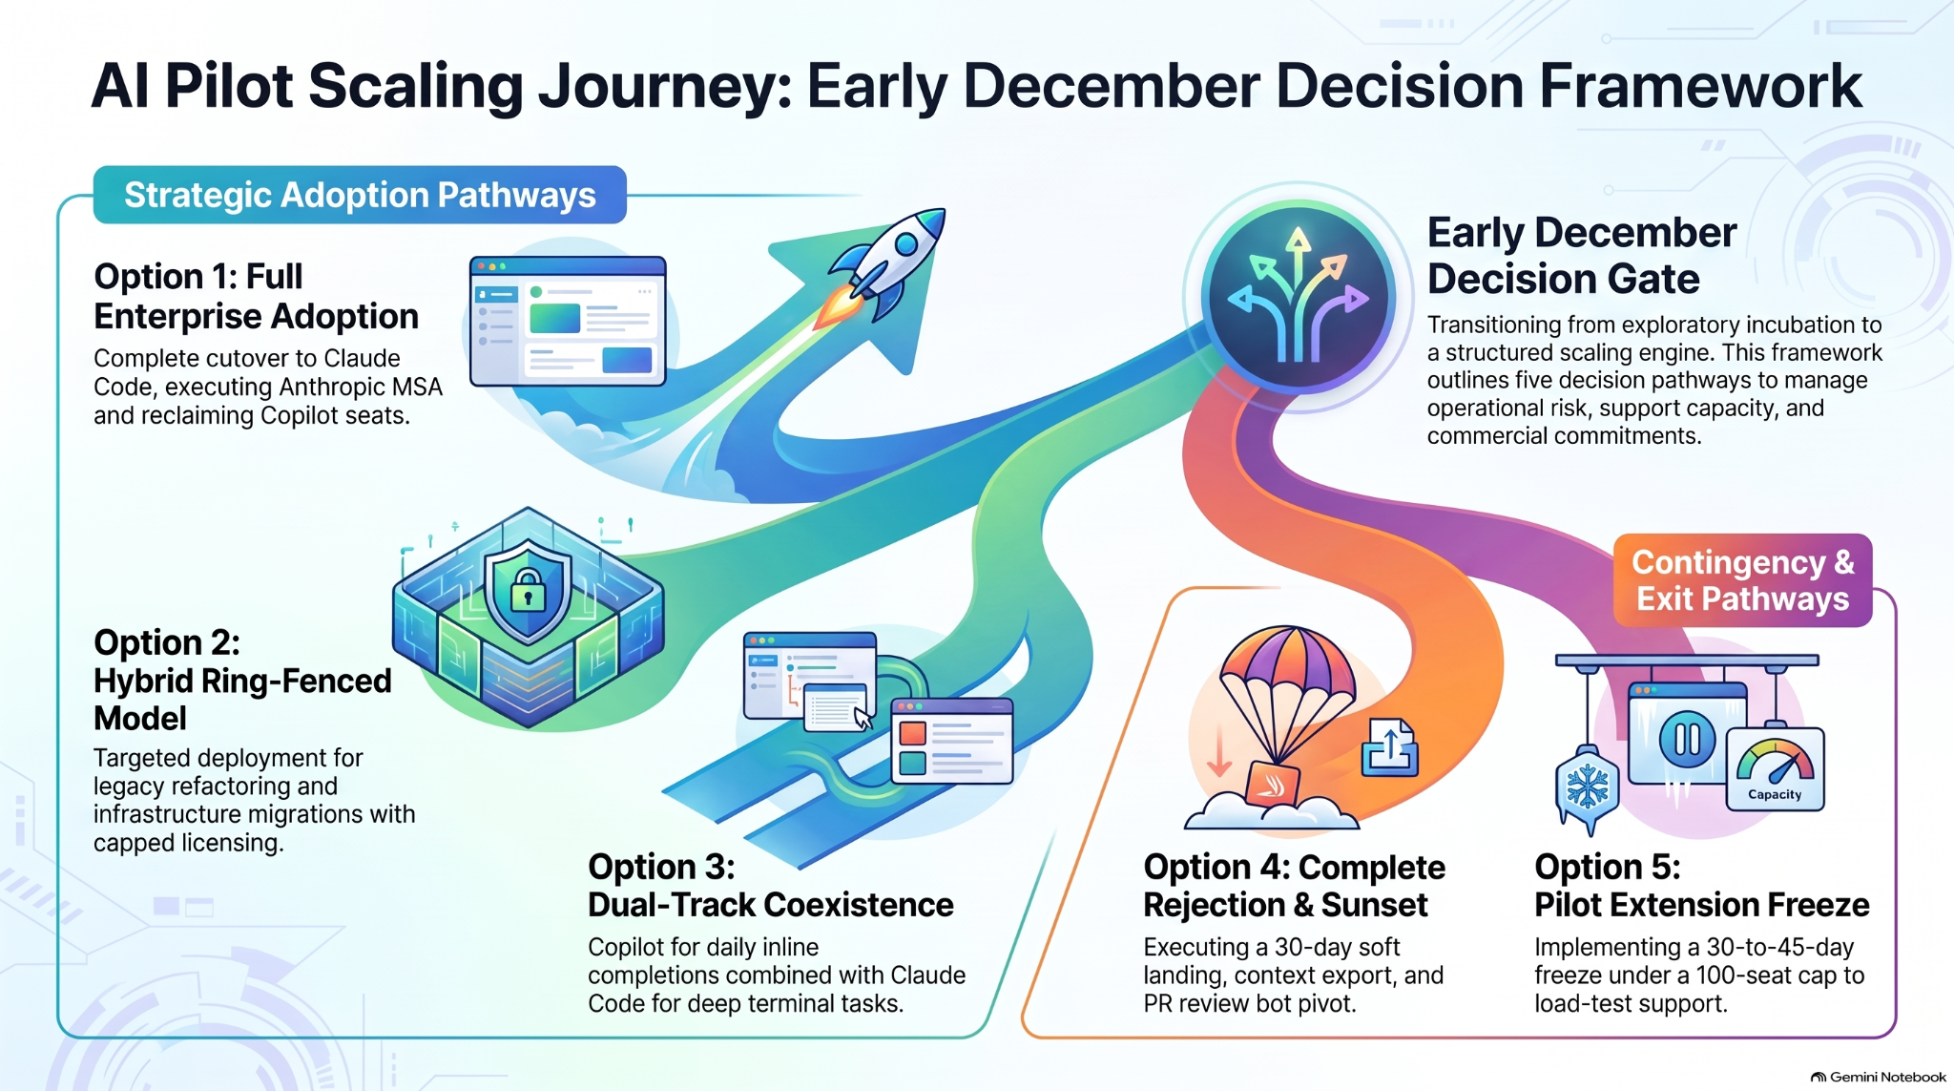

Slide 7

AI Pilot Scaling Journey: Early December Decision Framework
Strategic Adoption Pathways
Early December Decision Gate
Transitioning from exploratory incubation to a structured scaling engine. This framework outlines five decision pathways to manage operational risk, support capacity, and commercial commitments.
Option 1: Full Enterprise Adoption
Complete cutover to Claude Code, executing Anthropic MSA and reclaiming Copilot seats.
Contingency & Exit Pathways
Option 2: Hybrid Ring-Fenced Model
Targeted deployment for legacy refactoring and infrastructure migrations with capped licensing.
Option 3: Dual-Track Coexistence
Copilot for daily inline completions combined with Claude Code for deep terminal tasks.
Option 4: Complete Rejection & Sunset
Executing a 30-day soft landing, context export, and PR review bot pivot.
Option 5: Pilot Extension Freeze
Implementing a 30-to-45-day freeze under a 100-seat cap to load-test support.

Slide 8

AI Pilot Scaling Journey: Early December Decision Framework
Strategic Adoption Pathways
Early December Decision Gate
Transitioning from exploratory incubation to a structured scaling engine. This framework outlines five decision pathways to manage operational risk, support capacity, and commercial commitments.
Option 1: Full Enterprise Adoption
Complete cutover to Claude Code, executing Anthropic MSA and reclaiming Copilot seats.
Contingency & Exit Pathways
Option 2: Hybrid Ring-Fenced Model
Targeted deployment for legacy refactoring and infrastructure migrations with capped licensing.
Option 3: Dual-Track Coexistence
Copilot for daily inline completions combined with Claude Code for deep terminal tasks.
Option 4: Complete Rejection & Sunset
Executing a 30-day soft landing, context export, and PR review bot pivot.
Option 5: Pilot Extension Freeze
Implementing a 30-to-45-day freeze under a 100-seat cap to load-test support.

Slide 9
AI Assistant Pilot: What Happens Next? (5 Possible Scenarios)
We are deciding the future of the Claude AI pilot. Depending on the final review, here is how team ownership, licensing, technical support, and tool changes will work across 5 potential pathways for our 100-user limit.
1. Full Adoption
2. Hybrid Model
3. Dual-Track
4. Complete Rejection
5. Extending Pilot
Switch 100% to Claude Code.
Split tools by task and team.
Keep both tools side-by-side.
Cancel Claude and return to Copilot.
Delay decision & freeze seat count.
STRATEGIC DECISION
STRATEGIC DECISION
STRATEGIC DECISION
STRATEGIC DECISION
STRATEGIC DECISION
Replace GitHub Copilot; make Claude Code our main company tool.
Use Claude for complex tasks; keep Copilot for general coding.
Keep both active; define clear rules for when to use each.
Stop Claude Code; return 100% of developers to Copilot.
Freeze user count at 100 seats past Dec 1 while evaluating.
GOVERNANCE
GOVERNANCE
GOVERNANCE
OFFBOARDING
OPERATIONS
Finalize the long-term contract with Anthropic before April.
Cap costs; Carrie & Yannick set rules for who gets Claude access.
Publish exact usage guidelines from Athena & Sergey.
Provide a 30-day graceful exit with prompt-saving tools.
Run 30 to 45 days of heavy support testing under Brad's team.
OPERATIONS
OPERATIONS
OPERATIONS
ASSET SALVAGING
GOVERNANCE RISK
Hand over all tech support to Brad & Jim's team.
Focused support for power users.
Create guides and tracking for both products.
Turn built tools and connectors into automated PR bots.
Manage purchasing and risk approval timelines closely.
Who Does What in Each Scenario
Scenario Pathway
Legal & Business Lead
Support Lead
Key People Involved
Main Goal / Limitation
1. Full Adoption
Enterprise MSA (Dave / Anthropic)
Brad & Jim (Tier 1–3 Support)
Yannick, Brad, Carrie
Phase out Copilot; reclaim licenses
2. Hybrid Model
Carrie & Yannick (Access Rules)
Power-User Squads (Tier 2 Focus)
Carrie, Yannick, Brad
Cap spending; focus on high-impact areas
3. Dual-Track
Athena & Sergey (Usage Rules)
Brad's Team (Dual-Product Runbooks)
Athena, Sergey (GetDX)
Tools complement each other; terminal vs inline
4. Complete Rejection
Account Offboarding / End Contract
Ops Team (Data Migration)
Sergey (Telemetry Pivot), Brad
30-day smooth transition; reuse tools as bots
5. Extending Pilot
Anthropic Procurement & MRM Lead
Brad's Team (Load Testing Triage)
Brad (Ops Load Test), Sergey
Freeze at 100 seats; 30–45 day extra trial

Slide 10


